Slide 1
21AIE431 Applied Cryptography​
End Semester Project

Slide 2
Group Members :-​​
POBBATHI SAI SIDDHARTH (CB.EN.U4AIE21146)
RAVULAPATI VINAY SAI (CB.EN.U4AIE21153)
SANKURABHUKTA SRI MIDHINESH (CB.EN.U4AIE21162)

Slide 3
AES Enhanced Visual Cryptography Application

Slide 4
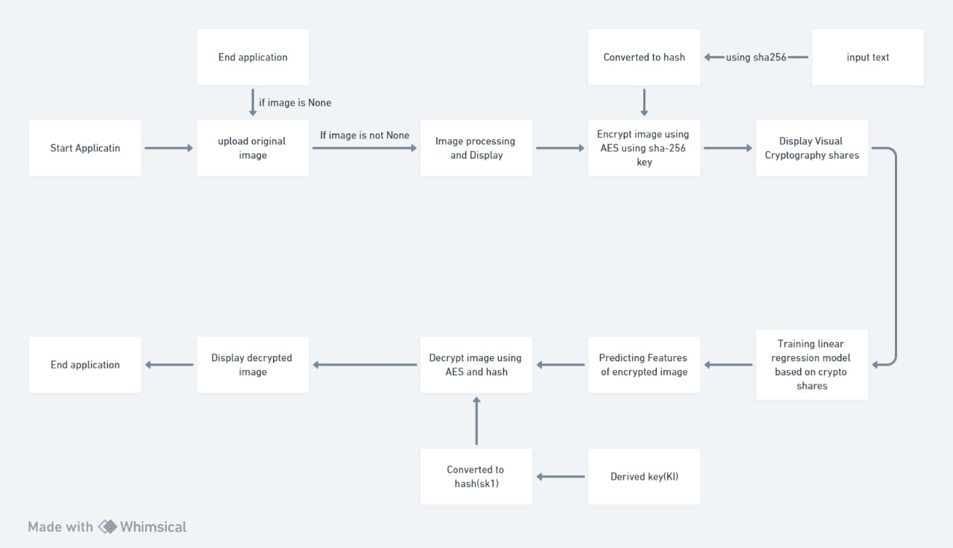
PROJECT OVERVIEW

Slide 5
AES Algorithm

Slide 6
AES ALGORITHM
The more popular and widely adopted symmetric encryption algorithm likely to be encountered nowadays is the Advanced Encryption Standard (AES). It is found at least six time faster than triple DES.
The features of AES are as follows –
Symmetric key symmetric block cipher
128-bit data, 128/192/256-bit keys
Stronger and faster than Triple-DES
Provide full specification and design details
Software implementable in C and Java

Slide 7
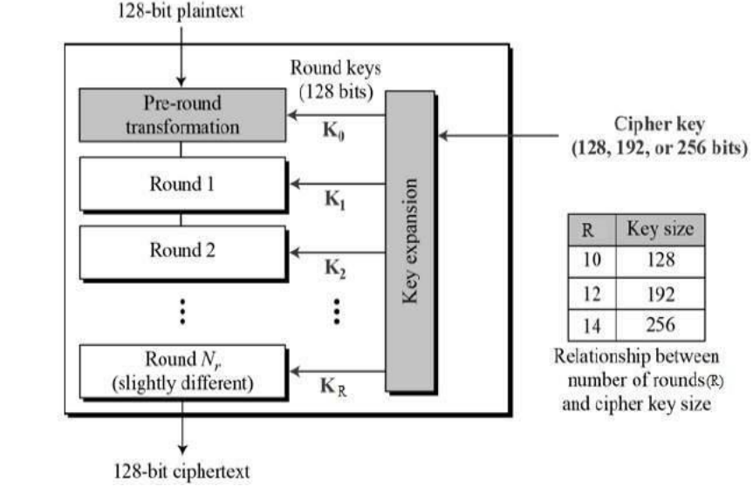
Schematic representation

Slide 8
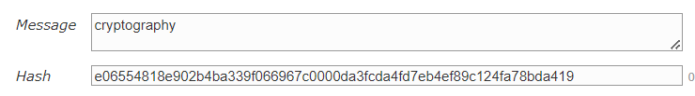
SHA-256
SHA-256 (Secure Hash Algorithm 256) is a cryptographic algorithm that creates a unique digital fingerprint of a file or message. It's a keyless hash function that's used to verify the authenticity of data
Output Size:- Fixed at 256 bits (32 bytes)/ 64 hexadecimal characters
In our Project
We use the SHA-256 Algorithm to compute the hash values of the entered key by the user

Slide 9


Visual cryptography
Visual cryptography is a cryptographic technique that allows visual information (such as images or text) to be divided into multiple shares in such a way that the original information can be revealed by stacking or overlaying a subset of the shares.
The key property of visual cryptography is that individual shares should reveal no information about the original content, but when combined, they should visually reveal the original information.

Slide 10
REFERENCES
) https://link.springer.com/chapter/10.1007/978-3-642-14298-7_5
2)https://link.springer.com/chapter/10.1007/3-540-44709-1_26
3)https://ieeexplore.ieee.org/abstract/document/7732289?casa_token=nh4QBGJbLB8AAAAA:JyvFPRZ57Z_kJYpITjppiX5y6Ex6_8fANnd_uuyU9us9LM76UivmMmr4n3lQO6SL-FLRD7BW9Tjnvw
4) https://www.sciencedirect.com/science/article/pii/S1877050915032445
5) https://nordvpn.com/blog/sha-256/#:~:text=SHA%2D256%20can%20help%20secure,decrypt%20and%20verify%20the%20signature.

Slide 11
THANK YOU

