Slide 1

B.Tech. Project (8th Semester) PRESENTATION of the project entitled
“Design of Compact Rectenna for UAV Applications”
For the award of the degree of Bachelor of Technology (B.Tech.) in Electronics and Communication Engineering (ECE)
By
Siddharth Yadav (2114098) Uttirna Talukdar (2114144) Niyar R Barman(2114145)
under the supervision of
Dr. Taimoor Khan
Associate Professor
Department of Electronics and Communication Engineering
National Institute of Technology Silchar, Assam, India

Slide 2
Outlines
INTRODUCTION
LITERATURE REVIEW
TECHNICAL NOVELTY
METHODOLOGY
RESULTS
REFERENCES

Slide 3
Introduction
Endurance Bottleneck in Modern UAVs
Drones are transforming surveillance, logistics, agriculture, disaster relief and more, yet mission length is capped by the modest energy density of onboard Li-ion packs.
Frequent land-and-recharge cycles interrupt operations and inflate costs, making a lightweight, in-flight power-supply strategy essential for truly autonomous, long-duration sorties.
Wireless-Power Transmission (WPT) & the Rectenna Solution
WPT delivers energy over metres-to-kilometres without physical connectors, perfectly matching the mobility and altitude of UAVs.
At the heart of WPT is the rectenna—a single module that captures the incident 24 GHz beam with a microstrip patch and instantly rectifies it to DC.

Slide 4
Literature Review
Sl No | Title of Paper | Authors | Description | Year of Publication
1 | From Waves to Watts: Advancements in rectenna arrays for radio-frequency energy harvesting and wireless power transfer | Partha P. Shome; Debanjali Sarkar; Taimoor Khan; Naoki Shinohara; Yahia M.M. Antar | The rapid advancement of radio-frequency energy harvesting (RFEH) and wireless power transfer (WPT) has led to significant progress in rectenna array technologies. This review outlines recent innovations aimed at enhancing the efficiency and functionality of rectenna arrays, covering key areas such as antenna structures, rectifier configurations, impedance matching, and material choices. It offers a concise overview of the principles and design strategies driving modern RFEH and WPT systems. | 2025
2 | 28 GHz Microwave Power Beaming to a Free-Flight Drone | Ryoma Moro; Naoki Keicho; Kota Motozuka; Maho Matsukura; Kohei Shimamura; Masafumi Fukunari | A 28 GHz microwave power transmission experiment was conducted in a 10 m anechoic chamber using an AR-drone guided by an indoor GPS and IFT control. A 50 % efficient rectifier and single-axis beamforming system transmitted 3.9 W via a 2-element horn antenna array. The drone, flying at 800 mm altitude, received power for 20 seconds continuously, achieving a maximum overall efficiency of 0.044 %. | 2021

Slide 5
Literature Review
Sl No | Title of Paper | Authors | Description | Year of Publication
3 | A novel 24 GHz circularly polarised metasurface rectenna | Wei Huang; Jinxin Du; Xue-Xia Yang; Wenquan Che; Steven Gao | A compact 24 GHz circularly polarised metasurface rectenna is presented, featuring a high-efficiency Schottky diode rectifier and a metasurface antenna with metal vias for enhanced gain. The antenna achieves 11.3 dBic gain and 2.5 dB axial ratio, while the rectifier reaches 63 % efficiency at 15.2 dBm input with a 300 Ω load. The low-profile design enables conformal integration with electronic equipment. | 2023
4 | High-Gain Electrically Small Modified Antipodal Vivaldi Self-Matched Rectenna for n77/n78/n79 Sub 6 GHz 5G Narrow Dual-Band Wirelessly Powering IoT Devices | Anjali Priya; Taimoor Khan | This study presents a compact dual-band hexagonal Vivaldi antenna for n77, n78, and n79 bands (3.3–5 GHz), achieving high gains of 5.19 dBi at 3.74 GHz and 4.97 dBi at 4.9 GHz. The antenna meets the electrically small condition (ka = 0.8) and offers dual impedance bandwidths. A shunt-diode rectifier circuit is integrated, with measured power conversion efficiencies of 58.5 % and 63 % at the two bands for 5 dBm input. | 2025

Slide 6
Literature Review
Sl No | Title of Paper | Authors | Description | Year of Publication
5 | Dual-Facet Loaded Dual-Polarized Quad-band Dielectric Resonator-Rectenna for RF Energy Harvesting in Smart City Applications | Desari Surender, Venkata Reddy, Taimoor khan | This paper presented a multiband dual-polarized dielectric resonator antenna for smart city applications using RFEH technology. The proposed DR antenna covers the frequency bands of WLAN 5.2 GHz, Wi-Fi 5.8 GHz, and future 6 GHz Wi-Fi bands of 6.2 GHz and 6.6 GHz. | 2023
6 | A 90° Twisted Quarter-Sectored Compact and Circularly Polarized DR-Rectenna for RF Energy Harvesting Applications | Desari Surender and Taimoor Khan | This paper presented a 90° twisted quarter sectored circu- larly polarized and high gain dielectric resonator antenna (DRA) operating within the 5.8 GHz Wi-Fi band, is investigated first time of its kind in this letter. A circular-shaped aperture coupled feeding approach is investigated for energizing the proposed antenna. | 2022

Slide 7
Literature Review
Sl No | Title of Paper | Authors | Description | Year of Publication
7 | Rectifier Circuits for RF Energy Harvesting and Wireless Power Transfer | Md. Ahsan Halimi , Taimoor Khan | This paper discusses rectifier circuits designed for RF energy harvesting and wireless power transfer (WPT), which are essential for powering low-power wireless sensors in smart applications. It highlights the limitations of batteries and emphasizes RF energy as a sustainable alternative. The work explores circuit designs and techniques to efficiently convert ambient RF energy into usable DC power. | 2022
8 | Design of a 2.45 GHz operated Rectifier with 81.5% PCE at 13 dBm Input Power for RFEH Applications | Desari Surender, Md. Ahsan Halimi and Taimoor Khan | This work presents a high-efficiency rectifier for RF energy harvesting (RFEH) and wireless power transfer (WPT) at 2.45 GHz ISM band. A dual stub matching network and a voltage doubler topology using an HSMS2862 diode are used to design a rectifier. | 2021

Slide 8
Technical Novelty
Compact 16 × 14 mm circularly-polarised (CP) 2 × 2 patch array.
Integrated rectifier hitting PCE = 67.26 % at 18 dBm, VDC = 2.02 V.
Antenna:
Modified baseline square-patch with triangular patch and parametric tuning 28 GHz array to work at 24 GHz
Rectifier:
Modified baseline rectifier with parasitic components and substrate change to work at 24 GHz with PCE = 67.26 %

Slide 9
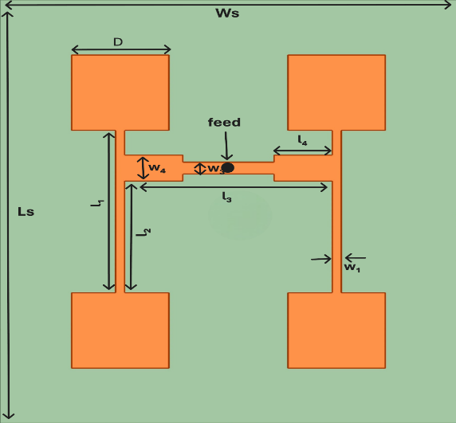
Methodology: Antenna Design
Antenna – Baseline Square Array (28 GHz)
The 2 × 2 coax-probe-fed square-patch array was recreated (18 × 15 mm, εr = 2.2).
Simulated: |S11| = –23 dB @ 28.2 GHz, Gain ≈ 11.5 dB .
Figure 1: 2x2 Coaxial Probe Feed Square Patch Antenna Array Geometry

Slide 10

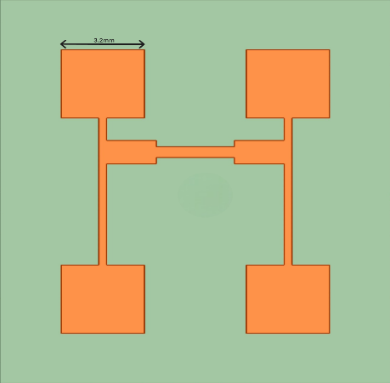
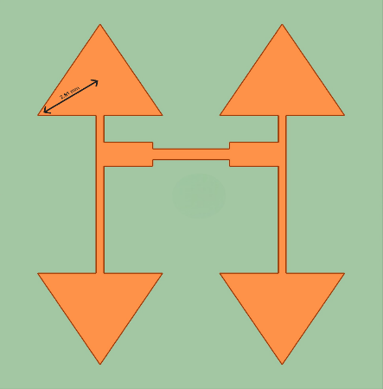
Methodology: Antenna Design
Equal-area square, circular, triangular patches yield:
Triangular resonates lowest (25.8 GHz) with similar gain → best for miniaturisation .
Table 1: Performance Comparison of Square, Circular and Triangular Patch Antenna Array
Parameters | Square | Circular | Triangular
Resonance Freq(GHz) | 28.2 | 30.6 | 25.8
S11(dB) | -23 | -20.7 | -17.2
Gain(dBi) | 11.54 | 11.26 | 11.4
Bandwidth(dB) | 1.15 | 1.30 | 1.22
Axial Ratio(dB) | 44.6 | 58.6 | 55
Figure 2: Circular Patch Structures of Equal Area
Figure 3: Square Patch Structures of Equal Area
Figure 4: Triangular Patch Structures of Equal Area

Slide 11
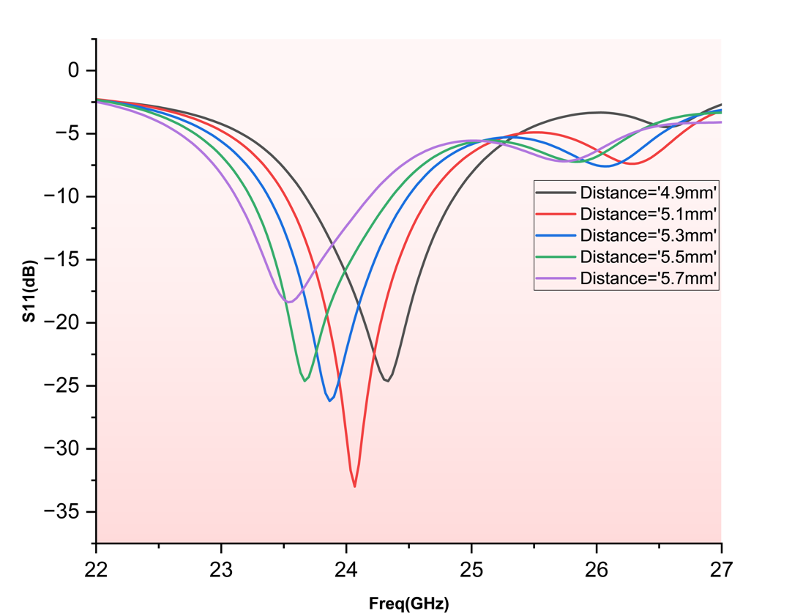
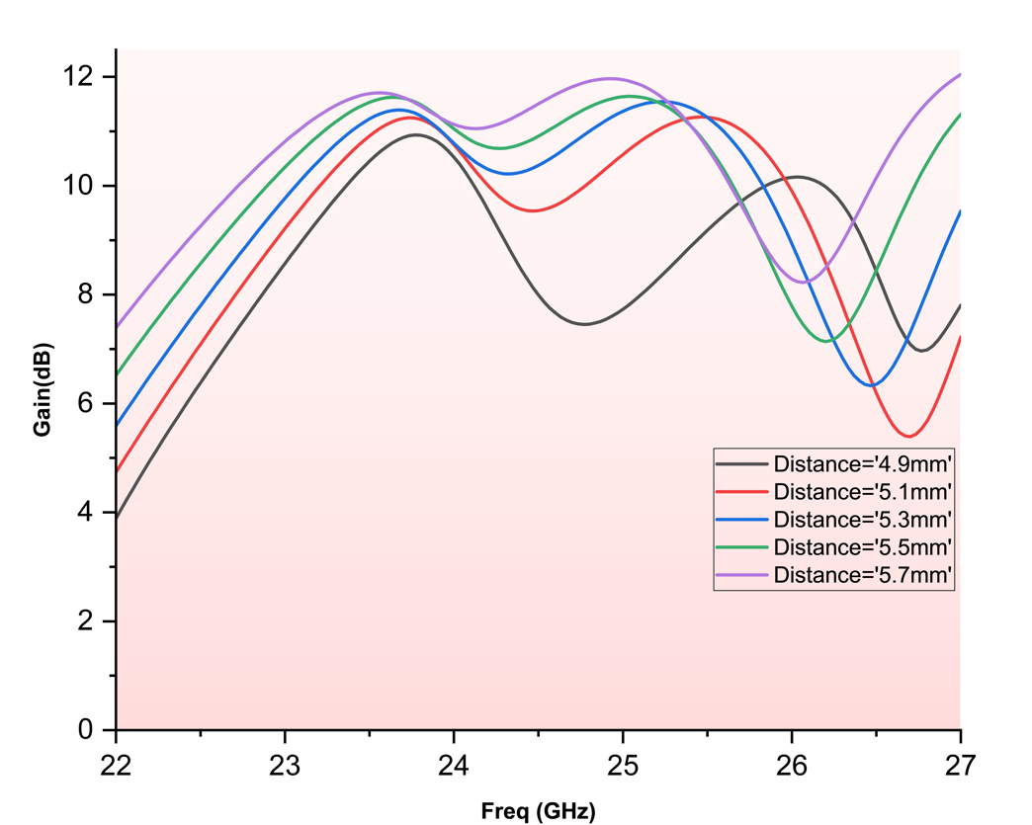
Methodology: Antenna Design
Inter-Patch Spacing Optimisation
Parametric sweep 4.9–5.7 mm centre-to-centre: optimum 5.1 mm gives |S11| = –35 dB, Gain = 10.7 dB .
Table 2: Performance Comparison of Antenna Array for Different Inter-Patch Distance
Patch Spacings(mm) | Resonance Frequency(GHz) | S11(dB) | Gain(dBi)
4.9 | 24.33 | -25.58 | 10.10
5.1 | 24.1 | -35.38 | 10.71
5.3 | 23.86 | 29.27 | 10.73
5.5 | 23.66 | -23.84 | 10.95
5.7 | 23.46 | -19.06 | 10.98
Figure 5: S11 vs Frequency Curve for Different Inter-Patch Distance
Figure 6: Gain vs Frequency Curve for Different Inter-Patch Distance

Slide 12
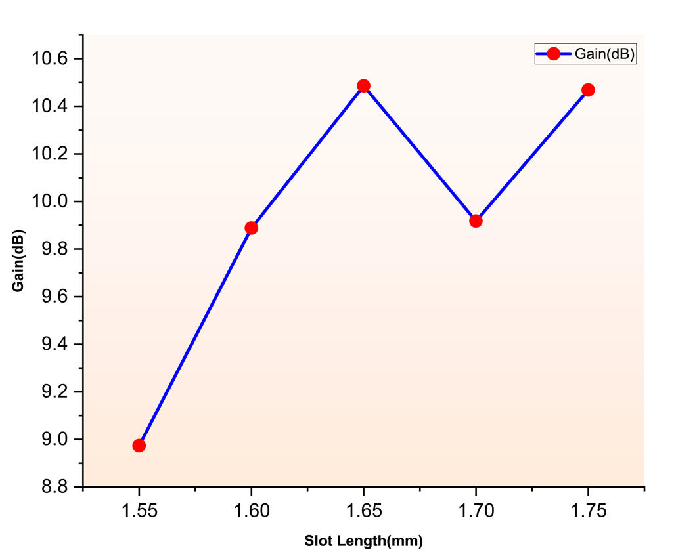
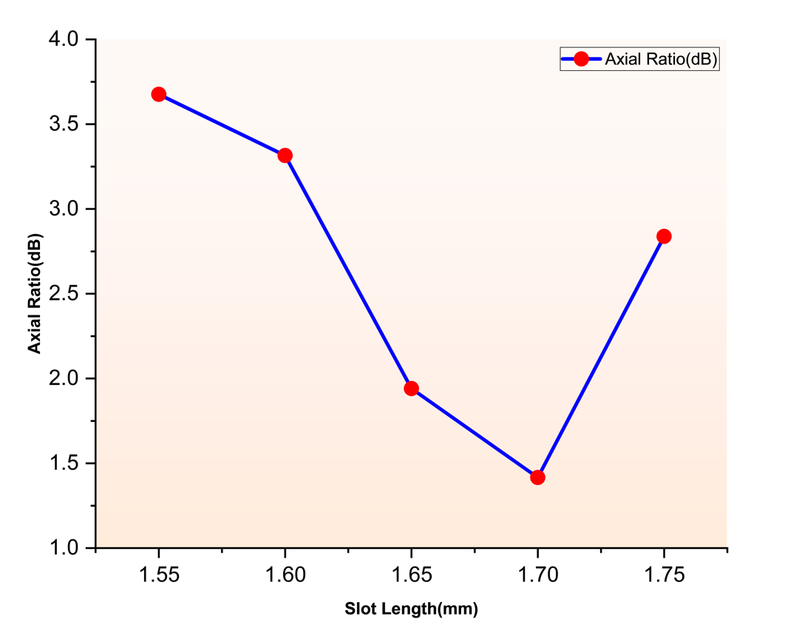
Methodology: Antenna Design
Slot Length Variation
A Slot Length of 1.65 mm was selected as optimal, providing the low axial ratio (1.9 dB) along with high gain (10.48 dB).
Figure 7: Gain at 24 GHz vs Slot Length
Table 3: Gain and Axial Ratio at 24 GHz for Different Slot Length
Slot Length(mm) | Gain(dBi) | Axial Ratio(dB)
1.55 | 8.97 | 3.60
1.60 | 9.88 | 3.30
1.65 | 10.48 | 1.94
1.70 | 9.91 | 1.41
1.75 | 10.46 | 2.83
Figure 8: Axial Ratio at 24 GHz vs Slot Length

Slide 13
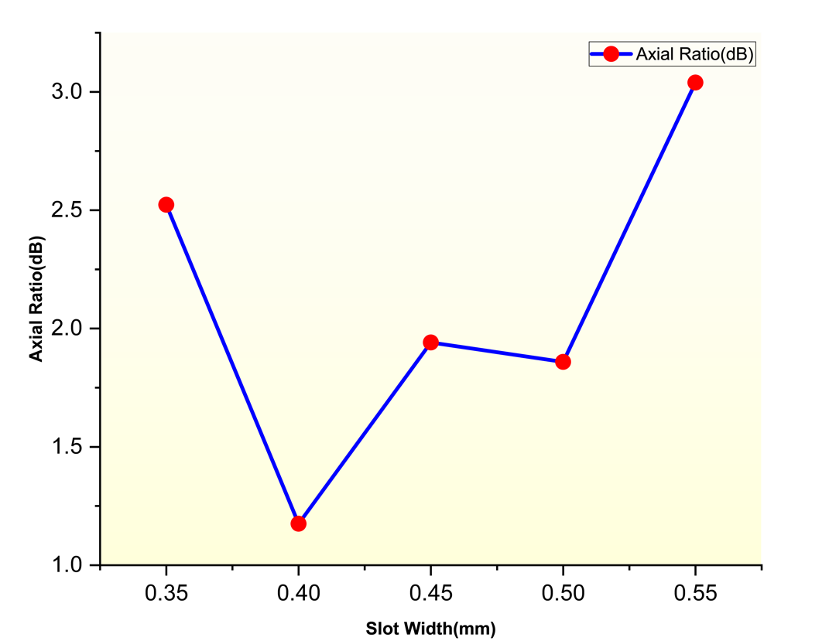
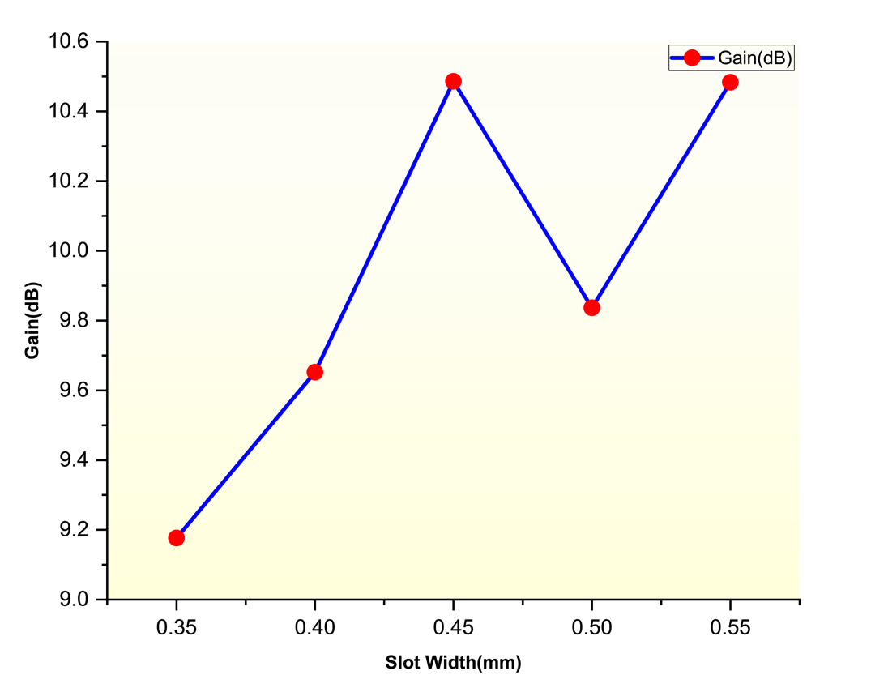
Methodology: Antenna Design
Slot Width Variation
A Slot Width of 0.45 mm was selected as optimal, providing the lowest axial ratio (1.94 dB) along with good resonance and gain.
Figure 9: Axial Ratio vs Slot Width Curve
Table 4: Gain and Axial Ratio at 24 GHz for Different Slot Width
Slot Width(mm) | Gain(dBi) | Axial Ratio(dB)
0.35 | 9.10 | 2.52
0.40 | 9.65 | 1.17
0.45 | 10.40 | 1.94
0.50 | 9.83 | 1.85
0.55 | 10.48 | 3.03
Figure 10: Gain vs Slot Width Curve

Slide 14
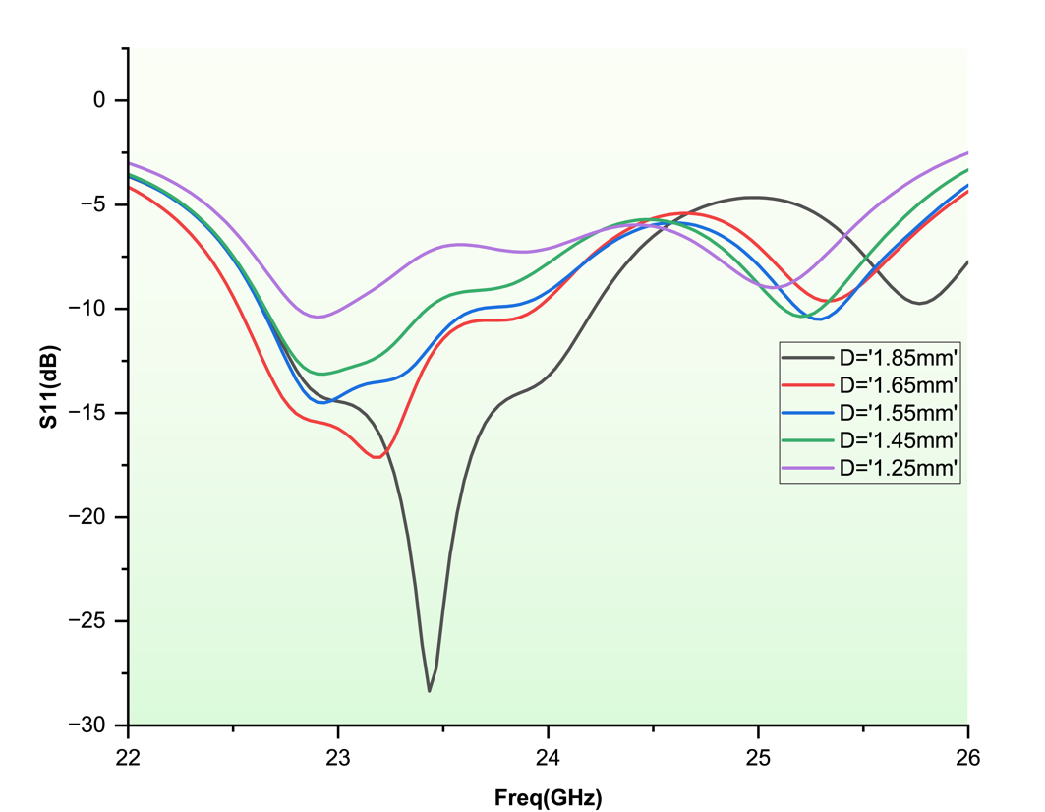
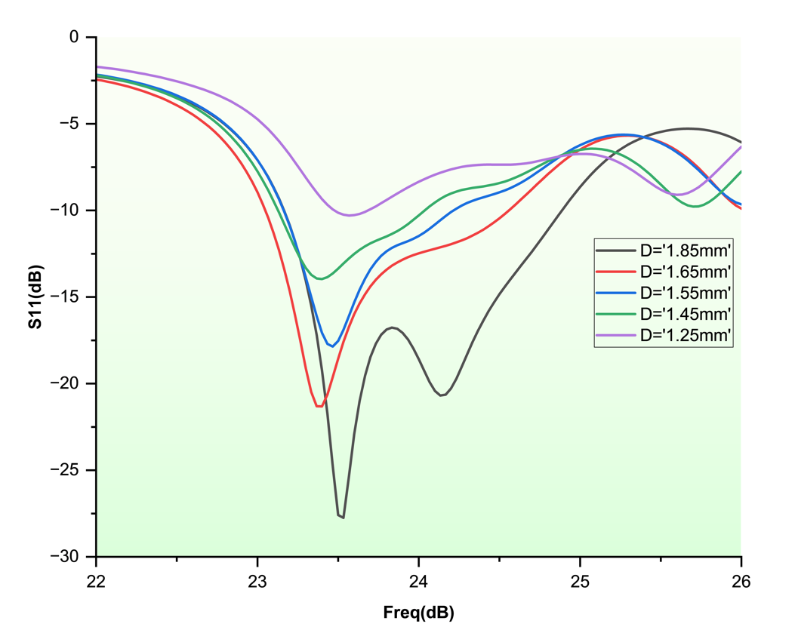
Methodology: Antenna Design
Patch Dimension Reduction and Feed Re-Optimization
To shift the resonant frequency upward towards 24 GHz, the dimensions of the triangular patch were reduced, the distance between vertex and centroid was decreased from 2.81 mm to 2.71 mm. This modification effectively increased the patch’s resonant frequency due to the inverse relationship between patch size and resonant frequency.
Figure 11: S11 vs Frequency Curves for Various Feed Position Before Patch Dimension Reduction
Figure 12: S11 vs Frequency Curves for Various Feed Position

Slide 15
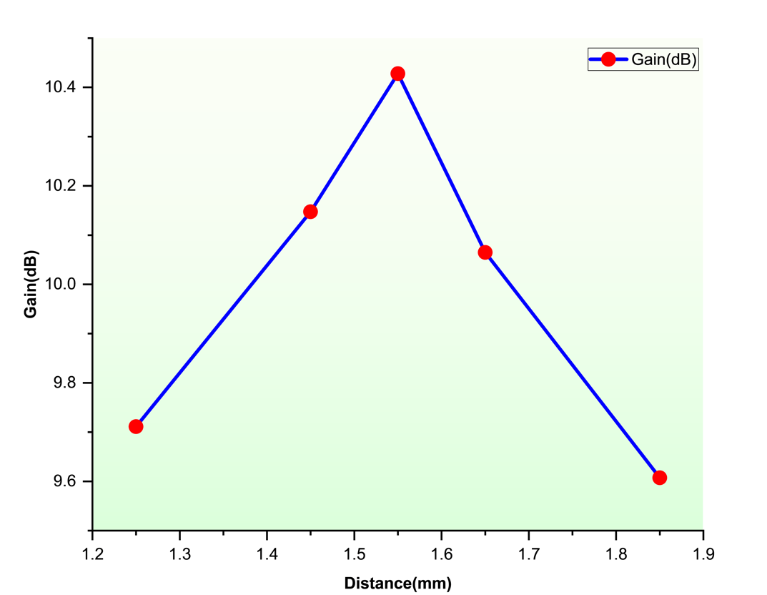
Methodology: Antenna Design
Patch Dimension Reduction and Feed Re-Optimization
After resizing the patch, a new parametric sweep of feed positions was conducted. The slot feed position was varied from 1.25 mm to 1.85 mm vertically upward from center of antenna, in increments of 0.1 mm.
Table 5: Antenna Array Gain for Various Feed Position
Distance(mm) | Gain(dBi)
1.25 | 9.71
1.45 | 10.14
1.55 | 10.42
1.65 | 10.06
1.85 | 9.60
Figure 13: Gain Vs Feed Position From Center of Antenna

Slide 16
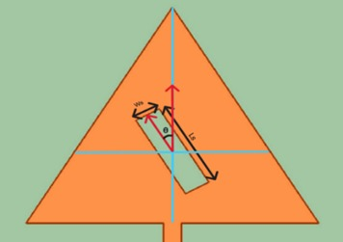
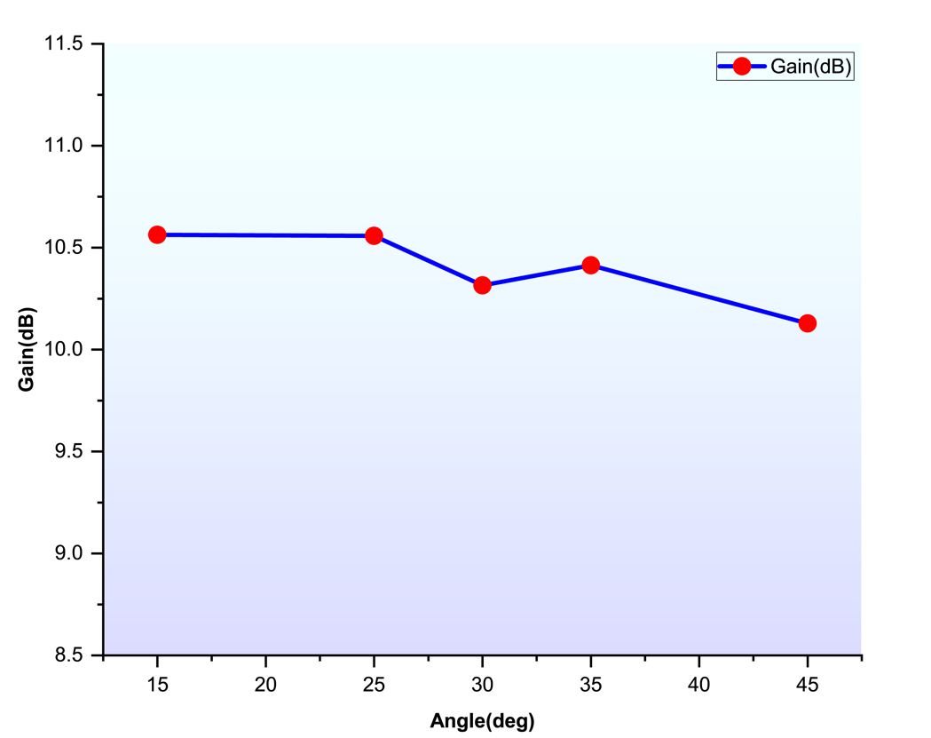
Methodology: Antenna Design
Slot-Angle for Circular Polarisation
Sweeping slot orientation 0–90°: 30° gives Axial-Ratio = 0.44 dB and maintains Gain ≈ 10.35 dBi
Figure 14: Slot Angle in Triangular Patch
Table 6: Gain and Axial Ratio for Various Slot Angle
Slot angle(degree) | Gain(dBi) | Axial Ratio(dB)
15 | 10.56 | 6.27
25 | 10.55 | 1.55
30 | 10.35 | 0.44
35 | 10.41 | 2.31
45 | 10.12 | 6.42
Figure 15: Gain vs Slot Angle Curve

Slide 17
Methodology: Antenna Design
Substrate Trim for Compactness
Length reduced to 16 mm and width to 14 mm while monitoring S11 & AR
Net footprint shrank by 22 % with negligible gain loss.
Table 7: Gain and Axial Ratio Value for Various Substrate Width
Table 8: Gain and Axial Ratio Value for Various Substrate Length
Slot Width(mm) | Gain(dBi) | Axial Ratio(dB)
14.4 | 9.83 | 0.74
14.2 | 9.88 | 0.51
14.0 | 10.37 | 1.32
13.8 | 9.88 | 0.64
13.6 | 9.89 | 0.41
Substrate Length(mm) | Gain(dBi) | Axial Ratio(dB)
16.8 | 10.35 | 0.23
16.4 | 10.2 | 0.21
16.0 | 10.3 | 1.08
15.6 | 10.2 | 0.69
15.2 | 10.16 | 0.75

Slide 18
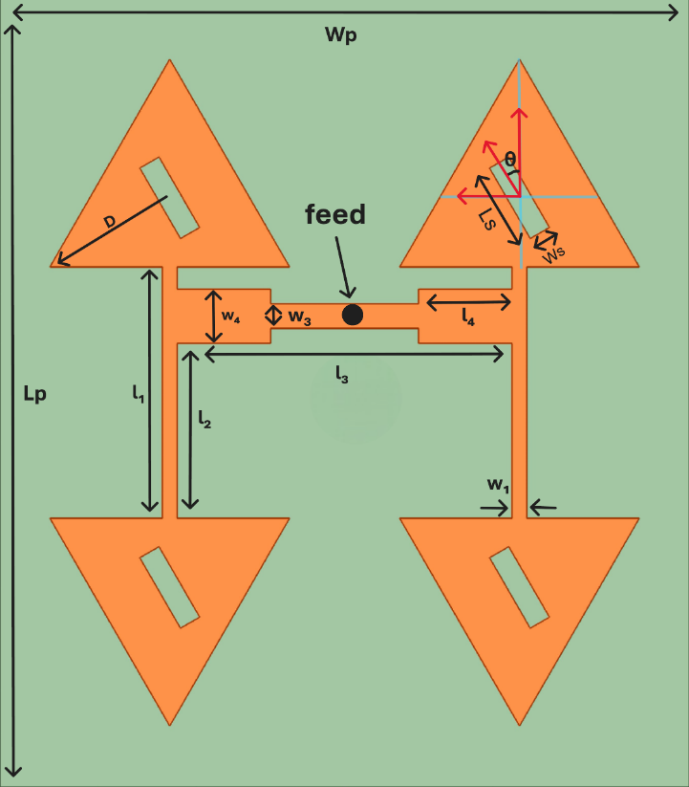
Methodology: Antenna Design
Final Antenna Performance
|S11| = –17.5 dB • BW = 1.31 GHz
Gain = 10.43 dBi
Axial Ratio = 1.32 dB (CP)
3D pattern broadside with low sidelobes
Table 9: Final Antenna Array Geometry
Substrate Length (Lp) | 16 mm
Substrate Width (Wp) | 14 mm
Slot Length (Ls) | 1.65 mm
Slot Width (Ws) | 0.47 mm
D | 2.695 mm
l₁ | 5.205 mm
l₂ | 3.515 mm
l₃ | 6.8 mm
l₄ | 1.9 mm
w₁ | 0.3 mm
w₃ | 0.5 mm
w₄ | 1.1 mm
θ | 30 degree
Figure 16: Final Antenna Array Geometry

Slide 19
Methodology: Rectifier Design
Rectification is the critical final stage of a rectenna system , responsible for converting the captured radio-frequency (Rf) signal into a usable direct-current (DC) output.
Purpose: Converts captured RF signal to usable DC output.
Key Metrics: Return Loss (|S11|), Power Conversion Efficiency (PCE), DC Output Voltage
Design: 24 GHz half-wave Schottky-diode rectifier, matched to companion patch antenna.
DESIGN TARGETS:
Freq. & Bandwidth : Centered at 24 GHz, ≥1 GHz BW (|S11| < –10 dB).
Impedance Match: |S11| ≤ –16 dB at 24 GHz.
Efficiency: PCE ≥ 65% @ 18 dBm input.
DC Output: ≥ 2 V across ~300Ω load.

Slide 20
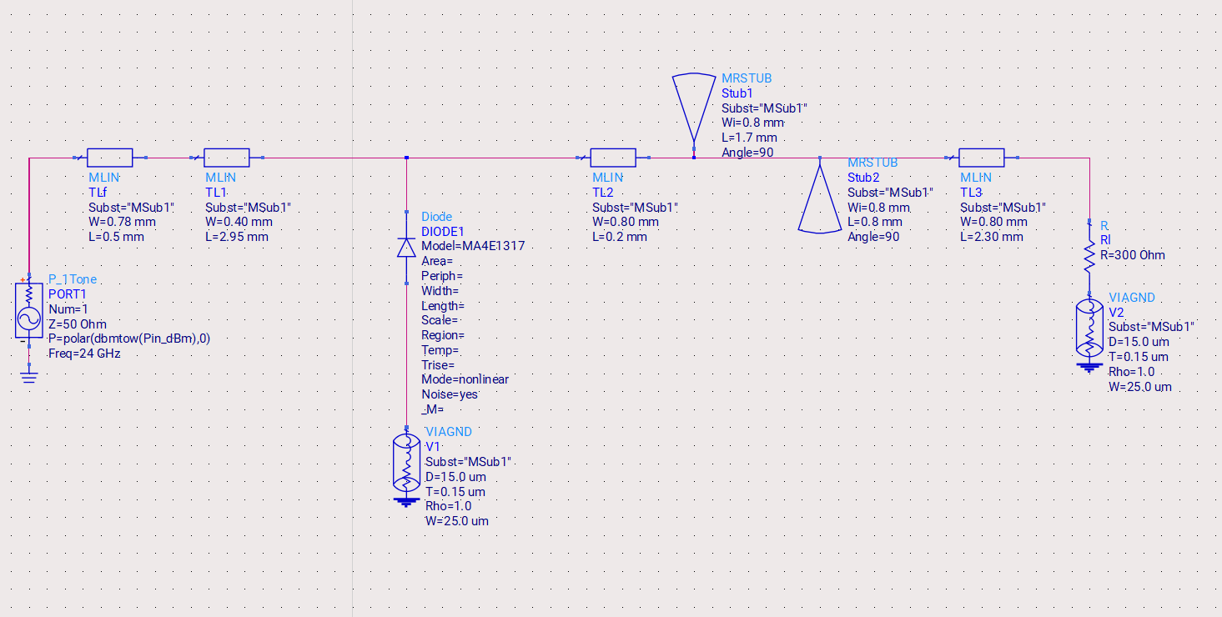
Methodology: Rectifier Design
Rectifier Iteration 0 – Baseline
Figure 17: ADS Circuit Diagram for Baseline Rectifier Diagram

Slide 21
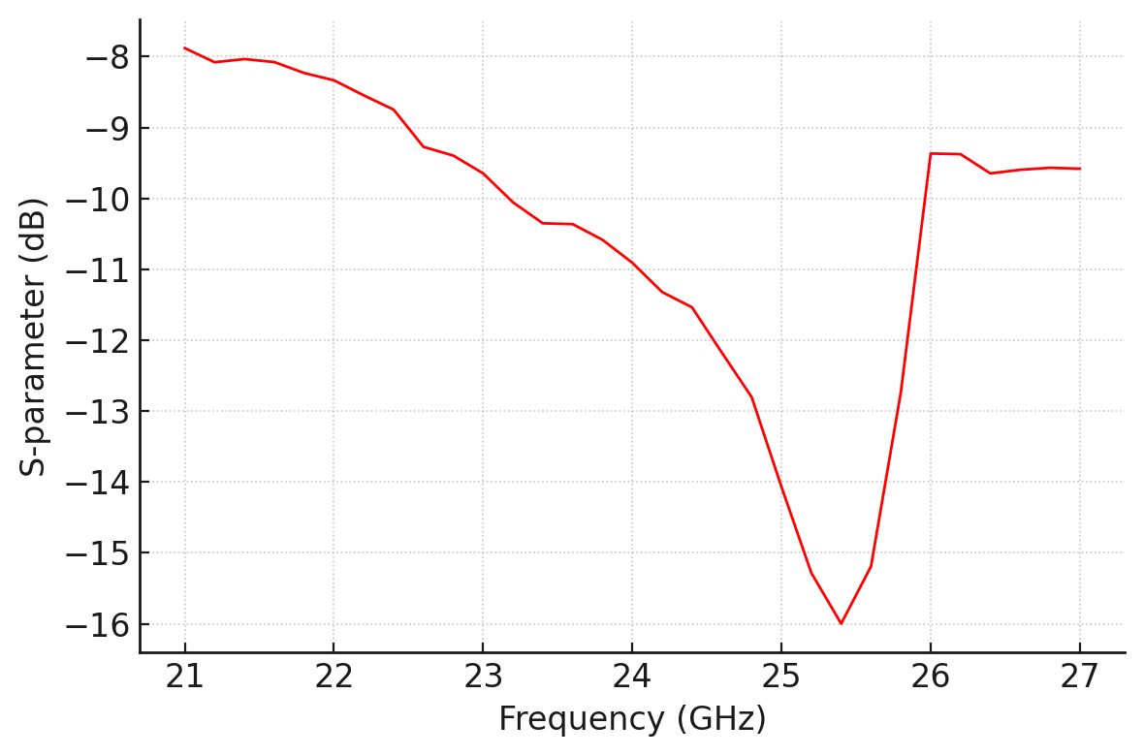
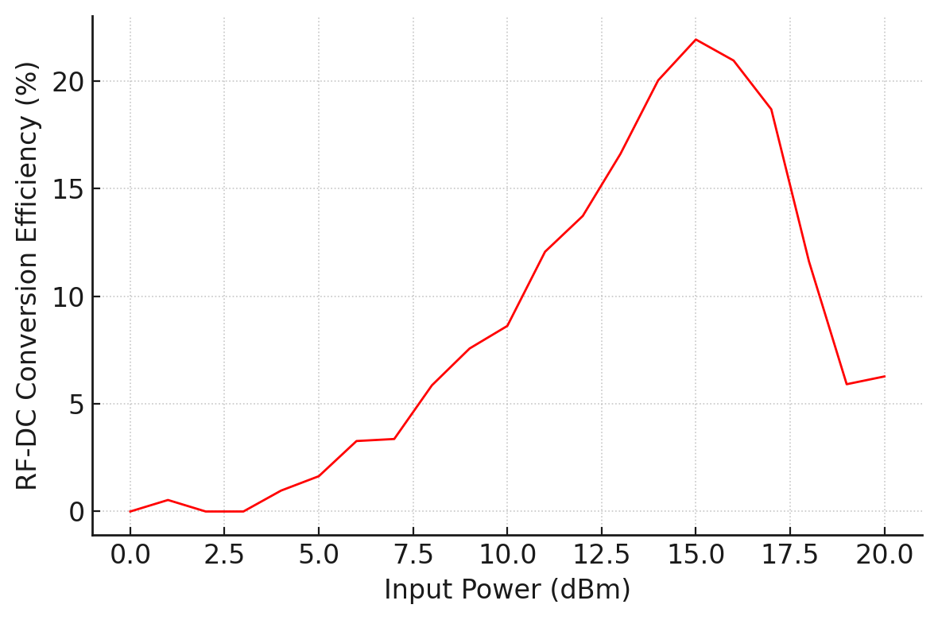
Methodology: Rectifier Design
Rectifier Iteration 0 – Baseline
Figure 18: S11 vs Frequency for Baseline Rectifier Design based on baseline]
Figure 19: RF-DC Conversion Efficiency vs Input Power (dBm) for Baseline Rectifier Design based on baseline

Slide 22
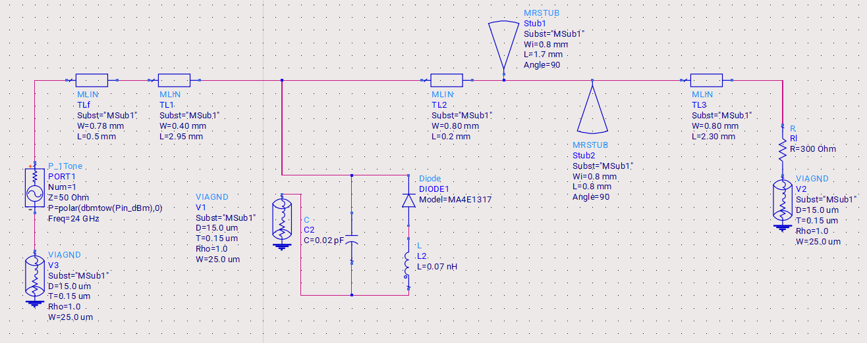
Methodology: Rectifier Design
Rectifier Iteration 1 – Parasitic‑Enhanced Design
Figure 20: ADS Circuit Diagram for Rectifier Design with Parasitic Components

Slide 23
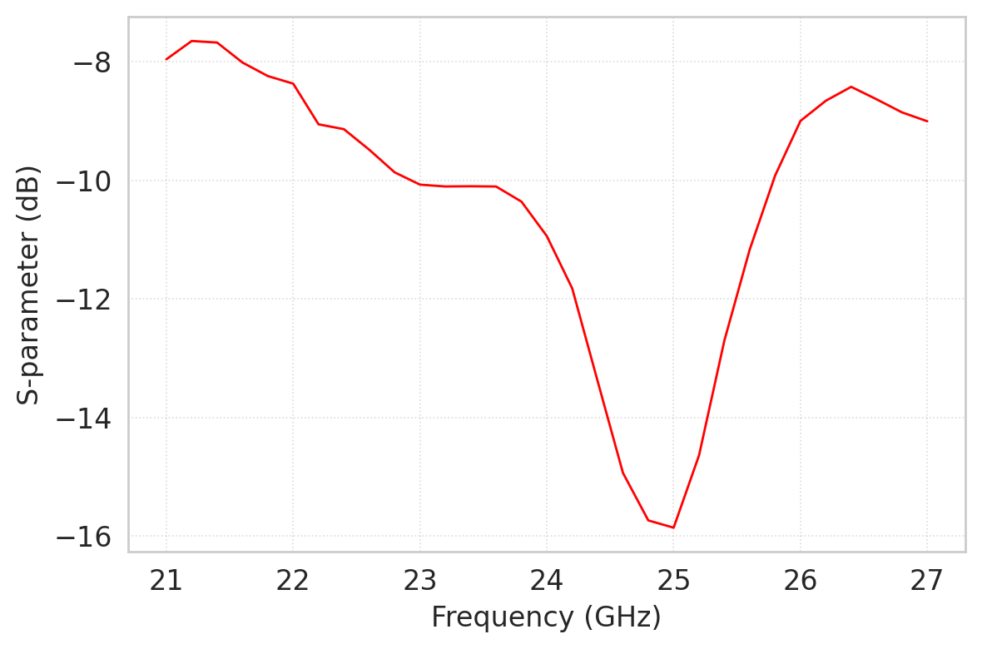
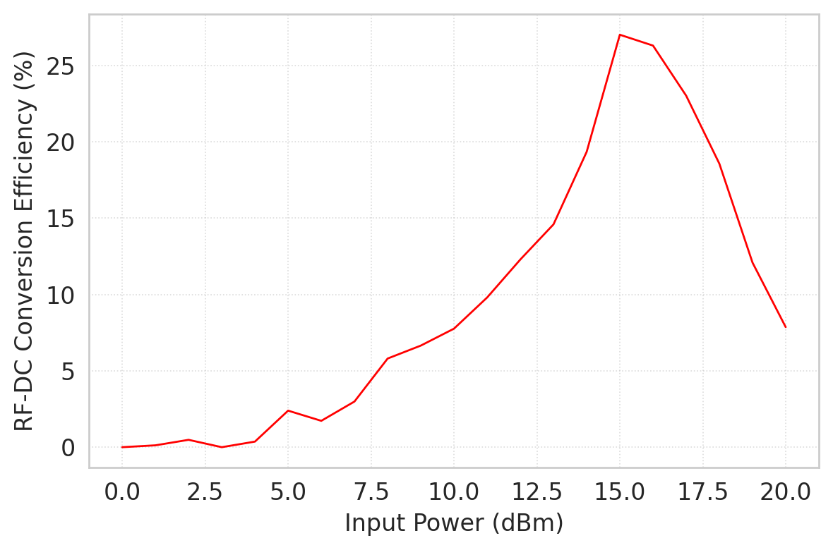
Methodology: Rectifier Design
Rectifier Iteration 1 – Parasitic‑Enhanced Design
Figure 21: S11 vs Frequency for Rectifier Design with Parasitic Components
Figure 22: RF-DC Conversion Efficiency vs Input Power (dBm) for Rectifier Design with Parasitic Components

Slide 24
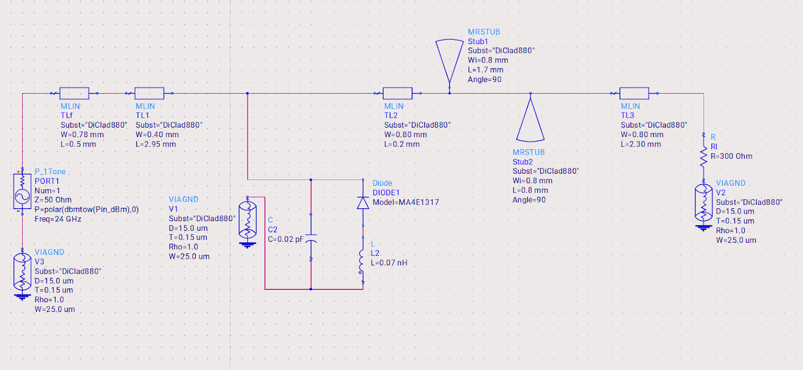
Methodology: Rectifier Design
Rectifier Iteration 2 – Substrate Migration to Rogers DiClad 880
Figure 23: ADS Circuit Diagram for Rectifier Design with Parasitic Components and DiClad 880 Substrate

Slide 25
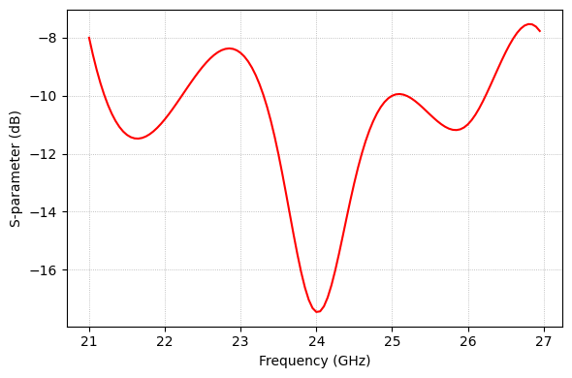
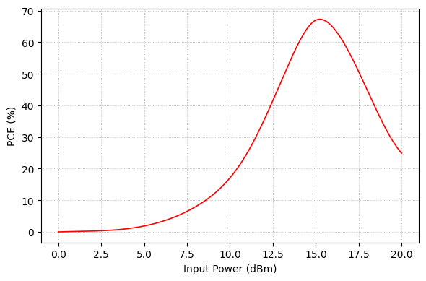
Methodology: Rectifier Design
Rectifier Iteration 2 – Substrate Migration to Rogers DiClad 880
Figure 24: S11 vs Frequency for Rectifier Design with Parasitic Components with DiClad 880 Substrate
Figure 25: PCE vs Input Power (dBm) for Rectifier Design with Parasitic Components with DiClad 880 Substrate

Slide 26
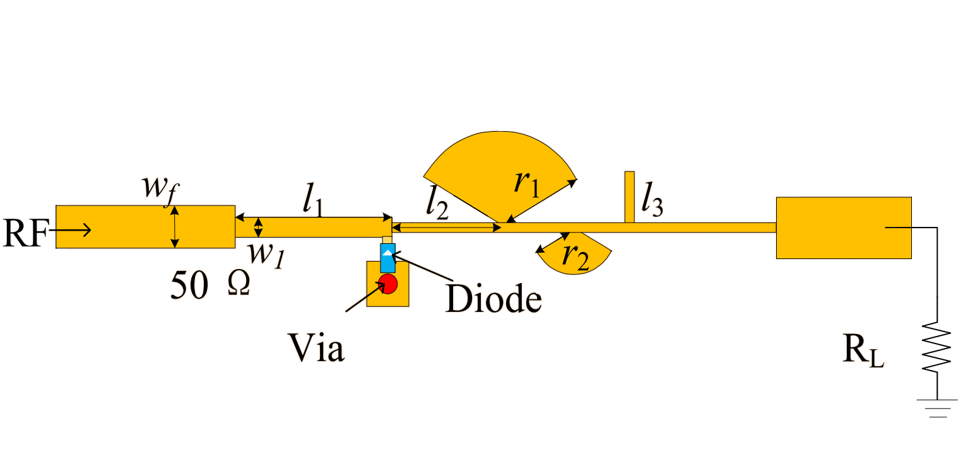
Methodology: Rectifier Design
Final Rectifier Topology
Table 10: Parameter Specifications for Final Rectifier Topology
Parameter | Value
wf | 0.78 mm
w₁ | 0.40 mm
l₁ | 2.95 mm
l₂ | 0.20 mm
r₁ | 1.7 mm
r₂ | 0.8 mm
l₃ | 2.30 mm
Figure 26: Annotated layout and equivalent ADS schematic of final rectifier circuit.

Slide 27
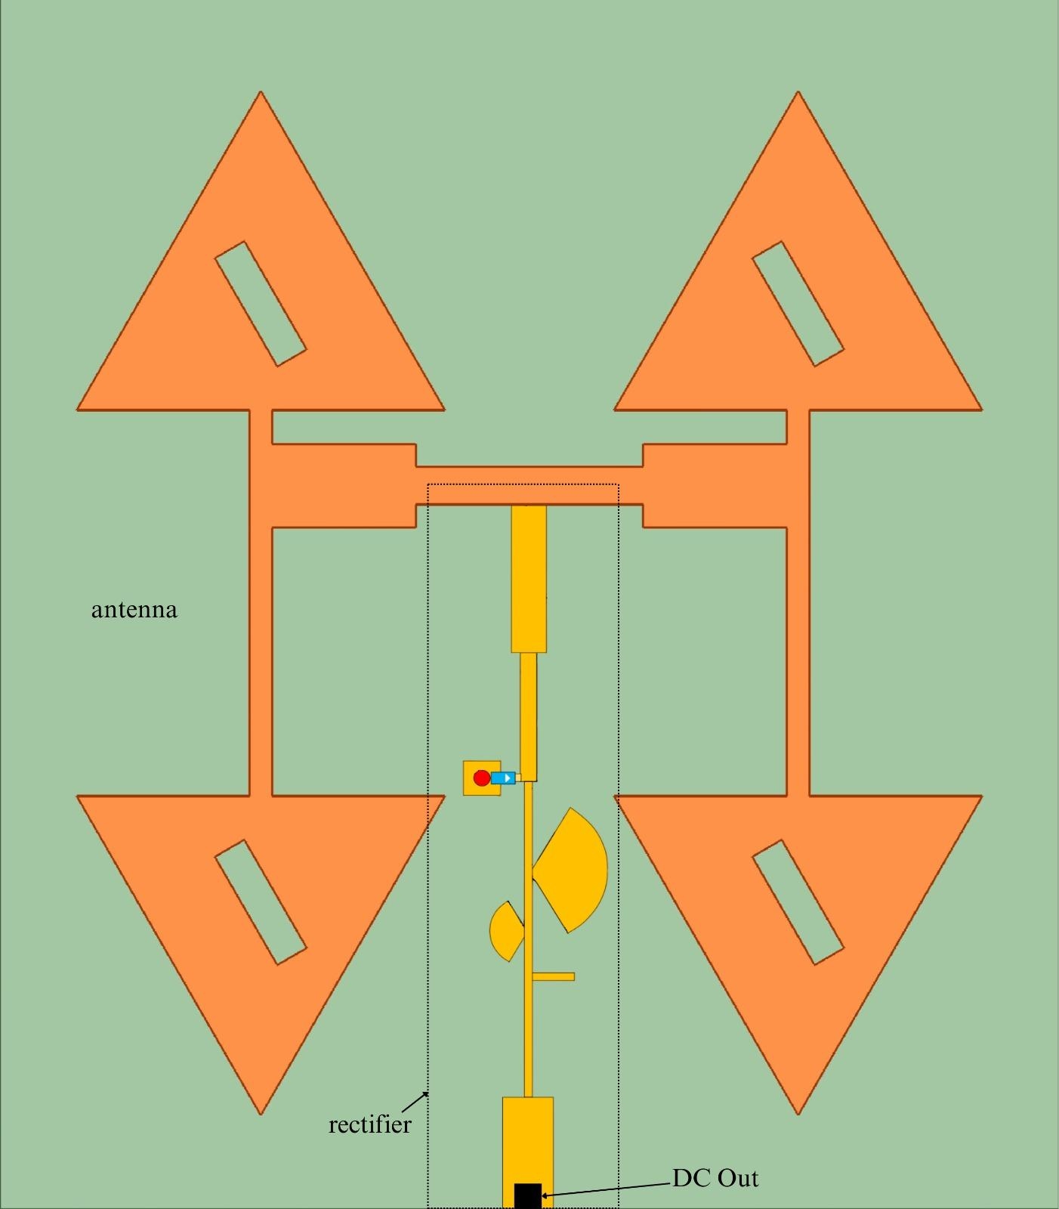
Methodology: Rectenna Design
Layout of Integrated Rectenna
Four triangular patch radiators (orange) form a dual-polarised receiving antenna arranged symmetrically about the centre
A vertical microstrip spine in the middle hosts the series-connected MA4E1317 Schottky-diode rectifier
Radial-stub harmonic termination and an output matching line are integrated along the spine to feed the load
Fabricated on a single Rogers DiClad 880 laminate, ensuring low dielectric loss at 24 GHz
Results in a compact, fully integrated rectenna that combines antenna and rectifier on one substrate for efficient 24 GHz energy harvesting
Figure 27: Complete layout of the proposed integrated rectenna.

Slide 28
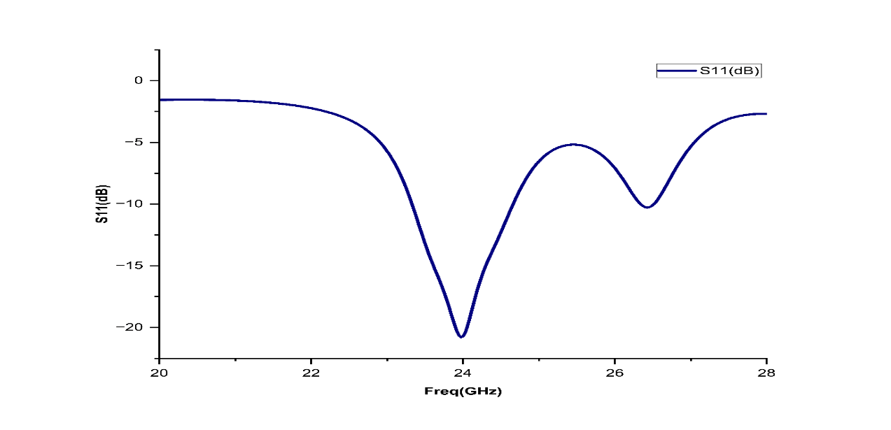
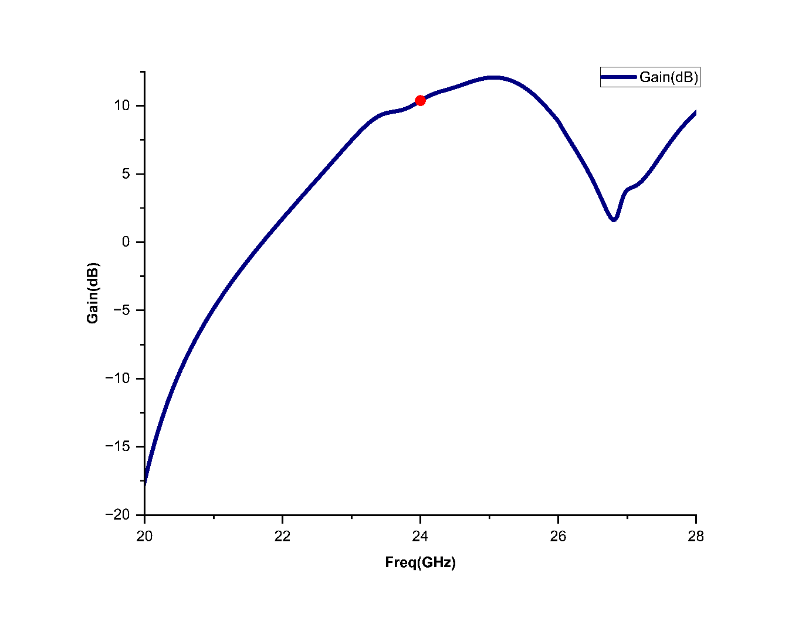
Results: Antenna Simulation
Figure 28: S11 vs Frequency Curve
Figure 29: Gain vs Frequency Curve Showing Resonance at 24 GHz

Slide 29
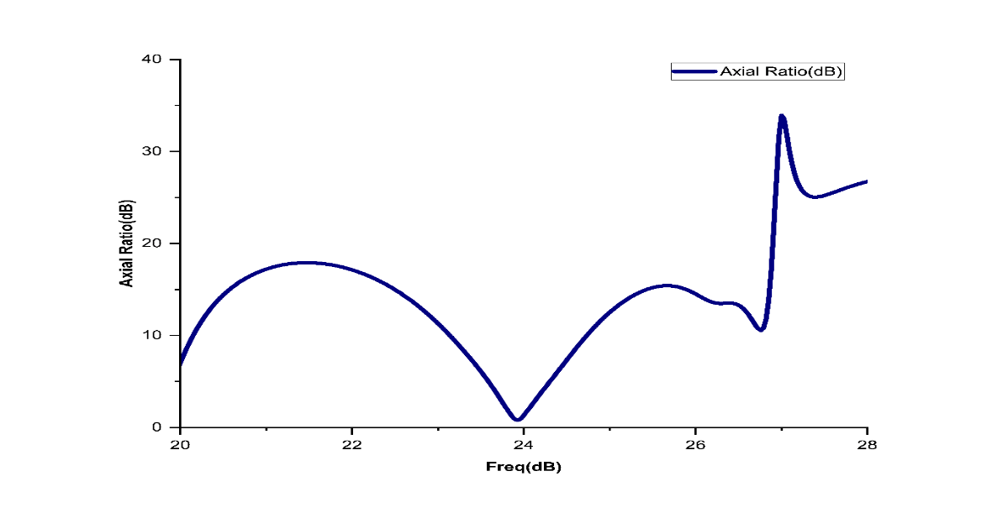
Results: Antenna Simulation
Table 11: Performance Parameters of The Designed Antenna Array
Resonance Frequency | 24 GHz
S11 | -20.2 dB
Bandwidth | 1.31 GHz
Gain | 10.43 dBi
Axial Ratio | 1.32 dB
Figure 30: Axial Ratio vs Frequency Curve Showing Axial Ratio Less than 3 dB at 24 GHz

Slide 30
Results: Rectifier Simulation
Figure 31: S11 vs Frequency Curve
Figure 32: PCE vs Input Power (dBm) at 24 GHz

Slide 31
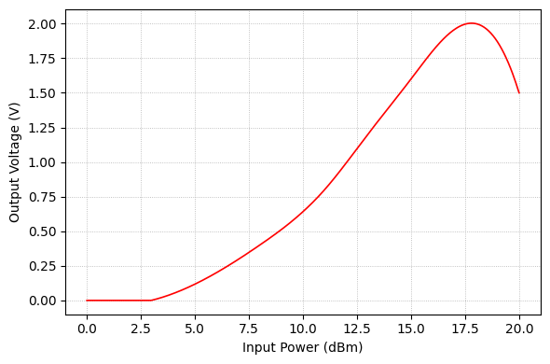
Results: Rectifier Simulation
Metric | Achieved | Requirement
|S11| @ 24 GHz | –17.6 dB | ≤ –16 dB
PCE peak | 67.26 % | ≥ 65 %
VOUT, pk @ 18 dBm | 2.02 V | ≥ 2 V
Figure 30: Output Voltage vs Input Power (dBm) at 24 GHz
Table 12: Performance Parameters of The Designed Rectifier

Slide 32
Results: Rectenna Integration
The integration of the antenna and rectifier subsystems was validated through close alignment of key electrical parameters, ensuring efficient RF-to-DC conversion:
Frequency Alignment:
The antenna resonates at 24 GHz, as confirmed by the S₁₁ curve (Figure 28) and gain peak (Figure 29).
The rectifier is optimized at the same 24 GHz, with |S₁₁| = –18 dB (Figure 31), satisfying return loss requirements for minimal reflection.
Impedance Matching:
The antenna return loss of –20.2 dB and rectifier’s –17.6 dB at 24 GHz indicate impedance matching, enabling maximum power transfer across the interface.

Slide 33
Results: Rectenna Integration
Polarization Compatibility:
The antenna shows an axial ratio of 1.32 dB, well below 3 dB (Figure 30), ensuring circular polarization—aiding in orientation-insensitive energy capture.
System Efficiency:
At 24 GHz and 18 dBm input, the rectifier achieves:
Peak PCE of 67.26%
Output Voltage of 2.02 V (Figure 33)
These meet and exceed target thresholds, indicating successful end-to-end RF-to-DC conversion.

Slide 34
References
[1] P. P. Shome, D. Sarkar, T. Khan, N. Shinohara and Y. M. M. Antar, "From Waves to Watts: Advancements in rectenna arrays for radio-frequency energy harvesting and wireless power transfer," in IEEE Antennas and Propagation Magazine, Issue 01 January, 2025.
[2] Ryoma Moro, Naoki Keicho, " 28 GHz Microwave Power Beaming to a Free-Flight Drone," 2021 IEEE Wireless Power Transfer Conference (WPTC),01-04 June 2021, San Diego, CA, USA.
[3] Huang, W., Du, J., Yang, X., Che, W., & Gao, S. (2023). A novel 24 GHz circularly polarised metasurface rectenna. IET Microwaves, Antennas & Propagation, 17(6), 419-426, Issue 01 february, 2023.
[4] A. Priya and T. Khan, "High-Gain Electrically Small Modified Antipodal Vivaldi Self-Matched Rectenna for n77/n78/n79 Sub-6 GHz 5G Narrow Dual-Band Wirelessly Powering IoT Devices," in Proc. IEEE WAMS, 2025.
[5]Desari Surender, Venkata Reddy, Taimoor khan, "Dual-Facet Loaded Dual-Polarized Quad-band Dielectric Resonator-Rectenna for RF Energy Harvesting in Smart City Applications," in IEEE Antennas and Microwave Symposium, Issue May, 2023.
[6]Desari Surender and Taimoor Khan, " A 90° Twisted Quarter-Sectored Compact and Circularly Polarized DR-Rectenna for RF Energy Harvesting Applications," IEEE ANTENNAS AND WIRELESS PROPAGATION LETTERS, VOL. 21, NO. 6, JUNE 2022
[7] Md. Ahsan Halimi , Taimoor Khan, & Gao, S. (2023).Rectifier Circuits for RF Energy Harvesting and Wireless Power Transfer, Digital Object Identifier 10.1109/MMM.2022.3211594, 01 December, 2022.
[8] Desari Surender, Md. Ahsan Halimi and Taimoor Khan, “Design of a 2.45 GHz operated Rectifier with 81.5% PCE at 13 dBm Input Power for RFEH/WPT Applications," 2021 IEEE Conference on Antennas and Propagation, 2021.

Slide 35
THANK YOU

