Slide 1
Algorithmic Trading: Predicting the S&P 500 with Hidden Markov Models
Siddharth Agarwal

Slide 2
Purpose
In today’s world, being able to accurately forecast the direction of the market in the future gives a huge edge to an investor. With publicly available data, and using free software, is it possible to model the market and make trades using a Hidden Markov Model?

Slide 3
Why a Hidden Markov Model?
Pattern recognition
Typical applications:
Speech analysis
Handwriting analysis
Gesture recognition
Fits with traditional market ‘state’ paradigm

Slide 4
Market Structure
Industry shift to electronic trading
Ability to execute trades quickly
High frequency trading
Bid/ask

Slide 5
Trading
Long/short positions
Leverage
Options, margin
S&P 500
E-Mini S&P 500 Futures

Slide 6
Algorithmic Trading
Widely used at most financial institutions
Machine learning with financial time series data
Brokerage APIs common

Slide 7
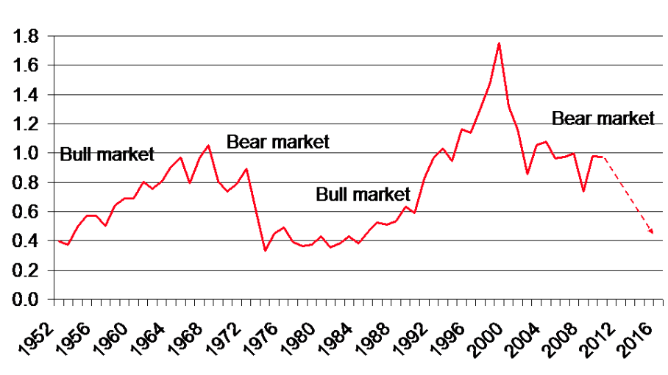
Bull/Bear Markets
Terminology for upward/downward trending markets
Source: https://thenextrecession.files.wordpress.com/2012/07/image010.gif

Slide 8
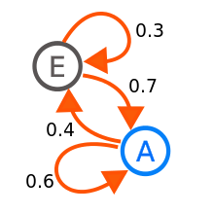
Markov Chains
E = bull market
A = bear market
Transition probabilities
E -> E
E -> A
A -> E
A -> A

Slide 9

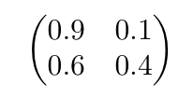
Discrete Time Markov Chain
Transition probability matrix θ
Example for a two state Markov chain:
θ =
Chain
{C_{t} | t ⋲ N }
Markov Property
P(C_{t+1}|C_{t},...,C₁) = P(C_{t+1}|C_{t})

Slide 10
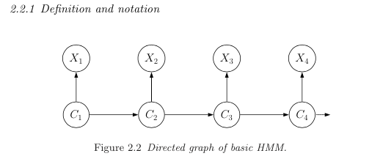
Hidden Markov Model
Chain
{C_{t} | t ⋲ N }
Observations
{X_{t} | t ⋲ N }
P(C_{t}|C_{t},...,C₁) = P(C_{t}|C_{t-1})
P(X_{t}|(X_{t},...,X₁),(C_{t},...,C₁)) = P(X_{t}|C_{t})

Slide 11
Hidden Markov Model
Each state {C_{t} | t ⋲ N } follows an independent probability distribution
Normal (Gaussian) distribution chosen for this project
C_{i} = N(μ_{i},σ_{i})
Observations {X_{t} | t ⋲ N } dependent on state parameters

Slide 12

Observations
Observations {X_{t} | t ⋲ N }
S&P 500 daily closing price
Log returns to normalize
t = 60 days
Yahoo Finance

Slide 13
EM Algorithm
Estimate θ
Loop until convergence
E step
Use current values of θ to compute conditional probability weights for each data point
M step
Update θ using new weights from previous step

Slide 14
State Probabilities
Using transition probability matrix θ, state probabilities at time t can be calculated
If the current state probability is (0,1), probability for the state at time t is
(0,1) θ^{t}

Slide 15
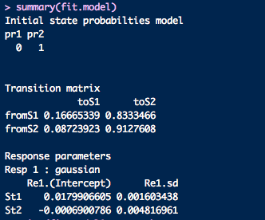
Sample HMM at 10/10/2012
Bull market: S1
Bear market: S2

Slide 16
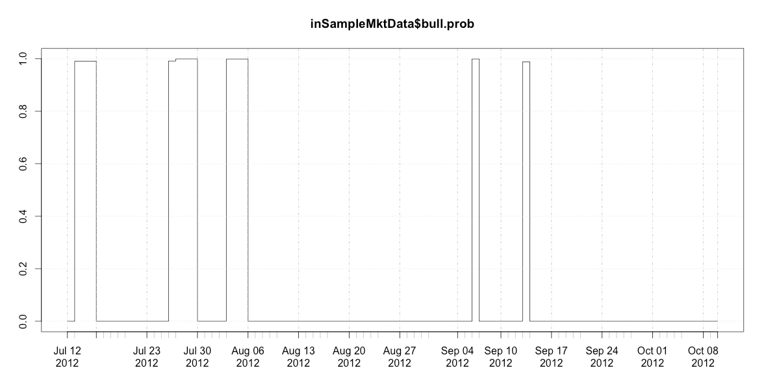
State Probabilities

Slide 17
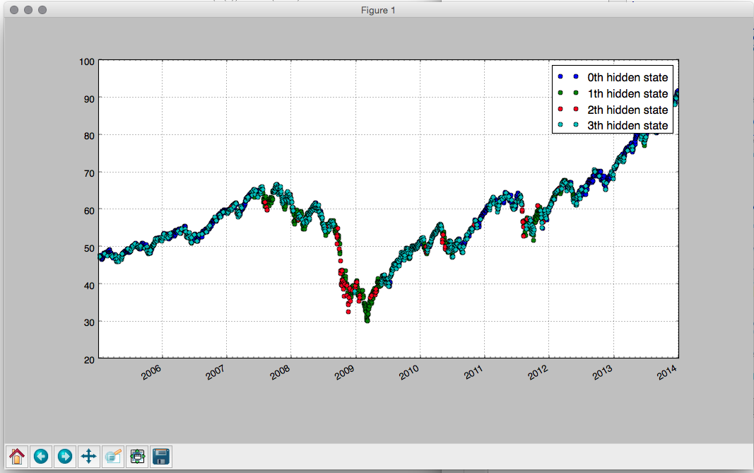
States
Notes:
Python

Slide 18
Algorithm
At time t,
Shift window from X_{(t-61)} to X_{t-1} to X_{(t-60)} to X_{t} and recalculate HMM
Use HMM to find probability p of current state
Recalculate 3 day exponential moving average using p
If probability p > 0.7, use respective bull/bear function
Bull: long position with (p * capital)
Bear: short position with (p * capital)

Slide 19
Benchmarking
Compared to same starting capital c invested in S&P 500
Absolute vs benchmark returns
Sharpe ratio
Risk/return
Expectancy

Slide 20
Returns
Year | ROI | Benchmark | Sharpe Ratio | Expectancy | Risk free rate
2001 | 4.6% | -24.7% | -0.197 | 0.0002 | 4.81%
2002 | 30.6% | -16.8% | 0.962 | 0.001 | 2.16%
2003 | -6.3% | 13.0% | 0.666 | -0.0004 | 1.36%
2004 | 0.79% | 9.72% | -0.125 | 0.0005 | 1.24%
2005 | 11.1% | 5.11% | 0.888 | 0.0008 | 2.86%
2006 | -6.84% | 11.2% | -1.212 | -0.0005 | 4.45%
2007 | -9.93% | 3.28% | -1.039 | -0.0007 | 5.06%

Slide 21
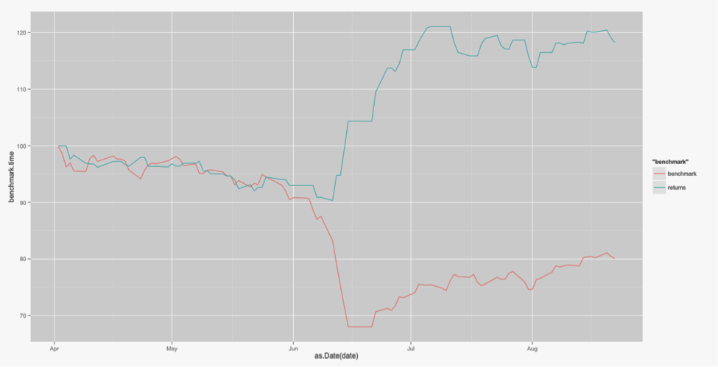
Return Graph: 01/04/2001- 08/22/2001

Slide 22
Variables to Improve Performance
Distribution of states
Number of states
Algorithm logic
Window of time

Slide 23
Applications to Live Trading
Factors not considered
Slippage
Transaction costs
Liquidity
Lookback bias
Ability to trade at the close
Short squeezes

Slide 24
Coding
Python, R
Wide array of financial packages for R (quantmod, TTR, etc)
Data pulled from Yahoo Finance using a quantmod function
Backtested using specific training/prediction data
Notes:
Experience with Java. Started off in Python, more availability in R.

Slide 25
GitHub
Code/Paper available on GitHub
https://github.com/siddharth-agarwal/hmm-algorithm.git

Slide 26
Sources
Davey, Kevin. Building Winning Algorithmic Trading Systems : A Trader's Journey from Data Mining to Monte Carlo Simulation to Live Trading. Wiley & Sons Canada, Limited, John, 2014. Print.
"Hidden Markov Models - Trend Following." Gekko Quant – Quantitative Trading. Web. 10 Feb. 2015. <http://www.gekkoquant.com>.
Hassan, Md Rafiul, and Baikunth Nath. "Stock market forecasting using hidden Markov model: a new approach." Intelligent Systems Design and Applications, 2005. ISDA'05. Proceedings. 5th International Conference on. IEEE, 2005.
Idvall, Patrik, and Conny Jonsson. "Algorithmic trading: Hidden markov models on foreign exchange data." (2008).
Zucchini, Walter, and Iain L. MacDonald. Hidden Markov Models for Time Series: An Introduction Using R. Boca Raton: CRC, 2009. Print.

