Slide 1
IE-500 Introduction to Statistical Machine Learning
Submitted by:
Siddharth Miteshkumar Haveliwala(50546666)

Slide 2

Predicting IPO performance using Statistical Machine Learning Methods

Slide 3
Introduction
Initial Public Offering (IPO) or Stock Launch
Pricing of the stock on Listing Day in Market.
Lack of understanding of determinants and driving factors underpricing and overpricing of IPO.
Build machine learning models and statistical inference
Interpreting patterns of historical IPOs to detect and predict the decisive variables in IPO listing day performance.

Slide 4
Analysis Procedures
Data Collection
Data Pre-Processing
Data Visualization & Analysis
Model Selection
Statistical Inference
Feature Selection & Engineering

Slide 5
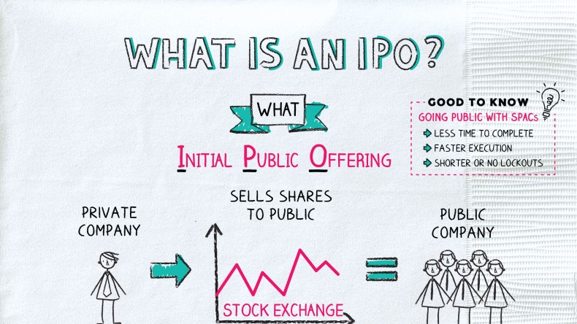
Dataset Description
We have IPO listing day subscription versus listing gains dataset for Indian Market.
The dataset contains 1429 samples for the period between 2017 and now.
Features – Company’s Financial Indictors, Offering data
Key features like Issue Price, Lot Size, QIB, NII, RII and many more.
Response – IPO performance indicator (Success or Failure)

Slide 6
Dataset Description
Feature | Definition
Issuer Company | Company that is offering its shares to the public for the first time through an IPO
Listing Date | Date on which a company's shares are officially listed and begin trading on a stock exchange.
Issue Price | Price at which the shares of the company are offered to the public during the IPO.
Lot Size | Minimum number of shares that an investor can bid for or purchase in a single transaction during the IPO.
Issue Price (Rs Cr) | Total value of the IPO in Indian Rupees (Rs) in crore (Cr).
Feature | Definition
NII | Investors who do not qualify as institutional buyers, such as high-net-worth individuals and corporate bodies.
RII | Individual investors who participate in the IPO with smaller investment amounts compared to institutional investors.
EMP | Reserved category for employees of the issuing company
TOTAL | Total number of shares offered in the IPO.
% Change | Percentage of change on the date of IPO listing.
QIB | Institutional investors allowed to participate in the IPO with higher investment limits compared to retail investors.

Slide 7
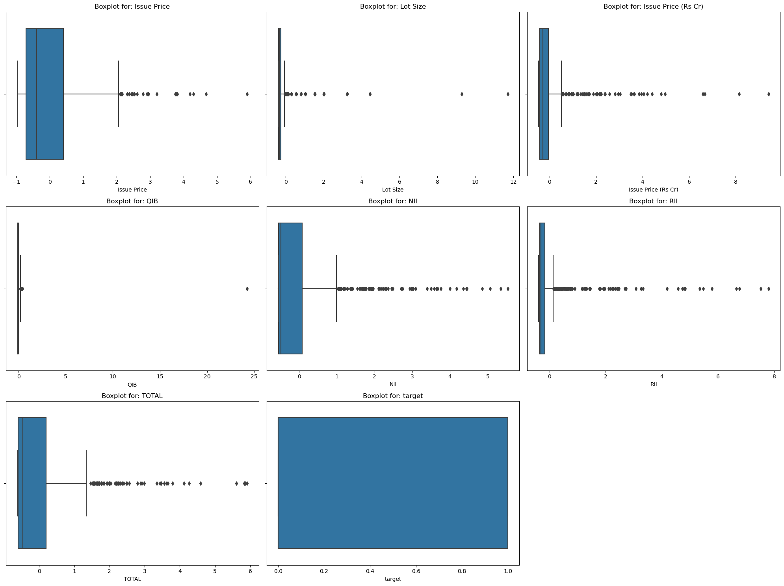
Data Pre-Processing
Identifying missing values.
Box-cox transformation for removing skewness
Standardization & Normalization of data.
Removal of outliers
Selection of significant features

Slide 8
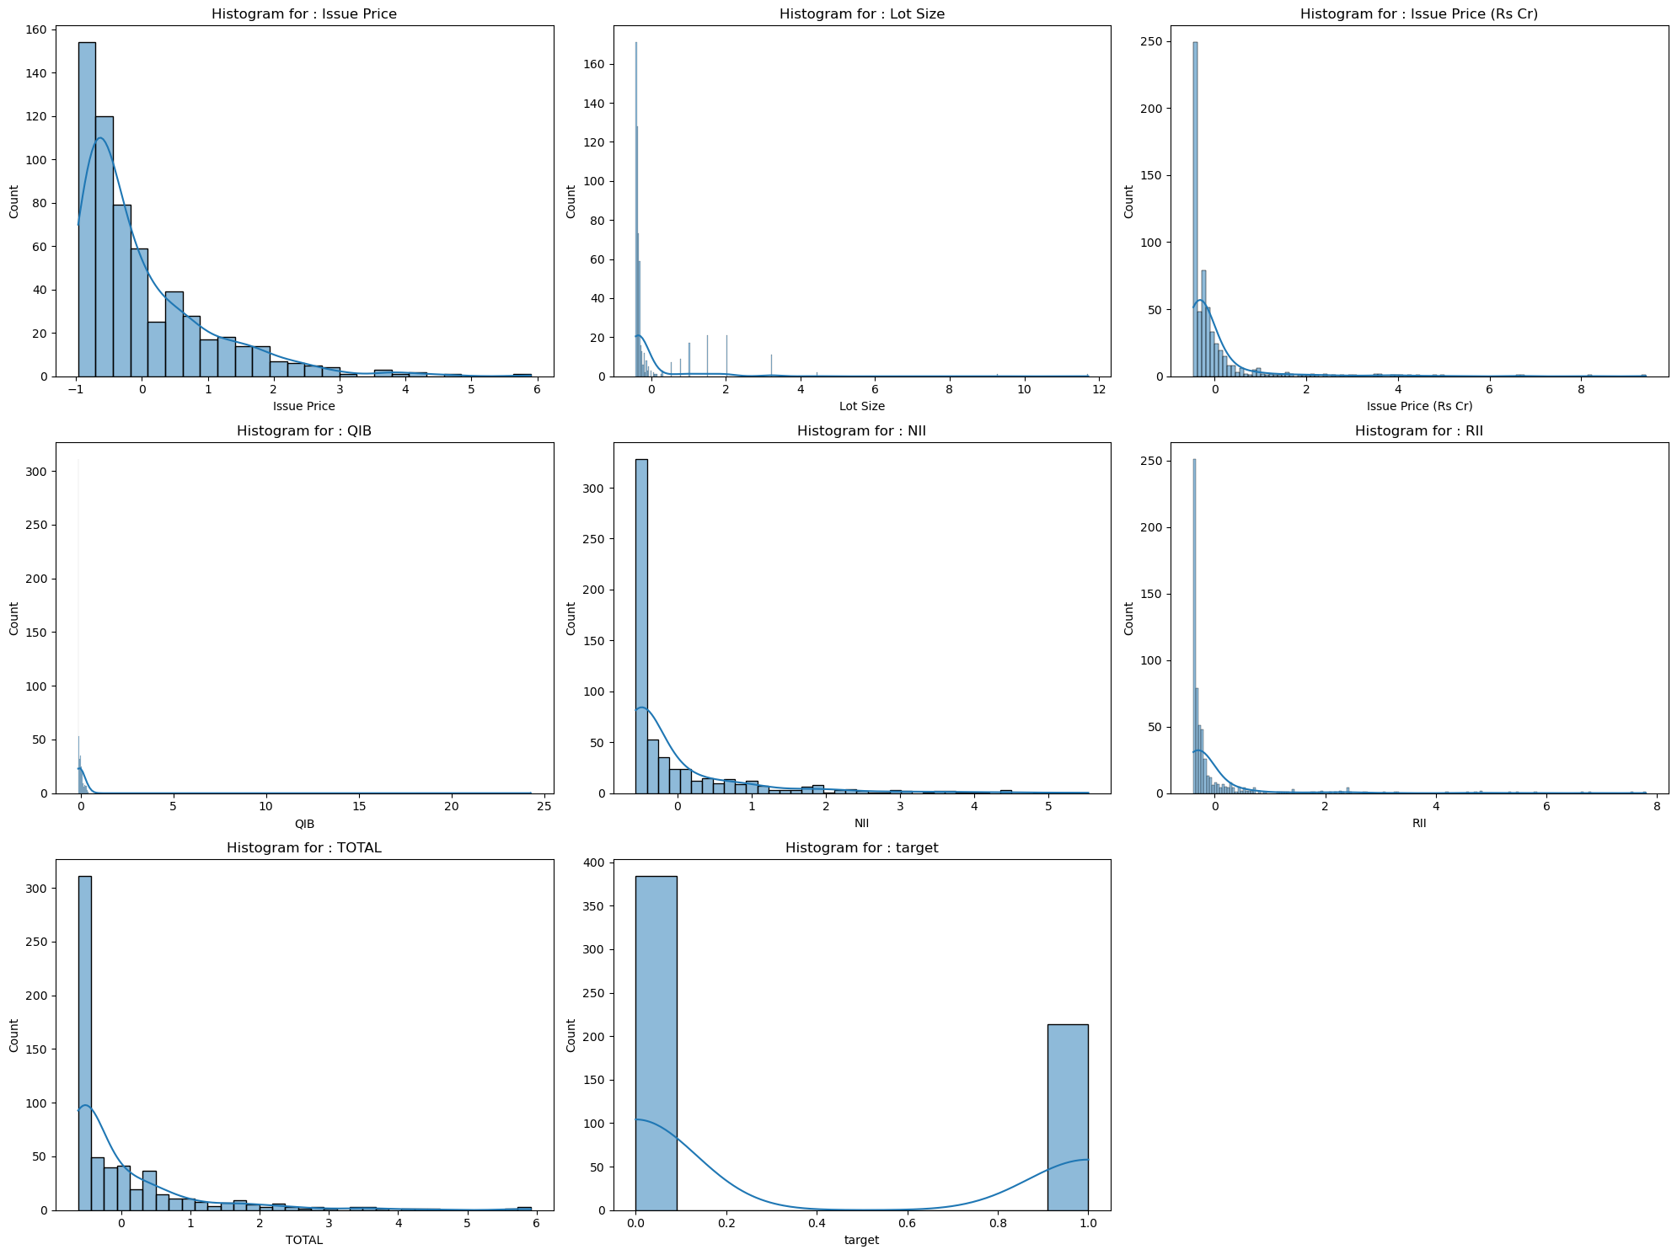
Data Visualization

Slide 9
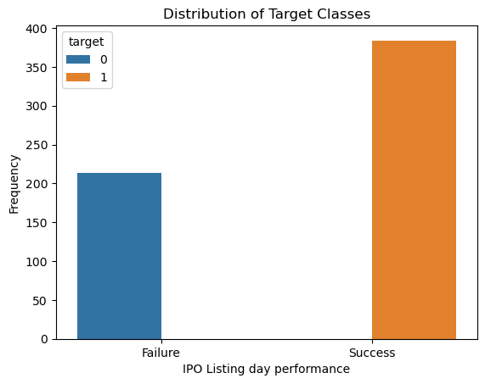
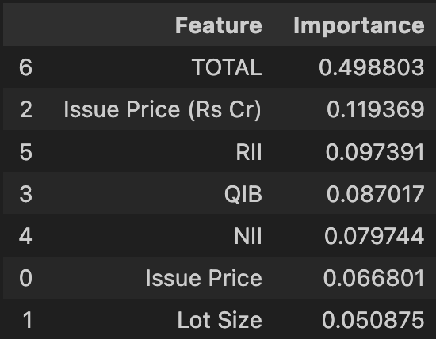
Feature Selection & Engineering
Selecting top seven features.
Standardization and Normalization of features
Encoded Response variable

Slide 10
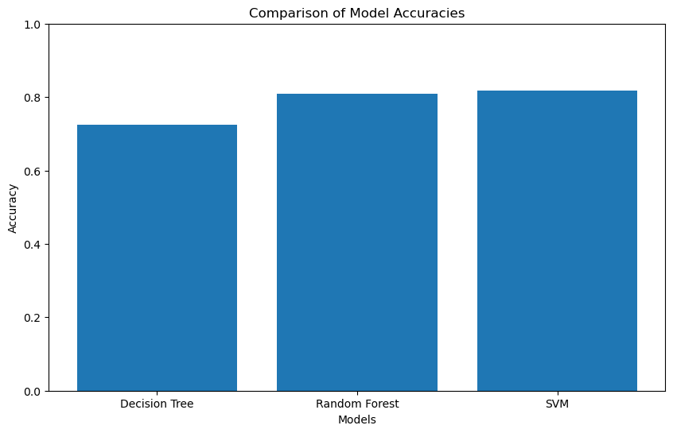
Model Selection (without Bayesian Optimization)
Decision Tree
Random Forest
Support Vector Machine (SVM)
Model | Testing Accuracy
Decision Tree | 0.725
Random Forest | 0.8083
SVM | 0.8166

Slide 11
Model Selection (with Bayesian Optimization)
Logistic Regression
Decision Tree
Random Forest
AdaBoost
CatBoost
XGBoost
Support Vector Machine (SVM)
Neural Network
Model | Testing Accuracy
Logistic Regression | 0.80
Decision Tree | 0.8083
Random Forest | 0.8167
AdaBoost | 0.7917
CatBoost | 0.8167
XGBoost | 0.7917
SVM | 0.7917
Neural Network | 0.8167

Slide 12
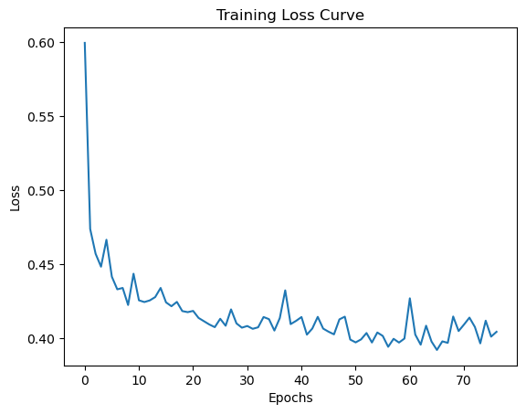
Final Model Selection
Key Highlights:
Ensemble methods, especially boosting techniques like CatBoosting & neural network performs superior on the dataset
Testing Accuracy: 81.67%
Adept at capturing complex patterns and relations in the data.
Models developed and optimized through Bayesian optimization show promising generalization capabilities.
Implication – Best models have the potential to offer valuable insights for predicting the performance of future IPOs on their listing day.

Slide 13
Future Scope
Enhanced Statistical Machine Learning Models:
Implement advanced statistical algorithms.
Utilize larger datasets for improved accuracy and generalization.
Exploring New Significant features:
Expand the scope of features to company’s previous quarterly revenues, recent market indicators, etc.
Incorporating natural language processing algorithms for sentiment analytics on financial market forums like reading the news or comments.

Slide 14
References
https://www.kaggle.com/code/gcabhishek/ipo-analysis-eda-and-success-prediction?kernelSessionId=116614889

Slide 15

THANK YOU

