Slide 2







Siddharth Vaghasia
Technical Consultant - SharePoint, Office 365, Azure, .NET, NODE JS
Office Development Microsoft MVP | C# Corner MVP (2x)
Speaker | Blogger | PnP contributor | SharePoint Stack Overflow
https://siddharthvaghasia.com
https://c-sharpcorner.com/members/siddharth-vaghasia
@siddh_me
siddharth-vaghasia
https://www.linkedin.com/in/siddharthvaghasia

Slide 4
Agenda
Overview of Teams Graph API.
List and description of available Endpoints
Protected APIs
What’s new and Latest
Demo
QnA

Slide 5
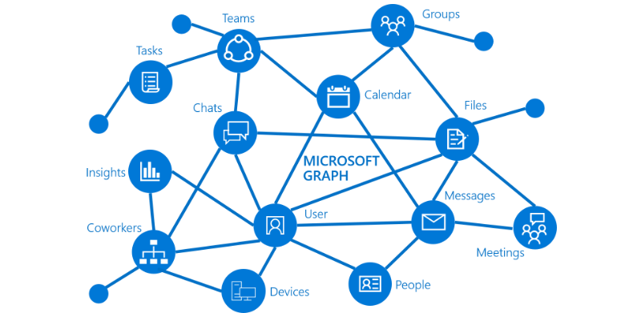
Graph API
Single endpoint for set of REST APIs
gateway to data and intelligence in Microsoft 365
unified programmability model
access the tremendous amount of data
Microsoft 365, Windows 10, and Enterprise Mobility + Security

Slide 6
Microsoft Teams
More than just a instant messaging solution
chat-based workspace
collaboration, meetings, calling, and enterprise voice features
Platform for teamwork, intelligent communication and much more
Teams is used as User’s Interaction as part of business process automation
Fact : Teams has acquired 115 million daily active users.

Slide 7
Concepts and Terminology
Team
Channel
Name
Description
Owners
Members
Channels
Settings
Apps
Tags
Name
Description
Owners(private)
Members(private)
Tabs
Messages
Settings

Slide 8
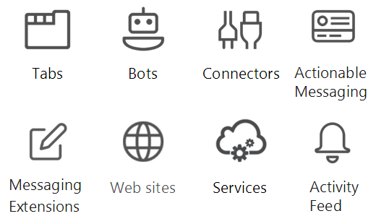
Teams Graph API
Teams API are part of Graph API Endpoints
which allows us to interact with Teams related resources and data
Use Teams Data in your custom application
Teams Customizations

Slide 9
Team – What we can do ?
List all channels
Create Channel
Update Channel
Delete Channel
List all your teams
List all teams(admin)
CRUD on team
Clone a team
Archive/Unarchive a team
Add/Remove Owners and Members
Get files, notebooks, plans, Calendars

Slide 10
Other operations
Operations related to teams tabs(add/edit/remove)
Operations related to teams App(list/publish/remove)
Chat Message (read/send) to Channels
Call (answer, reject, mute, unmute, list/invite participants)
Operations related to Shift , Schedule , time Off.

Slide 11
End Points Pattern
https://graph.microsoft.com/
/v1.0/{resource}?[query_parameters]
/beta/{resource}?[query_parameters]
Examples
https://graph.microsoft.com/v1.0/teams/ - List all team
https://graph.microsoft.com/v1.0/teams/{team-id} - Get a team
https://graph.microsoft.com/v1.0/teams/{team-id}/channels - Get all channels within team
https://graph.microsoft.com/v1.0/teams/{team-id}/channels/{channel-id} – Get a particular channel with teams
https://graph.microsoft.com/v1.0/teams/{team-id}/channels/{channel-id}/tabs - Get all tabs within a channel

Slide 12
Permissions are Important ☺
Every endpoint in Graph API requires permissions
Type of Permission
Delegated (work or school account)
Delegated (personal Microsoft account)
Application Permission
Azure AD App Registration
Create/Register a Azure AD App
Provide Permissions
Generate Secret key

Slide 13
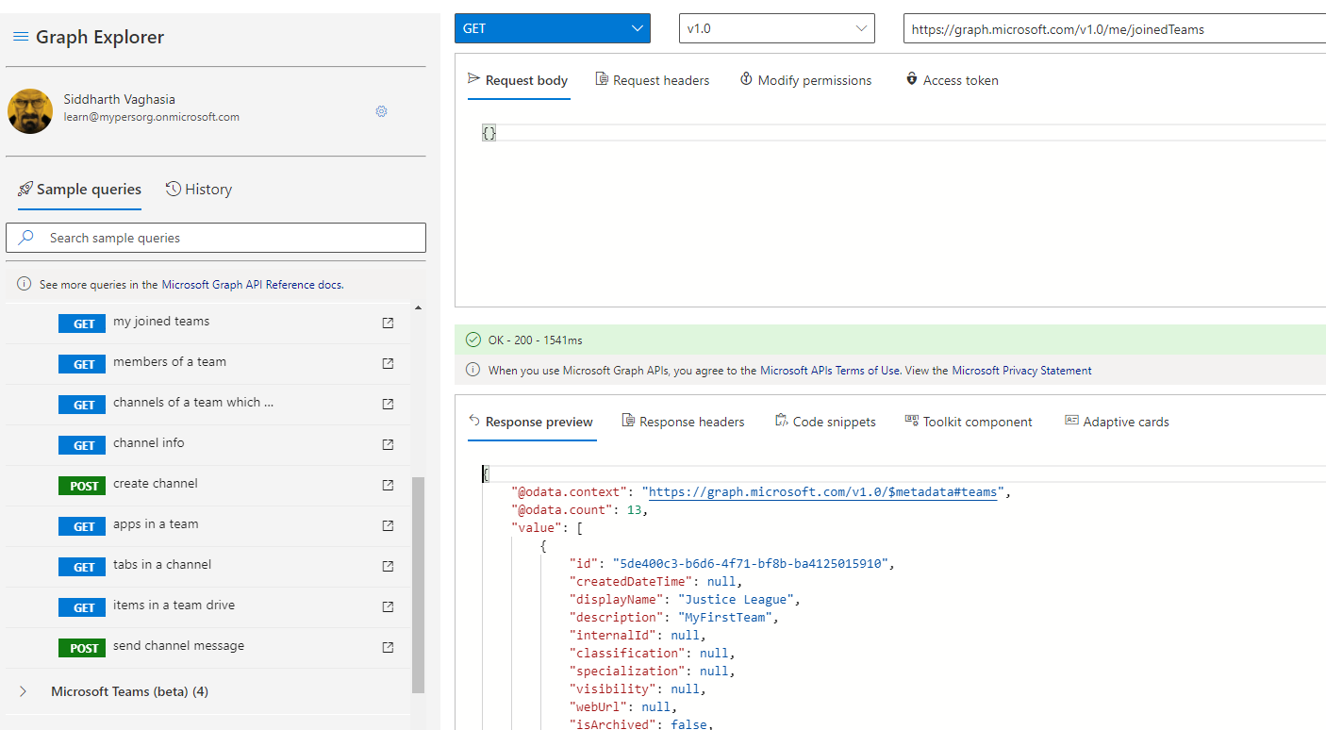
Graph explorer
https://docs.microsoft.com/en-us/graph/api/resources/teams-api-overview?view=graph-rest-1.0
https://developer.microsoft.com/en-us/graph/graph-explorer

Slide 14
Known Resources
Resource | Methods
team | List your teams, list all teams, create, read, update, delete, clone, archive, unarchive
group | Add member, remove member, add owner, remove owner, get files, get notebook, get plans, get calendar
channel | List, create, read, update, delete
teamsTab | List, create, read, update, delete
teamsApp | List, publish, update, remove
teamsAppInstallation | List, install, upgrade, remove
chatMessage | send
call | Answer, reject, redirect, mute, unmute, change screen sharing role, list participants, invite participants
schedule | Create or replace, get, share
schedulingGroup | Create, List, Get, Replace, Delete
shift | Create, List, Get, Replace, Delete
timeOff | Create, List, Get, Replace, Delete
timeOffReason | Create, List, Get, Replace, Delete

Slide 15
Protected APIs
Teams contains sensitive and private data to individual.
APIs that access sensitive data are considered protected APIs
These APIs require that you have additional validation, beyond permissions and consent, before you can use them.
To request access we will have to contact Microsoft via Request Form
https://aka.ms/teamsgraph/requestaccess
Review request every Wed and deploy approval every Friday.
https://docs.microsoft.com/en-us/graph/teams-protected-apis

Slide 16
Protected APIs
The following APIs are currently protected:
List channel messages using application permissions
Get chatMessages in a channel delta using application permissions
Get channel message using application permissions
Create subscription for new channel messages using application permissions
List replies to a message using application permissions
Get a reply to a message using application permissions
(List chats using application permissions doesn't exist, with or without protected API access)
List messages in a chat using application permissions
Get message in chat using application permissions
Create subscription for new chat messages using application permissions
List all hosted content using application permissions
Get hosted content using application permissions
List chat members using application permissions
Get chat member using application permissions
Ref - https://docs.microsoft.com/en-us/graph/teams-protected-apis

Slide 17
What’s New?
GA of Presence API
Added support for resource-specific consent (RSC) permissions to v1.0 APIs.
Added read channel message APIs.
Added the following methods to the channel resource: List channel members, Get channel member, Add channel member, Update channel member's role, Remove channel member.
https://docs.microsoft.com/en-us/graph/changelog

Slide 18
The Latest - Activity Feed Notification API
Microsoft Teams activity feed enables users to triage items that require attention by notifying them of changes
activity feed notification APIs in Microsoft Graph to extend this functionality to your apps.
Examples
Notify a user about a task created in a chat/team
Notify a user about an event using a custom topic
https://docs.microsoft.com/en-us/graph/teams-send-activityfeednotifications

Slide 19
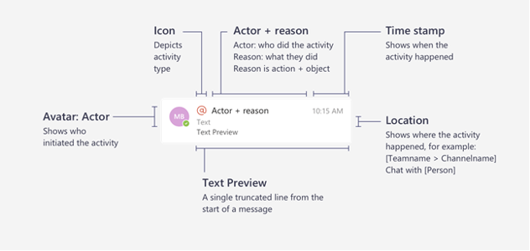

Basics of Activity Feed Notifications
The components include:
The actor who initiated the activity
An icon that represents the activity type
The reason the actor did the activity
A text preview
A time stamp
The location of the activity

Slide 20
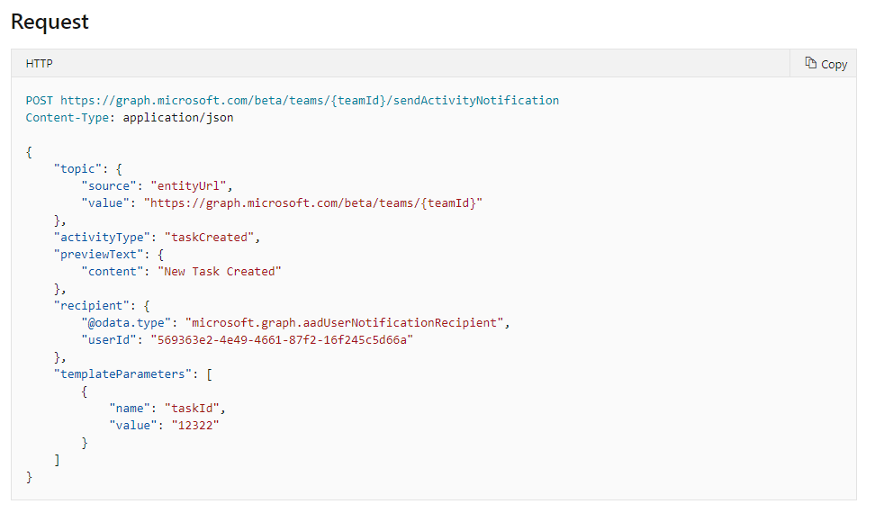
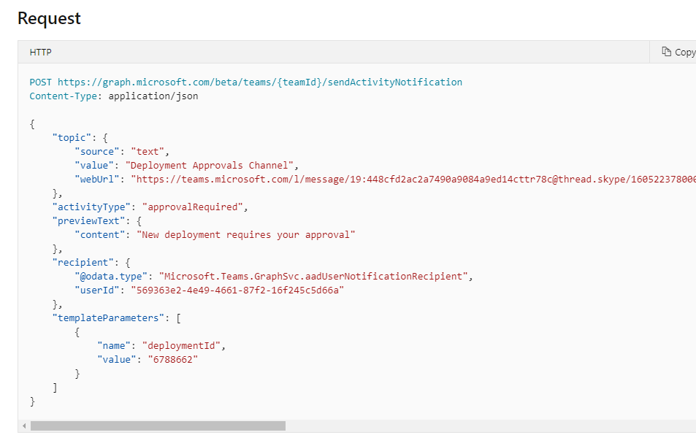
Examples of Usage
Notify a user about a task created in a team
Notify a user about an event using a custom topic

Slide 21
Teams Life Cycle
Create Team
Add owners and members
Settings
Create Channels
Install apps
Add tabs
Archive /Delete Teams

Slide 22
Why?
Organization needs to create a Team for a teams members to collaborate when business issue arises.
For School/Colleges need professors need to create a Team for a classes
Airlines wanted to create a team for every flight to collaborate.
Governance around Teams Creation
Teams can be created only after approvals

Slide 23
Demo
Automate Teams Life Cycle
Microsoft Forms
Power Automate
Graph API

Slide 24





Thank You !

