Slide 1
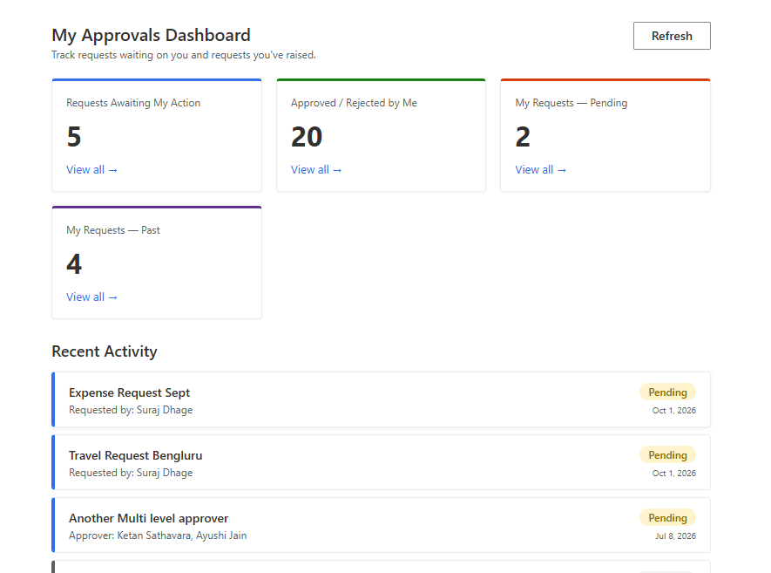
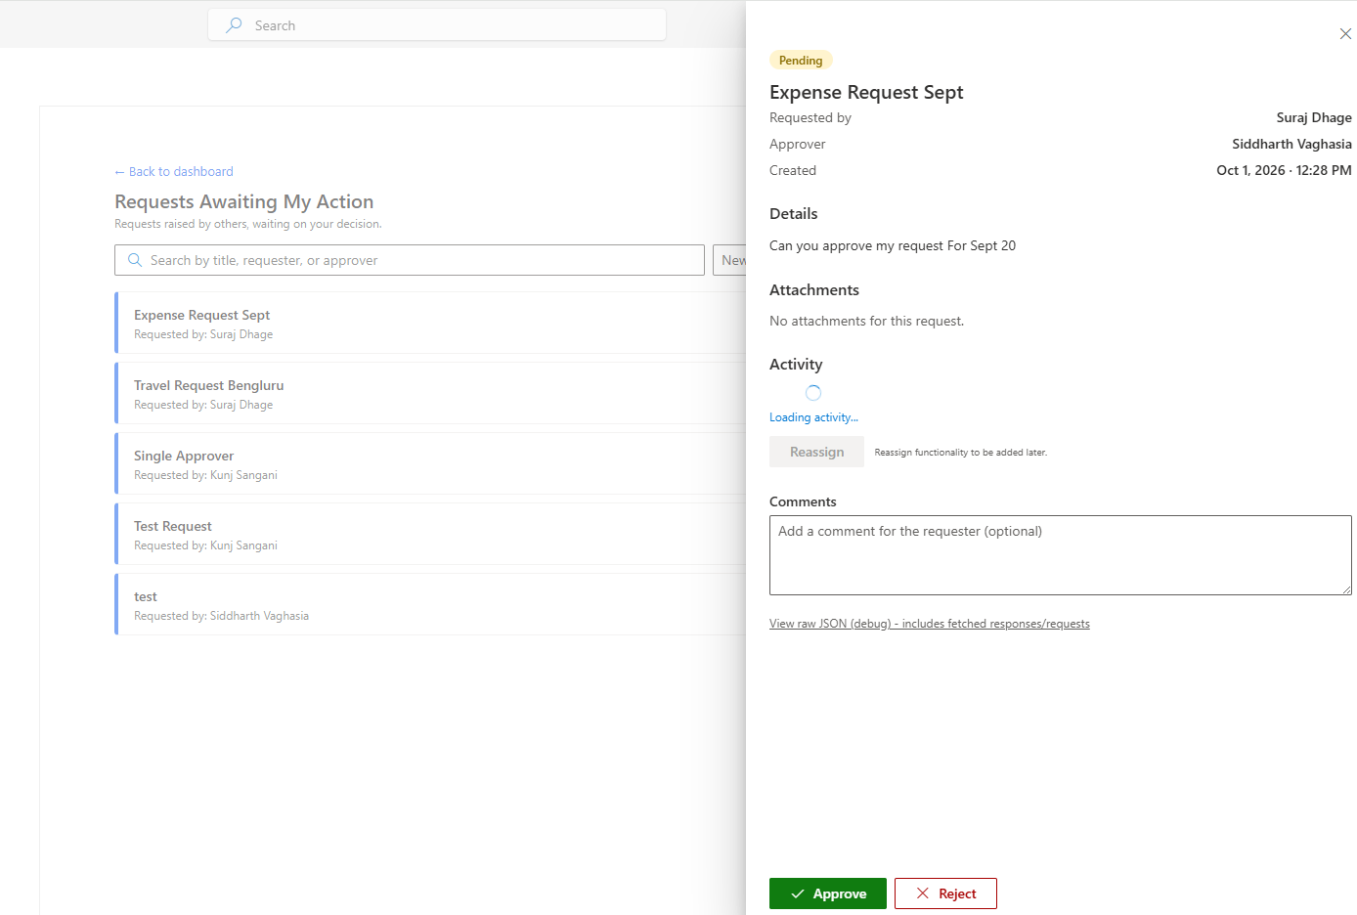
Power Automate Approvals
Dashboard with SPFx
Siddharth Vaghasia

Slide 2
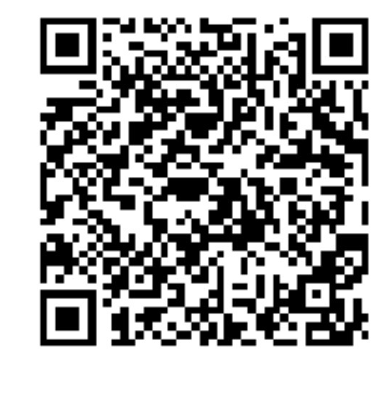

Siddharth Vaghasia
👨‍💻 Tech Veteran
18 years of IT industry experience (started when floppy disks were still cool!) 💾
Founder of BinaryRoots, helping organizations utilize Microsoft technologies 🦸‍♂️
Based in Pune, India—the perfect mix of tech and culture 🌏
🎯 Professional Superpowers
Specialist in M365, SharePoint, Power Platform, Copilot, Teams Apps Development, and beyond 🔧.
Passionate about simplifying workflows and building innovative solutions 🚀.
Open Source Contributor: Sharing knowledge one code snippet at a time 🌍.
👨‍👧‍👦 Life Outside the Office
Father of twins: Mastering the art of multitasking daily! 👶👶
Movies, Sitcoms & Music fanatic 🎬🎵—always ready for a Netflix binge or a new playlist.
Loves badminton and cricket: Smashing birdies and hitting boundaries like a pro 🏸🏏.
https://www.youtube.com/@codeman5277
Notes:
I'm [Your Name], and for the next 40 minutes, we're going to learn how to strategically respond to this AI demand. We'll explore four different development options, understand when to use each one, and give you a practical decision framework so you can deliver real AI value—whether that's building an HR assistant, extending Copilot, or creating the next great M365 experience.
By the end of this session, when someone asks you to 'add AI,' you'll know exactly which tool to reach for.
[Transition]
Ready? Let's begin our journey from Teams Toolkit to M365 Agents Toolkit."

Slide 3

Idea & Driving factors
Real world use case (customer’s ask)
Exploring Approvals APIs
Putting Approvals within SharePoint
Missed approvals in emails
Save context switching
https://pnp.github.io/sp-dev-fx-webparts/samples/pnp-sp-dev-spfx-web-parts-react-powerautomate-approvals/

Slide 4
Understanding Approvals API
Get Approvals Items
GET https://graph.microsoft.com/beta/solutions/approval/approvalItems
Get Approval Item Requests
GET https://graph.microsoft.com/beta/solutions/approval/approvalItems/{id}/requests
Get Approval Item Responses
GET https://graph.microsoft.com/beta/solutions/approval/approvalItems/{id}/responses

Slide 5
Understanding Approvals API
Submit Approve/Reject Operation
POST https://graph.microsoft.com/beta/solutions/approval/approvalItems/{id}/responses
{
"response": "Approve",
"comments": "Approve this request"
}

Slide 6
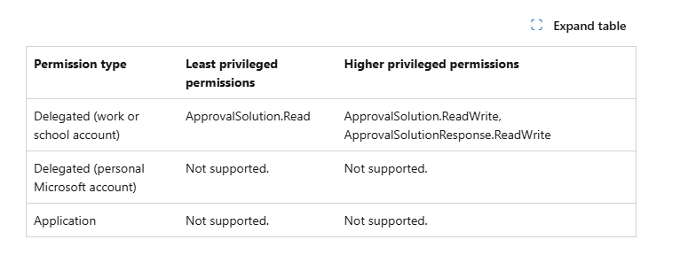
Permissions
https://learn.microsoft.com/en-us/microsoft-365/copilot/extensibility/api/ai-services/chat/copilotroot-post-conversations

Slide 7
Demo/ Code Walkthrough

Slide 8
Link to Download the Package
  THANK YOU
https://github.com/siddharth-vaghasia/public-docs/blob/master/react-powerautomate-approvals.sppkg

