Slide 1
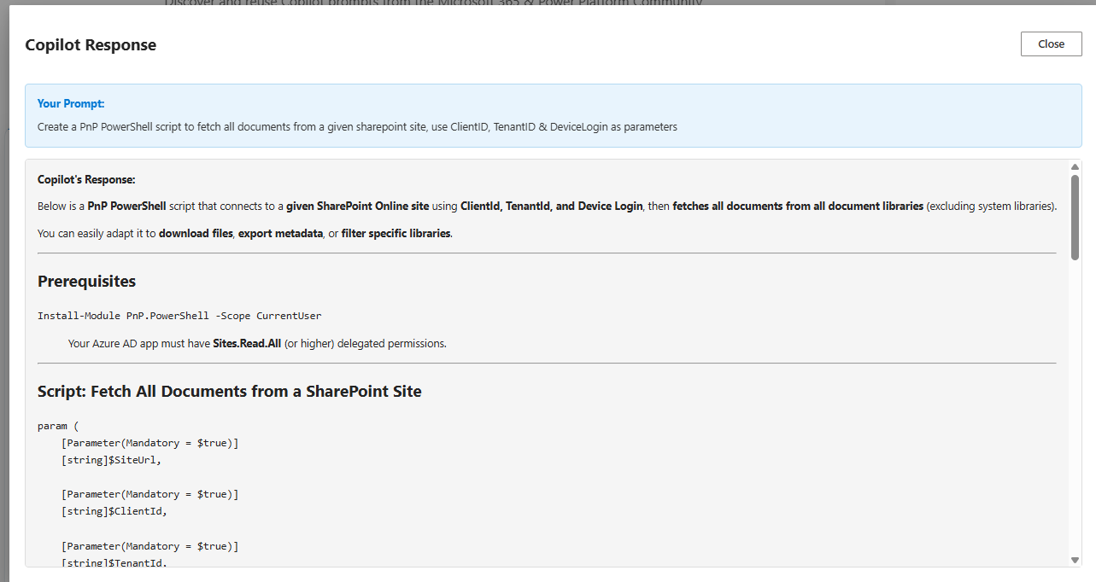
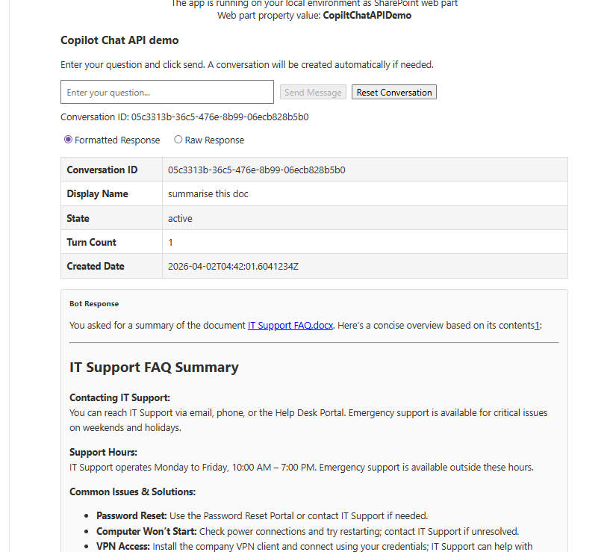
Building AI-powered SPFx apps
with Copilot Chat API
Siddharth Vaghasia

Slide 2


Siddharth Vaghasia
👨‍💻 Tech Veteran
16 years of IT industry experience (started when floppy disks were still cool!) 💾
Founder of BinaryRoots, helping organizations utilize Microsoft technologies 🦸‍♂️
Based in Pune, India—the perfect mix of tech and culture 🌏
🎯 Professional Superpowers
Specialist in M365, SharePoint, Power Platform, Copilot, Teams Apps Development, and beyond 🔧.
Passionate about simplifying workflows and building innovative solutions 🚀.
Open Source Contributor: Sharing knowledge one code snippet at a time 🌍.
👨‍👧‍👦 Life Outside the Office
Father of twins: Mastering the art of multitasking daily! 👶👶
Movies, Sitcoms & Music fanatic 🎬🎵—always ready for a Netflix binge or a new playlist.
Loves badminton and cricket: Smashing birdies and hitting boundaries like a pro 🏸🏏.
https://www.youtube.com/@codeman5277
Notes:
I'm [Your Name], and for the next 40 minutes, we're going to learn how to strategically respond to this AI demand. We'll explore four different development options, understand when to use each one, and give you a practical decision framework so you can deliver real AI value—whether that's building an HR assistant, extending Copilot, or creating the next great M365 experience.
By the end of this session, when someone asks you to 'add AI,' you'll know exactly which tool to reach for.
[Transition]
Ready? Let's begin our journey from Teams Toolkit to M365 Agents Toolkit."

Slide 3

Idea & Driving factors
Exploring the capabilities of the Copilot Chat API
Understanding how it can be leveraged within SPFx applications
Bringing AI into your existing SharePoint solutions
Passing custom contextual data to API
https://github.com/pnp/sp-dev-fx-webparts/tree/main/samples/react-copilot-chat-api-demo

Slide 4
How Copilot Chat API works?
STEP 1- Create copilotConversation
POST https://graph.microsoft.com/beta/copilot/conversations
STEP 2 - copilotConversation: chat (synchronously)
POST https://graph.microsoft.com/beta/copilot/conversations/{conversationId}/chat
copilotConversation: chatOverStream
POST https://graph.microsoft.com/beta/copilot/conversations/{conversationId}/chatOverStream
Send a chat message to Copilot and receive a streaming response.

Slide 5
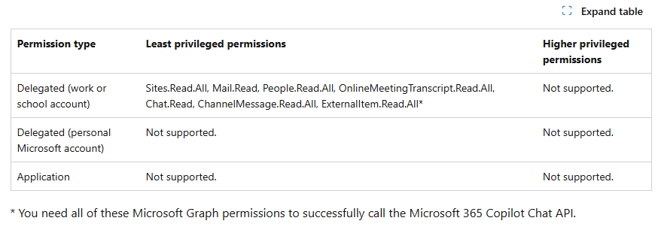
Permissions
https://learn.microsoft.com/en-us/microsoft-365/copilot/extensibility/api/ai-services/chat/copilotroot-post-conversations

Slide 6
Demo/ Code Walkthrough

Slide 7
Link to Download the Package

Slide 8
  THANK YOU

