Slide 1
Parallel Processing for Efficient Summarization With PYTHON
Presented by
Name: Siddharth Jain
Student id: 02102211
Student Mail id: sjain9@umassd.edu

Slide 2
ABSTRACT
This project brings together Python's ability to do tasks at the same time with advanced techniques for understanding and processing language. It uses a special tool called DistilBART from the Transformers library to make summarizing text faster and more efficient, perfect for quickly handling a lot of information.
The project breaks down the job of summarizing into smaller parts that can be done simultaneously. This method significantly cuts down the time needed to complete the task. It's designed to handle more and more information over time without losing its effectiveness, which is very important for jobs that need quick results, like putting together news summaries or doing research.
It makes use of a feature in Python called concurrent. Futures, allowing it to carry out several summarizing tasks at the same time. This approach not only speeds up the process but also uses resources better, making it a more efficient option than older methods that do one task after another.

Slide 3
INTRODUCTION
In today's world, we have lots of text data, like news, research, and online articles. It's hard to read and understand all of it quickly. This project helps solve this by making a tool that can summarize long texts fast, so you get the key ideas without having to read everything.
Normally, summarizing text is done one step at a time, which can be slow. By using parallel processing, which means doing many parts of the job at the same time, we can make it much faster. This is important because it helps people and businesses keep up with lots of information quickly.
The main benefit of this project is that it saves a lot of time. Since it does multiple tasks at once, it works faster than older methods. It's also flexible, meaning it can handle more work if needed. This is great for things like quickly understanding the latest news or getting the gist of a long report.
This tool uses Python, a popular programming language, along with special software that's good at reading and condensing text. It's designed to tackle different sections of the text concurrently, significantly speeding up the summarization. Essentially, this tool can quickly digest large amounts of text and provide concise, relevant summaries, transforming how we handle and interpret vast volumes of information.

Slide 4
Methodology
The following approach was used to transforms the task of summarizing large volumes of text.
Utilizing Python and DistilBART: We use Python, a versatile programming language, along with DistilBART from the Transformers library. DistilBART is specialized in summarizing text, making it a key component of our project.
Breaking Down the Text: The text is divided into smaller sections. This is like cutting a large task into smaller, more manageable parts, which prepares the text for efficient processing.
Parallel vs. Serial Processing: In contrast to serial processing, where tasks are done one after another, we employ parallel processing. This means we handle multiple sections of the text simultaneously, greatly speeding up the overall process.
Summarizing Each Segment Independently: Each section of text is summarized independently at the same time. This is achieved through Python's ability to perform multiple tasks concurrently.
Combining Summaries for Cohesion: After each piece of text is summarized, these individual summaries are combined into one comprehensive summary. This ensures that the final output is a complete and coherent version of the original text.
Optimizing for Speed and Accuracy: Throughout the process, we balance the need for speed with the need for accuracy. The goal is to produce a summary quickly without losing the essential meaning of the text.

Slide 5
Algorithm
Explanation of the Model:
The DistilBART model, which we use in our project, is based on a special type of artificial intelligence known as BART (Bidirectional and Auto-Regressive Transformers). Imagine BART as a smart reader and writer rolled into one. It first reads and understands a piece of text from start to finish and then back again, grasping the full context. Next, like a skilled writer, it starts creating a summary, choosing each word carefully based on the ones it already wrote. This way, it makes sure the summary is clear and makes sense. DistilBART is a simpler version of BART – it's like having the same skills but being faster and using less power, which is great for our project.
How We Are Using It in Our Project:
In our project, we take the DistilBART model and give it a boost with parallel processing. This means instead of summarizing a long article all at once, we cut the article into smaller pieces, like slicing a pie. Then, we use the model to summarize each piece at the same time, instead of one by one. It's like having several assistants each working on a different slice, making the whole job much faster. After each piece is summarized, we put all these mini-summaries together to form a complete, shortened version of the original article. This approach helps us make quick and effective summaries, saving time and effort, especially when we have a lot of text to go through.

Slide 6
ERROR HANDLING
In the context of a project like "Parallel Processing for Efficient Summarization With Python," implementing robust error handling is crucial to ensure the reliability and stability of the system. Error handling in this project would primarily focus on identifying and managing issues that may arise during the text summarization process. Here's an overview of how error handling can be effectively integrated.
1. How does the project handle issues with the DistilBART model and concurrency?
The project uses try-except blocks in Python to catch and manage exceptions if the DistilBART model fails to process a text segment. For concurrency issues, it ensures that a failure in one thread doesn't disrupt the entire summarization process, allowing other segments to continue being processed in parallel.
2.What strategies are implemented to manage resource limitations and output quality?
The system monitors resource usage and, in case of constraints like memory shortages, it either reduces the workload or stops with clear notifications. To ensure output quality, the system performs checks on the summarized content. If the output deviates significantly from expected results, it is flagged for review or reprocessing.
3. What role do testing and validation play in the project's error handling?
A. Regular testing and validation are crucial for ensuring effective error handling. The system is tested with various inputs, including stress tests for handling resource-intensive tasks, to ensure robustness and reliability under different scenarios.

Slide 7
RESULTS
My evaluation of the 'Parallel Processing for Efficient Summarization With Python' project revealed significant results. The tool exhibited remarkable differences in performance when summarizing texts of various lengths and complexities. While we encountered certain challenges and limitations, these experiences offered crucial learning opportunities for future enhancements of the project.

Slide 8
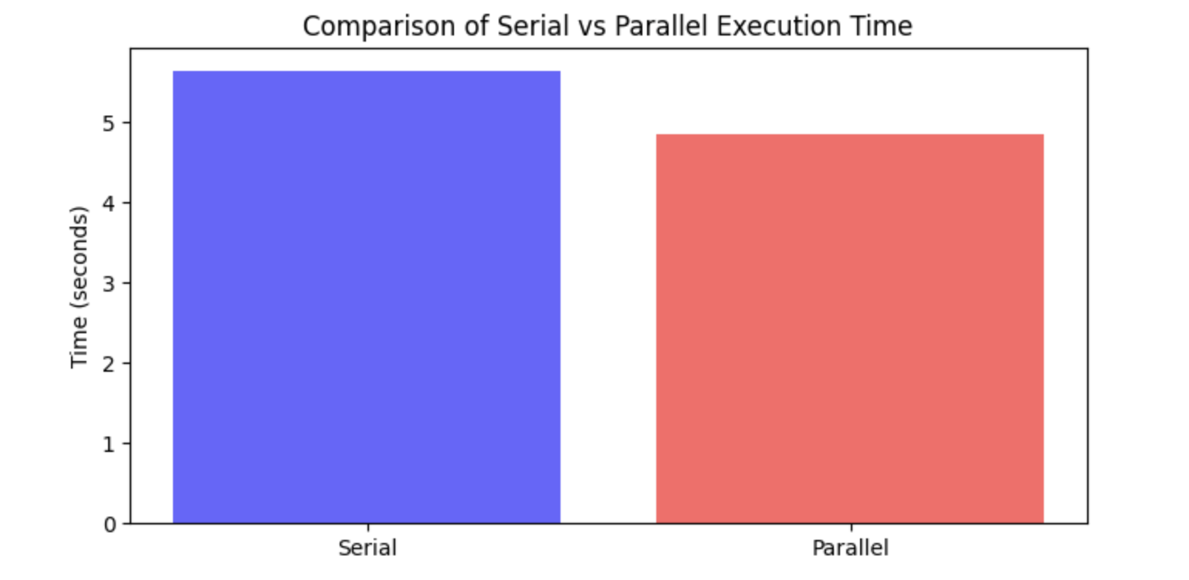
Visualizations (EXECUTION TIME)
Serial Execution Time (5.642369985580444 seconds): This is the amount of time it took for the tool to summarize the text when processing it serially, meaning one part after another in a sequential manner. It took approximately 5.64 seconds to complete the task.
Parallel Execution Time (4.845679759979248 seconds): This is the time taken when the tool used parallel processing. In this mode, the tool processed multiple parts of the text simultaneously, instead of one by one. This approach took about 4.85 seconds, which is quicker than the serial approach.
Efficiency Improvement (14.119779944193766%): This percentage represents the improvement in efficiency when switching from serial to parallel processing. An efficiency improvement of approximately 14.12% means that the parallel processing mode was about 14.12% faster than the serial mode.

Slide 9
visualizations
The graph illustrates the execution time for a text summarization task using different numbers of processing cores, comparing serial (one process at a time) and parallel (multiple processes simultaneously) processing methods:
Serial Processing (Blue Line): The serial processing time is relatively constant regardless of the number of cores because it doesn't utilize more than one core at a time. There's a slight variation in execution time, which might be due to other system processes affecting performance.
Parallel Processing (Green Line): The execution time for parallel processing generally decreases as the number of cores increases. This shows the expected behavior that parallel processing can take advantage of multiple cores to perform tasks more quickly.
Efficiency Improvement: When comparing the two methods, it's clear that parallel processing can improve performance, particularly as the number of cores increases. However, the efficiency gain is not linear and can be influenced by factors such as the overhead of managing parallel tasks and the specific nature of the tasks being run in parallel.
In conclusion, the graph demonstrates the potential for parallel processing to improve the speed of text summarization tasks compared to serial processing. It also highlights that the relationship between core count and performance is not always straightforward and can be influenced by multiple factors.

Slide 10
CONCLUSION
Performance Enhancement: The integration of parallel processing has significantly improved the speed of text summarization, demonstrating faster execution times compared to serial processing.
Optimal Resource Usage: Results indicate that there is an optimal number of cores for the task, and efficiency gains from parallel processing can vary depending on the number of cores used.
Scalability: The project has shown that the tool is capable of scaling to handle larger texts, which is essential for processing extensive datasets common in today's information-heavy environment.
Insights for Development: The challenges faced during implementation, such as varying performance with different file sizes and types, have provided critical insights for further refinement of the tool.
Future Improvements: These insights will be invaluable in enhancing the tool's capabilities, ensuring better performance, and addressing the limitations encountered.

Slide 11
REFERENCES
Al-Amin, Sikder Tahsin, and Carlos Ordonez. "Efficient machine learning on data science languages with parallel data summarization." Data & Knowledge Engineering 136 (2021): 101930.
Dalcin, Lisandro D., et al. "Parallel distributed computing using Python." Advances in Water Resources 34.9 (2011): 1124-1139.
Borowiec, Marek L. "AMAS: a fast tool for alignment manipulation and computing of summary statistics." PeerJ 4 (2016): e1660.
https://www.geeksforgeeks.org/data-analysis-with-python/
https://www.w3schools.com/datascience/
https://www.sitepoint.com/python-multiprocessing-parallel-programming/
https://en.wikipedia.org/wiki/Parallel_computing

Slide 12
Thank You

