Slide 1

VIDEO STREAMING USING SOFTWARE DEFINED NETWORKING(SDN)
Minor Project
Under the supervision of Mr. Nitin Shukla
Submitted By:-
Siddharth Malhotra(9917103050) F2 Harshwardhan Singh Karki (9917103037) F2 Chandragupta Mishra (9917103048) F2 Prakash Kumar (9917103049) F2
Submitted To:-
Dr. Devpriya Soni
Mr. Gaurav Kr. Nigam

Slide 2
Problem Statement
High quality online video streaming, both live and on-demand, has become an essential part of many consumers’ lives. 96% of total data packets being transferred on the network belongs to the video streaming.
The popularity of video streaming places a lot of burden on the underlying traditional network infrastructure. This is because it needs to be capable of delivering significant amounts of data in a time-critical manner to users.
Software-Defined Networking architecture is a promising solution to this problem.

Slide 3
State Of The Art & Challenges
Video streaming is an important service provided by military surveillance systems to enhance situation awareness.
Using principles of Software-Defined Networking (SDN) in video streaming for military surveillance system is producing promising results.
Skype or Google Handout already provide a live video service in today’s world but still have the limitation on scalability on-demand. Two key challenges need to be overcome in order to supply stable and reliable live video streaming among different locations:
The video service must provide a persistent two-way real-time interaction capability among a possible large amount of users.
2) Security is both a benefit and a concern for SDN.

Slide 4
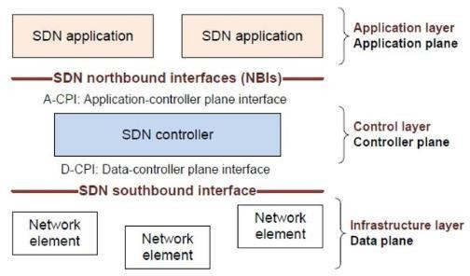
Software Defined Networking
The physical separation of the network control plane from the forwarding plane, and where a control plane controls several devices.”
Directly programmable
Agile: Abstracting control from forwarding
Centrally managed
Programmatically configured
Fig a. SDN Architecture

Slide 5
Project Objective
Monitor network conditions using VLC streaming in real world
environment.
Analyze the performance between the server and client during the data transmission while streaming using wireshark.
Analyze the performance between the server and client while streaming along with different stages of congestion (Using iperf, scapy) in the network using wireshark.
Compare the traffic statistics between Openflow reference and POX controller

Slide 6
Design
Setting up the real world environment(Ernet Topology) using python script.
Run two terminal(using xterm) for any pair of host.
Setting up the stream in VLC as one host as Sender(server) & other as receiver(client).
Start streaming and capture the received packets with Wireshark .
Analyse the parameters of video streaming & plot the graph based on performance metrics during different levels of congestion.

Slide 7
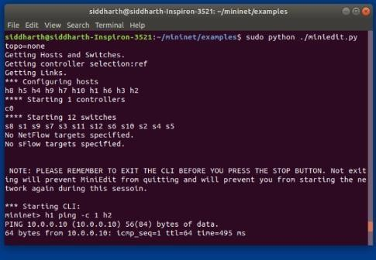
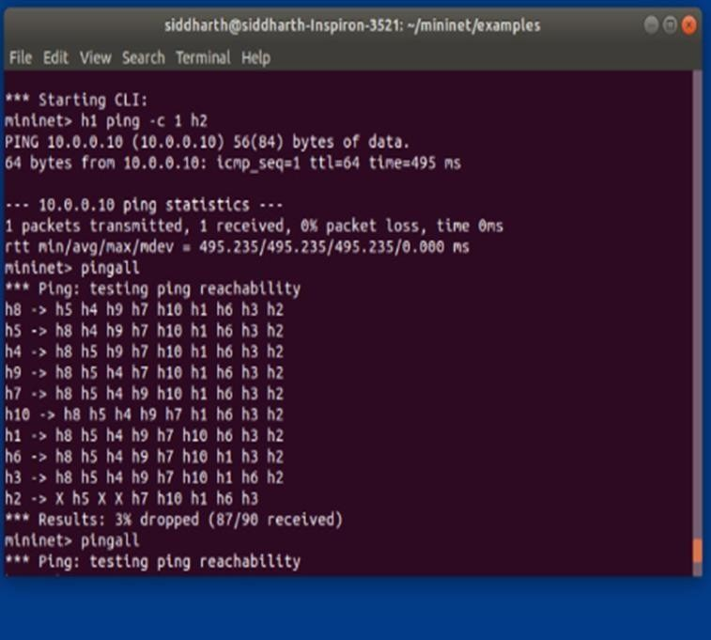
Implementation
.
Launch the topology using python script and start the interaction between hosts and switches with the help of Mininet
Testing reachability in network
Video is streamed from the video server to the video client in the topology through the SDN setup.
Traffic will be generated through iperf using one pair of host as server and other as a client.
Graph of traffic flow for such cases like iperf between host pairs can be obtained by capturing packet on wireshark and displaying it using gnuplot.
Fig 1(a) 1(b) Testing Reachabitility in network

Slide 8
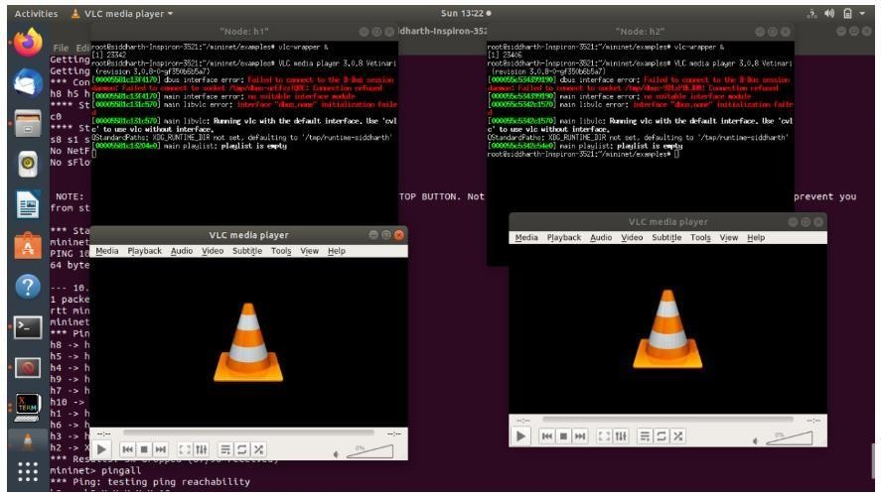
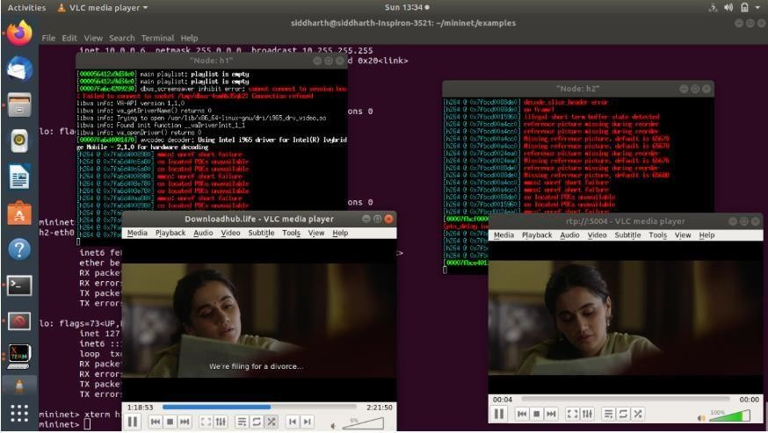
Result
Fig2 Setting up VLC streaming in Mininet b/w any pair of host
Fig 3 RTP Live Streaming

Slide 9
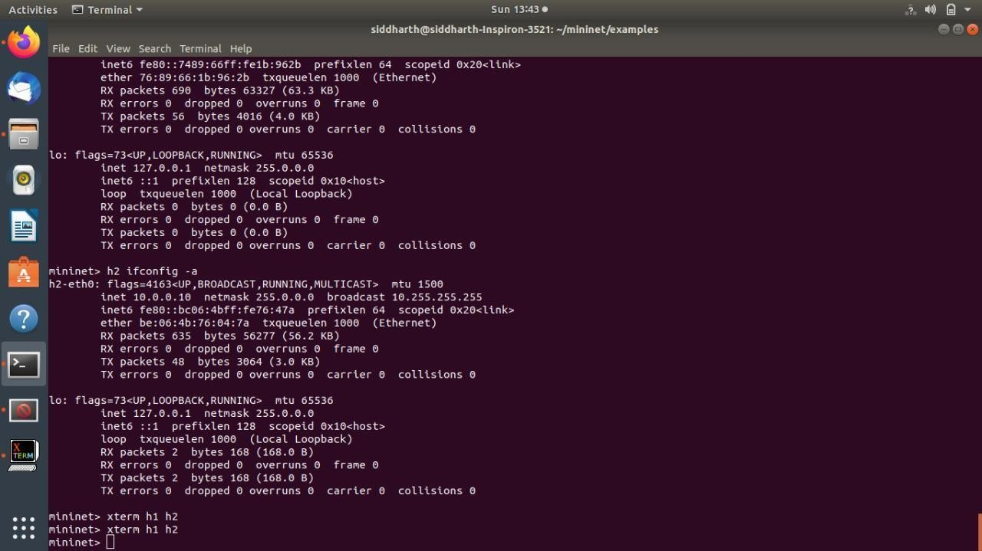
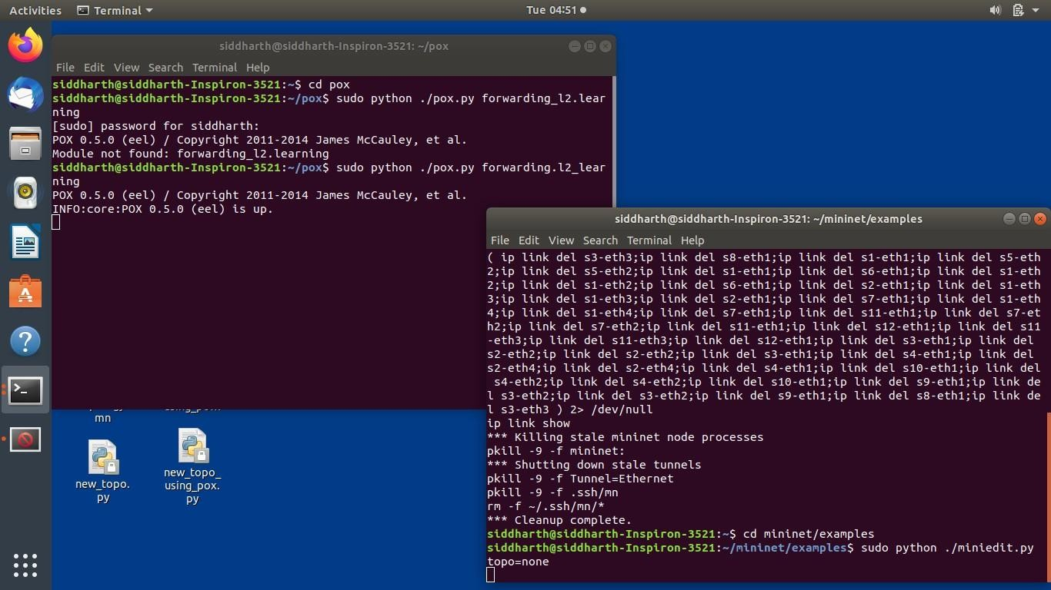
Fig 4 Inducing congestion in same hosts
Fig 5 Starting Pox controller

Slide 10
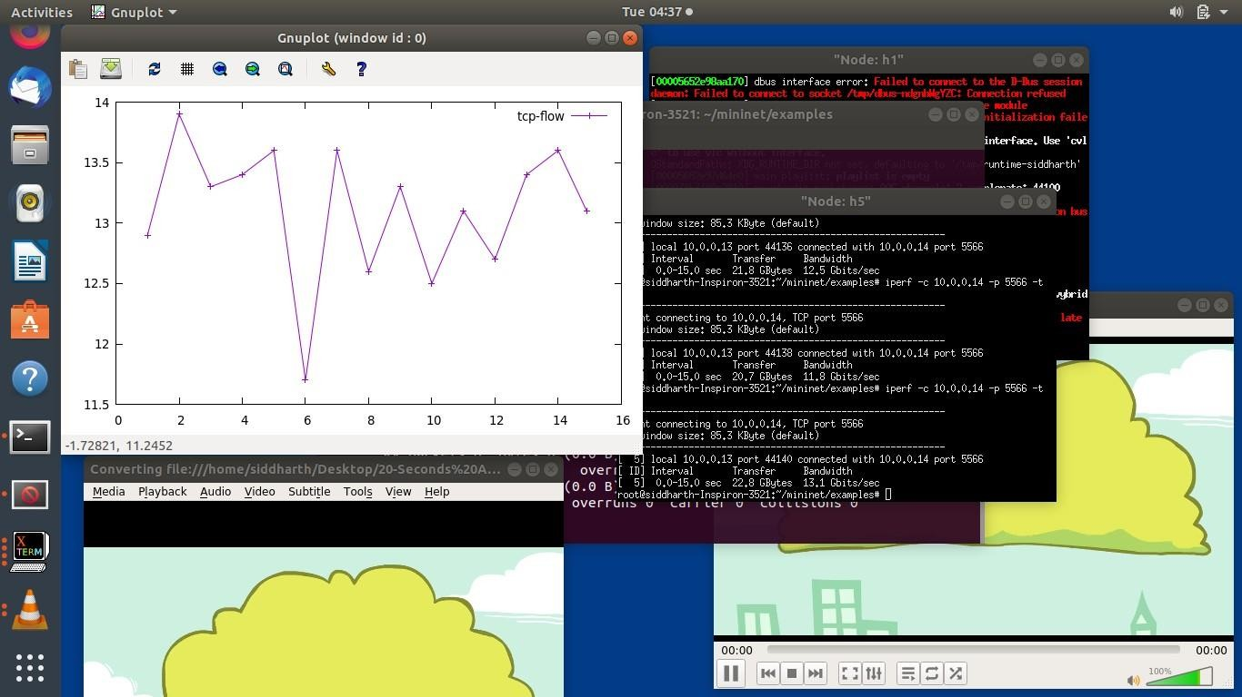
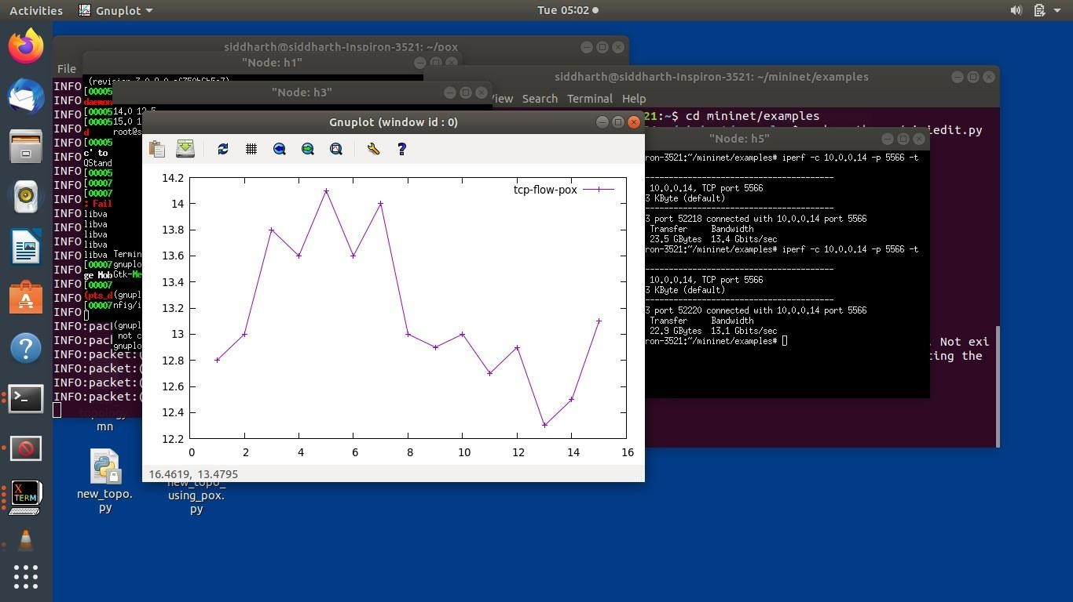
Fig 6 Performance analysis using openflow reference controller
Fig 7 Performance analysis in POX controller

Slide 11
Conclusion
Mininet is a platform for rapid network prototyping. It can run unmodified network application code on small networks as well as very large networks. It is an alternative to run SDN experiments on emulated networks.
The ability to direct and automate data traffic in SDN makes it easier to implement quality of services (QoS) for voice over IP and multimedia transmissions. Streaming high quality video is easier because SDN improves network responsiveness to ensure a flawless user experience.
On the basis of performance comparison of SDN controller it is concluded that POX controller was performing better in comparison to open flow reference controller

Slide 12
Future Scope
However, since SDN and Open Flow were conceived in a wired scenario, it is important to have accurate network information and a good control of the packet flow in a wireless scenario.
Moreover, many other issues have to be taken into account when we move from the wired to the wireless environment, especially when different technologies such as Wi-Fi, WiMAX, and LTE need to cooperate together.
SDN seek to drive a future software-based 5G networking solution that offers a flexible and automated feature selection for network connectivity and QoE provisioning to the end-users.
Efficient Topology gathering and resource monitoring methods need to be developed.

