Slide 1
SQL
SESSION - 4

Slide 2
Database Basics
In a relational database, data is stored in tables.
Tables
Database

Slide 3
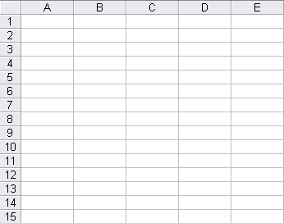
Database Basics
Each table consists of columns and rows. Each column is a field in a record, and there is a column name associated with each column.
Columns
Tables
Database

Slide 4
Database Basics
Each row represents one record. When we say how many records we have, we are referring to the number of rows.
Columns
Tables
Rows
Database

Slide 5
Introduction to SQL
1
  What is SQL?
  When a user wants to get some information from a database file, he can issue a query.
  A query is a user–request to retrieve data or information with a certain condition.
  SQL is a query language that allows user to specify the conditions. (instead of algorithms)

Slide 6
Introduction to SQL
1
  Concept of SQL
  The user specifies a certain condition.
  The program will go through all the records in the database file and select those records that satisfy the condition.(searching).
  Statistical information of the data.
  The result of the query will then be stored in form of a table.

Slide 7
Introduction to SQL
  How to involve SQL in FoxPro
  Before using SQL, the tables should be opened.
  The SQL command can be entered directly in the Command Window
  To perform exact matching, we should SET ANSI ON

Slide 8
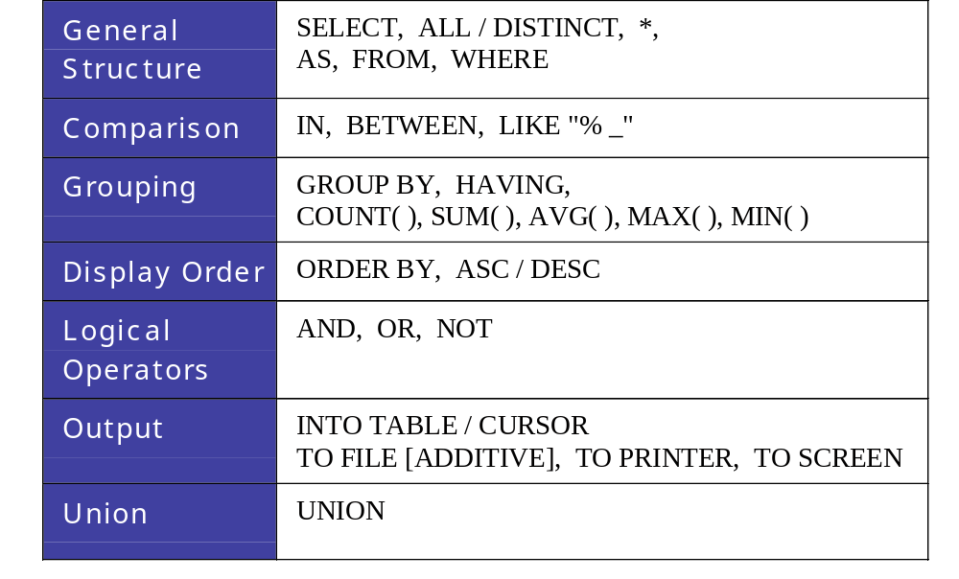
Basic structure of an SQL query

Slide 9
The Situation:
Student Particulars
    field type width contents
    id numeric 4 student id number
    name character 10 name
    dob date 8 date of birth
    sex character 1 sex: M / F
    class character 2 class
    hcode character 1 house code: R, Y, B, G
    dcode character 3 district code
    remission logical 1 fee remission
    mtest numeric 2 Math test score

Slide 10
General Structure
I
SELECT ...... FROM ...... WHERE ......
SELECT [ALL / DISTINCT] expr1 [AS col1], expr2 [AS col2] ;
FROM tablename WHERE condition

Slide 11
General Structure
I
SELECT [ALL / DISTINCT] expr1 [AS col1], expr2 [AS col2] ;
FROM tablename WHERE condition
  The query will select rows from the source tablename and output the result in table form.
  Expressions expr1, expr2 can be :
    (1) a column, or
    (2) an expression of functions and fields.
  And col1, col2 are their corresponding column names in the output table.

Slide 12
General Structure
I
SELECT [ALL / DISTINCT] expr1 [AS col1], expr2 [AS col2] ;
FROM tablename WHERE condition
  DISTINCT will eliminate duplication in the output while ALL will keep all duplicated rows.
  condition can be :
    (1) an inequality, or
    (2) a string comparison
    using logical operators AND, OR, NOT.

Slide 13
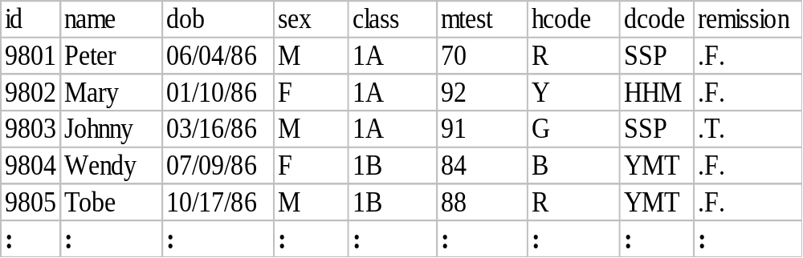
General Structure
I
Before using SQL, open the student file:
USE student
  eg. 1 List all the student records.
  SELECT * FROM student
Result

Slide 14
General Structure
I
  eg. 2 List the names and house code of 1A students.
  SELECT name, hcode, class FROM student ;
WHERE class="1A"
Class
Class
1A
✓
1A
1A
✓
1A
class="1A"
✓
1A
1A
1B
✗
1B
1B
✗
1B
:
:

Slide 15
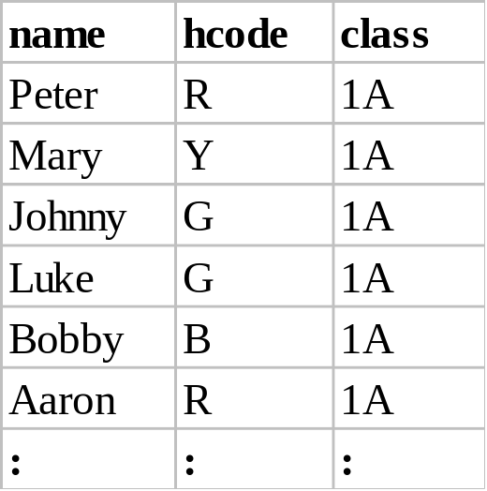
General Structure
I
  eg. 2 List the names and house code of 1A students.
Result

Slide 16
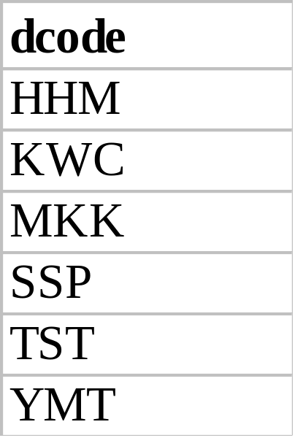
General Structure
I
  eg. 3 List the residential district of the Red House members.
  SELECT DISTINCT dcode FROM student ;
WHERE hcode="R"
Result

Slide 17
General Structure
I
  eg. 4 List the names and ages (1 d.p.) of 1B girls.
1B Girls ?

Slide 18
General Structure
I
  eg. 4 List the names and ages (1 d.p.) of 1B girls.
Condition for "1B Girls":
1) class = "1B"
2) sex = "F"
3) Both ( AND operator)

Slide 19
General Structure
I
  eg. 4 List the names and ages (1 d.p.) of 1B girls.
What is "age"?

Slide 20
General Structure
I
  eg. 4 List the names and ages (1 d.p.) of 1B girls.
Functions:
# days : DATE( ) – dob
# years :(DATE( ) – dob) / 365
1 d.p.: ROUND(__ , 1)

Slide 21
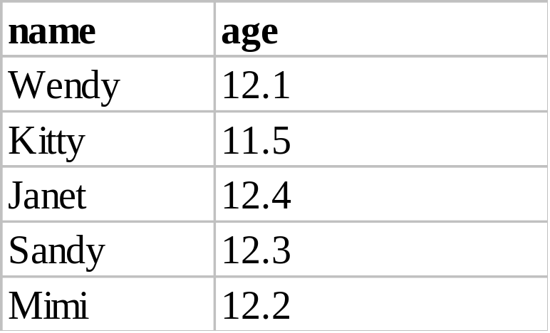
General Structure
I
  eg. 4 List the names and ages (1 d.p.) of 1B girls.
  SELECT name, ROUND((DATE( )-dob)/365,1) AS age ;
  FROM student WHERE class="1B" AND sex="F"
Result

Slide 22
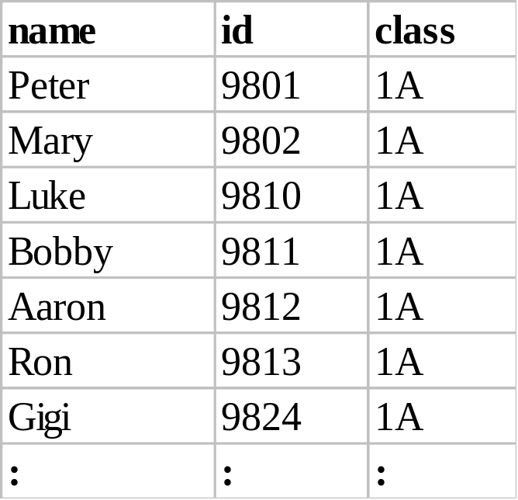
General Structure
I
  eg. 5 List the names, id of 1A students with no fee remission.
  SELECT name, id, class FROM student ;
WHERE class="1A" AND NOT remission
Result

Slide 23
Comparison
II
expr IN ( value1, value2, value3)
expr BETWEEN value1 AND value2
expr LIKE "%_"

Slide 24
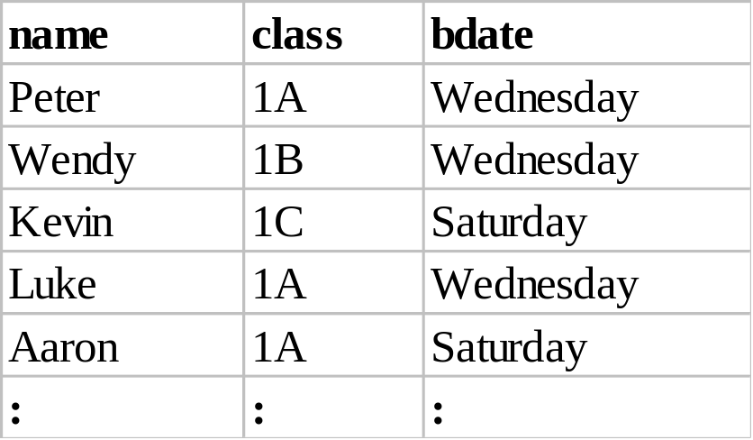
Comparison
II
  eg. 6 List the students who were born on Wednesday or Saturdays.
  SELECT name, class, CDOW(dob) AS bdate ; FROM student ;
WHERE DOW(dob) IN (4,7)
Result

Slide 25
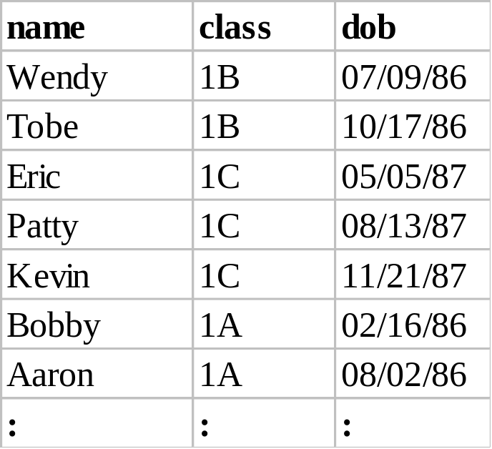
Comparison
II
  eg. 7 List the students who were not born in January, March, June, September.
  SELECT name, class, dob FROM student ;
WHERE MONTH(dob) NOT IN (1,3,6,9)
Result

Slide 26
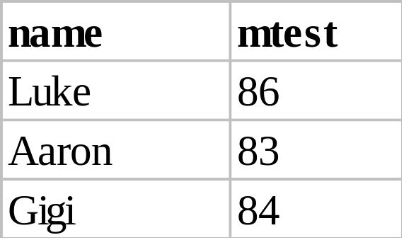
Comparison
II
  eg. 8 List the 1A students whose Math test score is between 80 and 90 (incl.)
  SELECT name, mtest FROM student ;
WHERE class="1A" AND ;
mtest BETWEEN 80 AND 90
Result

Slide 27
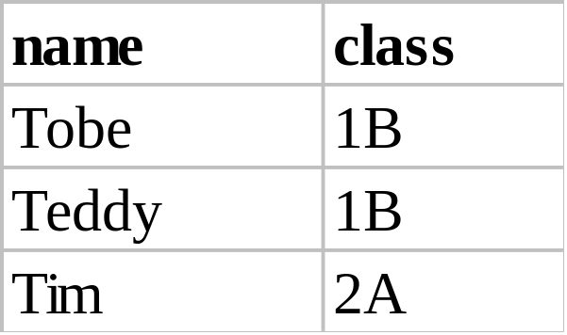
Comparison
II
  eg. 9 List the students whose names start with "T".
  SELECT name, class FROM student ;
WHERE name LIKE "T%"
Result

Slide 28
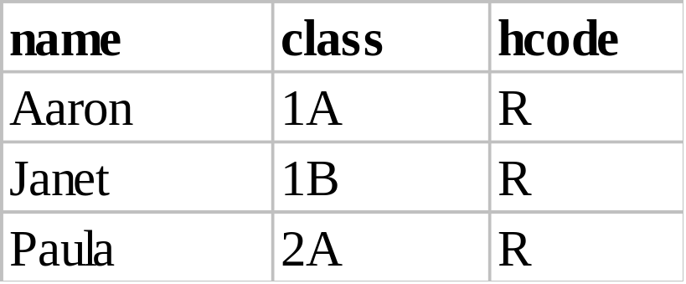
Comparison
II
  eg. 10 List the Red house members whose names contain "a" as the 2nd letter.
  SELECT name, class, hcode FROM student ;
WHERE name LIKE "_a%" AND hcode="R"
Result

Slide 29
Grouping
III
SELECT ...... FROM ...... WHERE condition ;
GROUP BY groupexpr [HAVING requirement]
Group functions:
COUNT( ), SUM( ), AVG( ), MAX( ), MIN( )
    – groupexpr specifies the related rows to be grouped as one entry. Usually it is a column.
    – WHERE condition specifies the condition of individual rows before the rows are group. HAVING requirement specifies the condition involving the whole group.

Slide 30
Grouping
III
  eg. 11 List the number of students of each class.

Slide 31
Group By Class
class
1A
1A
1A
1A
COUNT( )
1A
1B
1B
1B
1B
1B
COUNT( )
1B
1B
1B
1C
1C
1C
COUNT( )
1C
1C
Student

Slide 32
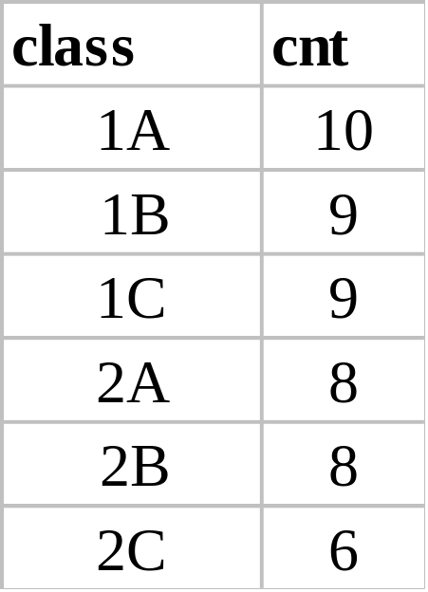
Grouping
III
  eg. 11 List the number of students of each class.
  SELECT class, COUNT(*) FROM student ;
GROUP BY class
Result

Slide 33
Grouping
III
  eg. 12 List the average Math test score of each class.

Slide 34
Group By Class
class
1A
1A
AVG( )
1A
1A
1B
1B
1B
1B
AVG( )
1B
1B
1B
1C
1C
AVG( )
1C
1C
Student

Slide 35
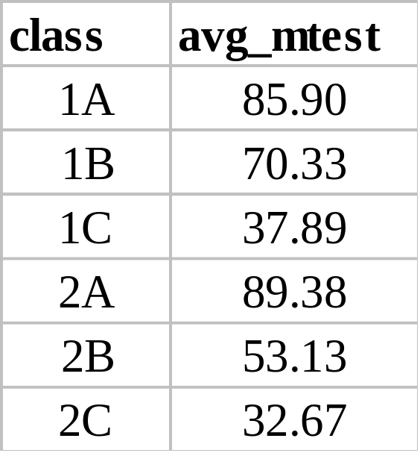
Grouping
III
  eg. 12 List the average Math test score of each class.
  SELECT class, AVG(mtest) FROM student ; GROUP BY class
Result

Slide 36
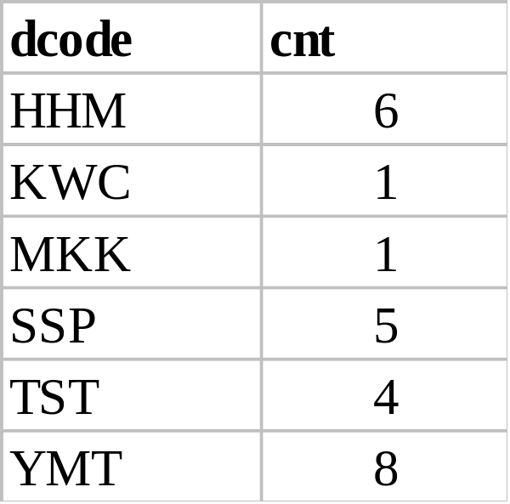
Grouping
III
  eg. 13 List the number of girls of each district.
  SELECT dcode, COUNT(*) FROM student ;
WHERE sex="F" GROUP BY dcode
Result

Slide 37
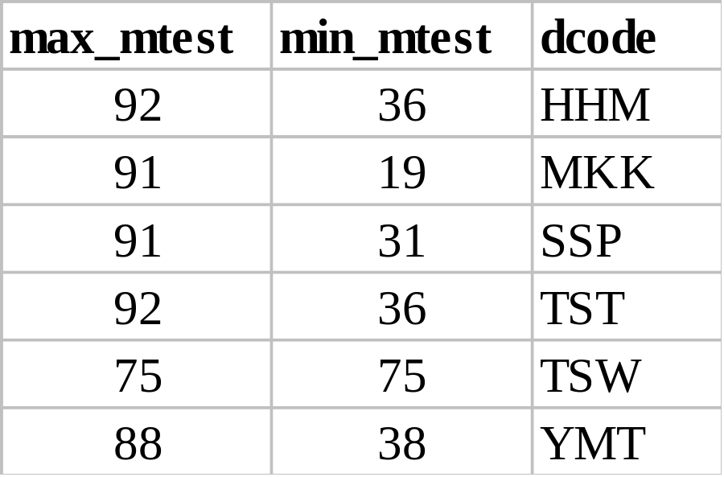
Grouping
III
  eg. 14 List the max. and min. test score of Form 1 students of each district.
  SELECT MAX(mtest), MIN(mtest), dcode ;
  FROM student ;
WHERE class LIKE "1_" GROUP BY dcode
Result

Slide 38
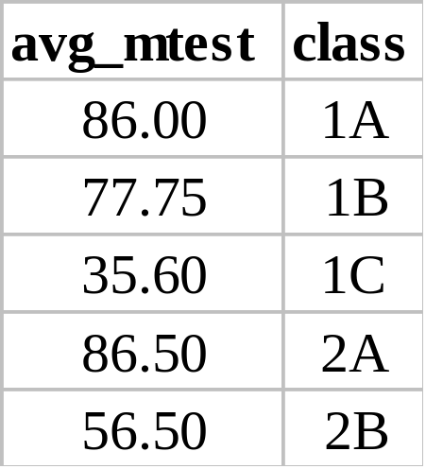
Grouping
III
  eg. 15 List the average Math test score of the boys in each class. The list should not contain class with less than 3 boys.
  SELECT AVG(mtest), class FROM student ;
WHERE sex="M" GROUP BY class ;
HAVING COUNT(*) >= 3
Result

Slide 39
Display Order
IV
SELECT ...... FROM ...... WHERE ......
GROUP BY ..... ;
ORDER BY colname ASC / DESC

Slide 40
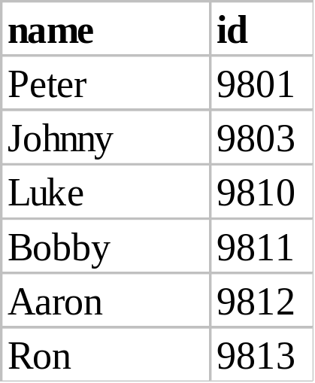
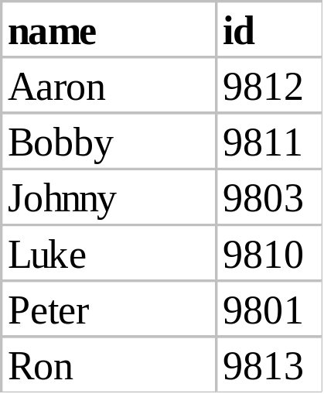
Display Order
IV
  eg. 16 List the boys of class 1A, order by their names.
  SELECT name, id FROM student ;
WHERE sex="M" AND class="1A" ORDER BY name
Result
ORDER BY
dcode

Slide 41
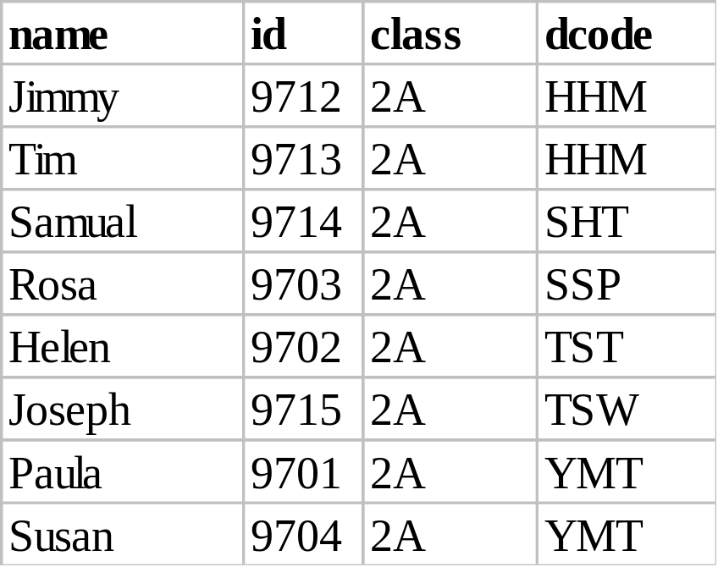
Display Order
IV
  eg. 17 List the 2A students by their residential district.
  SELECT name, id, class, dcode FROM student ;
WHERE class="2A" ORDER BY dcode
Result

Slide 42
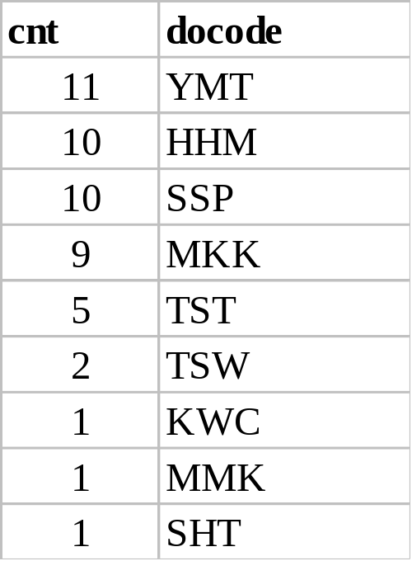
Display Order
IV
  eg. 18 List the number of students of each district
  (in desc. order).
  SELECT COUNT(*) AS cnt, dcode FROM student ;
GROUP BY dcode ORDER BY cnt DESC
Result

Slide 43
Display Order
IV
  eg. 19 List the boys of each house order by the classes. (2-level ordering)
  SELECT name, class, hcode FROM student ;
WHERE sex="M" ORDER BY hcode, class

Slide 44
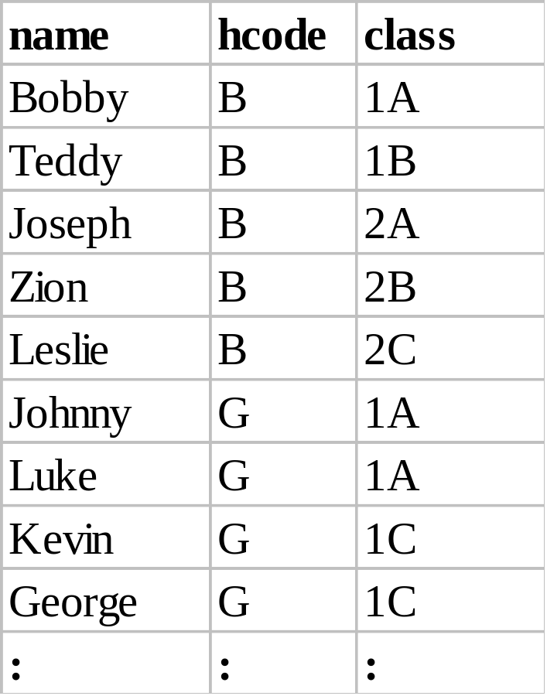
Display Order
IV
Result
Order by class
Blue
House
Order by hcode
Green
House
:
:

Slide 45
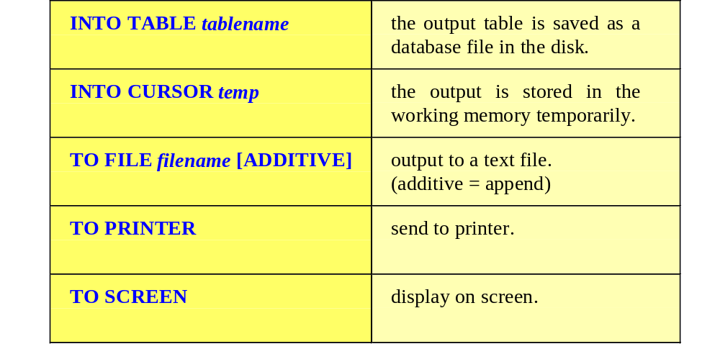
Output
V

Slide 46
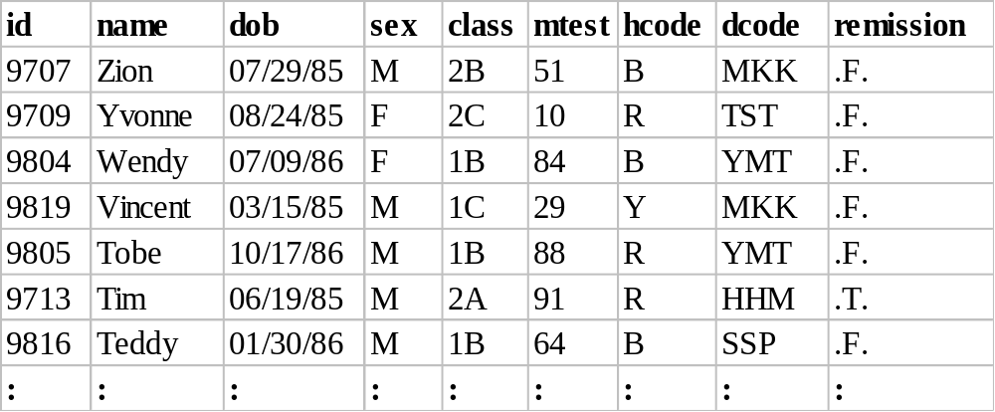
Output
V
  eg. 20 List the students in desc. order of their names and save the result as a database file name.dbf.
  SELECT * FROM student ;
ORDER BY name DESC INTO TABLE name.dbf
Result

Slide 47
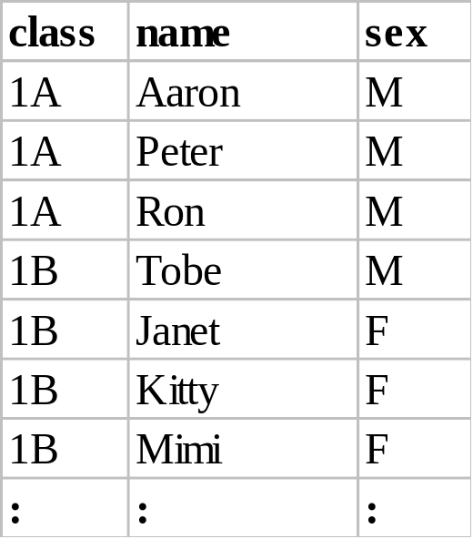
Output
V
  eg. 21 Print the Red House members by their classes, sex and name.
  SELECT class, name, sex FROM student ;
WHERE hcode="R" ;
ORDER BY class, sex DESC, name TO PRINTER
Result

Slide 48
Union, Intersection and Difference of Tables
3
The union of A and B (A∪B)
A
B
A table containing all the rows from A and B.

Slide 49
Union, Intersection and Difference of Tables
3
The intersection of A and B (A∩B)
A
B
A table containing only rows that appear in both A and B.

Slide 50
Union, Intersection and Difference of Tables
3
The difference of A and B (A–B)
A
B
A table containing rows that appear in A but not in B.

Slide 51
3
The Situation:
Bridge Club & Chess Club
Consider the members of the Bridge Club and the Chess Club. The two database files have the same structure:
field type width contents
id numeric 4 student id number
name character 10 name
sex character 1 sex: M / F
class character 2 class

Slide 52
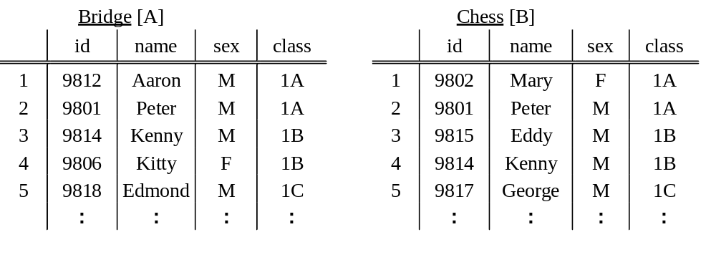
Union, Intersection and Difference of Tables
3
Before using SQL, open the two tables:
SELECT A
USE bridge
SELECT B
USE chess

Slide 53
Union, Intersection and Difference of Tables
3
SELECT ...... FROM ...... WHERE ...... ;
UNION ;
SELECT ...... FROM ...... WHERE ......
  eg. 22 The two clubs want to hold a joint party. Make a list of all students. (Union)
    SELECT * FROM bridge ;
    UNION ;
    SELECT * FROM chess ;
    ORDER BY class, name INTO TABLE party
Result

Slide 54
Union, Intersection and Difference of Tables
3
SELECT ...... FROM table1 ;
WHERE col IN ( SELECT col FROM table2 )
  eg. 23 Print a list of students who are members of both clubs. (Intersection)
    SELECT * FROM bridge ;
    WHERE id IN ( SELECT id FROM chess ) ;
    TO PRINTER
Result

Slide 55
Union, Intersection and Difference of Tables
3
SELECT ...... FROM table1 ;
WHERE col NOT IN ( SELECT col FROM table2 )
  eg. 24 Make a list of students who are members of the Bridge Club but not Chess Club. (Difference)
    SELECT * FROM bridge ;
    WHERE id NOT IN ( SELECT id FROM chess ) ;
    INTO TABLE diff
Result

Slide 56
Multiple Tables:
4
    SQL provides a convenient operation to retrieve information from multiple tables.
    This operation is called join.
    The join operation will combine the tables into one large table with all possible combinations (Math: Cartesian Product), and then it will filter the rows of this combined table to yield useful information.

Slide 57
Multiple Tables:
4
field1
field2
A
1
field1
field2
A
2
A
1
A
3
2
B
B
1
3
B
2
B
3

Slide 58
4
The Situation:
Music Lesson
Each student should learn a musical instrument.
Two database files: student.dbf & music.dbf
The common field: student id
field type width contents
id numeric 4 student id number
type character 10 type of the music instrument
SELECT A
    USE student
    SELECT B
    USE music

Slide 59
Natural Join
4
    A Natural Join is a join operation that joins two tables by their common column. This operation is similar to the setting relation of two tables.
SELECT a.comcol, a.col1, b.col2, expr1, expr2 ;
FROM table1 a, table2 b ;
WHERE a.comcol = b.comcol

Slide 60
Natural Join
4
  eg. 25 Make a list of students and the instruments they learn. (Natural Join)
id
name
class
id
type
9801
Same id
9801
Join
Student
Music
id
name
class
type
9801
Product

Slide 61
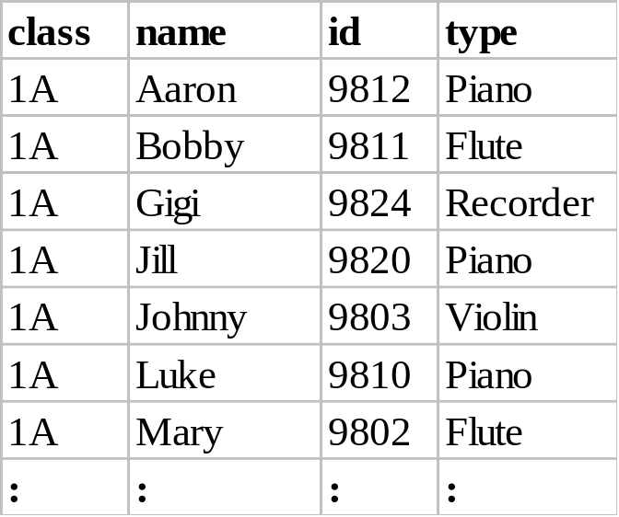
Natural Join
4
  eg. 25 Make a list of students and the instruments they learn. (Natural Join)
  SELECT s.class, s.name, s.id, m.type ;
  FROM student s, music m ;
    WHERE s.id=m.id ORDER BY class, name
Result

Slide 62
Natural Join
4
  eg. 26 Find the number of students learning piano in each class.
Three Parts :
(1) Natural Join.
(2) Condition: m.type="Piano"
(3) GROUP BY class

Slide 63
Natural Join
4
  eg. 26
Student
Join
Condition
Group By
m.type= "Piano"
class
Product
Music

Slide 64
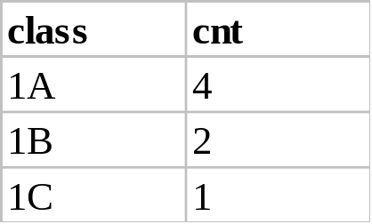
Natural Join
4
  eg. 26 Find the number of students learning piano in each class.
  SELECT s.class, COUNT(*) ;
  FROM student s, music m ;
    WHERE s.id=m.id AND m.type="Piano" ;
    GROUP BY class ORDER BY class
Result

Slide 65
Outer Join
4
    An Outer Join is a join operation that includes rows that have a match, plus rows that do not have a match in the other table.

Slide 66
Outer Join
4
  eg. 27 List the students who have not yet chosen an instrument. (No match)
id
name
class
id
type
9801
No match
Student
Music

Slide 67
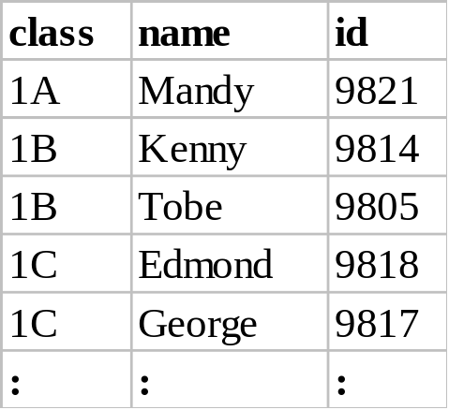
Outer Join
4
  eg. 27 List the students who have not yet chosen an instrument. (No match)
  SELECT class, name, id FROM student ;
    WHERE id NOT IN ( SELECT id FROM music ) ;
ORDER BY class, name
Result

Slide 68
Outer Join
4
  eg. 28 Make a checking list of students and the instruments they learn. The list should also contain the students without an instrument.
  (Outer Join)

Slide 69
Outer Join
4
  eg. 28
Natural Join
Outer Join
No Match

Slide 70
Outer Join
4
  eg. 28
  SELECT s.class, s.name, s.id, m.type ;
    FROM student s, music m ;
    WHERE s.id=m.id ;
    UNION ;
    SELECT class, name, id, "" ;
    FROM student ;
    WHERE id NOT IN ( SELECT id FROM music ) ;
    ORDER BY 1, 2

Slide 71
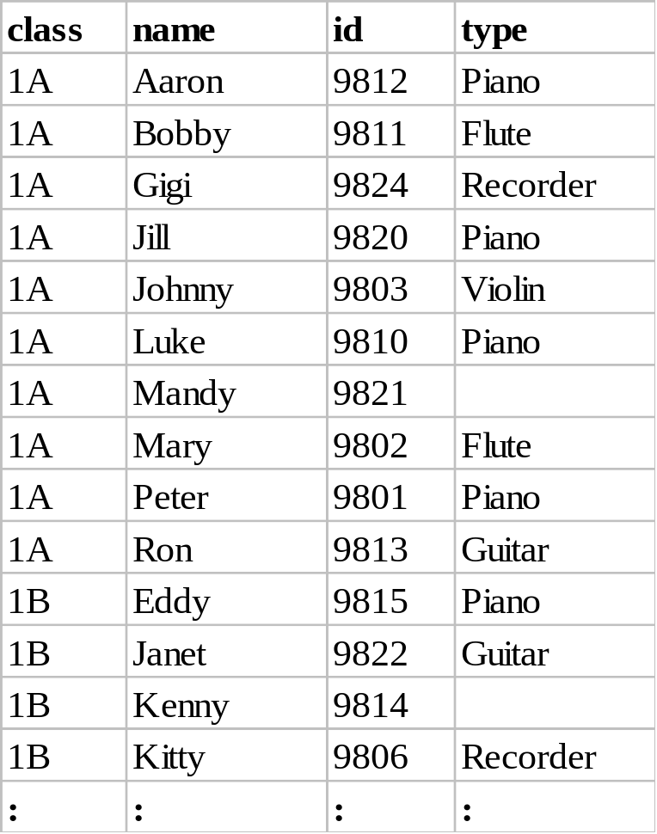
Outer Join
4
Natural Join
empty
No Match
Outer Join

