Slide 1
Steps to create a Login Form

Slide 2
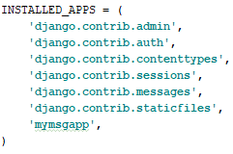
Create your app and register it in settings file under installed app
Ex.

Slide 3

Make your static directory and put bootstrap for css and js in it

Slide 4
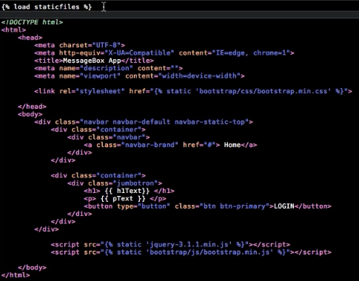

Slide 5
Add views
In Views.py add the following
from django.shortcuts import render # Create your views here. def home(request): return render (request, "mymsgapp/home.html", {'h1Text':'Message Box', 'pText': 'Welcome to the MessageBox App! Click the LOGIN button below to begin:' }),

Slide 6
Url : 127.0.0.1:800/login
Go to url.py add the following
from django.conf.urls import include, url from django.contrib import admin from mymsgapp import views as my_views from django.contrib.auth import views as admin_views urlpatterns = [ url(r'^admin/', include(admin.site.urls)), url(r'^$', my_views.home, name='home'), url(r'^login/$', admin_views.login,{'template_name':'login.html'}, name='mymsgsite_login'), ]

Slide 7
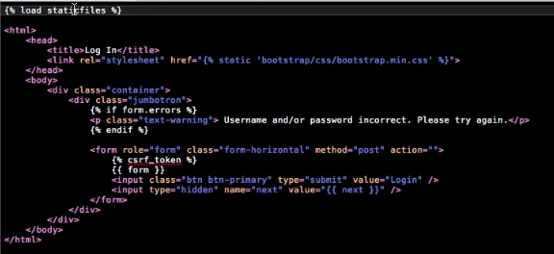
In your templates directory create a login.html file

Slide 8
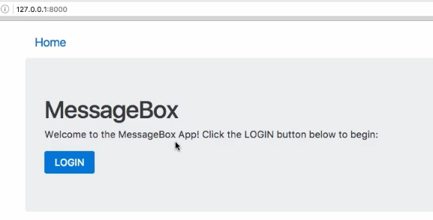
Use runserver to check you output

Slide 9

Go to Settings.py file
Add at the end
Add

Slide 10
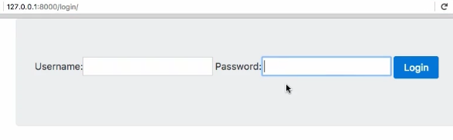
Use runserver to check your output

Slide 11
To make your form look nice
pip install django-crispy-forms
In settings add crispyform in installed apps
At the bottom add crispy template
CRISPY_TEMPLATE_PACK=‘bootstrap’
In login.html add the following at top in your second line
{% load crispy_forms_tag %}
In forms use the filter
{{ forms|crispy }}

Slide 12
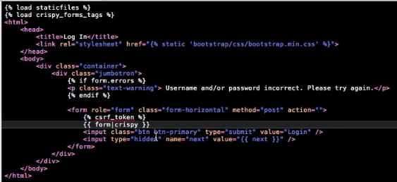

Slide 13
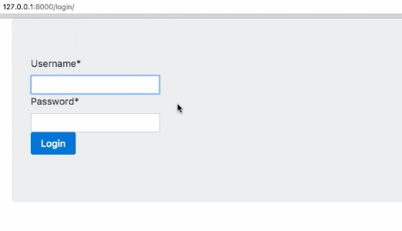
Use runserver to check your output

Slide 14
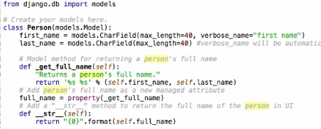
Adding models

Slide 15
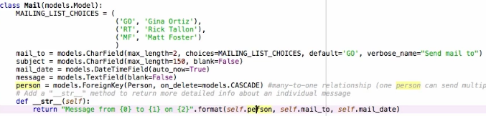
To add mailing list
This also goes in model file

Slide 16
migrate
Run the migration cmd
python manage.py makemigrations
python manage.py migrate
python manage.py inspectdb

Slide 17

Register your model in admin.py

