Slide 1
CLOCKS
SHABANA

Slide 2
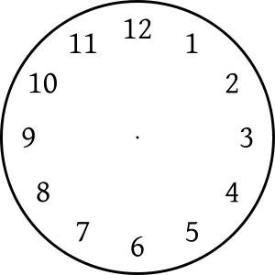

Slide 3
What is the angle between the hour hand and minute hand
of a clock at 5 hours & 45 minutes?
97.5 b. 122.5 c. 132.5 d. NOTA
What is the angle between the hour hand and minute hand
of a clock at 7 hours & 50 minutes?
a. 65 b. 75 85 d. NOTA
What is the angle between the hour hand and minute hand
of a clock at 3 hours & 20 minutes?
a. 30 b. 40 c. 50 d. NOTA

Slide 4
At what time between 3 o clock and 4 o clock will the hands
of a clock be together?
5 1/11 mins past 3 b. 12 4/11 mins past 3
c. 13 4/ 11 mins past 3 d. 16 4/11 mins past 3
At what time between 9 o clock and 10 o clock will the hands
of a clock be together?
A) (49 + 3/11) min past 11 B) (49 +1/11) min past 9
C) (45 +1/11) min past 9 D) (45 +7/11) min past 11

Slide 5
At what time between 7 o clock and 8 o clock will the hands
of a clock be opposite to each other?
5 mins past 7 b. 5 2/11 mins past 7
c. 5 3/11 mins past 7 d. 5 5/11 mins past 7
At what time between 1 o clock and 2 o clock will the hands
of a clock be opposite to each other?
a. 34(6/11) past 1'Oclock b. 38(2/11)past 1'Oclock
c. 56(8/11)past 1'Oclock d. 64(9/11)past 1'Oclock

Slide 6
At what time between 4 o clock and 5 o clock will the hands
of a clock be right angle to each other?
A) 3 5/11 B) 4 5/11 C) 5 5/11 D) 6 5/11
At what time between 7 o clock and 8 o clock will the hands
of a clock be right angle to each other?

Slide 7
At what time between 3 o clock and 4 o clock will the hands
of a clock be 4 minutes apart?
Either 14 mins past 3 or 20 8/11 mins past 3
Either 12 mins past 3 or 22 8/11 mins past 3
Either 14 mins past 3 or 22 8/11 mins past 3
Either 12 mins past 3 or 20 8/11 mins past 3

Slide 8
A clock is set right at 8 a.m. The clock gains 10 minutes in 24
Hours. What will be the true time when the clock indicates 1 p.m.
on the following day?
48 min. past 12.
46 min. past 12.
45 min. past 12.
47 min. past 12.

Slide 9
Question
Answer

Slide 10
Question
∆○→□
→□∆○
□∆○→
○→□∆
→□∆○
Answer
∆□→○
○∆□→
∆○→□
□∆○→
□→○∆

Slide 11
Question
Answer

Slide 12
Question
?
Answer

Slide 13
Question
Answer

Slide 14
FIND THE NUMBER OF TRIANGLES

Slide 15
FIND THE NUMBER OF TRIANGLES

Slide 16

FIND THE NUMBER OF TRIANGLES

Slide 18

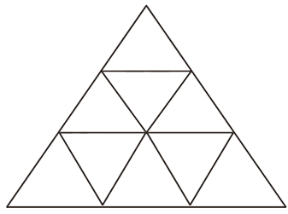

Slide 19
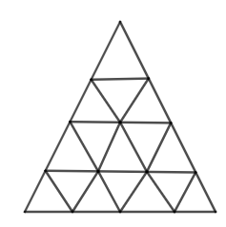
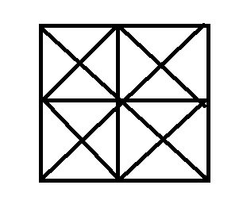

Slide 20
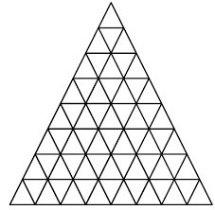

Slide 21
THANK YOU

