Slide 1

Digital Image Processing
Unit-1: Introduction
Dr. Piyush Joshi
Indian Institute of Information Technology
Sri City, Andhra Pradesh

Slide 2
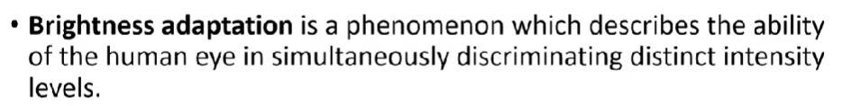
Brightness Adaption and Discrimination

Slide 3

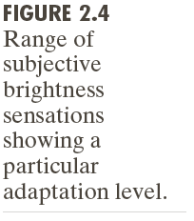
Elements of Visual Perception
Brightness Adaption and Discrimination

Slide 4
Elements of Visual Perception
Brightness Adaption and Discrimination

Slide 5
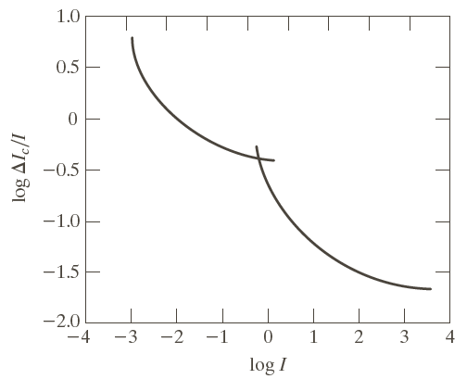
Elements of Visual Perception
Brightness Adaption and Discrimination

Slide 6
Elements of Visual Perception
Brightness Adaption and Discrimination
Our visual system depends what surrounding us

Slide 7
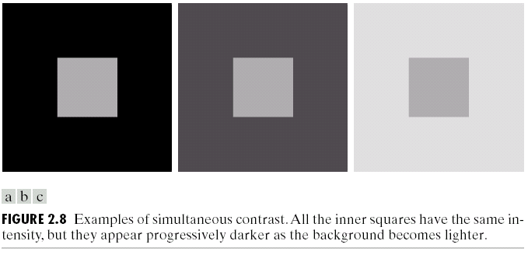
Elements of Visual Perception
Brightness Adaption and Discrimination

Slide 8
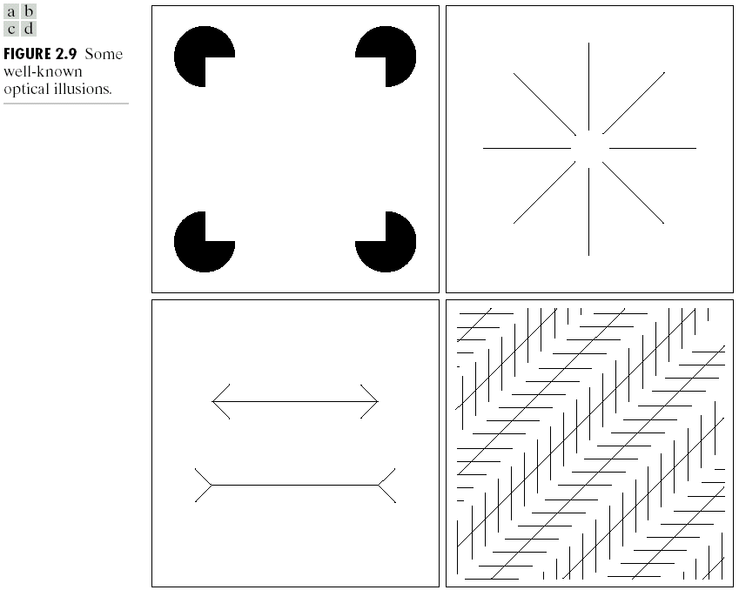
Elements of Visual Perception
Brightness Adaption and Discrimination

Slide 9
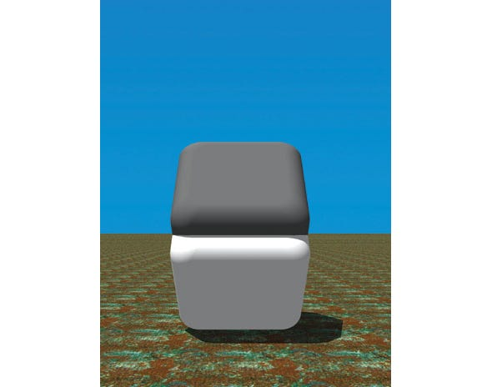
Importance of an edge

Slide 10
Representing Digital Images

Slide 11
Representing Digital Images
The representation of a $M×N$ numerical array as

Slide 12
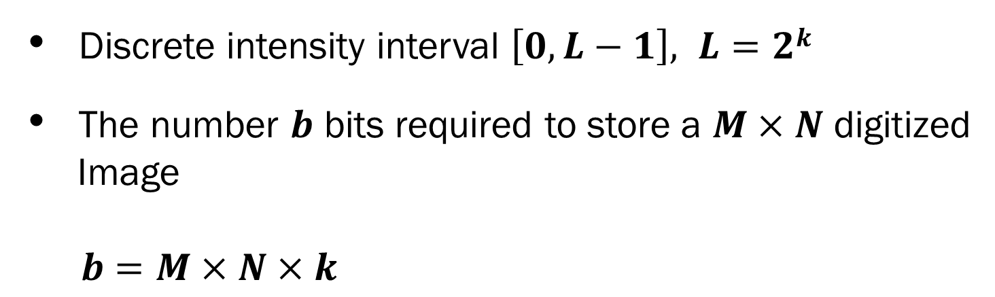
Representing Digital Images
Discrete intensity interval $\left[0, L−1\right], L=2k$
The number $b$ bits required to store a $M×N$ digitized
Image
$b=M×N×k$

Slide 13
Spatial and Intensity Resolution
Spatial Resolution
a measure of smallest discernible detail in an image
stated with dots (pixels) per unit distance, dots per inch (dpi)
Intensity Resolution
the smallest discernible change in intensity level
stated with 8 bits, 16 bits, 24 bits, etc.

Slide 14
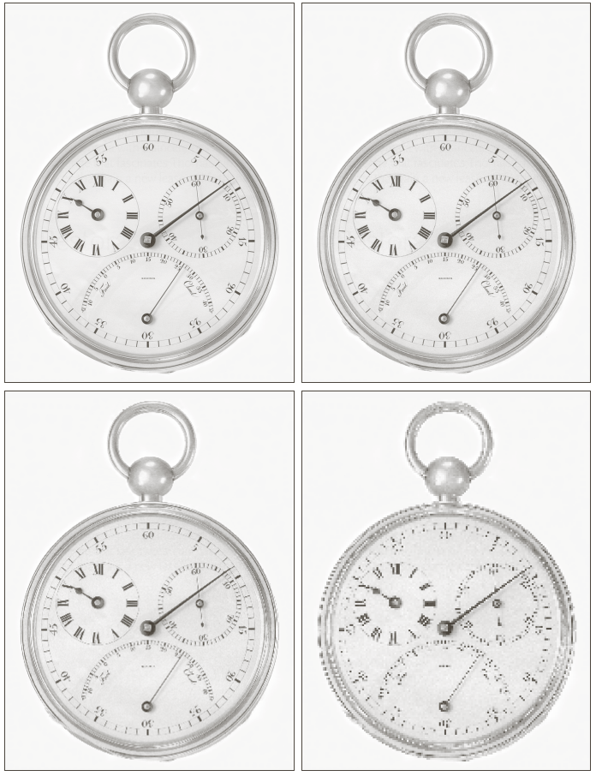
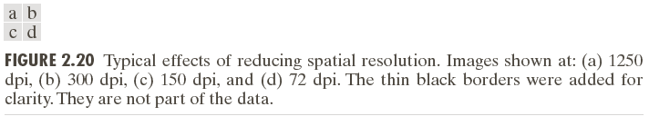
Spatial and Intensity Resolution
Sampling very fine
Sampling very coarse

Slide 15
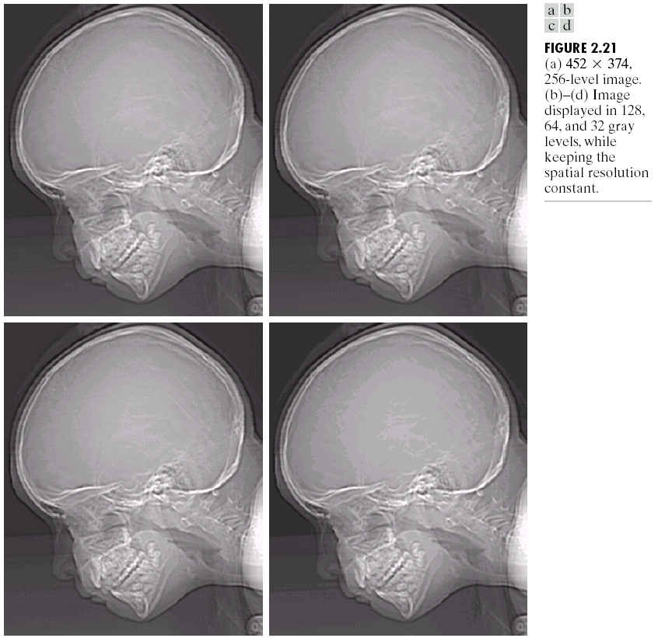
Spatial and Intensity Resolution

Slide 16
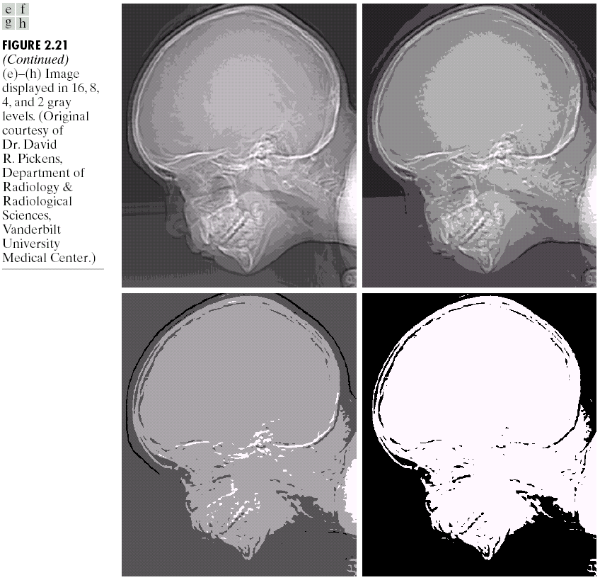
Spatial and Intensity Resolution

Slide 17
Unit-1: Introduction
Sub-topics:
Introduction to Digital Image Processing
Elements of Visual Perception
Image Sensing and Acquisition
Image Sampling and Quantization
Relationship between pixels

Slide 18
Relationship between Pixels
Neighbourhood
Adjacency
Connectivity
Paths
Regions and boundaries

Slide 19
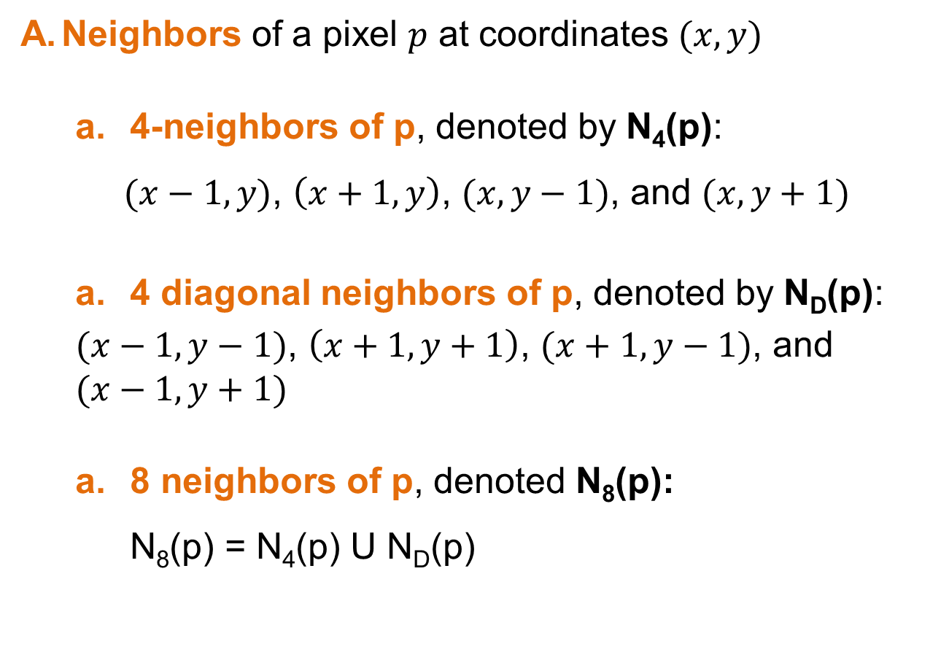
Relationship between Pixels
Neighbors of a pixel $p$ at coordinates $(x,y)$
4-neighbors of p, denoted by N₄(p):
$(x−1,y)$, $\left(x+1,y\right)$, $(x,y−1)$, and $(x,y+1)$
4 diagonal neighbors of p, denoted by N_{D}(p):
$(x−1,y−1)$, $\left(x+1,y+1\right)$, $(x+1,y−1)$, and $(x−1,y+1)$
8 neighbors of p, denoted N₈(p): N₈(p) = N₄(p) U N_{D}(p)

Slide 20
Relationship between Pixels
Adjacency
Let V be the set of intensity values.
4-adjacency: Two pixels p and q with values from V are 4-adjacent if q is in the set N₄(p).
8-adjacency: Two pixels p and q with values from V are 8-adjacent if q is in the set N₈(p).

Slide 21
Relationship between Pixels
c. m-adjacency: Two pixels p and q with values from V are m-adjacent if
q is in the set N₄(p), or
q is in the set N_{D}(p) and the set N₄(p) ∩ N₄(q) has no pixels whose values are from V.

Slide 22
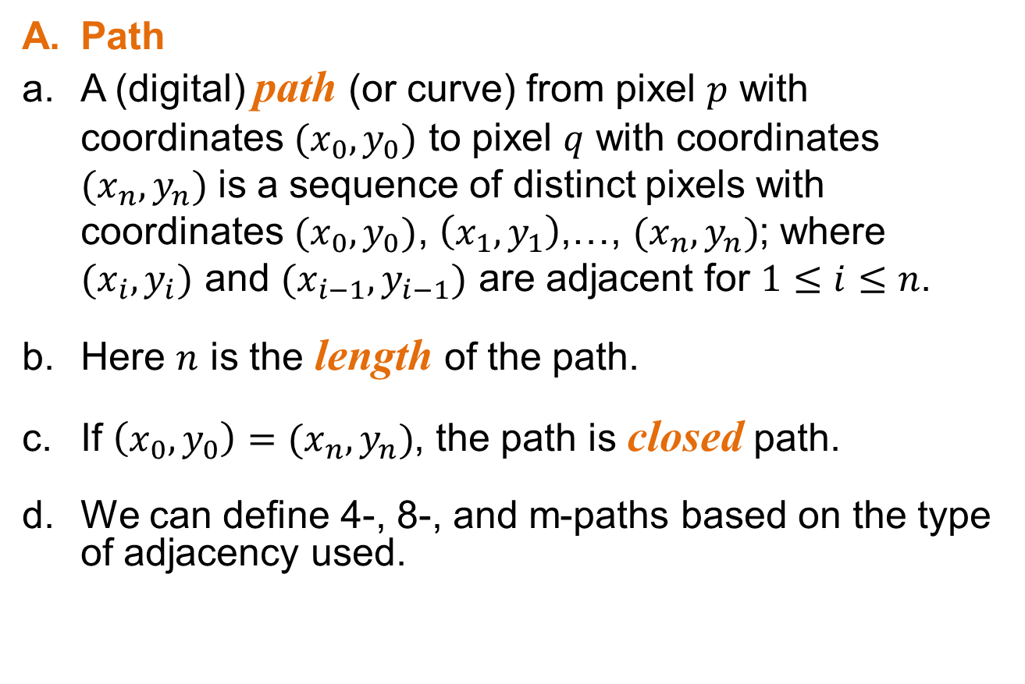
Relationship between Pixels
Path
A (digital) path (or curve) from pixel $p$ with coordinates $(x_{0},y_{0})$ to pixel $q$ with coordinates $(x_{n},y_{n})$ is a sequence of distinct pixels with coordinates $(x_{0},y_{0})$, $\left(x_{1},y_{1}\right)$,…, $(x_{n},y_{n})$; where $(x_{i},y_{i})$ and $(x_{i−1},y_{i−1})$ are adjacent for $1≤i≤n$.
Here $n$ is the length of the path.
If $\left(x_{0},y_{0}\right)=(x_{n},y_{n})$, the path is closed path.
We can define 4-, 8-, and m-paths based on the type of adjacency used.

Slide 23

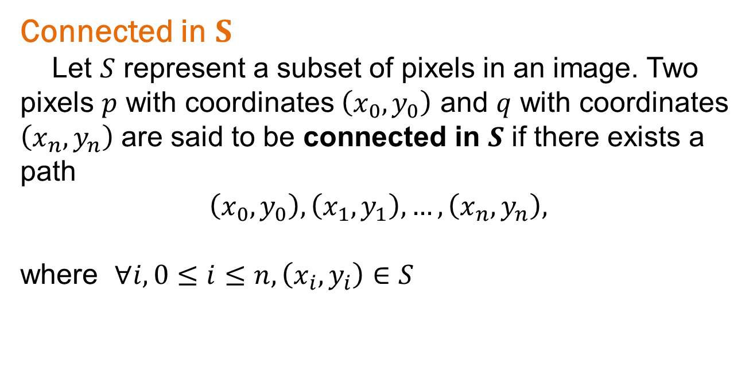
Relationship between Pixels
Connected in $S$
Let $S$ represent a subset of pixels in an image. Two pixels $p$ with coordinates $\left(x_{0},y_{0}\right)$ and $q$ with coordinates $\left(x_{n},y_{n}\right)$ are said to be connected in $S$ if there exists a path
$$\left(x_{0},y_{0}\right),\left(x_{1},y_{1}\right),…,\left(x_{n},y_{n}\right),$$
where $∀i, 0≤i≤n, \left(x_{i},y_{i}\right)∈S$

Slide 24
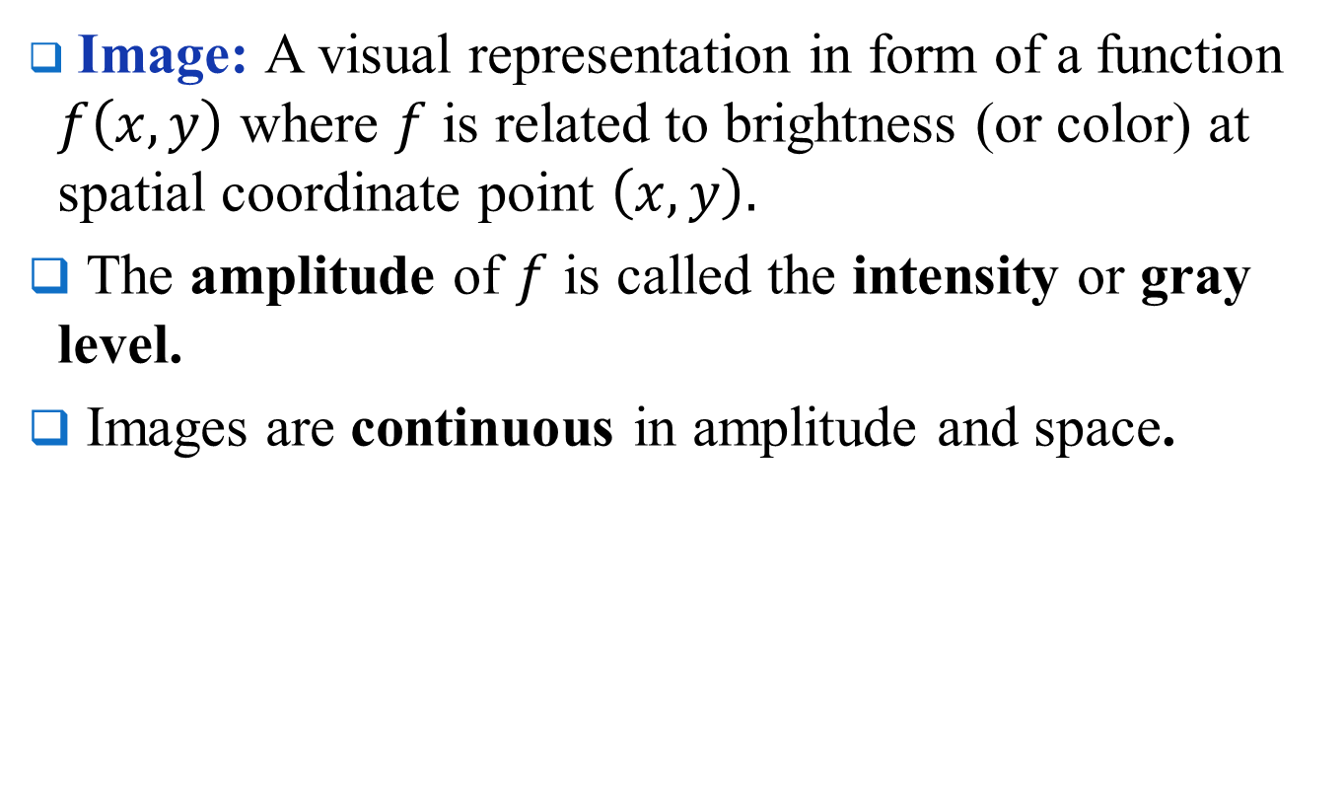
Relationship between Pixels
Let $S$ represent a subset of pixels in an image
For every pixel $p$ in $S$, the set of pixels in $S$ that are connected to $p$ is called a connected component of $S$.
If $S$ has only one connected component, then $S$ is called connected set.
We call $R$ a region of the image if $R$ is a connected set.
Two regions, $R_{i}$ and $R_{j}$ are said to be adjacent if their union forms a connected set.
Regions that are not to be adjacent are said to be disjoint.

Slide 25
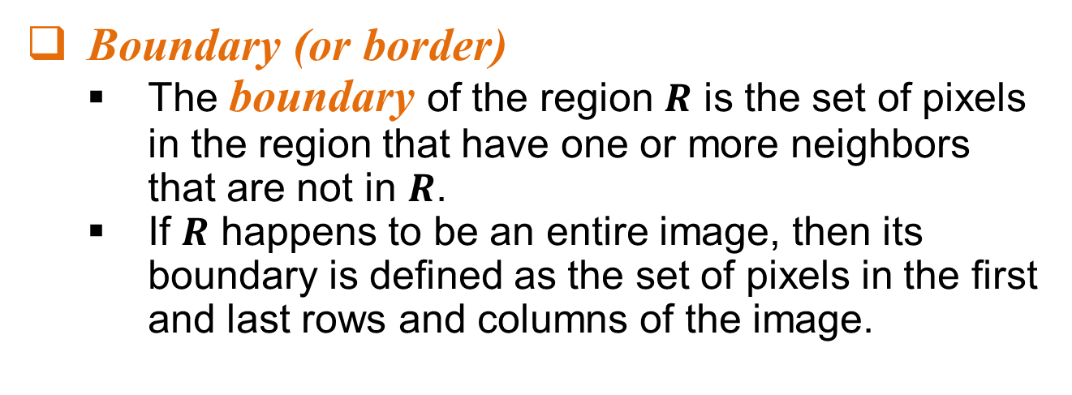
Relationship between Pixels
Boundary (or border)
The boundary of the region $R$ is the set of pixels in the region that have one or more neighbors that are not in $R$.
If $R$ happens to be an entire image, then its boundary is defined as the set of pixels in the first and last rows and columns of the image.

Slide 26
Relationship between Pixels
Distance Measure
Given pixels p, q and z with coordinates (x, y), (s, t), (u, v) respectively, the distance function D has following properties:
D(p, q) ≥ 0 [D(p, q) = 0, iff p = q]
D(p, q) = D(q, p)
D(p, z) ≤ D(p, q) + D(q, z)

Slide 28
Relationship between Pixels
Distance Measure
The following are the different Distance measures:
Euclidean Distance :
D_{e}(p, q) = [(x-s)² + (y-t)²]^{1/2}
City Block Distance:
D₄(p, q) = |x-s| + |y-t|
Chess Board Distance:
D₈(p, q) = max(|x-s|, |y-t|)

Slide 30
Mathematical Operations in DIP
Linear vs. Nonlinear Operation
H is said to be a linear operator
H is said to be a nonlinear operator if it does not meet the above qualification.
Additivity
Homogeneity

Slide 32
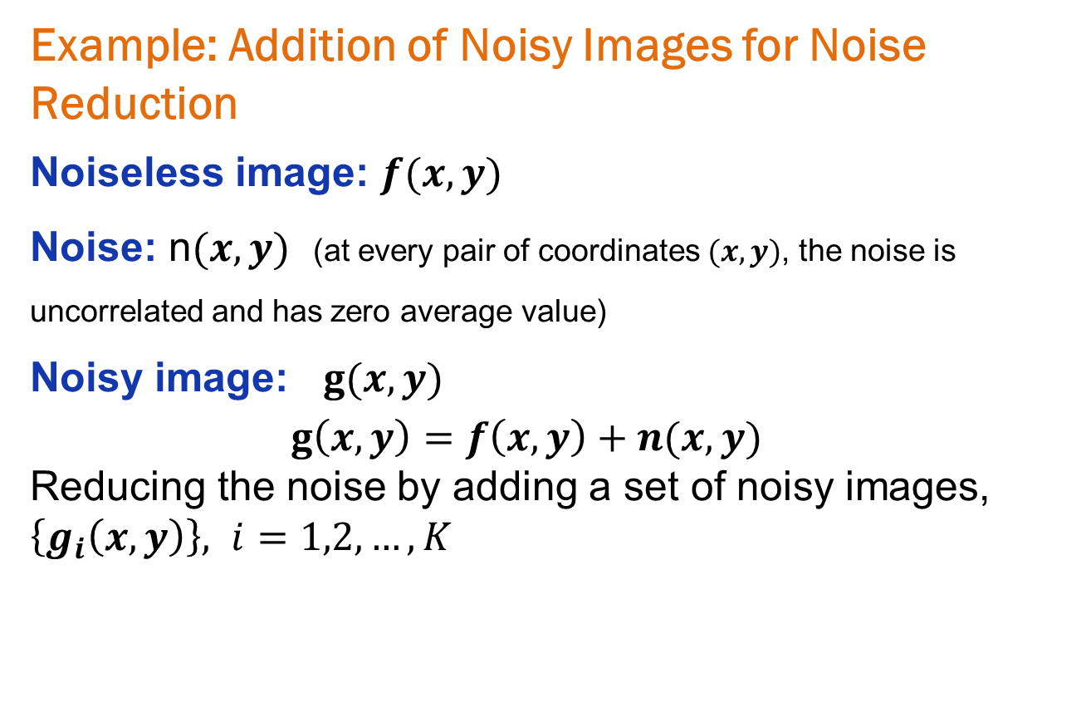
Mathematical Operations in DIP
Example: Addition of Noisy Images for Noise Reduction
Noiseless image: $f(x,y)$
Noise: n$(x,y)$ (at every pair of coordinates $(x,y)$, the noise is uncorrelated and has zero average value)
Noisy image: $g(x,y)$
$g\left(x,y\right)=f\left(x,y\right)+n(x,y)$
Reducing the noise by adding a set of noisy images, $\left\{g_{i}\left(x,y\right)\right\}, i=1,2,…,K$

Slide 33
Mathematical Operations in DIP
Example: Addition of Noisy Images for Noise Reduction

Slide 34
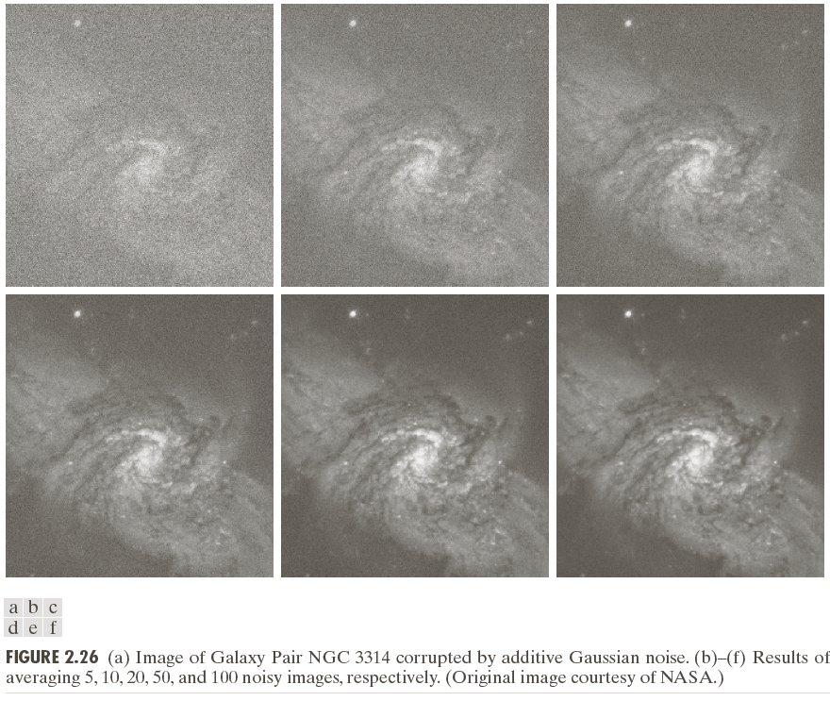
Mathematical Operations in DIP

