Slide 1

Digital Image Processing
Unit-5: Image Compression
Dr. Piyush Joshi
Indian Institute of Information Technology
Sri City, Andhra Pradesh

Slide 2

Image Compression
Goal:
Reduce the amount of data required to represent a digital image.
The underlying basis of reduction process is the removal of redundant data.
Usages:
Data storage
Data transmission
Applications:
Video conferencing, broadcast television, remote sensing, document and medical imaging etc.

Slide 3
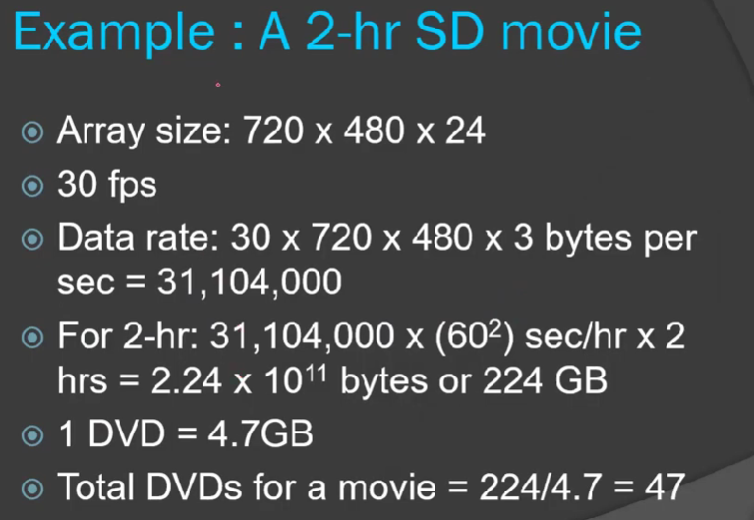

Slide 4
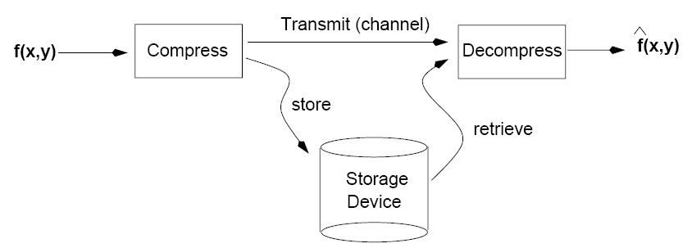
Image Compression

Slide 5
Image Compression
Data ≠ Information
Data and information are not synonymous terms!
Data is the means by which information is conveyed.
The same information can be represented by different amount of data.
Ex1: Your wife, Helen, will meet you at Logan Airport in Boston at 5
minutes past 6:00 pm tomorrow night.
Ex2: Your wife will meet you at Logan Airport at 5 minutes past 6:00 pm
tomorrow night.
Ex3: Helen will meet you at Logan at 6:00 pm tomorrow night
Goal: Reduce the amount of data while preserving as much information as possible!

Slide 6

Image Compression
Relative Data Redundancy
Let $n_{1}$ and $n_{2}$ denote the number of bits in two representations of the same information, the relative data redundancy $R$ of the first dataset is
$$R=1−1/C$$
$C$ is called the compression ratio, defined as
$C= \frac{n_{1}}{n_{2}}$
e.g., C = 10, the corresponding relative data redundancy of
the larger representation is 0.9, indicating that 90% of its
data is redundant.

Slide 7
Image Compression
Lossless
-- Information preserving
-- Low compression ratios
Lossy
-- Information loss
-- High compression ratios
Trade-off: information loss vs compression ratio

Slide 8
Image Compression
Types of Data Redundancy
Coding Redundancy
Interpixel Redundancy
Psychovisual Redundancy

Slide 9
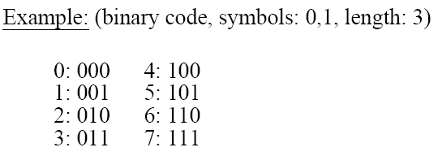
Image Compression
Coding Redundancy
To reduce coding redundancy, we need efficient coding schemes.
Code: a list of symbols (letters, numbers, bits etc.)
Code word: a sequence of symbols used to represent some information (e.g., gray levels).
Code word length: number of symbols in a code word.
-- Could be fixed or variable

Slide 10
Image Compression
Coding Redundancy
To compare the efficiency of different coding schemes, we need to compute the average number of symbols L_{avg} per code word.
Example: N x M image
r_{k}: k-th gray level
l(r_{k}): # of bits for r_{k}
P(r_{k}): probability of r_{k}
Average Image Size:

Slide 11
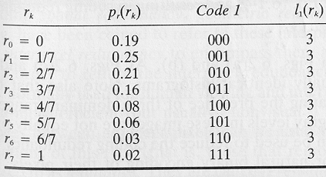

Image Compression
Coding Redundancy
Case 1: l(r_{k}) = fixed length (code 1)

Slide 12
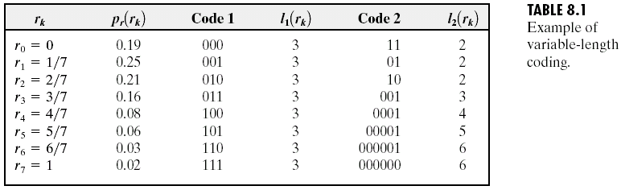
Image Compression
Coding Redundancy
Case 2: l(r_{k}) = variable length (code 2 – Huffman code)
Total number of bits: 2.7NM

Slide 13
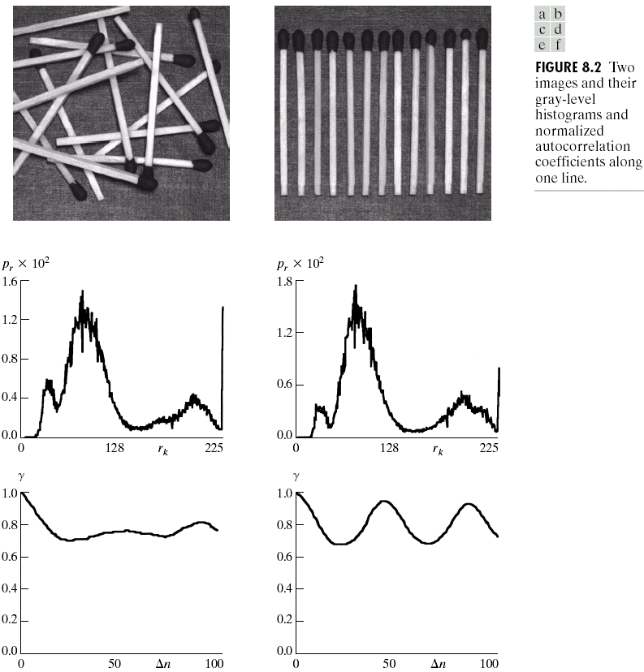
Image Compression
Interpixel Redundancy
Interpixel redundancy
implies that pixel values
are correlated (i.e., a
pixel value can be
reasonably predicted by
its neighbors).

Slide 14
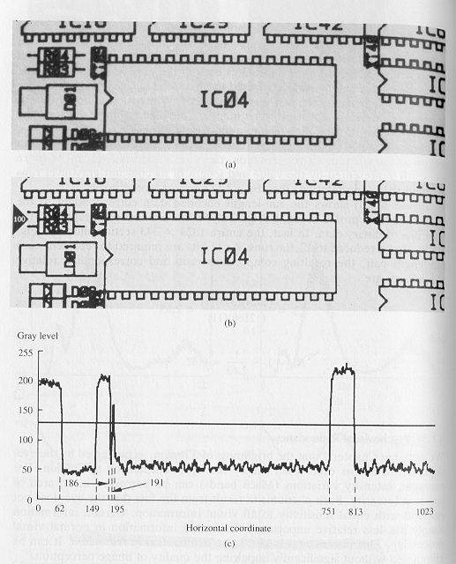
Image Compression
Interpixel Redundancy
To reduce interpixel redundancy, some kind of a transformation must be applied on the data.
Example
Additional savings using
run-length coding
Original
threshold
11 ……………0000……………………..11…..000…..
Binary image

Slide 15
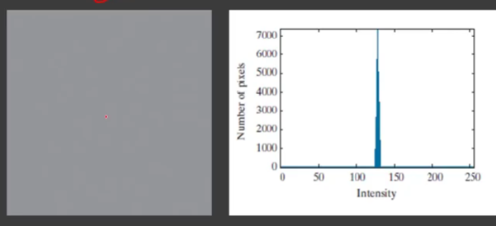
Image Compression
Psychovisual Redundancy
The human eye is more sensitive to the lower frequencies than to the higher frequencies in the visual spectrum.
Idea: discard data that is perceptually insignificant.
C=8/4 = 2:1

Slide 16
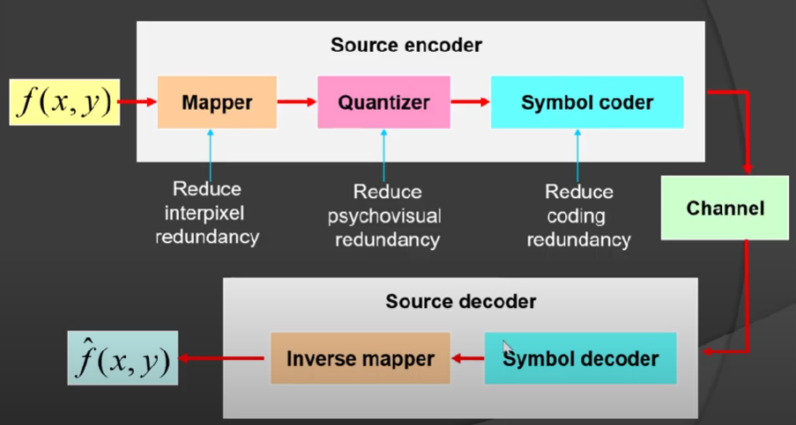
Image Compression
Image Compression Model

Slide 17
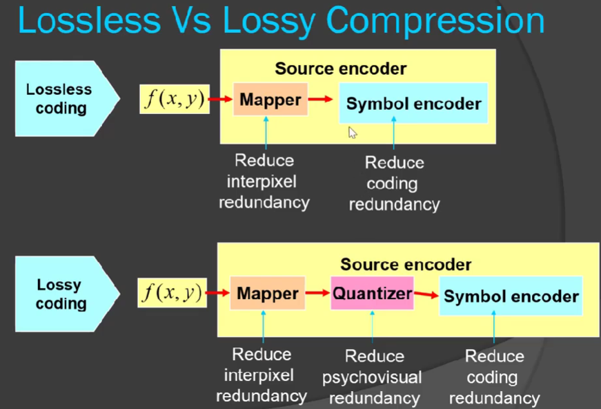

Slide 18

Image Compression
Fidelity Criteria
How close is $f(x,y)$ to $\hat{f}(x,y)$ ?
Criteria
Subjective: based on human observers
Objective: mathematically defined criteria

Slide 19
Image Compression
Lossless Coding Techniques
Statistical Encoding
Huffman Coding
Arithmetic Coding
Lempel-Ziv-Welch (LZW) Coding
Repetitive Sequence Encoding
Run-Length Encoding (RLE)

Slide 20
Image Compression
Huffman Coding
Addresses coding redundancy
A variable-length coding technique
Source symbols are encoded one at a time!
There is a one-to-one correspondence between source symbols and code words.
Optimal code - minimizes code word length per source symbol.

Slide 24
Image Compression
Huffman Coding: Forward Pass
Steps:
Sort probabilities per symbol
Combine the lowest two probabilities
Repeat Step2 until only two probabilities remain.

Slide 25
Image Compression
Huffman Coding: Backward Pass
Assign code symbols going backwards

Slide 26
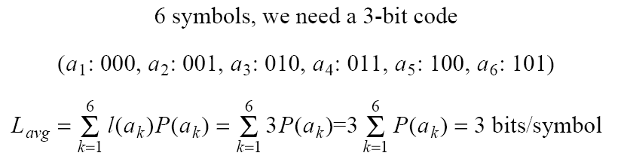
Image Compression
Huffman Coding
L_{avg} assuming binary coding:
L_{avg} assuming Huffman coding:

Slide 27
Image Compression
Arithmetic Coding
Addresses coding redundancy
Huffman coding encodes source symbols one at a time which might not be efficient.
Arithmetic coding encodes sequences of source symbols to variable length code words.
There is no one-to-one correspondence between source symbols and code words.
Slower than Huffman coding but can achieve better compression.

Slide 28
Image Compression
Arithmetic Coding
Map a sequence of symbols to a number (arithmetic code)
in the interval [0, 1).
Encoding the arithmetic code is more efficient.
The mapping depends on the probabilities of the symbols.
The mapping is built as each symbol arrives.
α₁ α₂ α₃ α₃ α₄

Slide 29
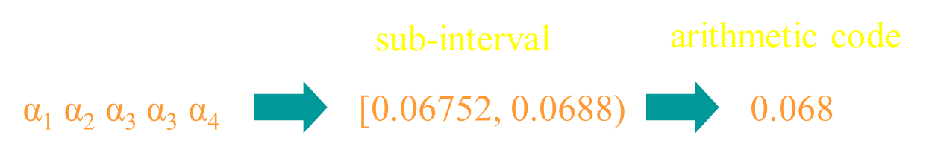
Image Compression
Arithmetic Coding
Start with the interval [0, 1)
A sub-interval of [0,1) is chosen to represent the first symbol (based on its probability of occurrence).
As more symbols are encoded, the sub-interval gets smaller and smaller.
At the end, the symbol sequence is encoded by a number within the final interval.

Slide 30
Image Compression
Arithmetic Coding: Example

Slide 31
Image Compression
Arithmetic Coding: Example
The arithmetic code 0.068 can be encoded using Binary Fraction:
0.0068 ≈ 0.000100011 (9 bits) (subject to conversion error;
exact value is 0.068359375)
Huffman Code:
0100011001 (10 bits)
Fixed Binary Code:
5 x 8 bits/symbol = 40 bits
α₁ α₂ α₃ α₃ α₄

Slide 32
Image Compression
Arithmetic Coding: Example
Decode 0.572. The length of the message is 5.
Since 0.8>code word > 0.4, the first symbol should be a₃.
1.0
0.8
0.72
0.592
0.5728
0.8
0.72
0.688
0.5856
0.57152
Therefore, the message is a₃a₃a₁a₂a₄
0.4
0.56
0.624
0.5728
056896
0.2
0.48
0.592
0.5664
0.56768
0.0
0.4
0.56
0.56
0.5664

Slide 33
Image Compression
Run-Length Coding (RLC)
Addresses interpixel redundancy.
Run-length Encoding, or RLE is a technique used to reduce the size of a repeating string of characters.
This repeating string is called a run, typically RLE encodes a run of symbols into two bytes, a count and a symbol.
RLE can compress any type of data.

Slide 34
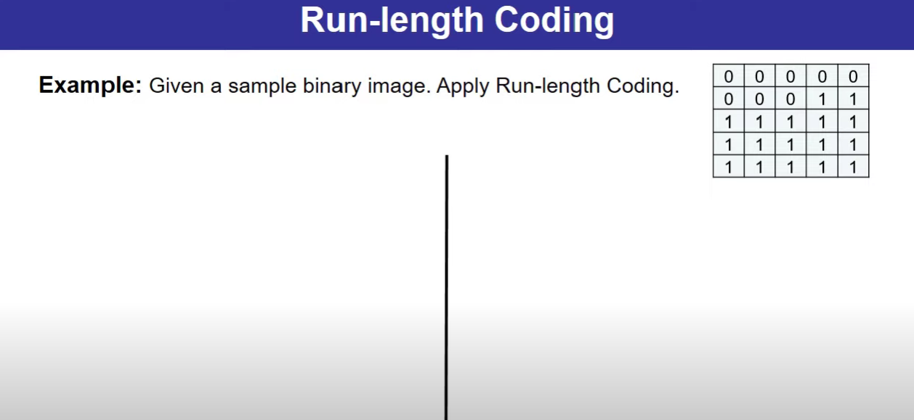

Slide 35
Image Compression
Run-Length Coding (RLC)
RLE cannot achieve high compression ratios compared to other compression methods.
It is easy to implement and is quick to execute.
Run-length encoding is supported by most bitmap file formats such as TIFF, BMP and PCX
1 1 1 1 1 0 0 0 0 0 0 1 → (1,5) (0, 6) (1, 1)
a a a b b b b b b c c → (a,3) (b, 6) (c, 2)

