Slide 1


COLOR FFREAK
College-portal
TEAM MEMBERS:
GUIDE’S NAME
k.Siddhartha (2451-10-737-081)
B.Pranay (2451-10-737-085)
Mohemmad Ali (2451-09-737-053)
P.Karthik
Designation: Asst. professor,
Department of Information Technology

Slide 2
Statement of problem:
The is a game where the player is given with a colored text and set of colored options, he need to find the appropriate text in the options for the given question color, the question and options are provided with irrelevant colors and text which leads to ambiguity for the player to select appropriate answer for the question. This game is developed as an app for android devices, so that user can use the app at any instance directly

Slide 3
Scope of work:
1.Eclipse software for development interface
2.Android SDK
4.Java JDK
3.SQLite database, Oracle database
7.Servlets for connectivity
5.Html5 for web Pages

Slide 4

CONTENTS
LOGIN FORM
PROFILE
LIBRARY
SCHEDULE
ATTENDANCE
FORUM
WEB PAGE

Slide 5

j individual contribution
Basic code-connecting different pages
logic for assigning colors and text
creation of menus
Database -connecting to database
insertion, up gradation of scores
retrieval of data in a desired format
Visualization- worked with different layouts
main frame
survival frame
how to play etc..

Slide 6
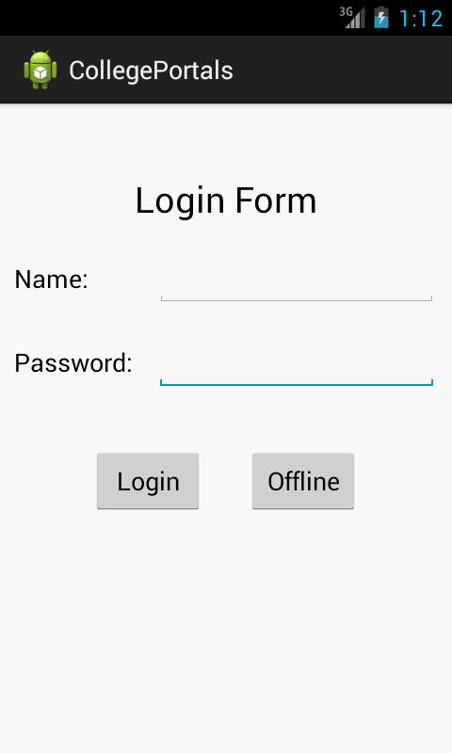
j Login Form
It helps us to enter into the application in two ways:
1. Authorized User: can be logged when internet is available.
2. Unauthorized User: can be logged when internet is unavailable.
Since it is a closed organization issue of id and passwords in undertaken by Admin

Slide 7
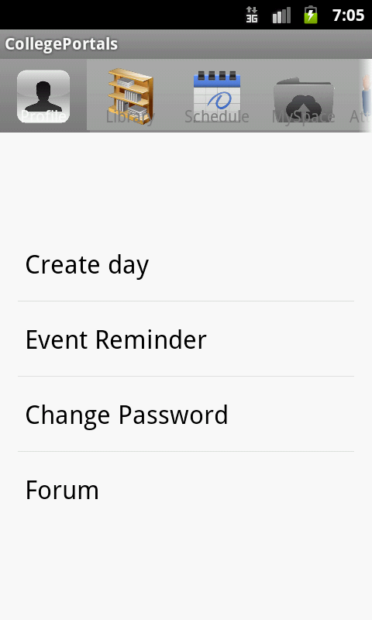
J Profile
Profile contains features like:
1.Create Day:
Add classes to a day, record lecture, take pictures, note important points of a session.
2.Event Remainder:
Add remainders of Exams, Meetings, Assignments etc.
3.Change Password
Can change your password if you are an authorized user

Slide 8
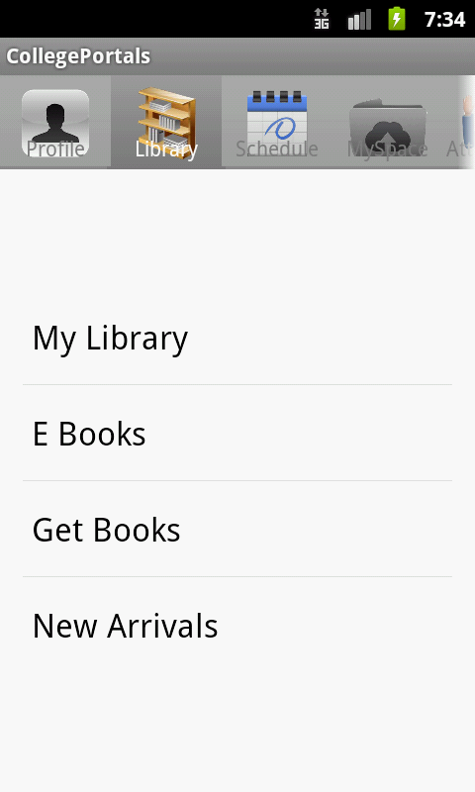
Library
Library contains features like:
1.My Library:
Place where downloaded books are stored
2.E Books:
Redirect to books available on internet
3.Get Books:
Books for download are available.
4.New Arrivals:
Updates about latest books and articles

Slide 9
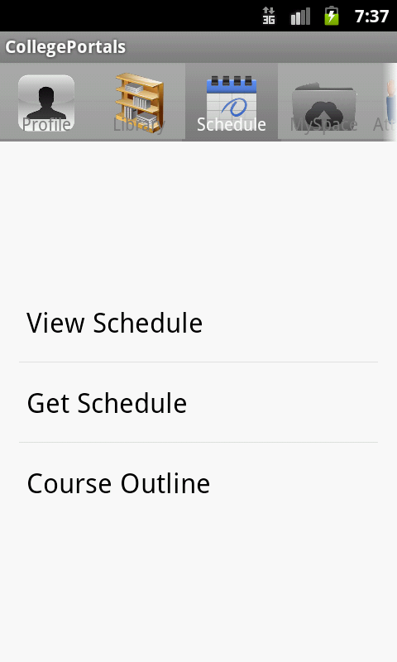
j Schedule
Schedule contains features like:
1.View Schedule:
Shows the schedule which is downloaded.
2.Get Schedule:
Searches for new schedules placed.
3. Course Outline:
Get the outline of different courses availing in college.

Slide 10
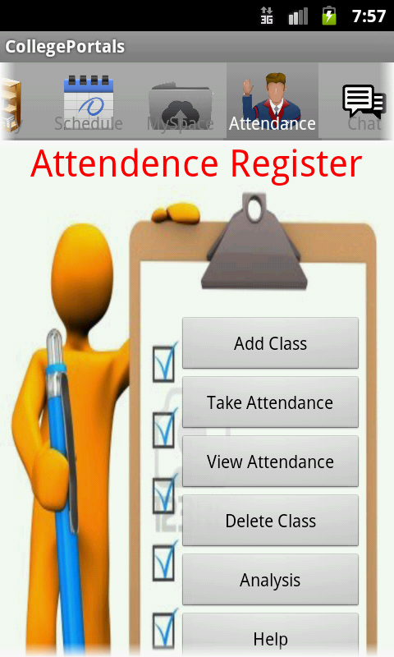
Attendance
Includes features like:
1.Add Class
2.Take Attendance
3.View Attendance
4.Delete Class
5.Analysis
6.Help

Slide 11
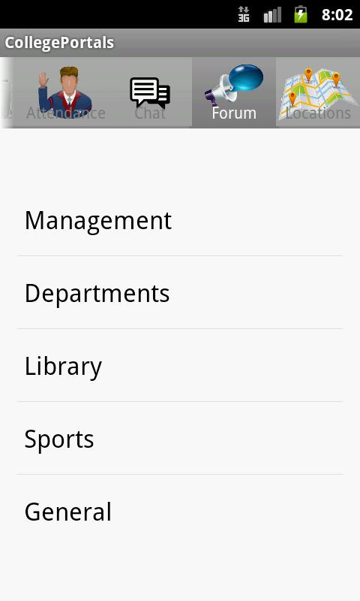
j Forum
Unlike chat which is a private area of discussion, Forum helps us to discuss our ideas and doubts and is a perfect place for student to clarify their doubts.
This is open and everyone can view posts and can share their knowledge.
This is divided into Management, Departments, Library, Sports, General Discussion.

Slide 12
j Web Page
different pages which satisfy all the above modules and some extra modules like account which are not frequently used

Slide 13


