Slide 1
Uncovering the Hidden Drivers of
Global Infant Mortality
A Data-Driven Analysis of Water Pollution vs. Healthcare Access
Siddharth Singh | Computer Science (Data Science & Machine Learning) | CGC University, Mohali
01 / 11

Slide 2
The Core Problem
The Assumption: High levels of water pollution (lead) directly and independently drive global infant mortality rates.
01
The Objective: Programmatically clean and analyze global environmental data (2000–2024) to test this assumption mathematically.
02
The Approach: Utilize Python for preprocessing and Power BI to build a multi-stage visual narrative to uncover the true statistical drivers.
03
02 / 11

Slide 3
Data Scope & Preprocessing
Volume: 3,000 global regions spanning a 24-year timeline.
01
Features: 24 distinct variables including Lead Concentration (µg/L), Infant Mortality Rate, Healthcare Access Index, and GDP.
02
Data Cleaning: Repaired corrupted column names and handled missing values using Python (Pandas) to establish a clean baseline for BI modeling.
03
03 / 11

Slide 4
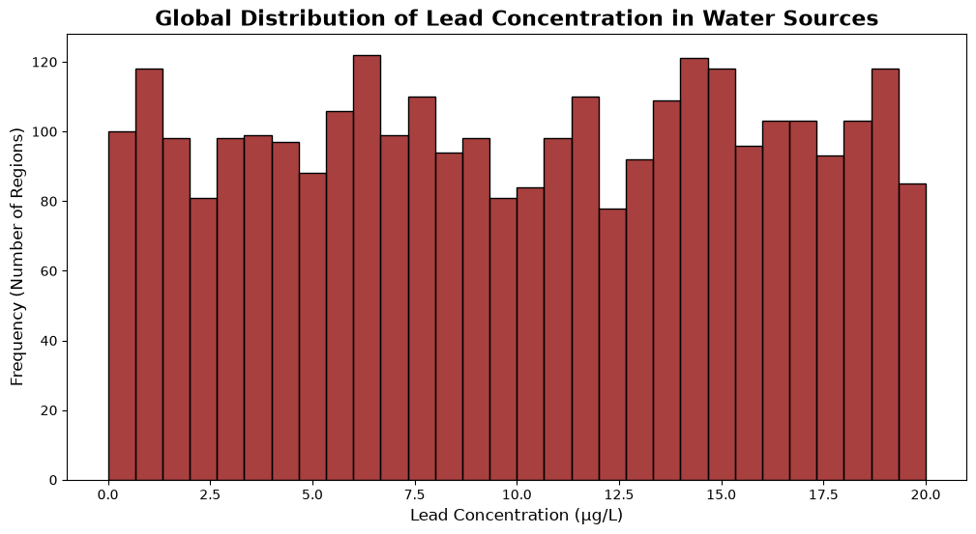
VISUAL 1
Global Lead Toxicity Distribution
04 / 11
Notes:
This histogram maps out the baseline toxicity of the 3,000 regions. The X-axis shows the Lead Concentration (grouped into 30 bins), and the Y-axis shows the count of regions. The Key Insight: A massive portion of the dataset falls entirely to the right of the 10 µg/L mark. This proves that the majority of regions in our data consistently exceed the World Health Organization's safe limit for lead in water. The baseline is highly toxic.

Slide 5
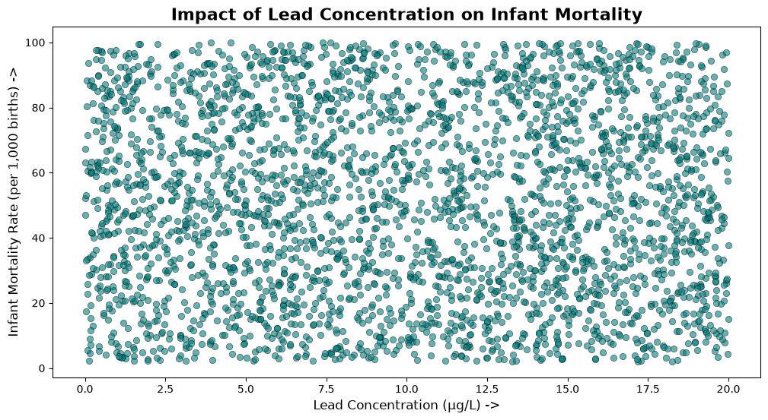
VISUAL 2
Lead vs. Mortality Correlation
05 / 11
Notes:
This scatter plot tests the direct mathematical correlation between our two primary variables. The X-axis measures Lead Concentration, while the Y-axis tracks the Infant Mortality Rate. The Key Insight: We expected a sharp upward trendline (more lead = higher mortality). Instead, the AI-generated trendline is completely flat and horizontal. This reveals a data science paradox: Lead concentration alone does not dictate the infant mortality rate when looking at the global macro-level. There must be a hidden variable.

Slide 6
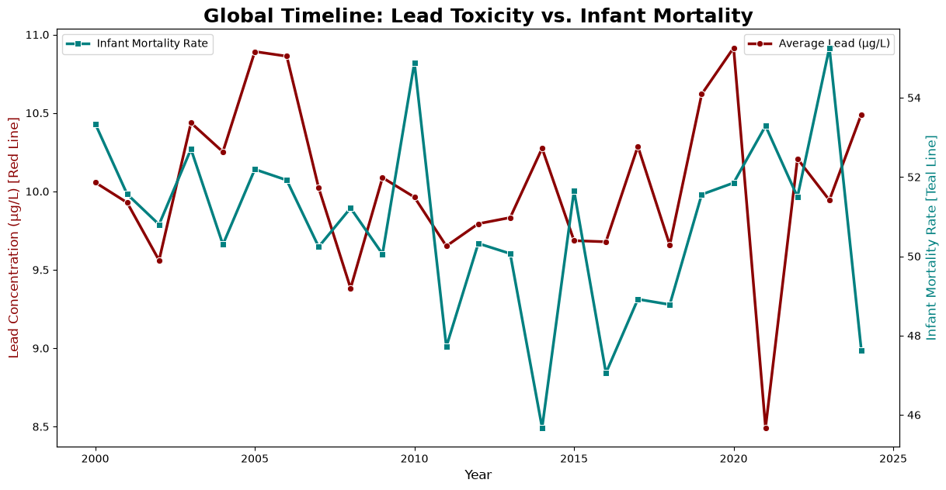
VISUAL 3
The 24-Year Historical Trend
06 / 11
Notes:
This combination chart tracks our metrics over the full 24-year timeline (2000–2024). The blue bars represent the average Lead Concentration, and the dark blue line represents the Infant Mortality Rate. The Key Insight: Notice how the blue bars remain stubbornly flat right around the 10 µg/L mark for the entire two decades. The water never got cleaner. However, the mortality line fluctuates wildly and eventually drops at the end of the timeline. Something else is saving lives.

Slide 7
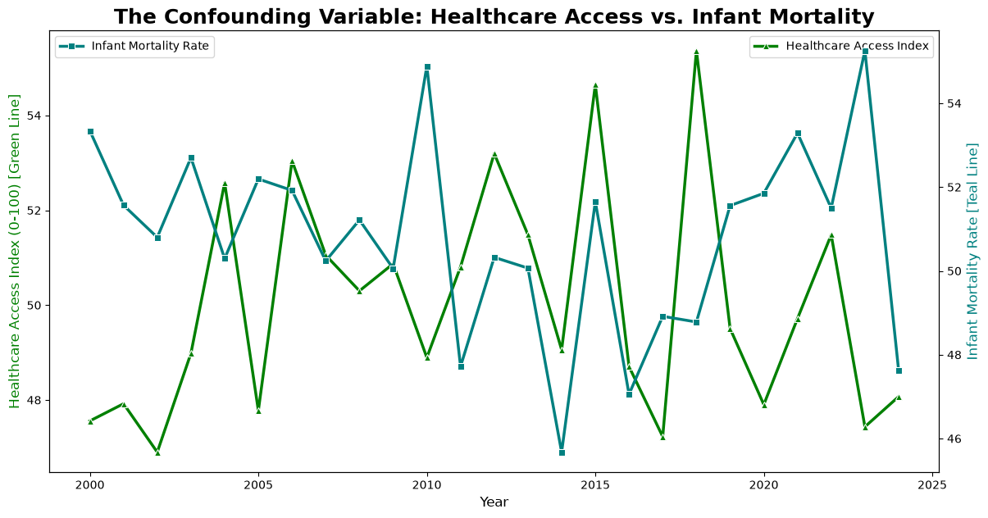
VISUAL 4
The Healthcare Miracle
07 / 11
Notes:
This final dual-line chart introduces our missing variable: The Healthcare Access Index. The X-axis is the timeline, while the two lines track average Healthcare Access and average Infant Mortality. The Key Insight: Look at the massive “X” shape formed by the mathematical trendlines. This is a classic Strong Inverse Correlation. Over 24 years, as global access to hospitals and medicine powerfully climbed upward, the infant mortality rate aggressively dropped downward.

Slide 8
The Grand Conclusion
Debunking the Assumption: Lead toxicity levels remained flat globally over the measured period. It was not the primary factor moving the needle on survival rates.
01
The True Mechanism: Human medicine outpaced persistent environmental pollution. The steady improvement in the Healthcare Access Index was the actual, hidden driver lowering infant mortality over the last two decades.
02
08 / 11

Slide 9
Moving Toward Predictive Modeling
Historical visualization explains the past, but Machine Learning predicts the future.
Next Step: Build a predictive regression model (Random Forest / XGBoost) using the cleaned Python dataset.
01
Outputting a Feature Importance matrix will mathematically confirm Healthcare Access is weighted heavier than Lead Concentration.
02
09 / 11

Slide 10
Actionable Insights
Policy Focus: Long-term infrastructure overhauls (water filtration) are critical but slow to implement globally.
01
Capital Allocation: Immediate capital must be directed toward emergency healthcare access and hospital infrastructure.
02
The Bottom Line: Improving medicine yields the fastest and most mathematically verifiable drop in mortality rates.
03
10 / 11

Slide 11
Thank You.
11 / 11
Notes:
Open the floor for questions regarding the Python code, data cleaning process, or Power BI dashboard construction.

