Slide 1
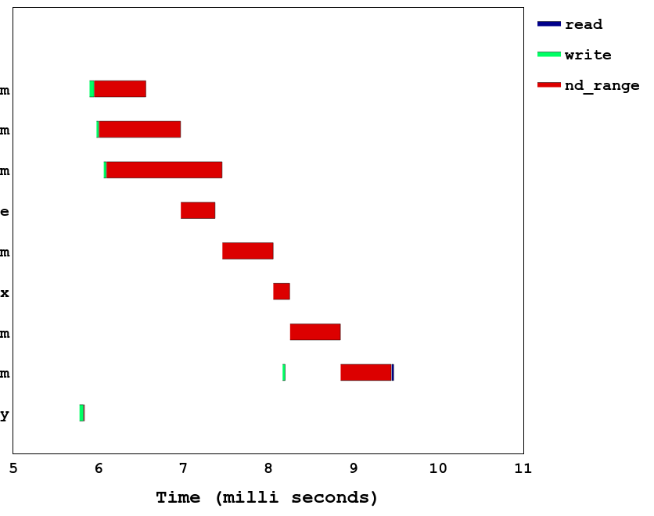
1_gemm (w₁,e₁)
Fine grained scheduling:
Interleaving of write and ndrange
1_gemm (w₂,e₂)
1_gemm (w₃,e₃)
2_transpose (e₄)
3_gemm (e5)
4_softmax (e₆)
5_gemm (e₇)
6_gemm (w₄,e₈,r)
initial copy (w₀)

