Slide 1
IISc Quiz Club
7th General Quiz
31 May 2009
Siddhartha Gadgil
Ulka Kelkar

Slide 2
The logo of which product is said to represent the integration of analog and digital technology, with half the logo representing an analog wave and the other half digital binary code?

Slide 3
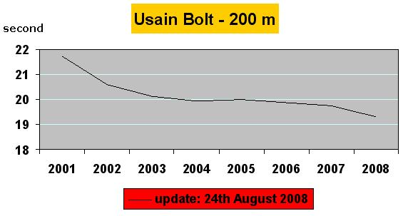
What does this graph show?
seconds

Slide 4
The Apgar score, devised in 1952, ranges from
0 to 10 based on the following components
Appearance
Pulse
Grimace
Activity
Respiration
What does the Apgar score evaluate?

Slide 5
APGAR is an example of a “backronym”.
What is a backronym?

Slide 6
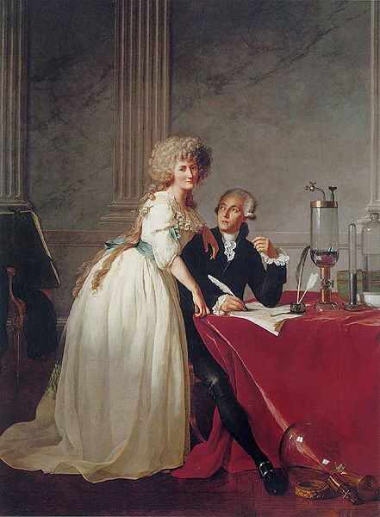
Identify this nobleman and tax collector, guillotined in the French Revolution, about whom
Joseph Lagrange said,
“It took them only an instant to cut off his head, but France may not produce another like it in a century.”

Slide 7
On 30 December 2008, the Consulate General of Israel in New York held a press conference about the war in Gaza.
In doing so, the Israeli government became the first to hold a press conference using – what?

Slide 8
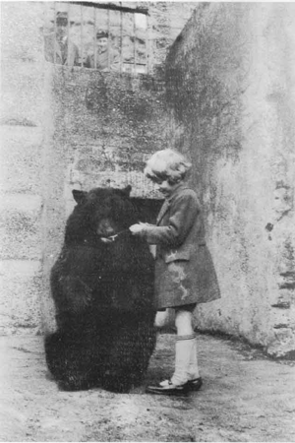
The child in this photo was the basis of a fictional character, but later wrote, “It seemed to me almost that my father had got where he was by climbing on my infant shoulders, that he had filched from me my good name and left me nothing but empty fame”.
Identify him.

Slide 9
Every Halloween pumpkins are dropped from the top of the ______ Library, the tallest building in Caltech.
There are many theories about this custom, but clearly one of its attractions is conducting the ______ Pumpkin Drop.
Fill in the blank.

Slide 10
The 1840 Presidential candidacy of Martin Van Buren, nicknamed “Old Kinderhook” after his hometown, has had a lasting impact on the English language.
What is it?

Slide 11
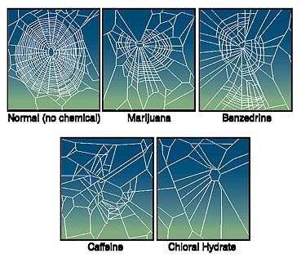
These are webs spun by spiders under the influence of different chemical substances. What is X?
Normal (no chemical) Marijuana Benzedrine
X Chloral hydrate

Slide 12
What is common between the
President of the United States
Vice President
Secretary of State
Chairman of the Senate Banking Committee
Secretary of Agriculture

Slide 13
To whom did the Brazilian football team dedicate their victory in the 1994 FIFA World Cup?

Slide 14
What did Harold Pinter describe as
“the greatest thing that God created on earth, certainly greater than sex, although sex isn't too bad either.”

Slide 15
This year, “Tea Party protests” are being organised across the United States to protest against Obama’s budget. The name is a reference to the Boston Tea Party of 1773. TEA is also said to stand for “Taxed Enough Already”.
Paul Krugman has called these events “Astroturf”.
Another example of “Astroturf” is the riot which stopped the Florida election recount in 2000.
What does “Astroturf” mean in this context?

Slide 16
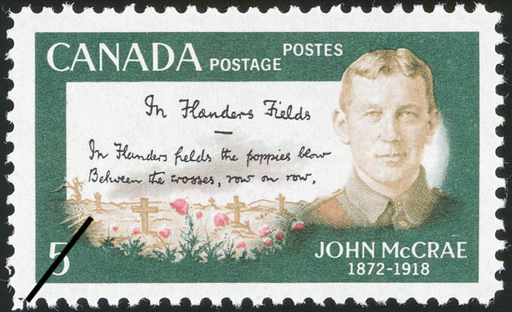
This stamp commemorates a poem.
What symbolic practice did the poem give rise to?

Slide 17
“The energy produced by ____________ is a very poor kind of thing. Anyone who expects a source of power from _____________ is talking moonshine.”
Who said this and about what?

Slide 18

A 1970s ad for Parker Pens showed a hand writing the following formula
Apparently they received inquiries from chemists, mathematicians, and physicists, asking for the meaning of the formula.
What was it?

Slide 19
Media references to “supercouples” include
Brangelina
Tomkat
Abhiash
Saifeena
What is this type of word called?

Slide 20
Which novel by a Punch cartoonist connects a men’s hat, an evil hypnotist, and
The Phantom of the Opera?

Slide 21
This substance was described as responsible for “almost all the tapers, lamps and candles that burn round the globe”. It was also the fuel that lit the street lamps of London. What is this substance?

