Slide 1
PS-04 · KOGNIVERA HACKATHON 2026 · TEAM RNG GODS · BMS COLLEGE OF ENGINEERING
PackagePro
Dynamic tour packages, priced live
The problem Holiday packages are sold as fixed bundles. Travellers can't reshape them, can't see what each part costs, and a local guide is picked from a static list — with no check that the guide is actually free on the trip's dates.
01
02
03
Rigid bundles
Opaque pricing
Guides picked blind
Changing the hotel, an activity or a transfer means calling an agent and waiting for a new quote.
One lump sum. Nobody can see what each part costs or what a change would do to the total.
A guide can be sold for a day they are already booked, and language or specialisation is ignored.
PackagePro · PS-04 Dynamic Tour Packages · Team RNG Gods
1 / 11
Notes:
PS-04 asks for dynamic tour packages. Today a package is a fixed bundle: you cannot swap parts, you cannot see the price of each part, and the local guide is a static dropdown with no availability check. Our job: a package you can reshape, priced live, with guides that are checked day by day.

Slide 2
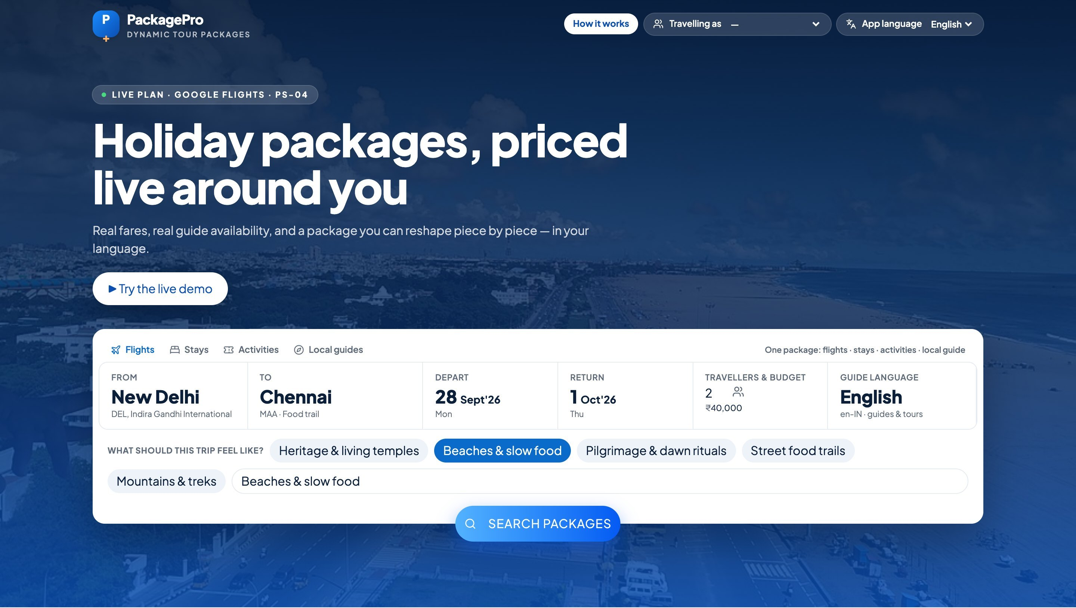
IDEA · PROPOSED SOLUTION
A package you can reshape — every change repriced live
Start from a curated package, reshape it piece by piece, add a guide checked against real availability, and book it — on the web or in Telegram, in your language.
1
Curated start
45 real PS-04 packages; picks follow your mood — beaches, heritage, mountains.
2
Reshape live
Swap hotel, activity or transfer, add extras, change days; the whole plan reprices.
3
Guides checked day by day
Refused with the clashing date named; a matching substitute is offered, repriced.
4
Your language, your channel
4 app languages · web, Telegram bot and a printable quotation on one engine.
Live app: the beach mood moved the destination to Chennai and re-ranked the packages.
PackagePro · PS-04 Dynamic Tour Packages · Team RNG Gods
2 / 11
Notes:
Four pillars: a curated start from the real PS-04 catalogue; live reshaping where the total is recomputed from the whole plan; the guide as a component with the mandatory availability check; and language plus channel choice. The screenshot is the running app: choosing a mood moves the destination, the hero photo and the ranking.

Slide 3
ARCHITECTURE · TECHNICAL APPROACH
One TypeScript service, two channels, one trip engine
Channels
API
Trip engine
Data
Web app
React 19 · Vite · Tailwind
Telegram bot
@wayypoint_Bot
tRPC + Zod
Node 22 · Express
Typed end to end,
inputs validated
Pricing in integer paise
Swaps · budget fixes
Guide check
Booking transaction
PS-04 dataset (read-only)
Canonical trips, itineraries,
items, bookings
+ app_* additions
AI — grounded, validated
Integrations
Sarvam sarvam-105b-conversations (OpenRouter fallback). Picks only real catalogue IDs; budget checked before and after the model; rule-based fallbacks.
SerpAPI Google Flights (live fares) · Sarvam mayura translation (cached) · Wikipedia photos · Railway deploy with a /data volume.
One engine, two channels: a rule is enforced once
Recompute, never accumulate: totals can't drift
BEGIN IMMEDIATE + idempotency key: no double booking
PackagePro · PS-04 Dynamic Tour Packages · Team RNG Gods
3 / 11
Notes:
The web app and the Telegram bot both call the same trip engine, so pricing, the guide check and booking behave identically everywhere. The engine reads the organisers' PS-04 dataset read-only and writes the shared model's canonical tables. Money is integer paise; the total is rebuilt from the plan on every change; booking is one SQLite transaction with a write lock and an idempotency key. The AI never sets a price.

Slide 4
EXPECTED MVP — 24-HOUR HACKATHON
Every MVP item, built and wired end to end
PS-04 expects | What PackagePro does | Status
Package listing + ONE fully customisable package | 45 curated packages by theme; any one opens fully customisable | Built · MVP
Swap hotel tier / activity / transfer / guide → itinerary and total update live | Same day and slot kept; total rebuilt from the whole plan in paise | Built · MVP
Guide as a component: language + specialisation + price | Guide planner grid; day rate × date multiplier added to the total | Built · MVP
Language preference changes packages, guides or content | Profile sets app + guide language; guides filtered; 4 app languages | Built · MVP
AI package-builder from free-text interests | Sarvam; interests + booking history; real catalogue IDs only | Built · Stretch
Save / share; full multilingual content | Drafts, share links, PDF quotation, Telegram; 4-language copy | Built · Stretch
Boundary rules enforced in the backend with tests: group size (min–max), BCP-47 languages, INR only, guide capacity, idempotent booking.
PackagePro · PS-04 Dynamic Tour Packages · Team RNG Gods
4 / 11
Notes:
Each MVP line from the statement, and where it lives in the product. Everything is wired end to end in code — the listing, the fully customisable package, live repricing on every swap, the guide as a priced component, and the language preference. Both stretch goals are built too: the AI package builder and save/share with full multilingual content.

Slide 5
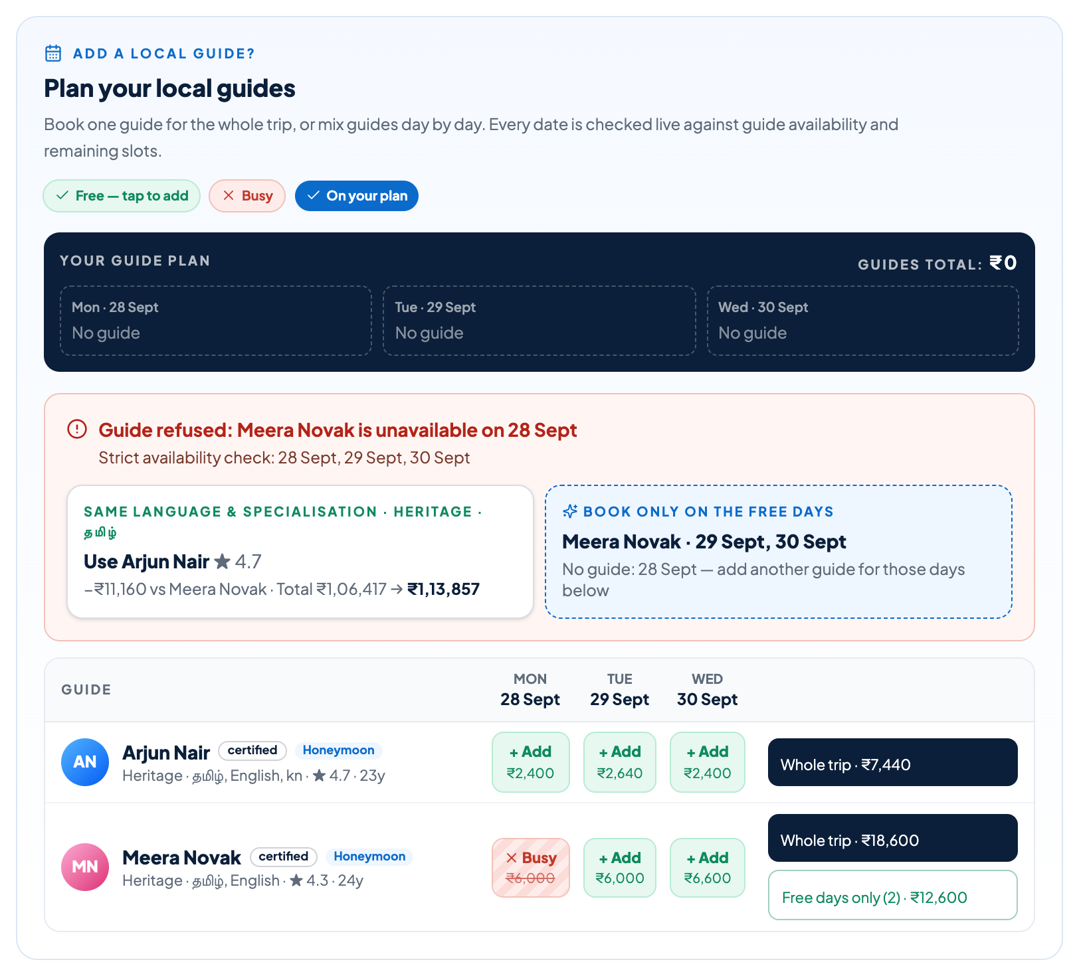
MANDATORY ENHANCEMENT
Guide Availability Check — never a static dropdown
1
Add a guide
to a package with real trip dates
2
Check every date
is_available = 1 and slots_available − confirmed bookings > 0
3
Refuse on a clash
the clashing date is named: Meera Novak, 28 Sept
4
Offer the nearest substitute
same language + specialisation, free on every date, nearest (≤ 400 km), then smallest price change
5
Reprice live
Arjun Nair −₹11,160 vs Meera → new total shown; re-checked inside the booking transaction
Proof tests/hardProof.guideAvailability.test.ts · same rule on web and Telegram · or book a guide only on the free days
PackagePro · PS-04 Dynamic Tour Packages · Team RNG Gods
5 / 11
Notes:
This is the mandatory enhancement, shown on the live screen. Adding a guide checks every trip date against guide_availability and our own confirmed bookings. Meera speaks Tamil and specialises in heritage, but is unavailable on 28 September — refused, date named. Arjun Nair, same language and specialisation, free on all three days, is offered at minus 11,160 rupees with the new total. The traveller can also book Meera only on her two free days. The rule is enforced in the backend, proven by the hard-proof test, and re-checked inside the booking transaction.

Slide 6
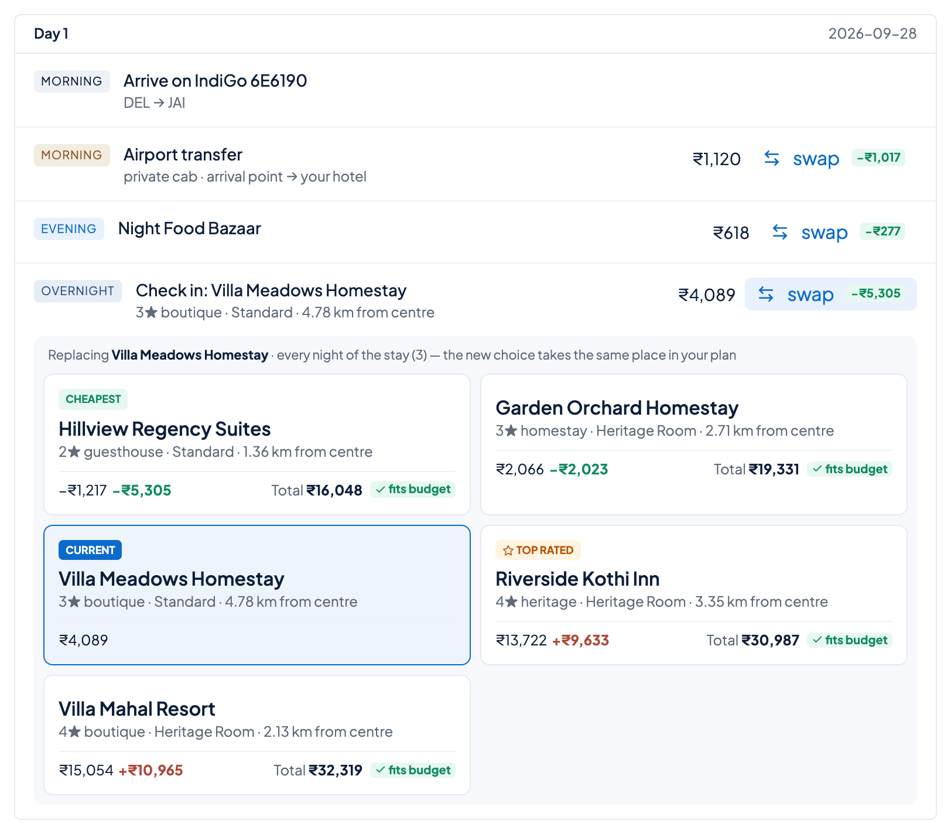
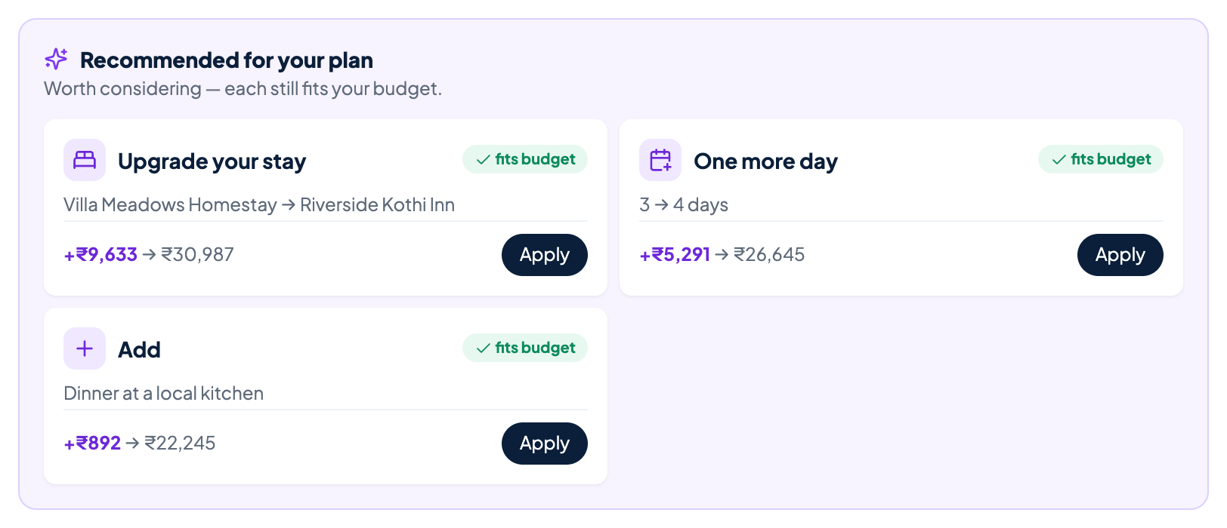
CUSTOMISATION
Swaps that keep their place, suggestions that fit the budget
Every option priced on the whole trip current choice, cheapest and top-rated tagged; new total and 'fits budget' on each
Context kept a swap takes the same day and slot; transfers start where you arrive
Recommended for your plan upgrades that still fit — or, over budget, the fixes that bring you back
Undo · Discard changes one tap back to the last plan or to the recommended package
PackagePro · PS-04 Dynamic Tour Packages · Team RNG Gods
6 / 11
Notes:
Customisation on the live screen. Opening a swap shows the current choice and every alternative, cheapest first, each priced on the whole trip with whether it still fits the budget. A swap keeps its place in the day. The strip on the right always recommends something useful — upgrades that fit, or fixes when over budget — and Undo or Discard takes you back.

Slide 7
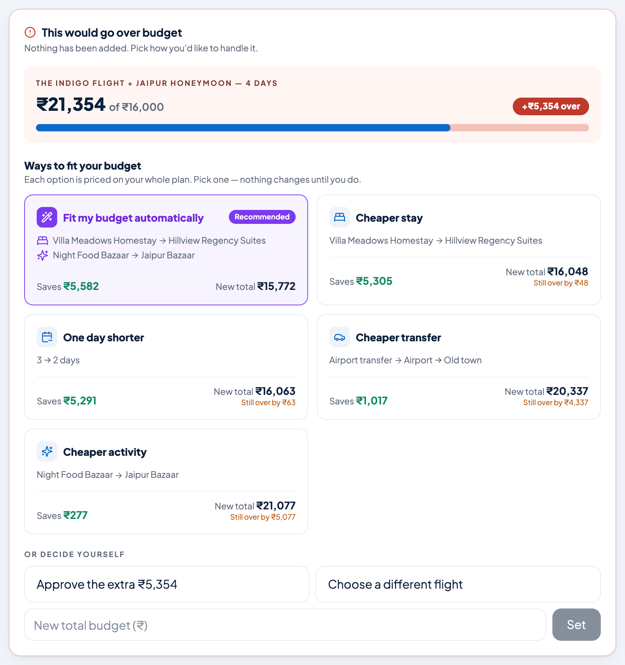
BUDGET INTELLIGENCE
Over budget? Priced fixes — never a dead end
Fit my budget automatically
1
The fewest cuts that get under the cap — here a cheaper stay + activity: ₹21,354 → ₹15,772 on a ₹16,000 budget.
Every option priced on the whole plan
2
Cheaper flight, stay, activity or transfer, drop an add-on or guide, one day shorter: saves, new total, still over by.
An honest minimum
3
When nothing fits: 'the lowest this trip can go is ₹X' and one tap that sets the budget and applies the cuts.
Keep customising after approving
4
Changes that don't raise the total apply at once; dearer ones ask only for the new extra.
PackagePro · PS-04 Dynamic Tour Packages · Team RNG Gods
7 / 11
Notes:
When a change breaks the budget we do not just say no. The engine re-prices every cheaper option on the whole plan. 'Fit my budget automatically' finds the fewest changes that fit — in this real screen, a cheaper stay and activity bring 21,354 rupees down to 15,772 on a 16,000 budget. If nothing can fit, the page says the honest minimum and sets it in one tap. The Telegram bot shows the same fixes as buttons.

Slide 8
DEMO
From search to booked trip in six steps
1
Try the live demo
2
Pick a live flight
3
Customise
Delhi → Thanjavur, 4 travellers, Tamil guide, ₹1,50,000 — live estimate: low · typical · high.
Google Flights fares via SerpAPI; the package loads with its itinerary.
Swap the hotel or an activity, add an extra, change the days — the total updates on every change.
4
Add a guide
5
Stay in budget
6
Confirm & share
Meera Novak is refused on 28 Sept; Arjun Nair is offered with the new total.
Over budget? Priced fixes, or 'fit my budget automatically' in one tap.
Booking reference, PDF quotation in 4 languages — and the same flow in Telegram.
CODE · GITHUB
DECK, VIDEO & DOCS
TELEGRAM BOT
kv-hack2026-rng-gods repository
Google Drive folder
@wayypoint_Bot → /demo
PackagePro · PS-04 Dynamic Tour Packages · Team RNG Gods
8 / 11
Notes:
Run 'pnpm db:reset' before the demo so the demo guide's slots are free. Click 'Try the live demo', pick the cheapest flight, swap the hotel, open the guide planner and pick Meera Novak — refused on 28 September, Arjun offered with the new total. Confirm to get a booking reference and download the PDF. Then show the same refusal in the Telegram bot. The code, this deck and the demo video are linked at the bottom.

Slide 9
PROOF
Backed by code, tests and the validator
61
PASS
120
4 · 2
automated tests
organisers' validator
bookable guides
languages · channels
including the hard-proof guide test, concurrency and idempotent booking
our canonical rows merged with PS-04 pass validate_conformance.py
each with a 30-day calendar; plus 45 packages and 1,200 traveller profiles from PS-04
English, Hindi, Tamil, Telugu on web and Telegram
Boundary rules live in the backend: group size, BCP-47 languages, INR only, guide capacity. Money is integer paise; itinerary lines add up to the total to the paisa.
PackagePro · PS-04 Dynamic Tour Packages · Team RNG Gods
9 / 11
Notes:
pnpm verify runs the type check, every test suite and the production build before every push. pnpm conformance merges our canonical rows with the PS-04 dataset and runs the organisers' validator — it prints PASS. Everything shown is backed by code.

Slide 10
IMPACT & BENEFITS
Better for travellers, guides and tour operators
Travellers
Local guides
Tour operators
• Build the trip they want, in their language
• See every line of the price
• Never booked with a guide who isn't free
• Stay in budget with one-tap fixes
• Bookings respect real availability and slots
• Matched on language and specialisation
• Nearby guides get offered as substitutes
• Paid per day at each date's rate
• Fewer manual re-quotes and call-backs
• No double-booked guides
• Upsell with upgrades that still fit
• One engine for web and chat
PackagePro · PS-04 Dynamic Tour Packages · Team RNG Gods
10 / 11
Notes:
Travellers get control and transparency in their own language. Guides are only booked when they are really free, and are matched on language and specialisation. Operators stop re-quoting by hand, never double-book a guide, and can upsell with upgrades that still fit the budget.

Slide 11
BUSINESS MODEL & SCALING
How PackagePro earns — and grows beyond one city
REVENUE
SCALING PATH
Booking commission
Today
One Railway service, SQLite, canonical tables, Telegram polling
[__%] of each confirmed package
Guide marketplace fee
Next
Postgres with the same schema; stateless engine on several instances
[__%] per guide-day booked
White-label for agencies
Then
Telegram webhook + WhatsApp; UPI payments and GST on the quotation
[₹__ / month] per agency, their brand and catalogue
Upgrades & add-ons
Later
More cities, guides and partner inventory through the same engine
margin on recommended upgrades that fit the budget
Thank you — questions?
Code · Deck, video & docs · Telegram @wayypoint_Bot
PackagePro · PS-04 Dynamic Tour Packages · Team RNG Gods
11 / 11
Notes:
Revenue: a commission on each booked package, a marketplace fee on guide-days, a white-label licence for agencies, and margin on upgrades. Fill in the rates before presenting. Scaling: today one service with SQLite by design; next Postgres with the same canonical schema and a stateless engine; then a Telegram webhook, WhatsApp, UPI payments and GST; then more cities and partner inventory — the engine code does not change.

