Slide 1
Dog vs Cat Classification Using CNN
UNIVERSITY –
Dr. A.P.J. Abdul Kalam Technical University Lucknow
Name:
SIDDHARTHA GUPTA
ROLL NO.-02

Slide 2
Project Introduction
Binary image classification using a CNN trained on the Kaggle Dogs vs Cats dataset.
Problem Statement:
Humans can easily distinguish between cats and dogs in images, but computers cannot understand images naturally. The challenge is to develop an automated system that can accurately identify whether a given image contains a cat or a dog. This project uses a Convolutional Neural Network (CNN) to learn features from labeled images and classify new images into one of the two categories: cat or dog.

Slide 3
Dataset & Data Loading
Dataset downloaded using Kaggle API and loaded with image_dataset_from_directory().
Kaggle
ZIP
Train/Test
TensorFlow

Slide 4
Data Preprocessing
Images resized to 256×256 and normalized to [0,1].
Resize
Normalize
Batch
Ready

Slide 5
CNN Architecture
3 Convolution Blocks + BatchNorm + MaxPooling + Dense Layers.
Input
256x256
Conv32
Conv64
Conv128
Flatten
Dense
Output

Slide 6
Model Training
Adam optimizer, Binary Crossentropy loss, 10 epochs.
Epochs=10
Adam
Binary CE

Slide 7
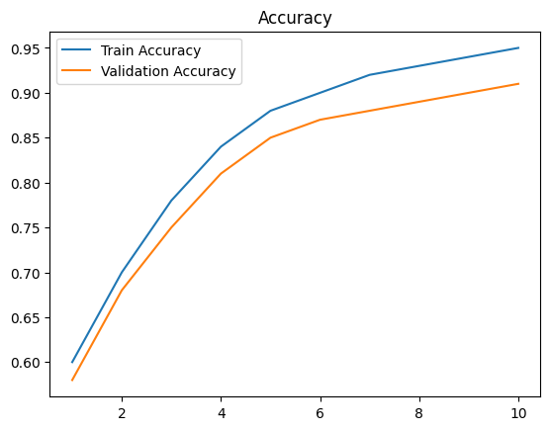
Accuracy Graph
Training vs Validation Accuracy

Slide 8
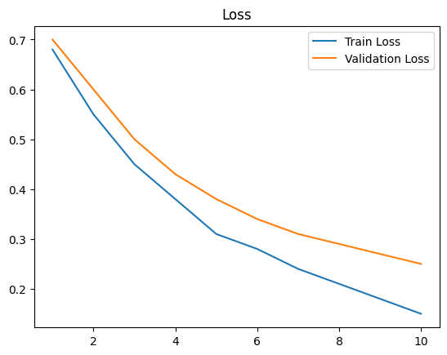
Loss Graph
Training vs Validation Loss

Slide 9
Inference & Prediction
Predict whether an input image is a dog or a cat.
Image
Resize
CNN
Dog/Cat

Slide 10
Thank You

