Slide 1

Analysis and Evaluation of Machine Learning Models for Diabetes Risk Prediction
Submitted By:
Sabin Adhikari
Sonam Gurung
Siddhartha Phuyal
Venkat Karthik Poreddy

Slide 2
Introduction
Global Impact: Diabetes affects over 422 million people globally, with early detection critical to prevent complications like cardiovascular disease, kidney failure, and nerve damage.
Limitations: Basic statistical techniques may fail to capture the complex relationships influencing diabetes risk, leading to less accurate predictions.
Power of Machine Learning: Machine learning enables models to learn from large datasets, detecting intricate patterns that improve prediction accuracy and aid in early diagnosis and intervention strategies.

Slide 3
Key Challenges and Objectives
The dataset we used suffers from class imbalance, where non-diabetic cases far outnumber diabetic patients, leading to biased predictions favoring the majority class.
The dataset includes features such as Age, BMI, Blood Glucose Levels, and HbA1c, with the goal of developing a model that accurately identifies diabetic patients while remaining clinically useful.

Slide 4
Literature Review
Machine Learning in Healthcare:
Machine learning models are increasingly used in healthcare for predicting conditions like diabetes due to their ability to uncover complex patterns in medical data.
Logistic Regression:
A simple, interpretable model, but limited in handling non-linear relationships and complex data patterns in diabetes prediction.
Decision Trees:
Offer interpretability but can overfit unless pruned or used with ensemble methods, making them less effective for large datasets.
Ensemble Models (Random Forest, XGBoost):
Combine multiple decision trees to reduce overfitting and improve accuracy, especially for imbalanced datasets like diabetes prediction.
Gradient Boosting Methods (LightGBM, CatBoost):
Known for efficiency and speed with large datasets, these models are well-suited for handling imbalanced data and achieving high prediction accuracy.

Slide 5
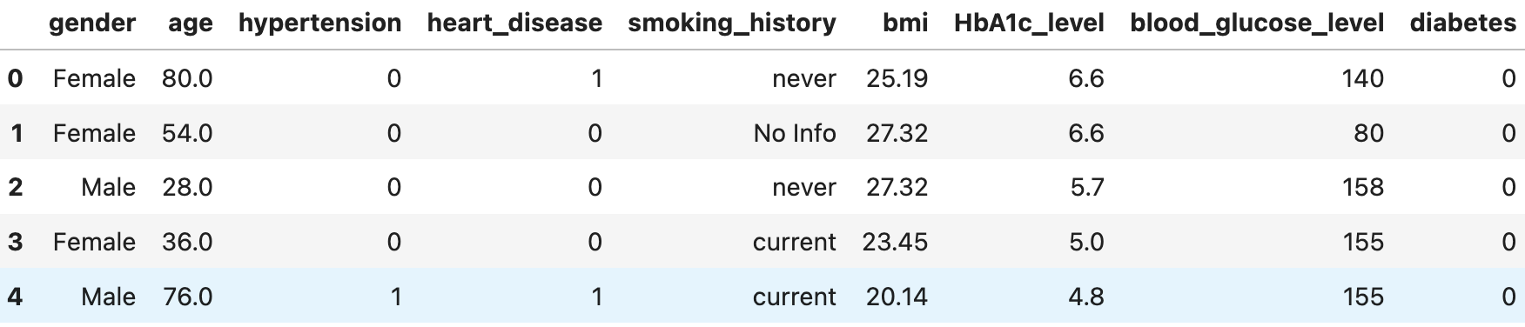
Methodology: Dataset and Data Preprocessing
The dataset for this project was sourced from Kaggle and contains features like Age, Gender, BMI, Hypertension, and Blood Glucose Levels, which are known to influence diabetes risk.
Cleaned the data by removing missing values

Slide 6
Categorical variables such as Gender and Smoking History were encoded using one-hot encoding to ensure they could be used by machine learning algorithms.
Continuous variables such as BMI and Blood Glucose Levels were standardized to have a mean of 0 and a standard deviation of 1, ensuring that all features were on the same scale.
Given the class imbalance in the dataset, we selected ensemble methods like Random Forest, XGBoost, LightGBM, and CatBoost for training, as these models are particularly well-suited to handling imbalanced data.

Slide 7
Methodology: Model Implementation
we evaluated several machine learning models to predict diabetes, including Decision Trees, Random Forest, XGBoost, LightGBM, and CatBoost.
These models were chosen for their ability to handle non-linearity in the data and their effectiveness in dealing with imbalanced datasets.
The dataset was then split into 80% training and 20% testing sets to train the model and evaluate its performance.

Slide 8
Methodology: Evaluation Metrics
To assess the performance of the models, we used several key metrics that are especially important when working with imbalanced datasets such as Precision, Recall, F1-score, ROC-AUC, Cross-validation accuracy and Cross-validation Std.
Precision measures the proportion of true positive predictions among all positive predictions made by the model, indicating how accurate the model is in identifying diabetic patients

Slide 9
Recall (or sensitivity) is another critical metric, as it measures the proportion of actual positive cases that are correctly identified, ensuring that diabetic patients are not missed by the model
The F1-score is the harmonic mean of precision and recall, providing a balanced view of performance.
ROC-AUC measures how well the model distinguishes between the positive and negative classes across different thresholds.

Slide 10
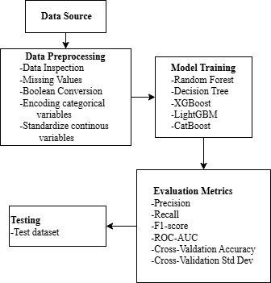
Proposed Framework

Slide 11
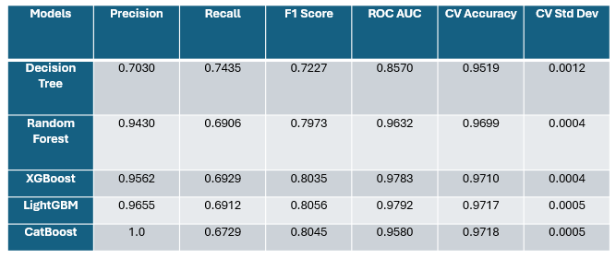
Results and Analysis

Slide 12
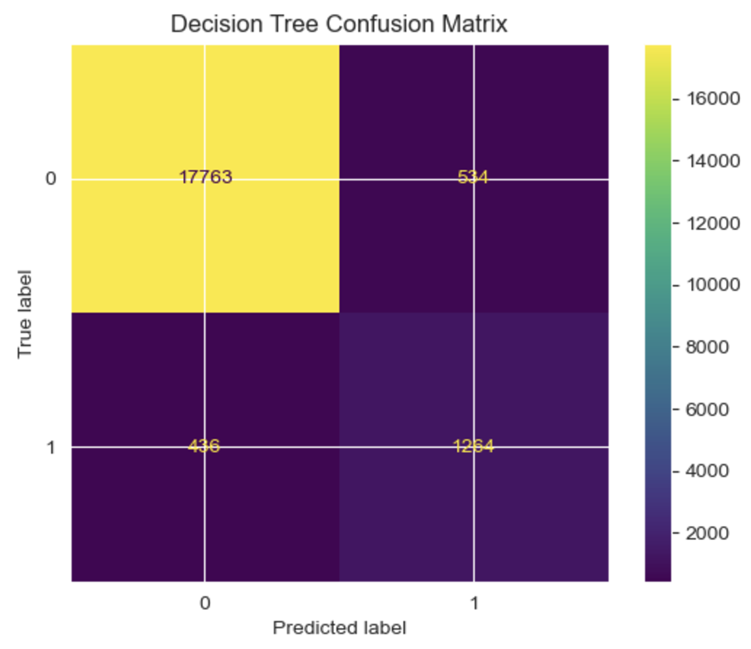
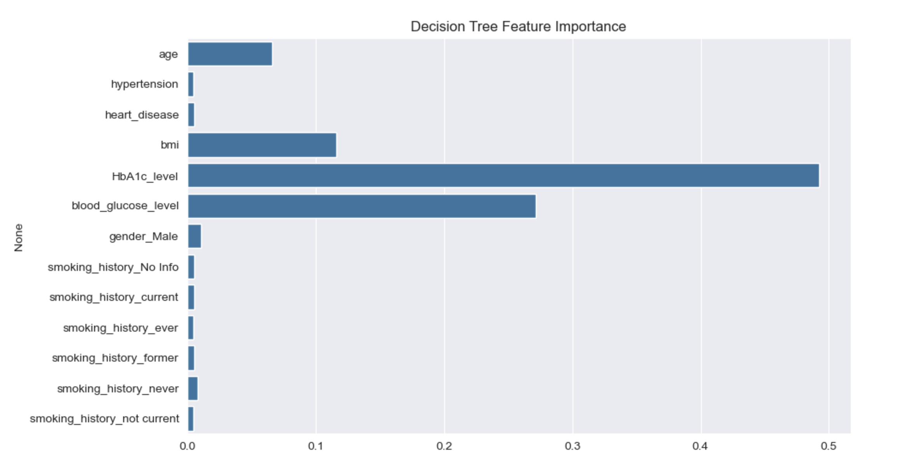

Slide 13
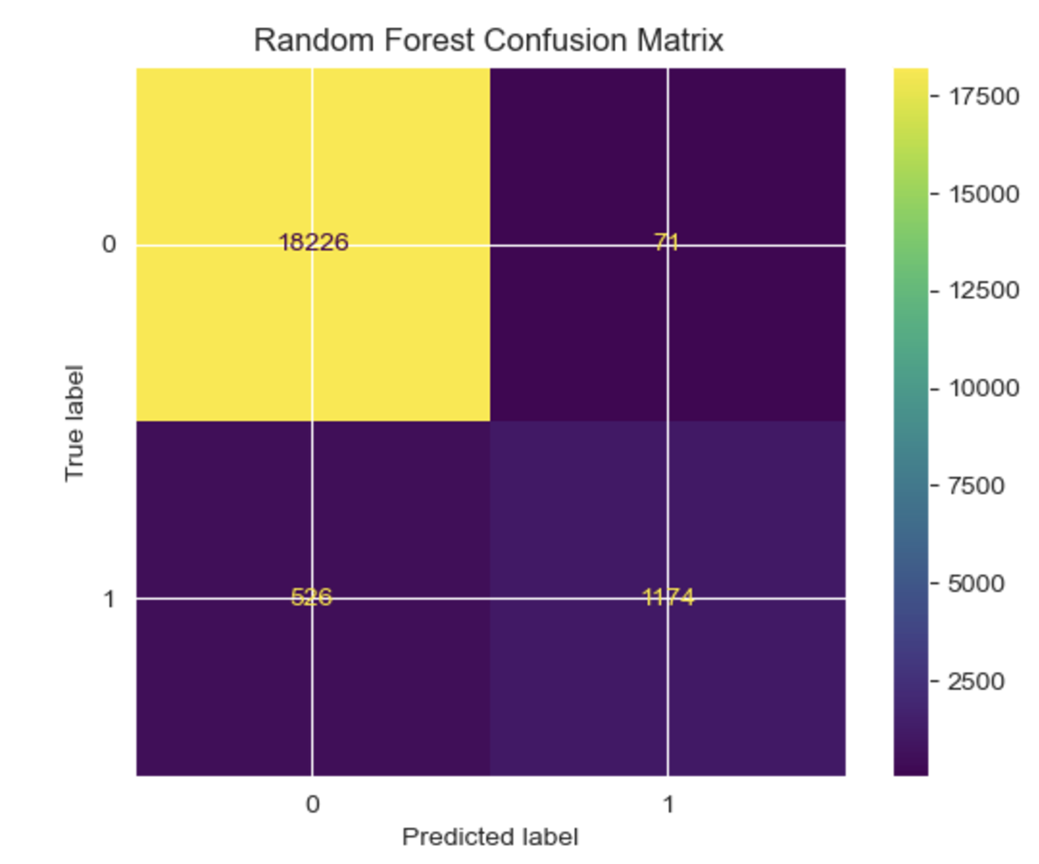
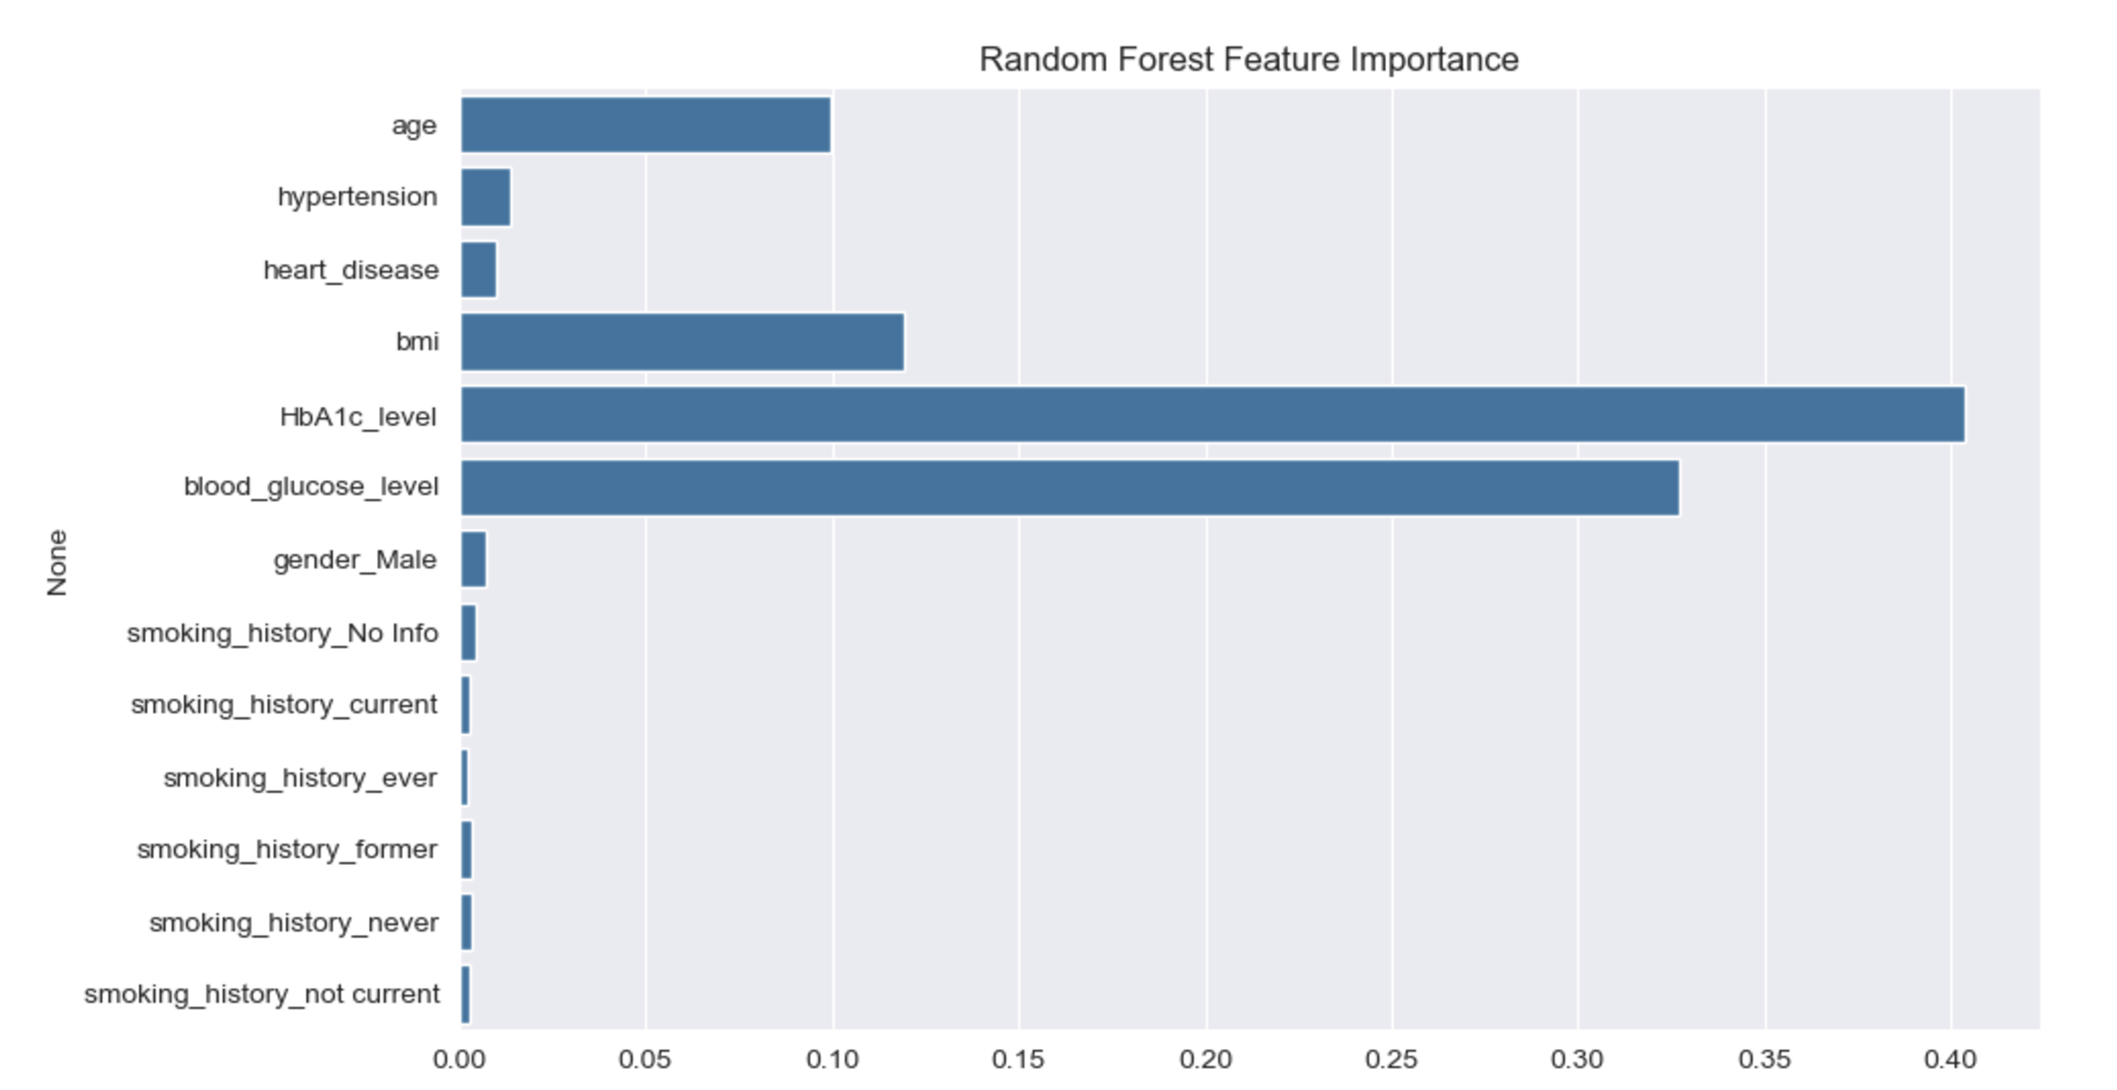

Slide 14
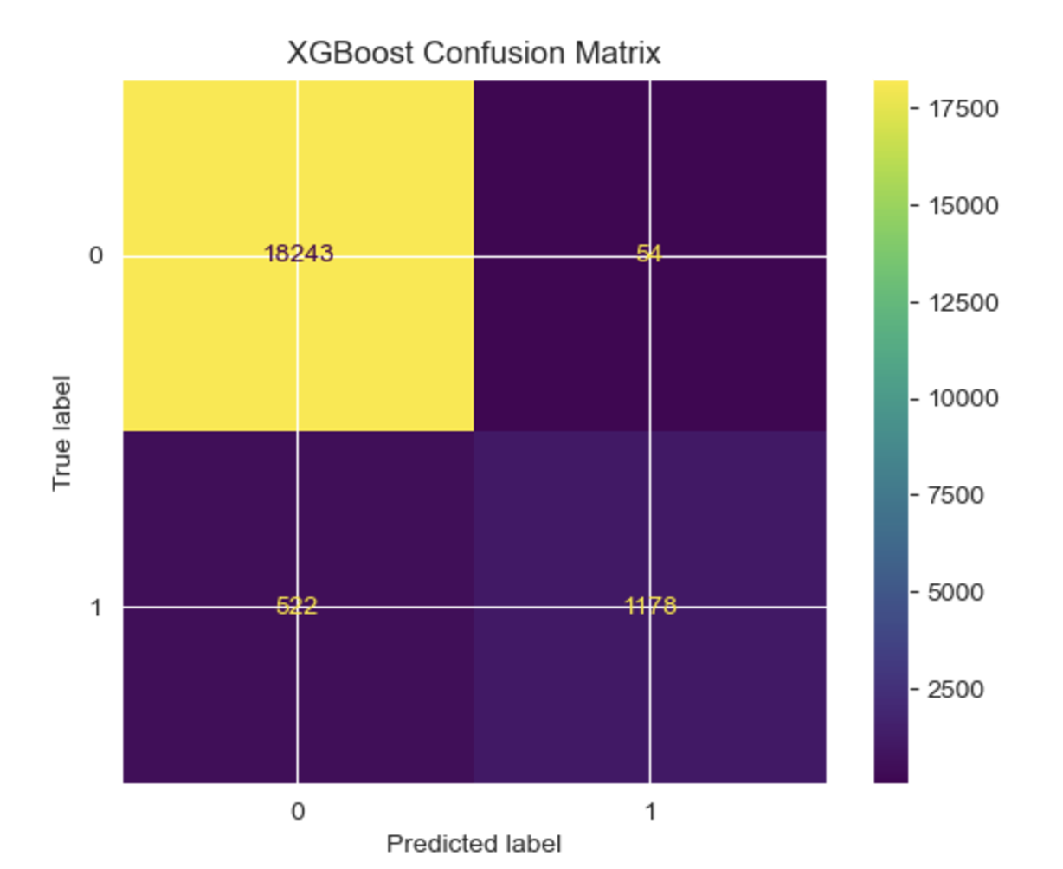
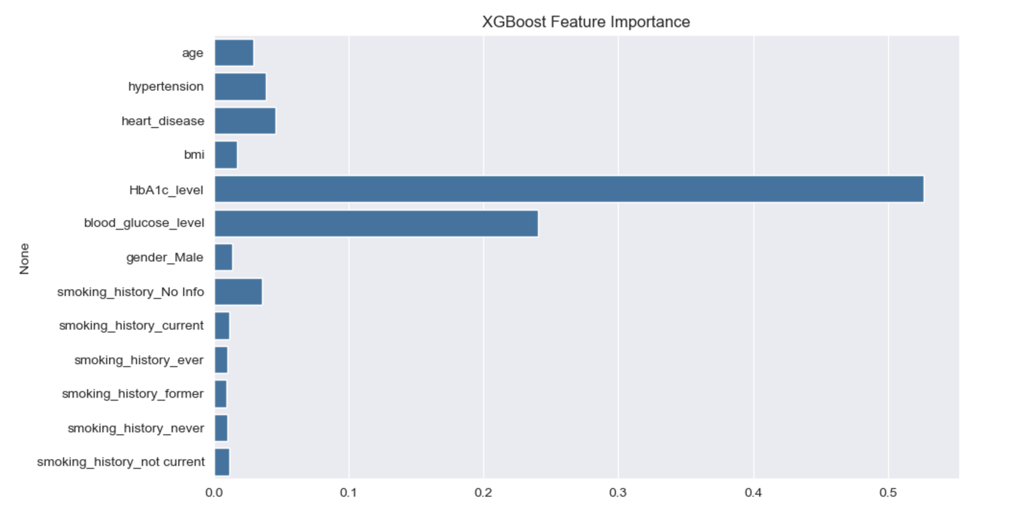

Slide 15

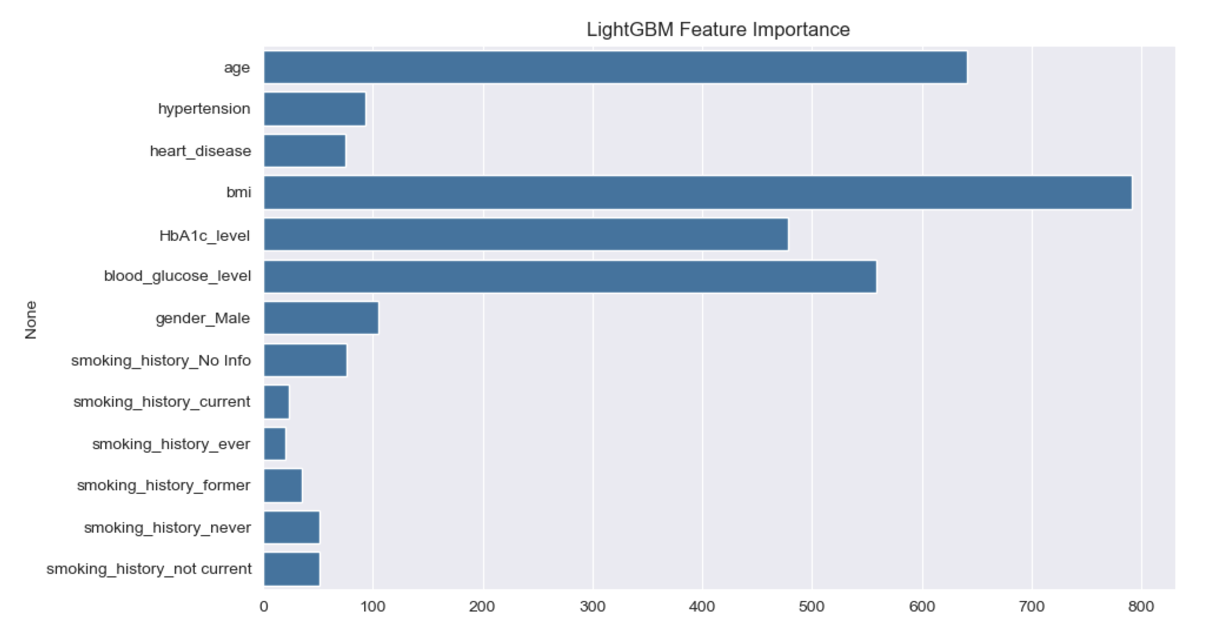

Slide 16
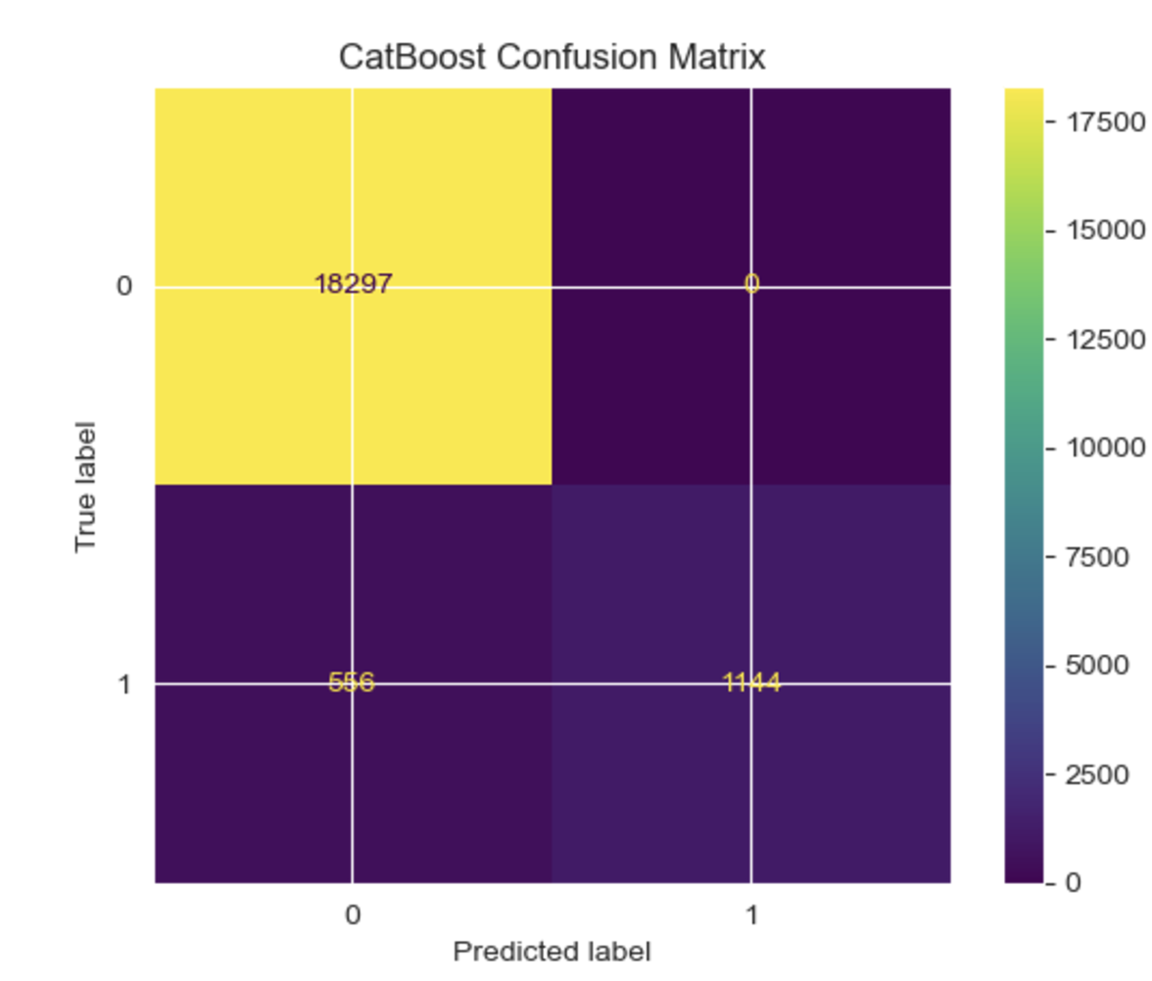
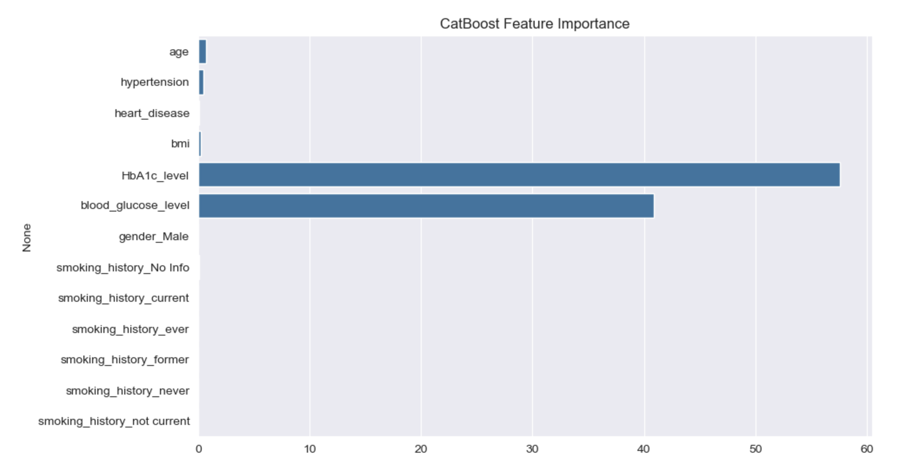

Slide 17
Decision Tree:
Despite having the lowest overall performance, it excelled in recall (0.7435), indicating effectiveness in identifying positive instances. However, lower precision (0.7030) and F1 score (0.7227) impacted its overall ranking. CV accuracy (0.9519) was relatively lower than other models.
Random Forest:
Demonstrated strong, consistent performance across all metrics, with high precision (0.9430) and an excellent ROC AUC (0.9632). Its CV accuracy (0.9699) reflects reliability and stability across different validation folds.
XGBoost:
Achieved solid performance with precision (0.9562) and a high ROC AUC (0.9783). Its F1 score (0.8035) was similar to LightGBM, and CV accuracy (0.9710) shows robustness in cross-validation, making it a dependable model.

Slide 18
CatBoost:
Excelled in precision with a perfect score (1.0) and had high CV accuracy (0.9718). However, its lower recall (0.6729) impacted the F1 score (0.8045). Despite this, it closely matched LightGBM in overall performance metrics.
LightGBM:
Outperformed other models, achieving the highest F1 score (0.8056) and ROC AUC (0.9792). Its CV accuracy (0.9717) confirms consistent performance across validation folds. Balanced precision (0.9655) and recall (0.6912) made it the best model overall.

Slide 19
F1 Score and ROC AUC:
LightGBM led with the highest F1 score (0.8056) and ROC AUC (0.9792), making it the most balanced classifier. CatBoost’s similar F1 score (0.8045) and slightly lower ROC AUC (0.9580) placed it as a strong contender.
Precision:
CatBoost achieved perfect precision (1.0), indicating zero false positives. LightGBM (0.9655) and XGBoost (0.9562) also performed exceptionally well, ensuring accurate positive predictions across validation sets.
Recall:
The Decision Tree model had the highest recall (0.7435), effectively capturing true positives but at the cost of lower precision. CatBoost and LightGBM had lower recall, impacting their F1 scores despite high precision.

Slide 20
Conclusion
LightGBM and CatBoost were the best-performing models for diabetes prediction in this study.
LightGBM achieved the highest F1-score and ROC-AUC, making it the most reliable model for predicting diabetes risk.
CatBoost demonstrated excellent precision but had slightly lower recall, leading to a slightly lower F1-score compared to LightGBM.

Slide 21
Both Random Forest and XGBoost performed reliably but did not surpass LightGBM in terms of F1-score and ROC-AUC.
Feature importance analysis identified HbA1c levels and Blood Glucose Levels as the most critical factors in predicting diabetes risk.

Slide 22
References
G. Kesavaraj and S. Sukumaran, “A study on classification techniques in data mining,” in 2013 Fourth International Conference on Computing, Communications and Networking Technologies (ICCCNT), Jul. 2013, pp. 1–7. doi: 10.1109/ICCCNT.2013.6726842
Y. Yang, X. Liu, and Q. Li, “Machine Learning for Predicting Diabetes: Advances and Future Directions,” J. Healthc. Inform. Res., vol. 2, no. 3, pp. 45–58, 2018.
A. Alghamdi, S. Alshammari, and R. Khan, “Logistic Regression in Predicting Diabetes Using PIMA Dataset,” Int. J. Artif. Intell. Res., vol. 5, no. 1, pp. 23–30, 2020.

Slide 23
P. Kukreja and A. Vashisht, “Decision Trees for Diabetes Prediction: Strengths and Weaknesses,” Data Sci. Appl. J., vol. 4, no. 2, pp. 95–102, 2019.
R. Tirthapura, V. Singh, and M. Rao, “A Comparative Analysis of Random Forest and Gradient Boosting in Healthcare Predictions,” in Proceedings of the IEEE Conference on Data Science, 2021, pp. 457–468.
X. Zhang, H. Wang, and Z. Lin, “Gradient Boosting for Predicting Diabetes: A Review of Current Advances,” Mach. Learn. Healthc., vol. 6, no. 1, pp. 89–101, 2022.
R. Gupta, S. Kumar, and M. Shukla, “Support Vector Machines in Medical Diagnoses: The Case of Diabetes,” Biomed. Eng. Insights, vol. 8, no. 3, pp. 112–121, 2020.
M. Al-Rakhami, S. Al-Amir, and M. Al-Mohanna, “Deep Learning in Diabetes Prediction: Achieving Accuracy and Scalability,” Appl. Artif. Intell., vol. 35, no. 4, pp. 178– 192, 2021.
N. Mishra, A. Verma, and K. Choudhary, “Addressing Privacy Challenges in Healthcare Machine Learning Models,” J. Med. Inform. Secur., vol. 9, no. 1, pp. 34–49, 2022

Slide 24
THANK YOU!!

