Slide 1

Image to Code/Compiler
Team- KillDBug
Siddhartha Bajpai
Himadri Nath

Slide 2
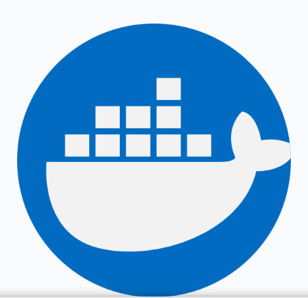
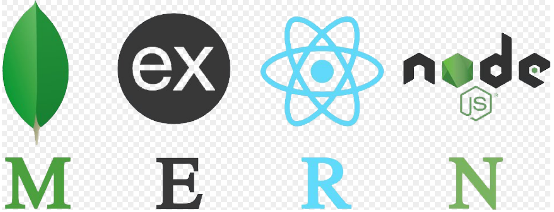

Tools/Technologies Used
1.MERN stack
2.Docker(running code in them)
3.Zeromq(async message queuing library)
4.Azure (for deployment)
5.Postman (for api testing)
6.Android Studio (Android App)

Slide 3
How We Approached the problem
We knew about exec system call that it can be used to run the cli commands through the language of our choice. So in brief I knew how to run the codes on the server. But this might not be that performant and would create some security issues to the server.
We then moved to docker. We ran these codes inside the docker containers , captured the output into a file and read it from server to send the results back to the user. Also after deeply studying the network calls happening over LeetCode.com We figured out that We can optimise the process further for higher concurrent users by splitting the requests over multiple servers through async message queuing using zeromq.

Slide 4
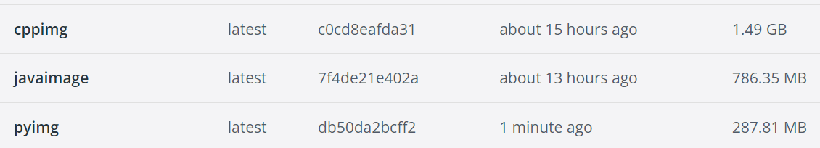
Compilation service diagram
6
8
INPUT.TXT
FILE COPIED
CONTAINER SPUN-UP
THE CODE IS RUN ON CUSTOM MADE LIGHTWEIGHT IMAGES
WHICH READ BOTH INPUT AND CODE FILES AND SAVES IT TO LOG.TXT
2
The log.txt is read on the host server
Created
1
REQ
3
9
FILE COPIED
Created
7
The container is then stopped and killed
CODE AND INPUT
CODE.PY
5
4
LANGUAGE
CPP
JAVA
PYTHON
DOCKER IMAGES

Slide 5
Compilation Service Diagram Details
According to request the input file and code files are generated
According to the language given by the user, the custom made docker container is spun up with a unique id assigned.
The filenames are concatenated with containers uid to copy them to that particular container(Example uid:123 , files File123.cpp, Input123.txt,container: 123)
Then when the files are ready they are compiled inside the container and the output is stored on a log.txt file.
Now this log.txt is read(tailed) on to server and the read data is sent for response
The docker containers are then stopped and killed.

Slide 6
Scalability
I was done with the basic prototyping of the app and it worked fine. Now scalability was the next target. While analysing the coding platforms Like Leetcode in their network tab, I found out that they are once registering their code on the server and keep on hitting the server till they get any response.
This pushed me to look into any async message queue distribution service. I used a library zeromq for that purpose and distributed the inputs over different worker servers. The efficiency might not be seen at lower concurrencies but at higher ones it works efficient whereas older approach bottlenecks.

Slide 7
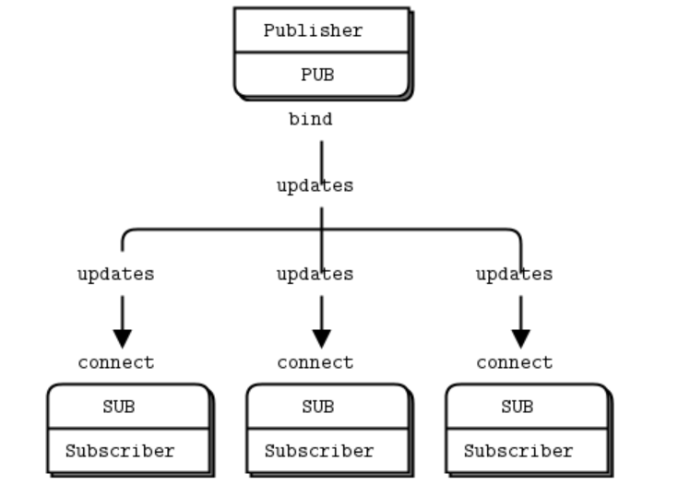
Scalable architecture(zeromq)
server receives the code and input files
/Check endpoint keeps hitting the database to check whether their code is compiled or not till now
output
Worker
With compilation services
Worker
With compilation services
Worker
With compilation services
mongoDb Database
Stores the outputs on database

Slide 8
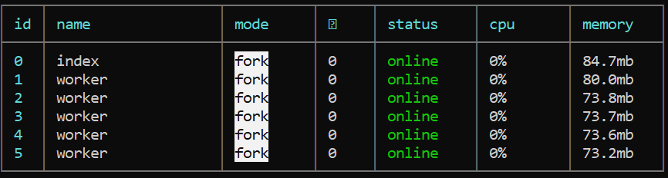
Scalable architecture
The architecture designed is like a master-slave relation where server distributes the calls to each of the worker servers equally.here all the workers are on same machine but they can be individual machines too. Thus it will help a lot in scaling up the app increasing the concurrency of the whole api.
Pm2 list of all the servers running on the System
These workers after compiling the code store the output on the database. For this whole distribution ZEROMQ library helped.

Slide 9
Extra Features
Rate Limiting (it is just implemented on the client side only)
Prevention from infinite loops which can degrade the server performance ,implemented using promise race.
Good responsive designed frontend , suitable for all ratios of screens , even phones
Highly Efficient , Takes around 2-4 sec to compile and run your codes even though running on bare minimum specs Virtual Machine
Highly Scalable , the asynchronous message distribution helps maintaining a lot of concurrency and scalability of the platform.
Supports 3 of the most Prominent languages i.e, C++, Java and Python

Slide 10
What have we achieved till now
Till now in the second day of the hackathon we were able to create an api which can receive the language and the piece of code along the inputs and give the out put of the given code just by calling the api.
For the demo and the working of the api we have also create the frontend of the api with react for the compilation of the programs. Later we thought of creating it an application which can read/scan the piece of code from the image and then easily throw out the output of the code scanned.

Slide 11
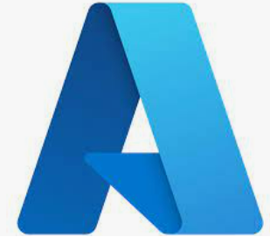
Android Application
As the whole compiler was built and was working fully functional as an api it can be used to work in an android application. The idea is that if we can scan these code we can run our codes on the run by simply writing them on the papers and scanning them.

Slide 12
Future Scopes
The architecture can be highly distributed and modified and the workers (in slide 7) can be more distributed as individual machine services
Rate limiting (over the server side)
Security of end points of the api
Expansion of this tool as a rest api as a service.
The machine specs can be improved to increase the overall performance.
The image to text conversion can also be improved and converted into an android application working and fully functional.

