Slide 1

Detecting Anomalies in Wafer Manufacturing
Siddhartha Guggulotu ME20B167
Karthikeya Putumbaka ME20B140
Shital Siddhagavali ME20B166
Srinivas Chowdary Ramineni ME20B174
Group 10

Slide 2
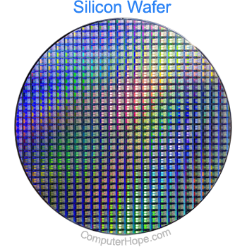
Introduction
In the world of semiconductor fabrication, detecting anomalies is crucial for maintaining product quality and performance. Anomalies, whether in the manufacturing process, equipment, materials, or yield, can significantly impact semiconductor devices' reliability. Today, we'll explore the challenges, types of anomalies, and data-driven solutions that play a vital role in ensuring the precision and quality of wafer manufacturing.

Slide 3
Wafer manufacturing process
Silicon Ingot Growth (crystal imperfections)
Ingot Grinding and Polishing (surface defects)
Wafer Slicing (chipping or cracking)
Surface Treatment (etching irregularities)
Photolithography (uneven patterns)
Ion Implantation
Thin-Film Deposition (contamination during deposition)
Chemical Mechanical Polishing (variability in planarization)
Wafer Cleaning (incomplete cleaning)
Inspection and Quality Control
Backside Grinding (Thinning)
Die Separation (Wafer Sawing)
Packaging
Final Testing (electrical performance testing)
Sorting and Marking
Finished Product

Slide 4
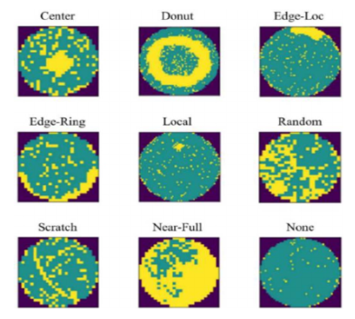
Types of Anomalies
Green: no deviation
Yellow: anomaly
The algorithm classifies each wafer image into one of the nine classes
Defect Classes:
Domain experts defined nine different defect classes.
172,950 (21.3%) of the wafers are manually labeled.
Imbalanced distribution with "None" defect class making up 85.2%.
Other defect classes include Center (2.5%), Donut (0.3%), Edge-Loc (3.0%), Edge-Ring (5.6%), Local (2.1%), Random (0.5%), Scratch (0.7%), and Near-full (0.1%).

Slide 5
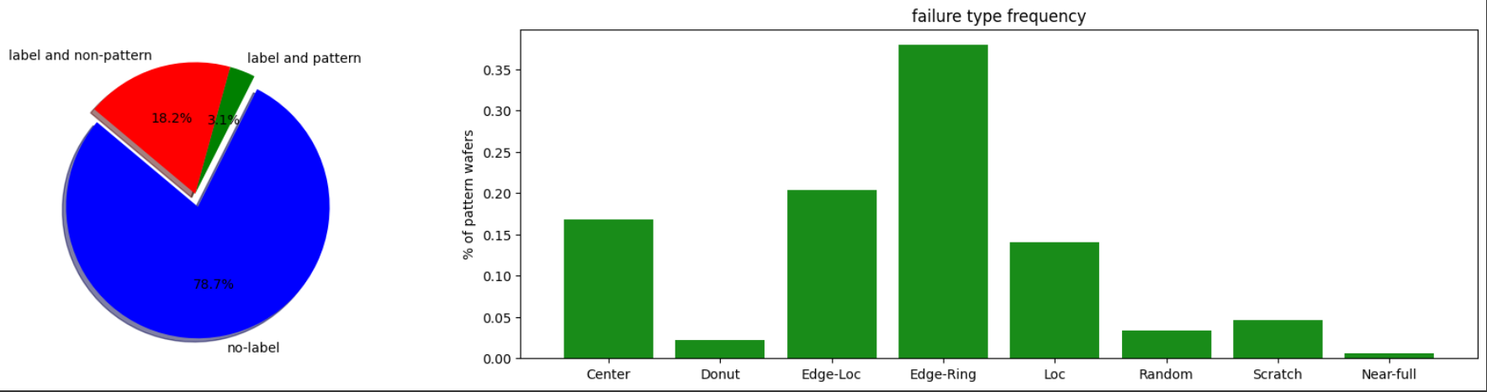
The Dataset

Slide 6
The Dataset
Dataset Overview:
The WM-811K dataset consists of 811,457 real wafer images from semiconductor fabrication.
Collected from 46,293 lots in a circuit probe (CP) test process.
Each lot should contain 25 wafers, resulting in a total of 1,157,325 wafers.
Data Pruning:
Some lots were pruned due to sensor faults or unknown reasons, resulting in the available dataset.
Additional information provided for each wafer, including lot name, die size, wafer index number, failure types, and training/test labels.
Image Sizes:
The dataset contains various wafer image sizes, ranging from (6×21) to (300×202).
Variability due to the two-dimensional nature and pixel values along the length and width.

Slide 7
Data Preprocessing
Data Augmentation:
To address the class-imbalance problem, data augmentation techniques were applied.
Augmentation methods included random rotation of 10 degrees, horizontal flipping, width shift, height shift, shearing range, channel shifting, and zooming by 20%, 20%, 15%, 10%, and 10%, respectively.
Increased Minority Data:
Data augmentation increased the size of minority data sample classes significantly.
Classes like Center, Donut, Edge-Loc, Local, Random, Scratch, and Near-Full saw size increases of up to 66% from the original data.
The new dataset now consists of 90,000 wafer defect images with a balanced distribution of nine different classes, each containing 10,000 data samples.
Dataset Split:
The dataset was divided into training (65%), validation (20%), and testing (15%) subsets.

Slide 8
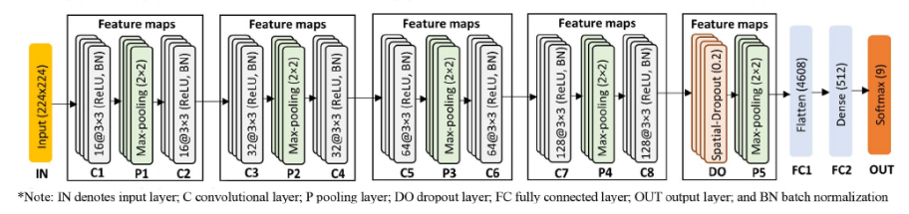
Algorithm
Convolutional Neural Network (CNN) utilized for image classification.
Supervised learning approach with labeled data.
Model Architecture:
CNN architecture with multiple convolutional and dense layers.
Rectified Linear Unit (ReLU) activation functions used.
Softmax activation for multi-class classification. Performance Evaluation:
Model evaluated on the test data to measure accuracy.
Confusion matrix, precision, recall, and F1-score assessed.
Visualization:
Feature map visualization at various convolutional layers.
Interpretation of model's response to input images.

Slide 9
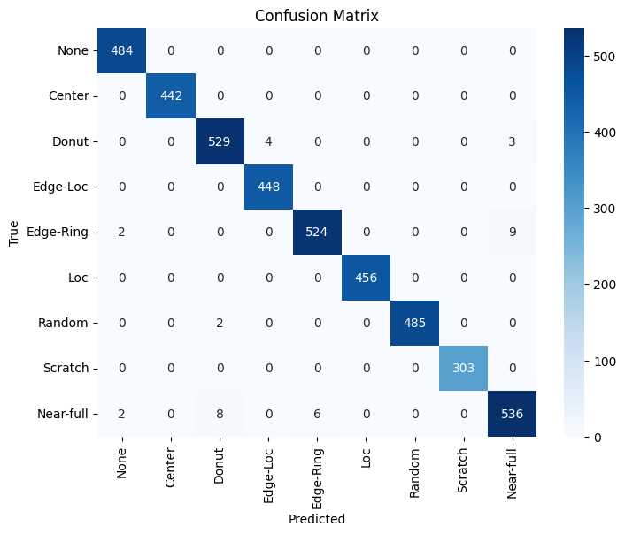
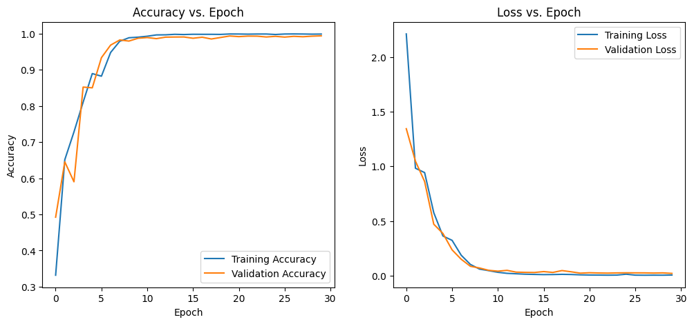
Performance Metrics

Slide 10
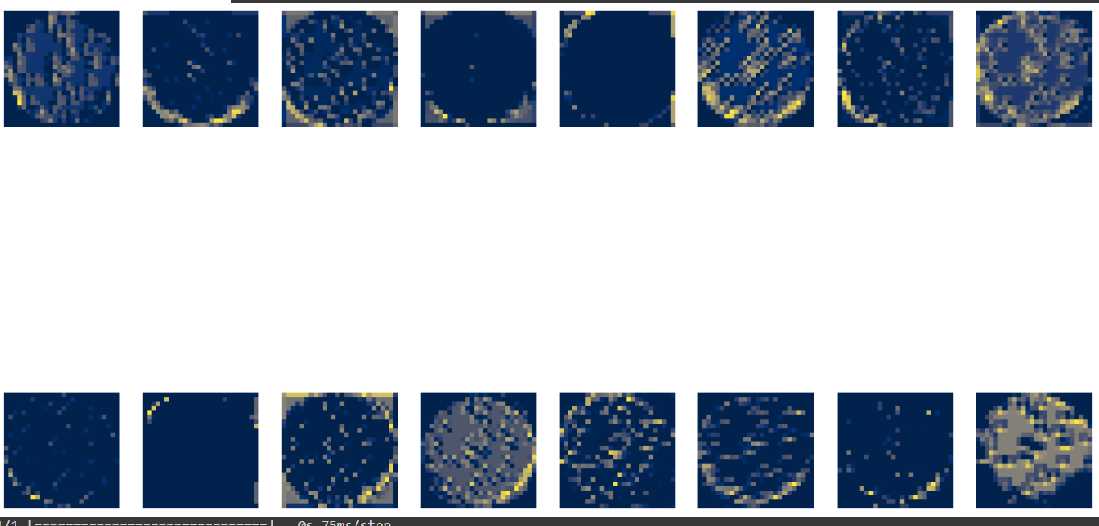
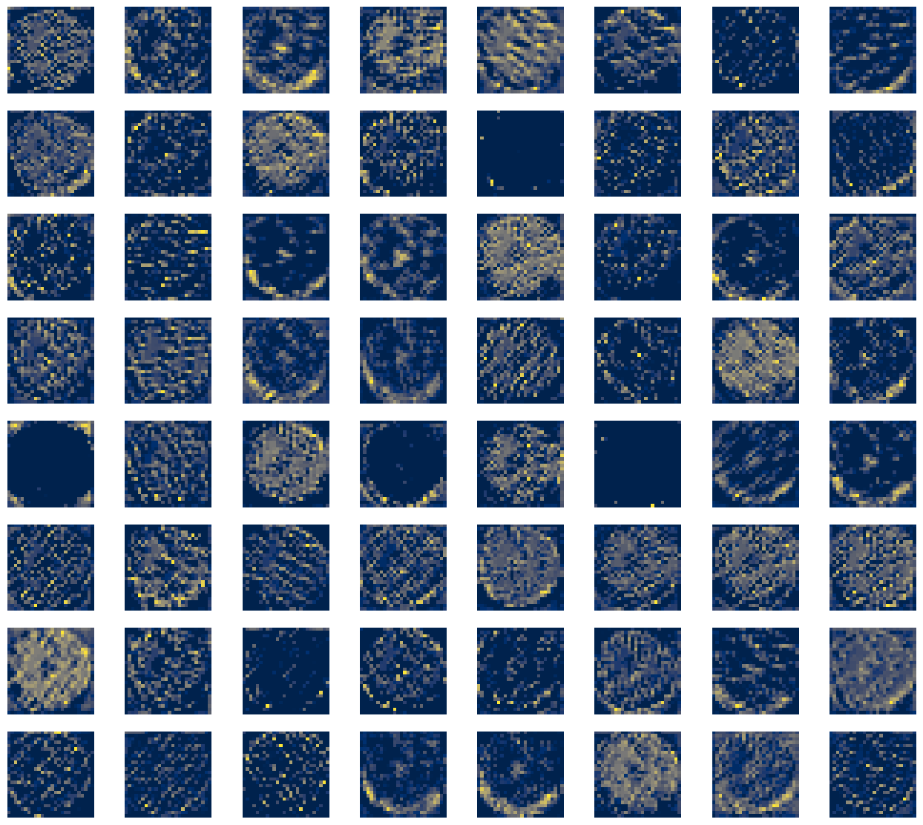
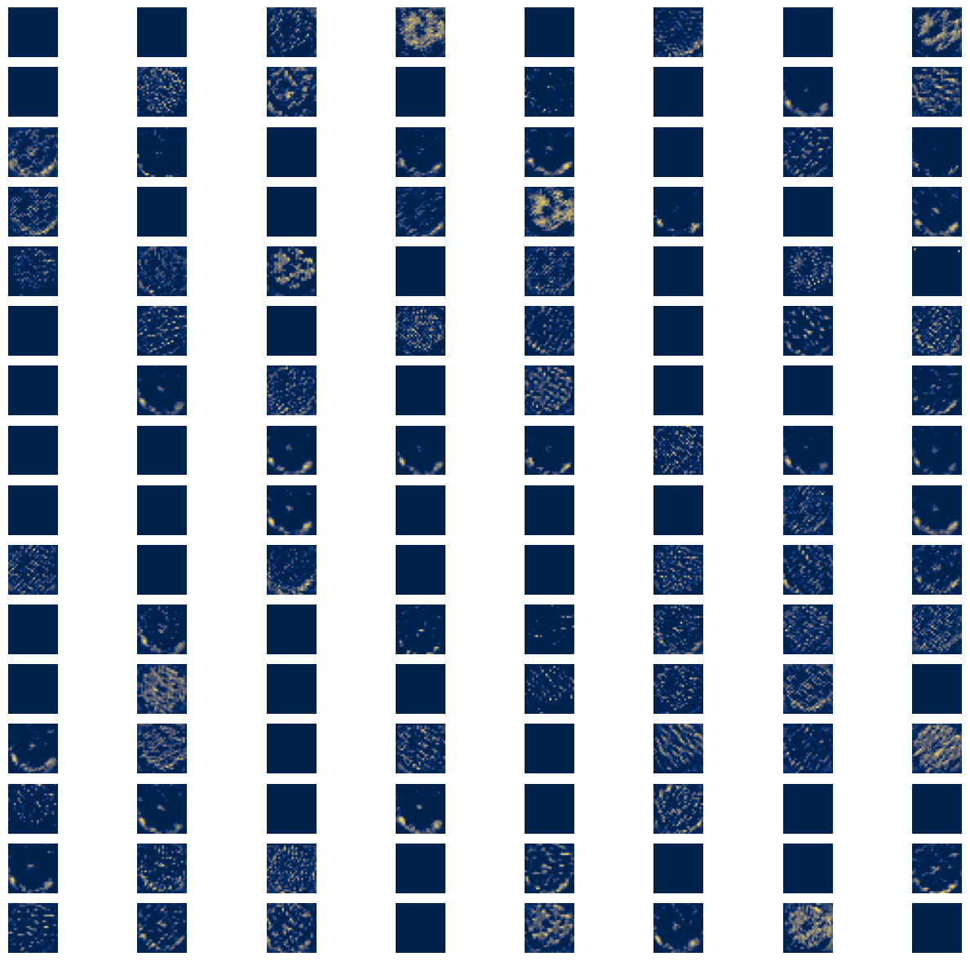
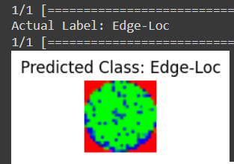
Simulation

Slide 11
Future Scope (reference)
Additional Data Sources:
Incorporate diverse and larger datasets to expand the model's knowledge.
Address challenges related to data collection and labeling.
Real-Time Classification:
Adapt the model for real-time image classification applications.
Explore edge computing and deployment on resource-constrained devices

