Slide 1
CS 5368 Intelligent Systems
Department of Computer Science
Texas Tech University
Network Intrusion Detection System using
Machine Learning Algorithms
Instructor: Jingjing Yao
Teaching Assistant: Amir Faiyaz
Siddhartha Bollam – R12071309 Varshitha Chowdary Thella – R12064879

Slide 2
Background
Why Network Intrusion Detection Systems Matter
Global losses from cybercrime were forecast to be $8 trillion in 2023 and are expected to increase to $13.82 trillion by 2028. This extent of harm demonstrates that cyber incidents are significant organizational risks with grave financial repercussions rather than isolated technological issues.
The number of cyberattacks is likewise unrelenting, with one recorded every 39 seconds. In reality, this means that companies must function under the assumption that intrusion attempts are inevitable.
Prevention is insufficient on its own because attacks are expensive and ongoing. Therefore, early detection of harmful activity is essential for effective protection.
This function is carried out by a Network Intrusion Detection System (NIDS), which continuously analyzes network traffic, detects unusual activity, and promptly issues alarms. NIDS helps lessen the chance that an intrusion will develop into a serious breach by facilitating earlier detection and quicker action.

Slide 3
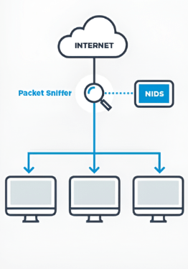
Project Definition What is Network Intrusion Detection System ?
Network Intrusion Detection System (NIDS) is a system that monitors network traffic and identifies suspicious or unauthorized activity by analyzing communication patterns within the network.
This project presents a machine learning-based framework for distinguishing normal traffic from intrusive traffic using network data. The workflow includes data preprocessing, feature extraction, and classification to prepare the data for analysis and prediction.
The project focuses on training and evaluating multiple classification models to compare their performance in intrusion detection. The objective is to identify an efficient approach that can effectively classify network behavior and support reliable attack detection.

Slide 4
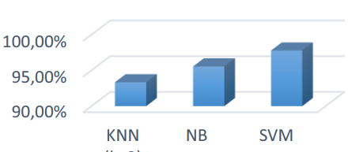
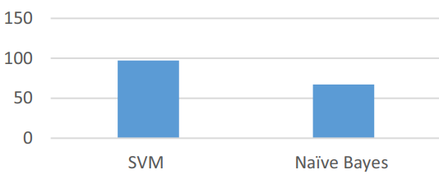
Existing System
The existing work employs benchmark intrusion detection datasets such as UNSW-NB15 and NSL-KDD, in which raw network records are organized into categories including normal, DoS, Probe, R2L, and U2R.
These categorized records are then subjected to machine learning classification algorithms, primarily Support Vector Machine, K-Nearest Neighbor, and Naive Bayes, for the purpose of distinguishing malicious traffic from legitimate traffic.
The performance of the applied algorithms is subsequently compared on the basis of classification accuracy, and Support Vector Machine is reported as the best-performing model among the considered classifiers.
UNSW-NB15 dataset results
NSL-KDD dataset results

Slide 5
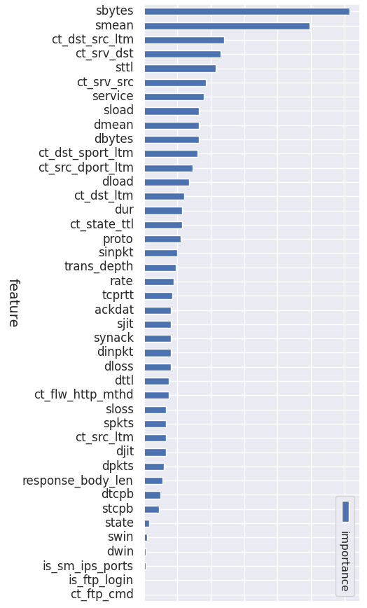
Limitations in Existing Work
The existing work mainly concentrates on classifier-level comparison and final accuracy values, while comparatively limited emphasis is placed on a detailed preprocessing methodology prior to model training.
Important stages such as data cleaning, categorical encoding, feature scaling, class balancing, and feature selection are not presented as a clearly structured core pipeline in the study.
Consequently, although the study identifies the better-performing classifier, it evaluates only a limited number of classifiers for NIDS, which provides less comprehensive insight into model comparison.

Slide 6
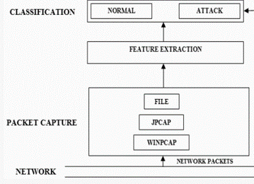
Proposed Work
Our work is based on the same objective of identifying intrusive and normal traffic using machine learning techniques, but it adopts a more comprehensive methodological pipeline before the stage of model comparison.
In our proposed approach, the data is processed through preprocessing, categorical encoding, feature scaling, class balancing, and feature extraction before being subjected to classification.
In addition, our work extends the comparative study by employing a broader range of algorithms, including Naive Bayes, K-Nearest Neighbour, Decision Tree, Logistic Regression, Random Forest, and Support Vector Machine, thereby enabling a more extensive evaluation of model performance.

Slide 7
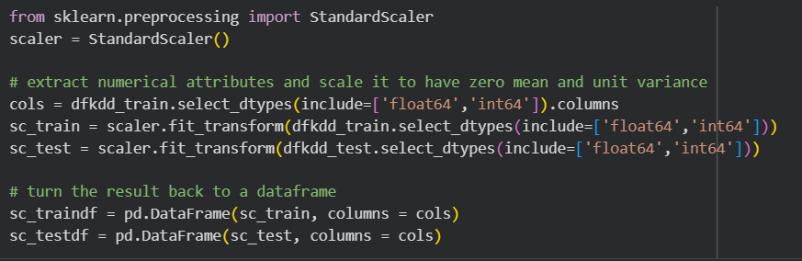
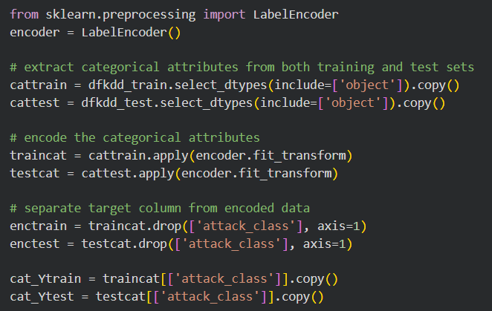
Scaling and Encoding of Attributes
Numerical attributes are scaled using StandardScaler to transform them toward zero mean and unit variance. This helps bring different numeric features to a comparable range for model training.
Categorical attributes are converted into numerical form using Label Encoding. This allows machine learning algorithms to process non-numeric fields such as protocol or service-related values.
After encoding, the target column is separated from the feature set for training and testing. These preprocessing steps make the dataset more suitable for classification in the intrusion detection system.

Slide 8
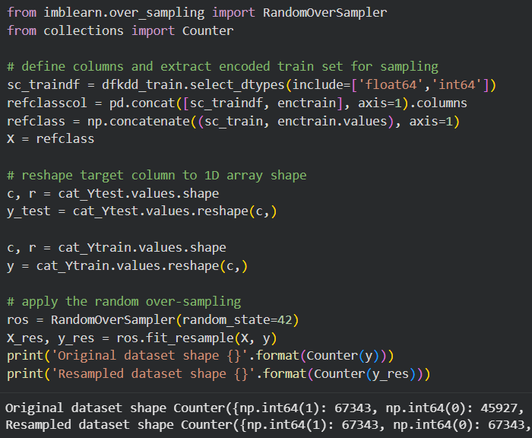
Data Sampling Using Random Oversampling
Random Oversampling is used to solve the class imbalance problem in the intrusion dataset. It increases the number of minority attack samples in the training data.
The method works by randomly duplicating existing instances from underrepresented classes. This helps create a more balanced class distribution for model training.
A balanced dataset reduces bias toward majority classes and improves learning for rare intrusion categories. In this system, oversampling is applied after selecting numerical features and encoding categorical attributes.

Slide 9
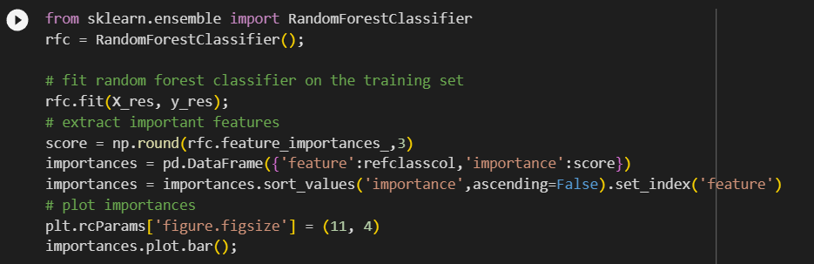
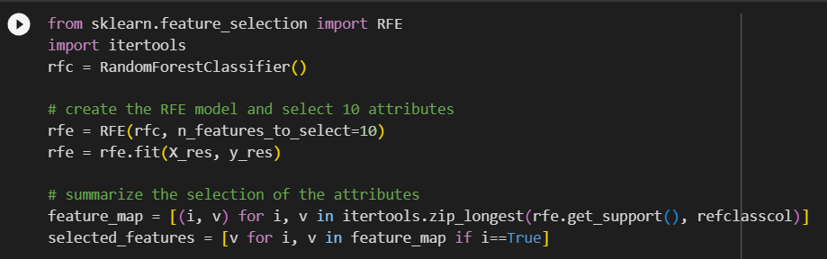
Feature Selection Techniques
Random Forest Feature Importance: The Random Forest classifier ranks features using the feature_importances_ attribute. Features with higher scores contribute more to reducing impurity and improving prediction accuracy.
Recursive Feature Elimination (RFE): RFE selects the best subset of features by repeatedly removing the least important ones. This helps reduce dimensionality and keeps only the most relevant attributes for classification.

Slide 10
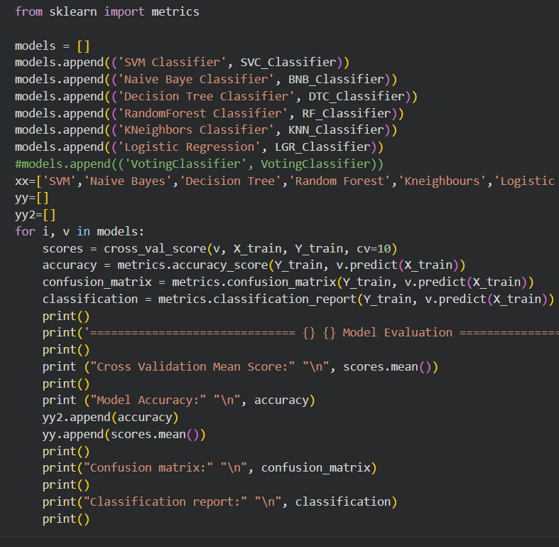
Training and Evaluating Classifiers
Multiple machine learning models—SVM, Naive Bayes, Decision Tree, Random Forest, KNN, and Logistic Regression—are developed to compare classifiers for network intrusion detection. Each model is evaluated using 10-fold cross-validation to assess average performance, ensuring consistency and reliability.
Accuracy, confusion matrix, and classification report are computed for each model to analyze prediction quality and effectiveness in detecting attacks. Finally, accuracy scores are compared to identify the best-performing classifier, supporting the selection of the most suitable model for the NIDS system.

Slide 11
Simulated Results
UNSW_NB15 Dataset
NSL-KDD Dataset

Slide 12
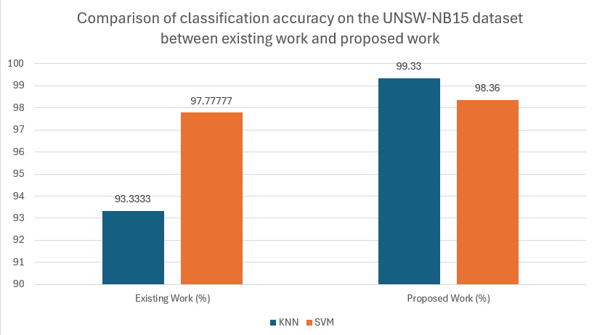
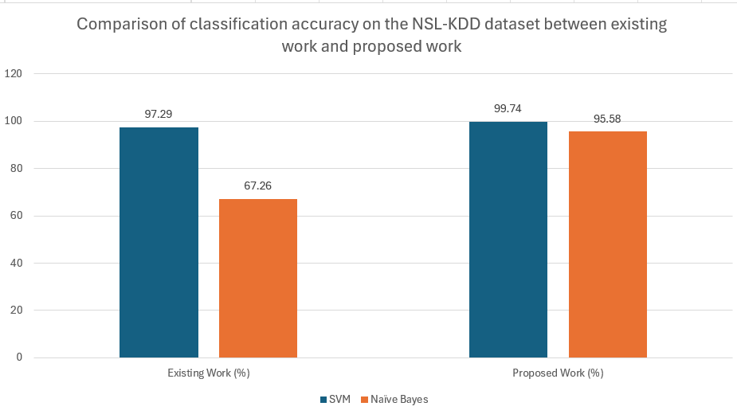
Existing work vs Proposed work
UNSW_NB15 Dataset
NSL-KDD Dataset

Slide 13
THANK YOU

