Slide 1
STOCK price PREDICTION
Presented By : Sahil Raza(22BCT10012)
Shresth(22BCT10013)
Krish Tyagi(22BCT10014)
Siddharth Aasal(22BCT10056)
Priyanshu Yadav(22BCT10057)

Slide 2
INTRODUCTION
Stock market prediction and analysis are some of the most difficult jobs to complete. There are numerous causes for this, including market volatility and a variety of other dependent and independent variables that influence the value of a certain stock in the market. These variables make it extremely difficult for any stock market expert to anticipate the rise and fall of the market with great precision.

Slide 3
Techniques & Models used
01
02
03
Simple moving averages
EXPONENTIAL moving averages
Statistical Model
Statistical Model
LSTM
Machine Learning Model

Slide 4
KEY FEATURES
Simple Moving Average is the average price over the specified period. We have implemented SMA for 100 day period.
An Exponential Moving Average is a type of moving average (MA) that places a greater weight and significance on the most recent data points.
LSTM is a RNN with special network structure with three “gate” structures. The three gates in an LSTM unit, called input gate, forgetting gate and output gate. While information enters the LSTM’s network, it can be selected by rules. Only the information conforms to the algorithm will be left, and the information that does not conform will be forgotten through the forgetting gate..

Slide 5
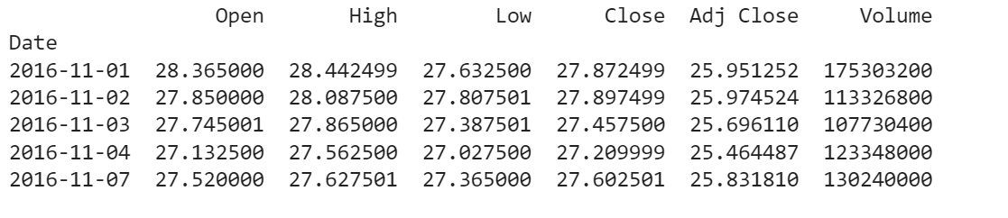
DATASET
The dataset used is of Apple company.
It has been imported from web.
The model has been trained using the “Close” attribute of the dataset.

Slide 6
PROPOSED WORK
Dataset
Pre-processing
Data splitting
LSTM Model Training
Predicted result

Slide 7
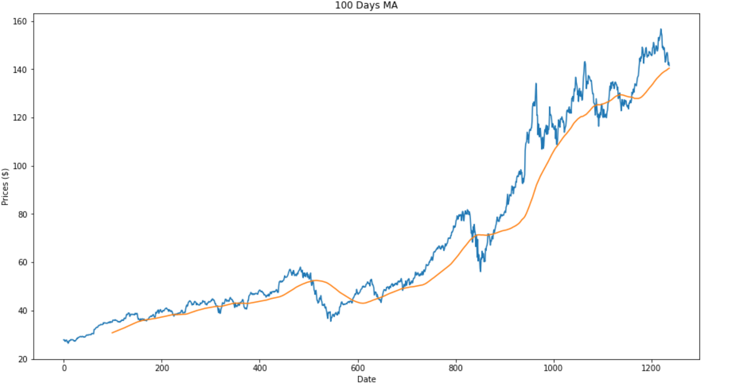
Predicted sma graph
RMSE – 10.17
MAPE – 6.41

Slide 8
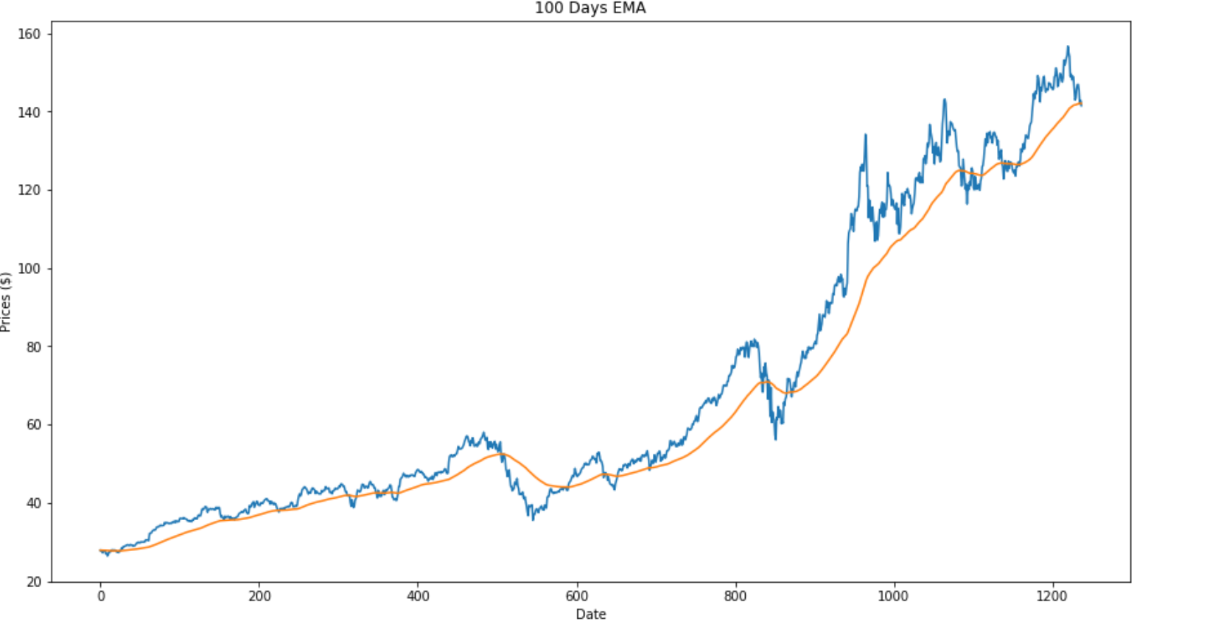
EMA RESULTS
RMSE – 10.06
MAPE – 6.39

Slide 9
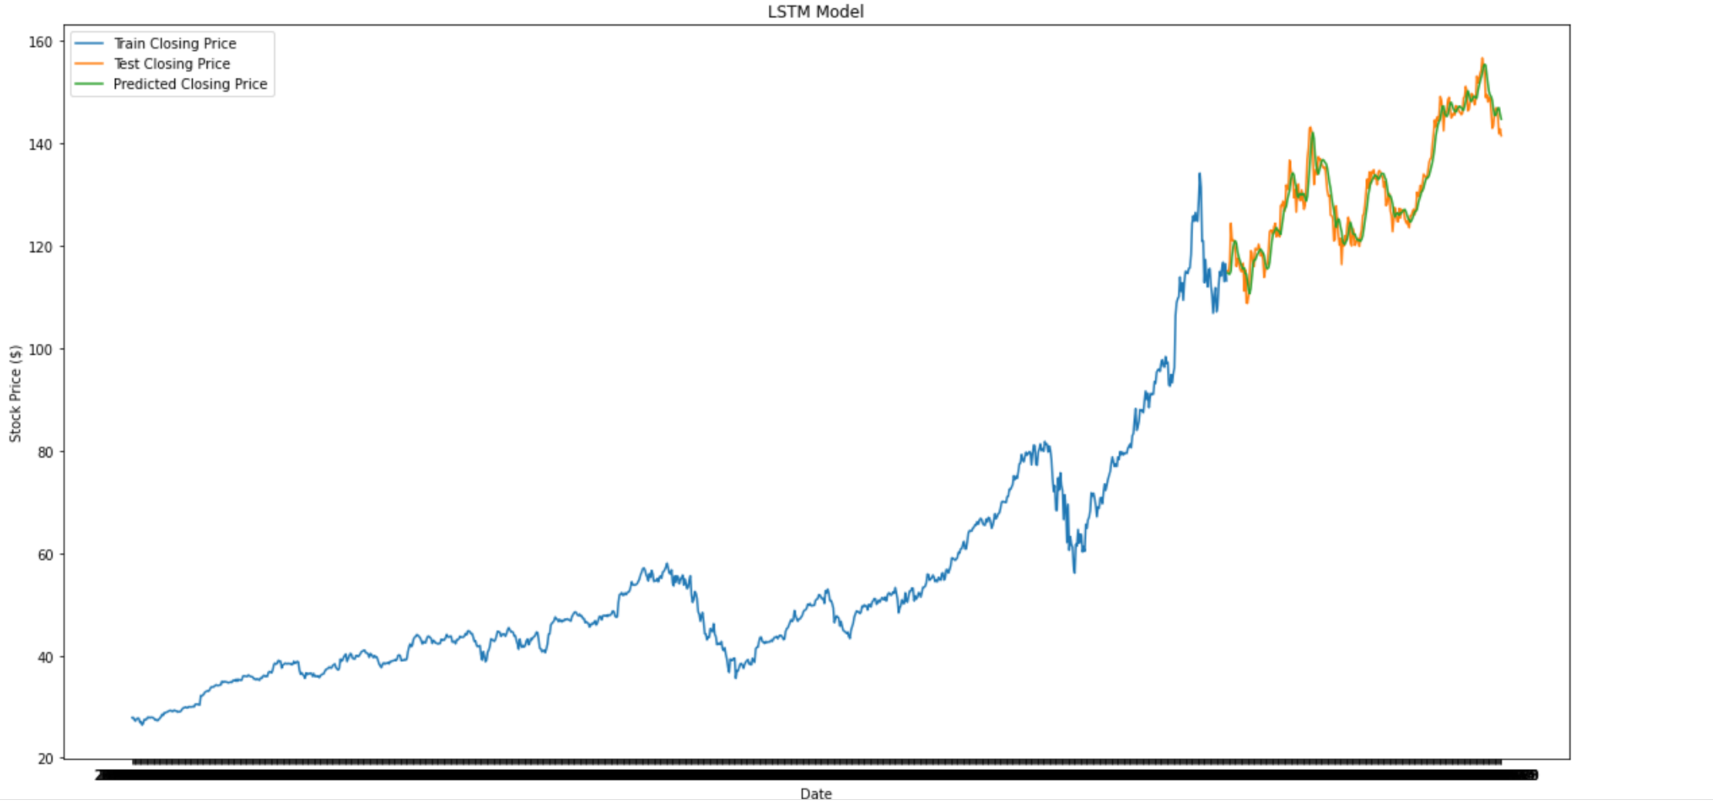
LSTM RESULTS
RMSE – 2.80
MAPE – 1.65

Slide 10
Conclusion and future work
The prices of Apple have been predicted through Simple Moving Averages, Exponential Moving Averages and Long Short-Term Memory models. On comparison the LSTM model showed least error and hence proved itself suitable for stock price predictions.
We will extend this project into a fully-fledged web application.
We will add sentiment analysis as well in the project in addition to the technical analysis for better prediction of the stock prices.

Slide 11
THANK YOU!

