Slide 1
Website Traffic Prediction
Machine Learning Project Presentation
Name : K.Siddhartha
Course : data science
Company : Inno fortune it

Slide 2
Project Objective
To develop a machine learning model that can predict future website traffic based on historical data.
Predict website traffic using machine learning techniques.

Slide 3
Tools and Technologies
Python
Pandas
Numpy
Matplotlib
Scikit-learn
Jupyter Notebook

Slide 4
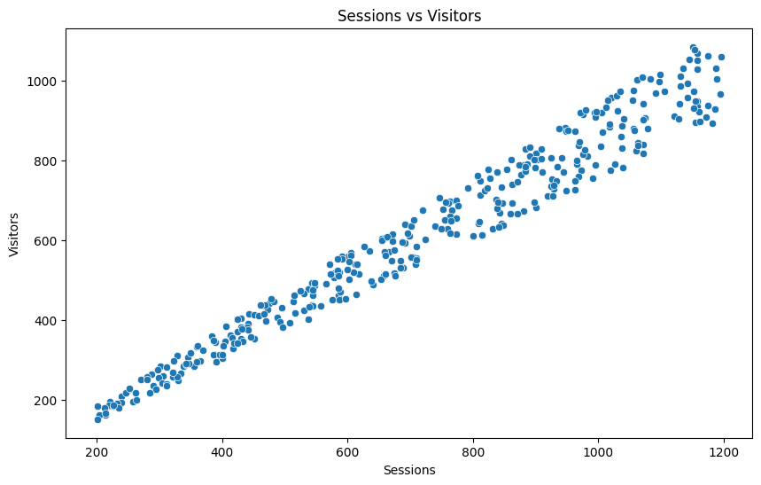
Sessions vs Visitors

Slide 5
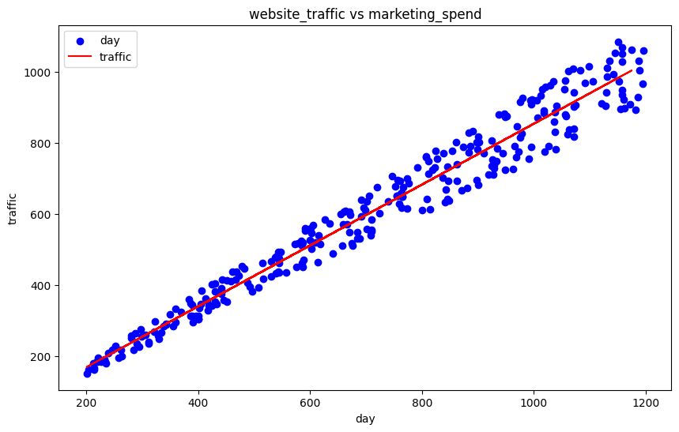
Website Traffic vs Marketing Spend

Slide 6
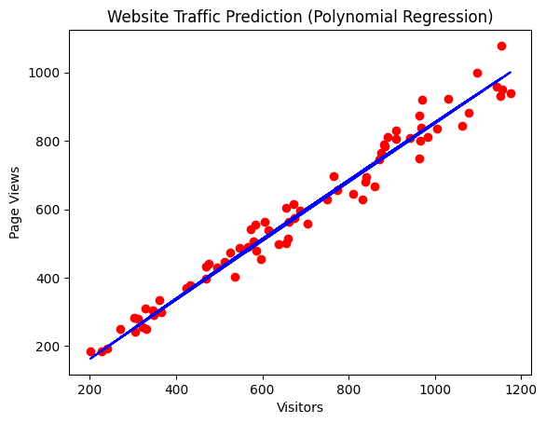
Polynomial Regression Prediction

Slide 7
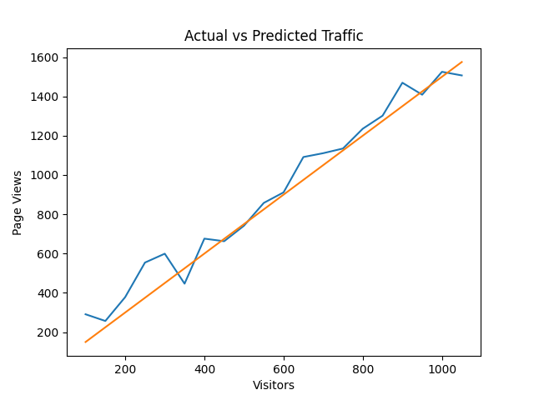
Actual vs Predicted Traffic

Slide 8
Conclusion
The model predicts website traffic trends using machine learning and regression techniques.

