Slide 1

Project Title -Seasonal Agriculture Performance Analysis
Student Name: Siddharth Sanjay Amrutkar
College Name- JSPM,JSCOE,Hadapser
AICTE STU ID : (STU6904e8ac916d21761929388)

Slide 2

PROBLEM STATEMENT
(Agricultural activities are influenced by seasonal variations in environmental conditions, farming practices, resource availability and market conditions. As a result, agricultural performance may differ from one season to another. However, raw agricultural data does not clearly explain how agricultural performance changes across seasons or what patterns can be observed in different seasonal conditions. The problem is to analyze the given agricultural dataset and investigate seasonal differences in agricultural performance by identifying meaningful patterns, trends, relationships and variations within the available data.

Slide 3
Project Description
Seasonal Agriculture Performance Analysis
This project analyzes agricultural activities across different seasons, geographical areas, and farming conditions.
The dataset contains information about:
Farming practices
Environmental conditions
Crop production
Resource usage
Economic performance
The main aim is to identify seasonal patterns, trends, relationships, and variations in agricultural performance.
The project involves data cleaning, analysis, statistical techniques, visualization, and interpretation.
The final results can provide data-driven recommendations for better seasonal agricultural planning.

Slide 4

WHO ARE THE END USERS?
👨‍🌾 Farmers – To understand seasonal performance and improve farming decisions.
🌾 Agricultural Planners – To support better seasonal agricultural planning.
🏛️ Government & Agricultural Departments – To understand regional and seasonal agricultural trends.
📊 Agricultural Analysts – To analyze patterns and relationships in agricultural data.
🔬 Researchers & Students – To study seasonal variations and develop further insights.

Slide 5

Technology Used
Google colab
Python – Data analysis and processing
Pandas – Data cleaning and manipulation
NumPy – Numerical calculations
Matplotlib / Seaborn – Data visualization

Slide 6
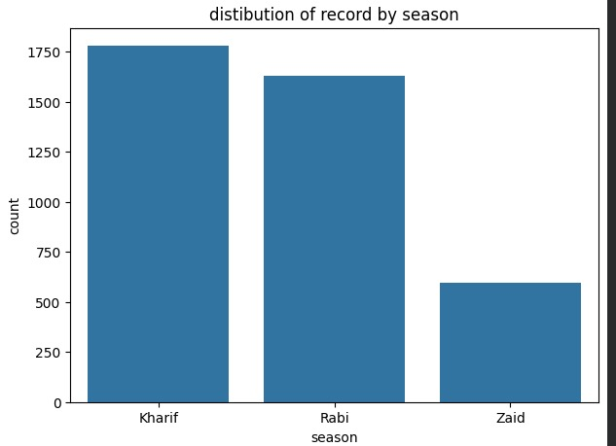
RESULTS

Slide 7
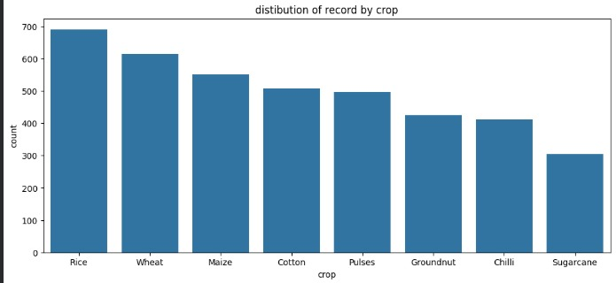
RESULTS

Slide 8
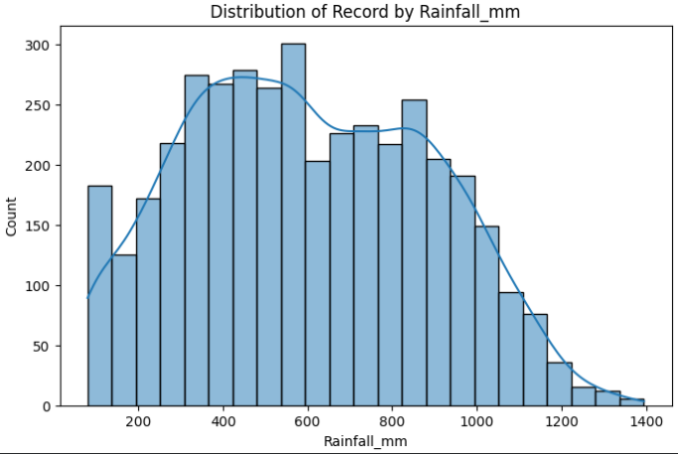
RESULTS

Slide 9
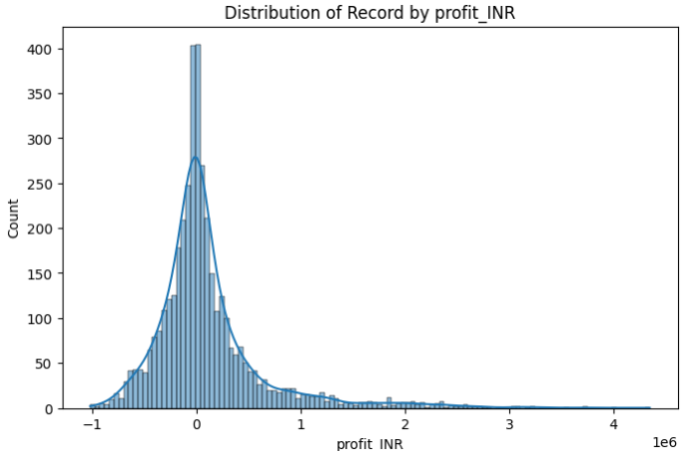
RESULTS

Slide 10
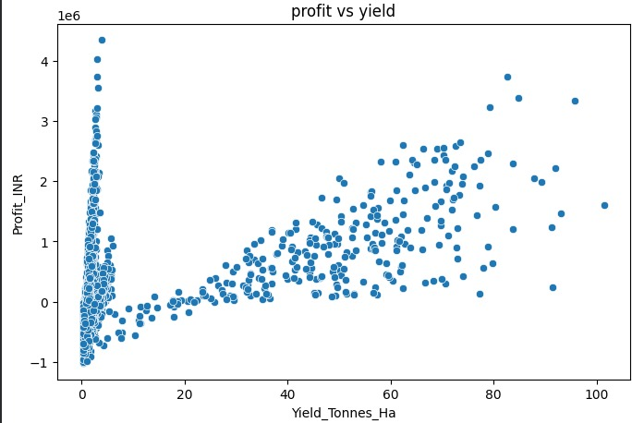
RESULTS

Slide 11
Future scope
Develop AI/ML models to predict agricultural performance.
Predict crop performance for upcoming seasons.
Provide early warnings about unfavorable seasonal conditions.
Analyze larger datasets from multiple regions.
Integrate real-time weather and environmental data.
Develop a dashboard/mobile application for farmers and agricultural planners.
Use historical data to recommend better resource allocation.
Extend the system to support data-driven agricultural decision-making.

Slide 12
GitHub Link
https://github.com/siddharthamrutkar2005/Seasonal-Agriculture-Performance-Analysis.git

Slide 13

VOIS Course completion certificate -
Course name- Data Visualization

Slide 14
Thank you
.
.

