Slide 1


Regime-Sensitive Assessment of Wholesale Electricity Price Risk in New Zealand Hydro-Risk Price Forecasting Model
Master of Analytics (Business) Paper Code: 115.801
Siddharthan Muthukumaran Student ID: 25007430
Supervisor: Dr. Shafiq Alam Organisation: Wellington Electricity

Slide 2
Research Context: Hydro-Dominated Electricity Markets
• New Zealand’s electricity market is structurally hydro-dominated • Hydro storage functions as an intertemporal economic resource shaping marginal price formation • Sustained low-storage (dry-year) conditions coincide with structural wholesale price spikes • Existing monitoring frameworks focus on averages, not regime shifts • Extreme price risk remains insufficiently quantified

Slide 3

Decision-Making Problem
Electricity retailers in New Zealand face material procurement cost exposure during hydro scarcity regimes.
• Wholesale price behavior becomes non-linear as storage approaches scarcity thresholds • Regime transitions are not formally detected within conventional monitoring frameworks • Extreme tail risk is insufficiently integrated into operational risk management
How can hydro storage indicators be systematically transformed into early-warning signals for extreme wholesale price risk?

Slide 4
Research Objectives & Hypotheses
Research Objectives
• Identify whether hydro storage functions as a regime-switching variable • Quantify non-linear price sensitivity under scarcity • Measure extreme tail risk under low-storage conditions • Develop an early-warning framework for operational decision-making
Hypotheses
H1: Wholesale price sensitivity increases non-linearly as storage declines
H2: Low-storage regimes exhibit significantly higher tail risk (CVaR)
H3: Regime shifts produce persistence in elevated price states

Slide 5

Literature Positioning & Gap
Literature Positioning
• Hydro-dominated electricity markets exhibit scarcity-driven marginal pricing dynamics • Existing literature documents volatility but rarely formalises regime identification mechanisms • Risk modelling frameworks frequently emphasise mean behaviour rather than tail risk structure • Integration of hydrological storage indicators into operational risk systems remains limited
Research Gap: Absence of a regime-sensitive, tail-aware wholesale price risk modelling framework in hydro-dominated markets.

Slide 6
Conceptual Framework: Hydro-Regime Price Dynamics
Regime Classification (Normal/Low)
Tail Amplification (P95 / CVaR)
Procurement Risk Exposure
Hydro Storage Level
Scarcity Threshold (10th Percentile)
Price Distribution Shift
Hydro storage functions as a structural state variable governing price dynamics
Scarcity alters the shape of the price distribution
Tail-risk concentration drives procurement volatility

Slide 7
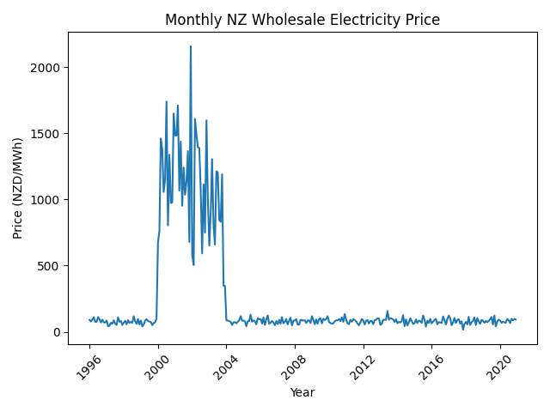
Data Overview & Sample Structure
Sample coverage
Full aligned dataset: 1996–2024 (279 monthly observations)
Modelling sample (HVDC + lag availability): 1996–2019 (241 monthly observations)
Frequency: Monthly (chosen to align hydro conditions with observable price dynamics and reduce short-term noise)
Dataset structure
Unified monthly “risk panel” indexed by Year–Month
All sources cleaned, standardized, and aligned for comparability
Data inputs (monthly, harmonised to Year–Month)
Wholesale electricity prices (NZD/MWh)
National hydro storage (active)
HVDC inter-island flows
Tributary inflows and spill volumes
Climate indicators (NIWA monthly)
Derived storage capacity / specific energy series
Descriptive Snapshot (Modelling Sample: 1996–2019)
Total observations: 241 monthly observations
Scarcity months (≤10th percentile): ~24 months
Average wholesale price: 179.5 NZD/MWh
Average storage level: 61.8% of full capacity
Scarcity months represent ~10% of the empirical distribution by construction

Slide 8
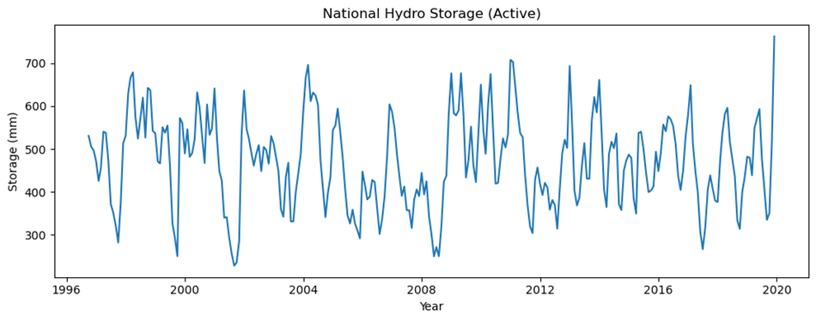
Regime Identification Framework
Conceptual Framing
Hydro storage is modelled as a structural state variable governing wholesale price dynamics.
Regime Definition
Active storage percentage employed as the primary regime indicator.
Scarcity threshold defined at the 10th percentile of the empirical storage distribution
Binary regime specification: Normal Regime Low-Storage (Scarcity) Regime
Rationale
Regime classification:
Enables estimation of non-linear price sensitivity
Allows explicit differentiation of tail-risk behavior
Facilitates persistence analysis within scarcity regimes
Low-storage regime defined as storage ≤ 10th percentile (≈ 34% of full capacity).

Slide 9
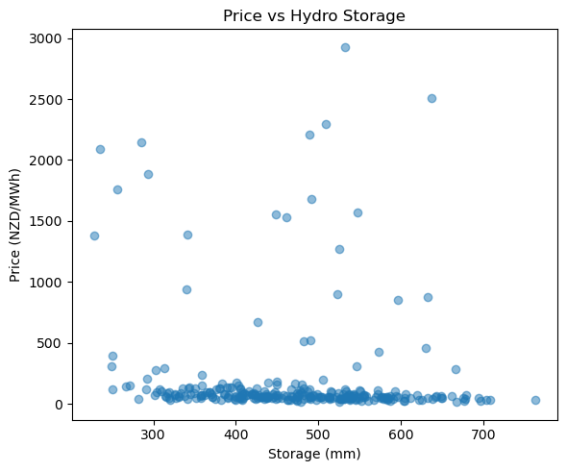
Empirical Evidence of Regime-Dependent Price Behavior
Extreme price spikes concentrate at low storage levels
Upper-tail outcomes are disproportionately observed under scarcity
Evidence of non-linear price sensitivity
Supports threshold-based regime classification (≈34%)
Scarcity is not gradual — it is structural.
Extreme price observations cluster disproportionately at low storage levels.

Slide 10
Model Specification & Estimation Strategy
Monthly wholesale price modelled as a function of storage regime
Binary regime indicator captures non-linear scarcity effects
BaselineSpecification:
Priceₜ = β₀ + β₁(Storage Regimeₜ) + εₜ
Focus is structural regime characterization rather than point forecasting.
Tail-risk metrics estimated via empirical quantiles (P95, CVaR95)
Heteroskedasticity-robust standard errors applied
Estimation Framework
Regime classification using 10th percentile threshold
Conditional distribution analysis (Normal vs Scarcity)
Transition dynamics estimated via first-order Markov process
Monthly aggregation to align hydro fundamentals with observable price risk

Slide 11
Tail Risk Amplification Under Scarcity
Mean wholesale prices increase by ~73% under scarcity
Price volatility rises by ~31% in low-storage regimes
Upper-tail (P95) outcomes more than double under scarcity
CVaR95 increases by ~27%, indicating concentrated tail exposure
Scarcity regimes display multi-month state persistence
Hydro scarcity fundamentally reshapes the price distribution — risk escalation is driven by tail concentration rather than average price drift.
Regime | Mean | Volatility | P95 | CVaR95
Low Storage | 300.96 | 541.46 | 1791.5 | 2118.51
Normal | 173.58 | 412.48 | 834.14 | 1665.64
CVaR95 = expected shortfall conditional on exceeding the 95th percentile.

Slide 12
Regime Persistence & Transition Dynamics (Monthly)
Normal conditions are highly persistent (95% monthly retention)
Entry into scarcity is relatively infrequent (5%)
Once in scarcity, the system remains there with 55% probability
Scarcity exhibits state dependence and multi-month persistence
Persistent scarcity compounds procurement risk exposure
Low-storage regime defined as storage ≤ 10th percentile (monthly sample 1996–2019).
From \ To | Normal | Low Storage
Normal | 0.95 | 0.05
Low Storage | 0.45 | 0.55

Slide 13
Integrated Structural Findings
Structural Evidence Summary
Storage threshold (~34%) identifies a clear structural regime break in wholesale price dynamics
Mean wholesale prices increase by ~73% under low-storage conditions
Volatility rises materially (~31%) during scarcity periods
Upper-tail risk escalates sharply: P95 and CVaR95 more than double relative to normal regime
Scarcity exhibits strong state persistence (55% monthly retention)
Expected scarcity duration ≈ 1 / (1 − 0.55) ≈ 2.2 months
Hydro scarcity restructures the entire price distribution — risk escalation is structural and tail-driven, not merely incremental.

Slide 14
Early-Warning & Risk Monitoring Framework
Monitor active storage relative to 10th percentile threshold
Estimate conditional probability of remaining in scarcity
Quantify regime-specific tail risk (P95 / CVaR95)
Trigger procurement review when scarcity risk exceeds tolerance
Adjust forward hedging and contracting strategy accordingly
Hydro storage functions as a leading risk signal, not merely a descriptive metric.
Hydro Storage Monitoring
Regime Classification (Normal/Low)
Regime Classification (P95/ CVaR95)
Procurement Decision Adjustment

Slide 15
Business Implications for Wellington Electricity
Low-storage regimes materially increase wholesale procurement exposure
Tail-risk amplification drives extreme cost volatility
Regime persistence compounds cumulative financial risk
Mean-based monitoring materially understates exposure
Regime-sensitive monitoring improves procurement stability and reduces unexpected cost shocks.
Strategic Actions
Implement storage-based early-warning triggers
Dynamically adjust hedge ratios under scarcity
Integrate CVaR95 into enterprise risk tolerance
Stress-test procurement under 1-in-10 and 1-in-20 dry-year scenarios
Embed regime signals into budget forecasting

Slide 16
Limitations & Governance Considerations
Methodological Limitations
Regime threshold defined using historical empirical distribution (static percentile)
Storage used as primary state variable; other structural drivers may interact
Transition probabilities estimated from historical data (no structural break modelling)
CVaR estimates sensitive to extreme outliers
Monthly frequency may smooth short-term intra-month volatility
Governance Framework
Periodic recalibration of scarcity threshold
Annual validation of tail-risk metrics
Integration with existing enterprise risk framework
Back-testing of early-warning triggers
Scenario stress-testing under extreme dry-year events
The framework is robust for monitoring structural risk but requires ongoing recalibration and validation.

Slide 17
Conclusion & Strategic Contribution
Key Findings
Hydro storage operates as a structural state variable in NZ electricity markets
Scarcity regimes exhibit non-linear price sensitivity
Tail-risk amplification is materially higher under low-storage conditions
Regime persistence compounds cumulative procurement exposure
State-dependent monitoring improves risk transparency
Hydro risk is not merely cyclical — it is structural, measurable, and actionable.
Strategic Contribution
Developed regime-sensitive price risk framework
Integrated tail-risk metrics (P95 / CVaR95) into operational context
Established transition-based early-warning structure
Demonstrated decision relevance for Wellington Electricity
Provided foundation for future regime-aware forecasting models

