Slide 1
Data Structures and Algorithms -3 (25CS2103E)
Near-Duplicate Question Finder
Team Members
2520090119 A. SIDDHARTHA VARMA
2520090202 P. GOWTHAM VARMA
252009215 K. GIREESH CHOWDARY
Under the Esteemed Guidance of
Name of the DSA-3 faculty name with designation and department

Slide 2
Contents
1. Abstract
2. Introduction
3. Literature Survey
4. Problem Statement & Objectives
5. Proposed Methodology
6. System Architecture
7. Hardware & Software Requirements
8. Final Implementation
9. Modules
10. Algorithm
11. Code / Implementation
12. Testing
13. Results
14. Performance Analysis
15. Conclusion
16. Future Scope
17. References

Slide 3
Abstract
Online Q&A platforms collect many questions that ask the same thing in different words, which splits answers and clutters search. Comparing every pair of questions is too slow for large collections.
This project finds near-duplicate questions in four steps: questions are cleaned and cut into token 3-gram shingles, each shingle gets two polynomial hashes that feed a 60-value MinHash signature, locality-sensitive hashing (LSH) groups similar signatures into buckets, and only the resulting candidate pairs are verified exactly with a longest-common-substring and Jaccard check.
A Flask web application lets users compare two questions, upload a CSV/Excel dataset, view duplicates, see precision/recall/F1 and download results.
60
MinHash values per question
3 / 3
demo duplicate pairs found
0.933
F1 on 12-pair sample

Slide 4
Introduction
1
Context
2
Why it matters
3
Our approach
Q&A sites, help desks and learning portals receive thousands of questions a day. Many repeat an existing question, e.g. “How can I learn Python programming?” vs “What is the best way to learn Python programming?”.
Duplicates scatter answers, add noise to search and force manual merging. Brute-force comparison needs n(n−1)/2 checks, and each exact check costs O(m·n).
Shrink each question to a short signature, use LSH to pick only likely pairs, then confirm them with an exact check. Delivered as a usable web tool.
DSA concepts used: hashing, sets and dictionaries, dynamic programming, complexity analysis.

Slide 5
Literature Survey
Work | Key idea | Relevance to this project
Broder, 1997 | Shingling and resemblance (Jaccard of shingle sets) | Basis of our token 3-gram shingles
Indyk & Motwani, 1998 | Locality-sensitive hashing for similarity search | Basis of our LSH banding stage
Charikar, 2002 | SimHash: short fingerprints for similarity | Possible alternative to MinHash
Henzinger, 2006 | Compared shingling and SimHash on 1.6B web pages | Supports a filter-then-verify design
Manku et al., 2007 | 64-bit SimHash for web-crawl near-duplicates | Shows need at production scale
Rajaraman & Ullman (MMDS) | Pipeline: shingling → MinHash → LSH banding | Our implementation follows this chapter
Also reviewed: Quora Question Pairs dataset, Karp–Rabin polynomial fingerprints, datasketch library (full list under References).

Slide 6
Problem Statement & Objectives
Problem statement: Efficiently detect near-duplicate questions in a large collection without comparing every pair, while keeping results accurate.
Questions that mean the same thing are worded differently, so exact matching fails, and brute force grows quadratically.
Objectives
Represent questions as token k-gram shingles after cleaning
Build 60-value MinHash signatures with double polynomial hashing
1
2
Use LSH so only similar-looking questions are compared
Verify candidates exactly (longest common substring + Jaccard)
3
4
Build a web app: compare, upload dataset, download results
Evaluate with precision, recall and F1 on labelled pairs
5
6

Slide 7
Proposed Methodology
1
2
3
4
5
6
Preprocess
Shingle
Double hash
MinHash
LSH
Verify
lowercase, remove symbols and stop words
overlapping token 3-grams
two polynomial hashes per shingle
60-value signature per question
bucket signature bands → candidates
LCS + Jaccard decision rule
Filter, then verify. Steps 1–5 are cheap and reduce n(n−1)/2 pairs to a small candidate set; only those pairs reach the exact O(m·n) check.
Decision rule: duplicate if LCS ≥ 3 tokens AND (coverage ≥ 0.50 OR Jaccard ≥ 0.50). Thresholds are adjustable in the web interface.

Slide 8
System Architecture
Browser
Flask API (app.py)
Algorithm engine (main.py)
index.html, style.css, script.js
/api/compare /api/upload /download
NearDuplicateFinder
Compare form, dataset upload, results table, metrics
Validates input, runs the finder, returns JSON / CSV
Preprocess → Shingle → Hash → MinHash → LSH → Verify
Inside the engine
Questions
{id: text}
Tokens
Shingles
Signatures
(60 values)
LSH buckets
Candidates
Verified
duplicates
Data flow: the browser sends a question pair or a CSV/Excel file → Flask loads it with pandas → NearDuplicateFinder fits and runs → results return as JSON for the page and are saved as CSV files for download.

Slide 9
Hardware & Software Requirements
Hardware
Software
Processor: Intel Core i3 / Ryzen 3 or better (2 GHz+)
RAM: 4 GB minimum, 8 GB recommended for large datasets
Storage: 500 MB free space
Standard monitor, keyboard and mouse
OS: Windows 10/11 (Linux/macOS also work)
Python 3.9 or later
Flask, pandas, openpyxl, Werkzeug
HTML5, CSS3, JavaScript (fetch API)
VS Code, PowerShell, Chrome or Edge

Slide 10
Final Implementation
Project structure
Configuration used
near_duplicate_finder_web/
├─ main.py algorithm
├─ app.py Flask API
├─ requirements.txt
├─ templates/
│ └─ index.html
├─ static/
│ ├─ style.css
│ └─ script.js
├─ uploads/ dataset files
└─ results/ output CSVs
Parameter | Value
Shingle size k | 3 tokens
MinHash values | 60
LSH bands × rows | 60 × 1
Min common tokens | 3
Min Jaccard | 0.50
Run it
python -m pip install -r requirements.txt
python app.py
→ open http://127.0.0.1:5000

Slide 11
Modules
1
Preprocessing
2
Shingling
3
Double hashing
preprocess(), tokenize()
make_shingles()
polynomial_hash(), double_hash()
Lowercase, strip symbols, remove 40 stop words
Overlapping token k-grams (k = 3)
Two polynomial hashes (different bases and primes)
4
MinHash
5
LSH
6
Verification
minhash_signature()
lsh_candidates()
exact_verify(), longest_common_substring_length()
60-value signature approximating Jaccard similarity
Band buckets; shared bucket → candidate pair
DP longest common run + Jaccard decision rule

Slide 12
Algorithm
1
For each question: tokenize (lowercase, remove symbols and stop words).
Time complexity
Build the shingle set of token 3-grams.
Tokenize / shingle: O(L) per question
Hash + MinHash: O(s·h) per question
LSH: O(n·b) + pairs inside buckets
Verify: O(m·n) per candidate (O(n) space)
Brute force: O(N²·m·n) for N questions
2
3
Hash every shingle with two polynomial hashes (h1, h2).
4
For i = 1…60: gᵢ = (aᵢ·h1 + bᵢ·h2 + cᵢ) mod p; keep the minimum → signature.
5
LSH: split the signature into bands; questions sharing a bucket form a candidate pair.
6
For each candidate: compute LCS (DP) and Jaccard.
7
Report duplicate if LCS ≥ 3 and (coverage ≥ 0.5 or Jaccard ≥ 0.5).

Slide 13
Code / Implementation (1/2)
def preprocess(text):
text = str(text).lower()
text = re.sub(r"[^a-z0-9\s]", " ", text)
tokens = [t for t in text.split()
if t not in STOP_WORDS]
return " ".join(tokens)
def make_shingles(tokens, k=3):
if len(tokens) < k:
return ({" ".join(tokens)}
if tokens else set())
return {" ".join(tokens[i:i+k])
for i in range(len(tokens)-k+1)}
def polynomial_hash(text, base, mod):
h = 0
for ch in text:
h = (h * base + ord(ch)) % mod
return h
def double_hash(shingle):
return (polynomial_hash(shingle, BASE1, MOD1),
polynomial_hash(shingle, BASE2, MOD2))
def minhash_signature(shingles, num_hashes=60):
signature = [MOD1 - 1] * num_hashes
for shingle in shingles:
h1, h2 = double_hash(shingle)
for i in range(num_hashes):
a = (i * 2 + 1) * 104729 + 17
b = (i * 3 + 1) * 130363 + 31
c = i * i + 97
v = (a * h1 + b * h2 + c) % MOD1
if v < signature[i]:
signature[i] = v
return signature

Slide 14
Code / Implementation (2/2)
def lsh_candidates(signatures, bands=60, rows=1):
buckets = defaultdict(list)
cands = set()
for qid, sig in signatures.items():
for band in range(bands):
s = band * rows
part = tuple(sig[s:s+rows])
buckets[(band, hash(part))].append(qid)
for ids in buckets.values():
for i in range(len(ids)):
for j in range(i + 1, len(ids)):
pair = (ids[i], ids[j])
cands.add(tuple(sorted(pair)))
return cands
def longest_common_substring_length(a, b):
prev = [0] * (len(b) + 1)
best = 0
for x in a:
curr = [0] * (len(b) + 1)
for j, y in enumerate(b, start=1):
if x == y:
curr[j] = prev[j - 1] + 1
best = max(best, curr[j])
prev = curr
return best
# duplicate if:
# lcs >= 3 and (coverage >= 0.5
# or jaccard >= 0.5)

Slide 15
Testing
Test case | LCS / Jaccard | Expected | Actual | Status
T1 Identical questions | 5 / 1.00 | Duplicate | Duplicate | Pass
T2 Paraphrase (learn Python) | 3 / 0.38 | Duplicate | Duplicate | Pass
T3 Unrelated topics | 1 / 0.10 | Not duplicate | Not duplicate | Pass
T4 Same pattern, Java vs Python | 1 / 0.43 | Not duplicate | Not duplicate | Pass
T5 Case and punctuation changed | 5 / 1.00 | Duplicate | Duplicate | Pass
T6 Very short question (1 token) | 1 / 1.00 | Not duplicate | Not duplicate | Pass
T7 Word order changed | 3 / 0.80 | Duplicate | Duplicate | Pass
T8 Stricter threshold (min 4 tokens) | 3 / 0.38 | Not duplicate | Not duplicate | Pass
T9 Synonym only (study vs learn) | 1 / 0.11 | Duplicate (meaning) | Not duplicate | Known limit
8 of 9 cases behave as designed. T9 shows the method is lexical: it cannot recognise synonyms.

Slide 16
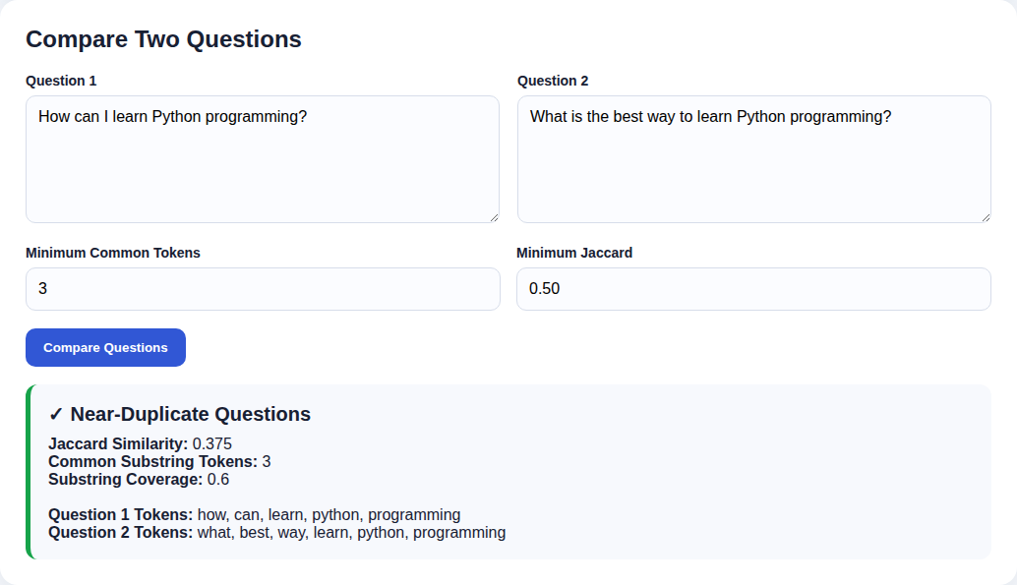
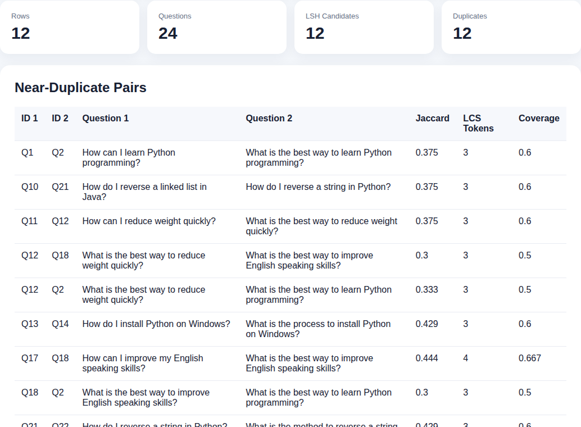
Results
Two-question comparison: the Python-learning pair is reported as a near-duplicate (Jaccard 0.375, 3 common tokens).
Dataset analysis: 12 rows → 24 questions → 12 candidates; duplicate pairs listed with scores.
3 / 3
1.00
0.875
demo pairs found
recall (12-pair sample)
precision

Slide 17
Performance Analysis
n | All pairs | LSH 60×1 candidates | LSH recall 60×1 | LSH recall 20×3
100 | 4,950 | 25 | 1.00 | 0.52
200 | 19,900 | 66 | 1.00 | 0.50
400 | 79,800 | 120 | 1.00 | 0.61
800 | 319,600 | 249 | 1.00 | 0.51
At n = 800 only 249 of 319,600 pairs (0.08%) are verified, and run time is about 12× lower than brute force.
Synthetic questions (random vocabulary with planted near-duplicates), measured on this project’s code. For very small n (100) brute force is still faster. The 20×3 setting is faster but finds only about half of the true duplicates, so 60×1 is kept.

Slide 18
Conclusion
A complete pipeline was built: preprocessing, shingling, double polynomial hashing, MinHash, LSH and exact verification.
1
The demo found all 3 true duplicate pairs, and the 12-pair sample gave precision 0.875, recall 1.0, F1 0.933.
2
LSH cut the verified pairs to under 0.1% of all pairs at n = 800 with no true duplicate lost in our tests.
3
The Flask web app makes the system usable for comparing questions and analysing CSV/Excel datasets.
4
Limitation: matching is lexical, so synonyms are missed and generic phrases can cause false positives.
5

Slide 19
Future Scope
Near term
Medium term
Long term
Tune bands × rows and thresholds
Add question words to the stop-word list
Remove empty questions before processing
Evaluate on Quora Question Pairs
Paging and per-user result files in the web app
Synonym / stemming support
Embedding similarity as a second stage
SimHash as an alternative signature
Automated unit tests
REST API for other applications
Semantic duplicate detection with sentence embeddings
Multi-language support
Streaming check on every new question
Production deployment

Slide 20
References
[1] A. Z. Broder, “On the resemblance and containment of documents,” IEEE SEQUENCES, 1997.
[2] P. Indyk and R. Motwani, “Approximate nearest neighbors: towards removing the curse of dimensionality,” ACM STOC, 1998.
[3] A. Broder, M. Charikar, A. Frieze, M. Mitzenmacher, “Min-wise independent permutations,” JCSS 60(3), 2000.
[4] M. Charikar, “Similarity estimation techniques from rounding algorithms,” ACM STOC, 2002.
[5] M. Henzinger, “Finding near-duplicate web pages: a large-scale evaluation of algorithms,” ACM SIGIR, 2006.
[6] G. Manku, A. Jain, A. Das Sarma, “Detecting near-duplicates for web crawling,” WWW, 2007.
[7] J. Leskovec, A. Rajaraman, J. Ullman, Mining of Massive Datasets, Ch. 3, mmds.org.
[8] Quora Question Pairs dataset, Kaggle: kaggle.com/c/quora-question-pairs
[9] R. Karp and M. Rabin, “Efficient randomized pattern-matching algorithms,” IBM J. Res. Dev., 1987.
[10] datasketch library (MinHash and LSH for Python): github.com/ekzhu/datasketch

Slide 21
Thank you

