Slide 1
HPCA 2026
DSASSASSIN
Cross-VM side-channel attacks by exploiting
Intel’s Data Streaming Accelerator
Ben Chen · Kunlin Li · Shuwen Deng · Dongsheng Wang · Yun Chen
HKUST (Guangzhou) · Tsinghua University
Presented by [your name] · ECE-MAR · 27 October 2026
1
Notes:
MAIN TALK | ~40 s
Datacenters race to move memory work off the CPU. Intel's DSA ships in every recent Xeon. This is the first public security analysis of it. Seed the thesis: VT-d isolates addresses, not the accelerator's shared heartbeat.
SOURCE:

Slide 2
The wall has a crack
Address isolation still leaves the shared activity visible
VM A — victim
VT-d / PASID
isolates translation
VM B — observer
Private address space
PASID A
Private address space
PASID B
Shared engine state · shared queue occupancy
The leakage is about resource use — not access to victim memory.
Paper §§ I, IV–V · pp. 1–8
2
Notes:
MAIN TALK | ~70 s
The thesis in one picture. Two VMs, each its own PASID, cannot read each other's memory — VT-d works. But both use the SAME physical accelerator, whose internal state is NOT split. DSASSASSIN never reads victim memory; it watches the accelerator twitch. Confidentiality of addresses is not confidentiality of activity.
SOURCE: Paper §§ I, IV–V · pp. 1–8

Slide 3
The wall has a crack
Four demonstrations, one humble signal
17.19 kbps
85.73%
Covert channel
Website fingerprinting
DevTLB · 4.63% bit error
100 sites · 1% baseline
98.4%
98.6%
Keystroke timing F1
LLM fingerprinting
SWQ · 1.21 ms deviation
Validation · 8 models
None of these reads a byte of victim memory.
Paper § VI, Tables III–IV · pp. 9–12 · reported results
3
Notes:
MAIN TALK | ~70 s
The twitch is enough for: a 17.19 kbps covert channel (5x faster, 4x cleaner than prior IPI); website fingerprinting 85.73% over 100 sites vs 1% baseline; SSH keystroke timing 98.4% F1; LLM fingerprinting 98.6%. Same 'accelerator is busy' signal, four different secrets. I'll flag which are rock-solid vs caveated.
SOURCE: Paper § VI, Tables III–IV · pp. 9–12 · reported results

Slide 4
The wall has a crack
The route — from shared state to application leakage
THEME
COVERS
TIME
I
The wall has a crack
thesis + payoff
4 min
II
Meet the machine
architecture + threat model
8 min
III
The detective story
reverse engineering + two primitives
16 min
IV
What it steals
covert channel + three attacks
12 min
V
Does it hold up?
robustness, comparison, defenses
6 min
VI
My verdict
strengths, limits, open questions
5 min
A running theme: VT-d guards addresses, not the accelerator’s shared heartbeat.
Six acts + backup
4
Notes:
MAIN TALK | ~55 s
The map. Machine, then the detective story of reverse engineering, then the four attacks, then defenses and comparison, then my own critique. Hold mechanism questions until after Act III.
SOURCE: Six acts + backup

Slide 5
Act 2 of 6
02
Meet the machine
What DSA is and how a job flows through it
The device-side translation cache (DevTLB)
The honest threat model — and two kinds of sharing
5
Notes:
ACT 2: Meet the machine
What DSA is and how a job flows through it · The device-side translation cache (DevTLB) · The honest threat model — and two kinds of sharing

Slide 6
Meet the machine
Memory offload creates a new place to observe
Common operations
DSA offload
Observable state
memcpy · memset
compare · checksums
descriptor submission
asynchronous execution
translation cache
queue occupancy
Moving work off the CPU moves the side-channel surface with it.
Paper §§ I–II-A · pp. 1–2
6
Notes:
MAIN TALK | ~65 s
DSA is a data mover: software hands it copy/compare/checksum jobs, done asynchronously. For years we studied how these ops leak on the CPU; the fix was partly to move them. The premise: 'somewhere else' is a new, unstudied, shared place to watch. We relocated the side channel to a building with no cameras.
SOURCE: Paper §§ I–II-A · pp. 1–2

Slide 7
Meet the machine
A DSA operation is a descriptor-driven pipeline
Application
Portal + WQ
DSA engine
Completion
prepare descriptor
submit / buffer
decode → write
notify CPU
The attacker owns two handles —
“was my submission accepted?” · “how long did my completion take?”
Observe request acceptance, or observe how long completion takes.
Paper § II-A, Fig. 1 · pp. 2–3
7
Notes:
MAIN TALK | ~75 s
Follow one job: software fills a descriptor, writes it to an MMIO portal, it lands in a work queue, an engine executes and writes a completion record. Remember two observation handles: did my submission get in? and how long until my completion? Everything later is one of those two.
SOURCE: Paper § II-A, Fig. 1 · pp. 2–3

Slide 8
Meet the machine
The device keeps its own translation cache
Device request
DevTLB / ATC
Host memory
virtual address + PASID
hit → reuse translation
physical transaction
Miss → Translation Agent → page-table walk
A cached translation stays locked — but its replacement leaks activity.
Paper § II-B, Fig. 1 · pp. 2–3
8
Notes:
MAIN TALK | ~75 s
To avoid asking the IOMMU every time, DSA caches translations on the device — the DevTLB. Key subtlety: it's read-only and PASID-tagged, so it does NOT leak contents. The leak is REPLACEMENT: if a neighbor evicts my entry, I can't see their address but I know they moved. First weapon is eviction, not disclosure.
SOURCE: Paper § II-B, Fig. 1 · pp. 2–3

Slide 9
Meet the machine
The attacker needs DSA access and co-location
Assumed
Not needed
DSA-enabled Xeon + IDXD + VT-d scalable mode
A shared CPU core
Victim actually uses DSA
Shared victim memory
Attacker may submit descriptors (CAP_SYS_RAWIO)
Permission to read victim addresses
Shares the engine (DevTLB) or the SWQ
Root / authority to reconfigure host DSA
May set its own engine / queue affinity
“Unprivileged” still depends on pre-provisioned device access and co-location.
Paper § V-A · pp. 7–8
9
Notes:
MAIN TALK | ~75 s
Be scrupulous. Unprivileged in the way that matters: no root, no host reconfiguration, no reading victim memory, and NOT sharing a CPU core — genuinely cross-VM, cross-core. But it still assumes provisioned device access and co-location on the same engine/queue. An assumption; I revisit it in the critique. Note a tension in §V-A: it first says configuring engine affinity / WQ settings needs root, then says setting affinity to an engine or queue does NOT need root — read this as: creating/configuring queues is root (accel-config), but binding to an existing portal is not. Kernel 6.11.0-25, IDXD driver.
SOURCE: Paper § V-A · pp. 7–8

Slide 10
Meet the machine
Two channels cross two different boundaries
DevTLB timing channel
SWQ contention channel
Victim and attacker may use
different work queues —
if they share one engine.
Different queues can still interfere.
Victim and attacker must
share the same work queue.
The same queue must be shared.
Separate work queues are not enough if the engine is shared.
Paper §§ IV-A, V · pp. 3–8
10
Notes:
MAIN TALK | ~80 s
The slide I'd tattoo on an operator. DevTLB channel needs only the same ENGINE — different queues still leak. SWQ channel needs the same QUEUE. So separate queues, which operators call isolation, do NOT stop the DevTLB channel because the cache lives below the queues, at the engine. Remember this one fact.
SOURCE: Paper §§ IV-A, V · pp. 3–8

Slide 11
Meet the machine
Reverse engineering answers three questions
01
02
03
What is shared?
What is visible?
What can it reveal?
Capacity, indexing,
replacement policy,
PASID behaviour
Privileged counters
vs. user-observed
latency and flags
Eviction → activity
Admission → occupancy
Each microbenchmark links an implementation behaviour to an observable signal.
Paper §§ III–IV · pp. 3–7
11
Notes:
MAIN TALK | ~60 s
No datasheet exists. So: form a hypothesis about structure, design a probe that gives a visibly different result under each hypothesis, keep the survivor. The next ten minutes are a chain of these, each eliminating a possibility until the scary truth is all that's left.
SOURCE: Paper §§ III–IV · pp. 3–7

Slide 12
Meet the machine
Characterization counters ≠ attack signals
Reverse engineering · privileged PMU
Attack signal · unprivileged
EV_ATC_ALLOC
DevTLB · own completion time (rdtsc)
EV_ATC_NO_ALLOC
SWQ · ENQCMD result via EFLAGS.ZF
EV_ATC_HIT_PREV
Platforms: Xeon Platinum 8468V (local) · 8475B (Alibaba cloud) · Linux 6.11 · IDXD · VT-d scalable mode · SR-IOV (DevTLB setup) / Scalable IOV (shared SWQ)
PMU access supports the explanation; it is not needed for the attack loop.
Paper § IV-B, Table I · pp. 4–6
12
Notes:
MAIN TALK | ~70 s
Fair challenge: aren't you using privileged counters? To UNDERSTAND the hardware, yes — Perfmon, for ground truth. But the ATTACK reads only what any user can: its own completion time, or whether its own submission succeeded. Counters are the microscope in the lab, not part of the weapon. Done on local and a real cloud instance.
SOURCE: Paper § IV-B, Table I · pp. 4–6

Slide 13
Act 3 of 6
03
The detective story
Each microbenchmark rules out an alternative
Five one-entry slots — indexed by engine and field, not PASID
Prime → Idle → Probe and Congest → Idle → Probe
13
Notes:
ACT 3: The detective story
Each microbenchmark rules out an alternative · Five one-entry slots — indexed by engine and field, not PASID · Prime → Idle → Probe and Congest → Idle → Probe

Slide 14
The detective story
Clue #1 — the opcode chooses which slot you touch
OPERATION
ADDRESS FIELDS
COMPLETION
WHY USEFUL
noop
none
comp
Minimal timing probe — the scalpel
memcmp / compare
src + src2
comp
Two independent reads
memcpy
src + dst
comp
Read / write separation
dualcast
src + dst + dst2
comp
Multiple destination slots
Byte 24 is src2 for compare but dst for copy — same bits, different meaning.
The opcode changes field meaning; field meaning changes which slot is used.
Paper § IV-B, Fig. 3 · pp. 4–5
14
Notes:
MAIN TALK | ~70 s
First clue. The cache is indexed by a field's ROLE — src, src2, dst, dst2, comp — not by address. The authors pick which roles to exercise by picking the opcode. noop is the scalpel: touches only the completion slot, cheapest, cleanest timing. dualcast lights four slots. Surgical control.
SOURCE: Paper § IV-B, Fig. 3 · pp. 4–5

Slide 15
The detective story
The reveal — five drawers, one translation each
Engine 0
src
src2
dst
dst2
comp
one page
translation
one page
translation
one page
translation
one page
translation
one page
translation
A single different page in a field’s role replaces the one translation in that slot — no eviction set required.
One-slot replacement makes a neighbour’s activity trivial to detect.
Paper §§ IV-A–B, Fig. 2 · pp. 3–6 · empirical model
15
Notes:
MAIN TALK | ~75 s
Spoiler so the experiments make sense: each engine's DevTLB has exactly five entries, one per field role, each holding ONE translation. Direct-mapped to the extreme. Why catastrophic? No eviction set needed — any single different page in that role evicts the occupant. The drawer only fits one sock.
SOURCE: Paper §§ IV-A–B, Fig. 2 · pp. 3–6 · empirical model

Slide 16
The detective story
Proof of “one slot” — base → offset → base
1
2
3
Probe base
→
Probe base + offset
→
Probe base again
Load one page translation
Keep or replace it
Did it survive?
OFFSET
FINAL BASE OBSERVATION
INTERPRETATION
< 4 KiB
Hit
Same page retained
≥ 4 KiB
Miss
A different page replaced it
A single different page is enough to evict the tested field’s translation.
Paper § IV-B, Listing 2 · pp. 4–5
16
Notes:
MAIN TALK | ~70 s
Load base. Touch an address 'offset' away. Re-check base. Inside the same 4KB page, base survives → page granularity. Cross a page boundary → base is gone → only ONE slot (two would survive). They even evict a 4KB entry with a 2MB huge-page address — no separate drawers per page size.
SOURCE: Paper § IV-B, Listing 2 · pp. 4–5

Slide 17
The detective story
The drawers are independent — even sharing bits
Independent fields
Shared encoding, distinct slots
copy(src A, dst D)
copy(src B, dst D)
Source replaced; destination retained
→ separate slots.
compare(src A, src2 X)
copy(src A, dst X)
Only the src reuse
produces the shared hit.
The organisation follows field semantics, including src2 versus dst.
Paper § IV-B, Listings 3–4 · p. 5
17
Notes:
MAIN TALK | ~75 s
Change the source, keep the destination → destination survives: independent drawers. Then the elegant one: src2 and dst are encoded in the SAME bytes, told apart only by opcode. If indexed by raw bytes they'd collide. They don't — routed by MEANING, not bit position. This is what makes the reverse engineering credible.
SOURCE: Paper § IV-B, Listings 3–4 · p. 5

Slide 18
The detective story
A slot remembers the last page, not the history
One descriptor crossing several source pages
Page A
Page B
Page C
Page D
Retained in the src slot: Page D
The batch fetcher’s own descriptor reads and completion-record writes did not populate these slots — a separate translation path.
A slot records recent field-specific state, not a page-access history.
Paper § IV-B · pp. 5–6
18
Notes:
MAIN TALK | ~60 s
Big transfers split per-page; the drawer keeps only the FINAL page's translation — a snapshot, not a replayable log. Also: batch-fetcher reads and completion writes bypass the cache. For the attacker that's a note: use ordinary work descriptors for reliable interference, not batch tricks.
SOURCE: Paper § IV-B · pp. 5–6

Slide 19
The detective story
The money shot — eviction follows the engine, not the queue
E0
E1
E2
same WQ · same engine
different WQ · same engine
different WQ · different engine
Miss
Miss
Hit
Cross-VM interference
Queue separation insufficient
No cross-engine eviction
E2 is the control that proves it: engine sharing is necessary and sufficient.
Paper § IV-B, Fig. 5 · p. 6
19
Notes:
MAIN TALK | ~85 s
Three experiments, two VMs. E0: same queue + engine → miss, expected. E1 (the dangerous one): DIFFERENT queues, same engine → still miss. So the leak isn't about the queue, and PASID isn't partitioning this cache. E2 is the beautiful negative control: separate ENGINES → hit, no leak. Separate engines fix it; separate queues don't. Spend time here.
SOURCE: Paper § IV-B, Fig. 5 · p. 6

Slide 20
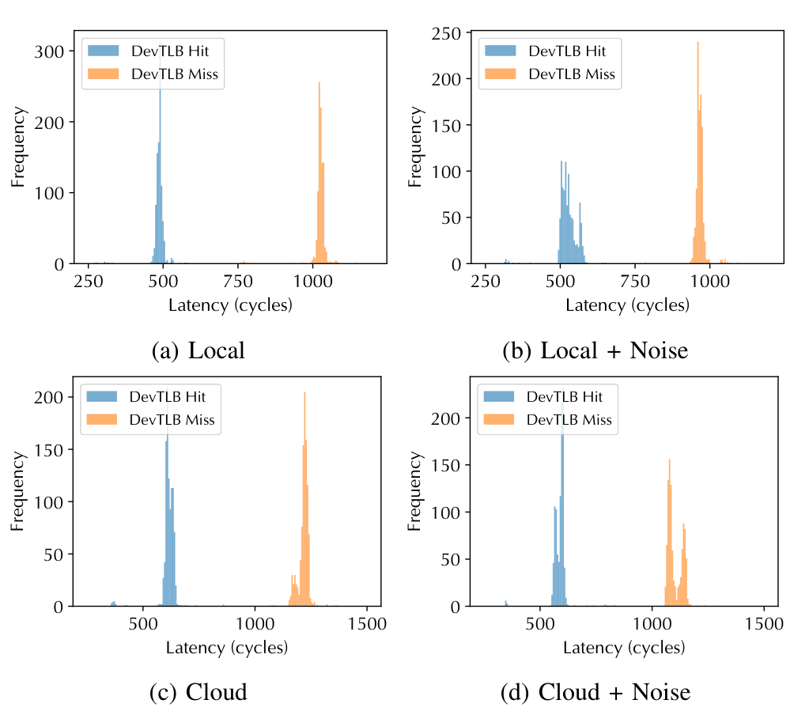
The detective story
The clock still works — even under noise
Measured signal
Hit
≈ 500 cycles
Miss
≈ > 1000 cycles
Threshold
600 – 900
Noise shifts latency; the separation survives in every tested environment.
An unprivileged clock cleanly tells a hit from a miss.
Paper § IV-B, Fig. 4 · pp. 5–6 · original distributions
20
Notes:
MAIN TALK | ~70 s
The attacker's real view: just rdtsc on its own completion. Hits ~500 cycles, misses >1000 — two clean humps, threshold 600-900. They deliberately stress PCIe (2 GB/s NVMe) and memory (10 GB/s). Humps shift ~89 cycles in the cloud but never merge. Lab result survives reality.
SOURCE: Paper § IV-B, Fig. 4 · pp. 5–6 · original distributions

Slide 21
The detective story
Weapon #1 — Prime → Idle → Probe
1
2
3
Prime
→
Idle
→
Probe
Submit noop → cache my own
completion-record page
Wait > one DSA op; a victim
on this engine may evict it
Submit noop again,
time it with rdtsc
Fast probe → retained state. Slow probe → the victim moved.
Paper § V-B · p. 8
21
Notes:
MAIN TALK | ~75 s
Prime+Probe with a twist. I prime a slot with MY OWN completion-record address — never need the victim's. Go quiet. If the victim runs anything on this engine, my single-slot drawer is evicted. Probe = re-run noop, time it. Fast = nobody moved (bit 0); slow = victim moved (bit 1). One bit of 'is the neighbor alive', from my own stopwatch.
SOURCE: Paper § V-B · p. 8

Slide 22
The detective story
Why it’s powerful — and what it cannot do
No address guessing
the attacker primes its own completion-record page
No eviction-set search
one slot — a single different page evicts it
A broad activity signal
meaning comes later, from timing patterns and a classifier
The primitive yields a heartbeat; the application supplies its meaning.
Paper §§ IV-B, V-B · pp. 4–8 · interpretation
22
Notes:
MAIN TALK | ~60 s
Versus LLC Prime+Probe, half the battle is eviction sets and alignment. Here the one-slot design hands you the eviction for free — that's the power. The limit, honestly: the signal is coarse, just 'the engine was busy'. So every real attack is a pattern-recognition problem on top of this heartbeat. That framing is where my critique bites.
SOURCE: Paper §§ IV-B, V-B · pp. 4–8 · interpretation

Slide 23
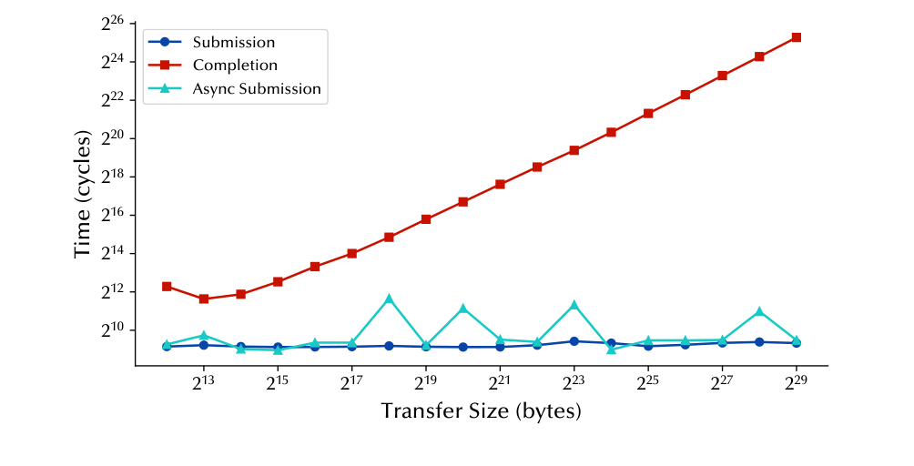
The detective story
The dead end that wasn’t — a flag talks
Two observables
Submission
flat ≈ 700 cycles
Completion
grows with size
Queue-full
a visible flag
The SWQ channel uses ENQCMD / EFLAGS.ZF — no timing threshold at all.
Paper § IV-C, Fig. 6 · pp. 6–7 · original latency plot
23
Notes:
MAIN TALK | ~70 s
You'd expect a shared queue to leak via submission timing. They measure it — submission time is FLAT. Timing is a dead end. The save: submission is a Deferrable Memory Write, and when the queue is full the hardware refuses and sets EFLAGS.ZF. Fullness leaks through yes/no, not how-long. Timer-free — better, no clock noise.
SOURCE: Paper § IV-C, Fig. 6 · pp. 6–7 · original latency plot

Slide 24
The detective story
Learning to hold the queue hostage
Admission path
Execution path
Portal → per-queue metadata check
Fixed-time occupancy test
Success or retry stays visible
Work queue + batch buffer → arbiter
Arbiter prefers work over batch
So: use a long ordinary copy
The attacker holds the engine with a long ordinary copy, not batch priority.
Paper §§ IV-A, IV-C · pp. 3–4, 6–7
24
Notes:
MAIN TALK | ~65 s
Two facts to pin down. One: the fullness check happens at enqueue against config registers in constant time — that's why the flag is timer-free. Two: the arbiter always prefers WORK descriptors over BATCH (race them, latency unchanged). So to hold the queue hostage reliably, use one long ordinary memcpy, not a batch trick.
SOURCE: Paper §§ IV-A, IV-C · pp. 3–4, 6–7

Slide 25
The detective story
The trap — leave exactly one seat open
Target state: effective occupancy N − 1
LONG
COPY
WORK
WORK
WORK
WORK
WORK
FREE
If the victim submits during the hold window, it consumes the last seat — the queue goes full.
The anchor must be large: contention only appeared for transfers ≥ 2²⁵ bytes (32 MiB). Queue size is readable via accel-config without root.
Probe before the long copy completes and the queue starts draining.
Paper §§ IV-C, V-C, Listing 6 · pp. 7–8
25
Notes:
MAIN TALK | ~70 s
A theater with N seats. The attacker buys all but one — a long copy holds the front row so the queue drains slowly, fillers take the rest. One seat left. If the victim submits, it takes that seat and the house is full. Queue size readable without root. A stopwatch-free race against the long copy finishing.
SOURCE: Paper §§ IV-C, V-C, Listing 6 · pp. 7–8

Slide 26
The detective story
Weapon #2 — Congest → Idle → Probe
1
2
3
Congest
→
Idle
→
Probe
Long memcpy + fillers →
near-full SWQ
Hold the window;
the victim may enqueue
Submit once,
read EFLAGS.ZF
ZF = 0 → accepted (victim idle)
ZF = 1 → rejected (victim moved)
“Timer-free” describes the signal; the window still needs control.
Paper § V-C · p. 8
26
Notes:
MAIN TALK | ~75 s
Same three-beat rhythm as DevTLB. Congest to one-from-full. Hold it there. Try to submit one job and read the flag. ZF=0 it went in → victim idle. ZF=1 it bounced → victim took the last seat → active. No timer anywhere. Virtue: precision. Cost (I hammer later): it's LOUD — actively congesting a resource the victim needs.
SOURCE: Paper § V-C · p. 8

Slide 27
The detective story
Two weapons, two personalities
PROPERTY
DEVTLB
SWQ
Shared resource
same engine (queues may differ)
same shared work queue
Observed signal
completion latency
submission success / retry
Preparation
prime comp translation
hold queue near-full
Timer
rdtsc required
none
Footprint
light noop probes
heavy active congestion
Best at
covert bandwidth
keystroke timing
Both infer activity through the attacker’s own requests.
Paper §§ V–VI · pp. 7–12 · footprint row = presenter reading
27
Notes:
MAIN TALK | ~70 s
DevTLB: quiet sniper — tiny noops, reaches anyone on the engine, needs a clock. SWQ: blunt instrument — must actively jam a shared queue, reaches only queue-mates, no clock, gorgeous timing. You'll see DevTLB win covert bandwidth, SWQ win keystroke timing. The 'footprint' row is my interpretation — flagged as such.
SOURCE: Paper §§ V–VI · pp. 7–12 · footprint row = presenter reading

Slide 28
Act 4 of 6
04
What it steals
A covert channel proves the channel carries bits
Websites, SSH keystrokes, and the LLM next door
Strong numbers — quoted honestly, caveats and all
28
Notes:
ACT 4: What it steals
A covert channel proves the channel carries bits · Websites, SSH keystrokes, and the LLM next door · Strong numbers — quoted honestly, caveats and all

Slide 29
What it steals
Can it even carry a message?
PHASE
RECEIVER
SENDER
Synchronize
detect preamble
transmit consecutive 1 bits
Prepare
prime DevTLB / congest SWQ
wait for data slot
Encode
open observation window
1 → submit · 0 → idle
Decode
time completion / read ZF
advance to next slot
Covert-channel feasibility is a separate claim from inference accuracy.
Paper § VI-A · p. 9 · simplified protocol
29
Notes:
MAIN TALK | ~65 s
A covert channel is the controlled test: make the 'victim' a cooperative SENDER and see how cleanly bits move. Sender encodes 1 by causing activity, 0 by idling; receiver reads the heartbeat. A preamble of 1s syncs the clocks. This proves capacity under clean conditions — real victims are messier.
SOURCE: Paper § VI-A · p. 9 · simplified protocol

Slide 30
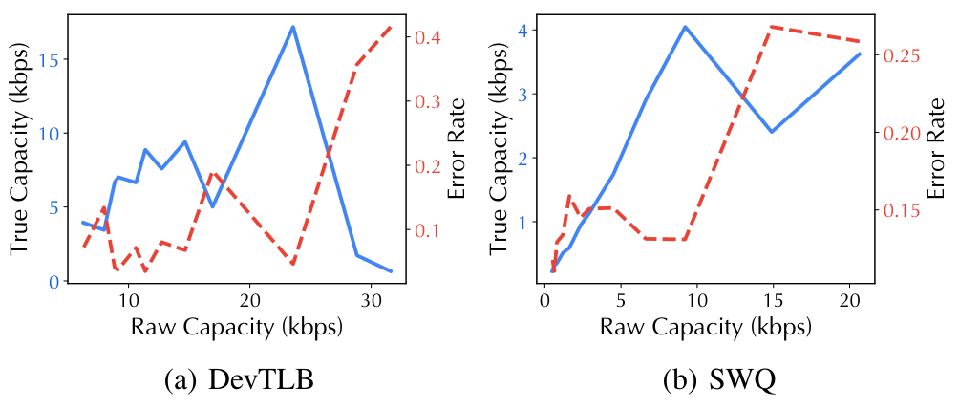
What it steals
17.19 kbps — and a bandwidth / error tradeoff
17.19 kbps
DevTLB
4.63% bit error
4.02 kbps
SWQ
13.11% bit error
Faster raw signalling loses useful throughput as the error rate climbs.
Paper § VI-A, Fig. 9, Table IV · pp. 9, 12
30
Notes:
MAIN TALK | ~70 s
DevTLB hits 17.19 kbps under 5% error — quiet sniper packs probes tightly, beats SWQ. Curve shape: crank the RAW rate and errors climb until USEFUL throughput peaks then collapses — hence a best point. That 17-and-change is 5x faster, 4x cleaner than the prior IPI channel. Capacity: proven.
SOURCE: Paper § VI-A, Fig. 9, Table IV · pp. 9, 12

Slide 31
What it steals
Attack #1 — websites leak through the stack
Website visit
Packet movement
Engine activity
Observer trace
victim browser
VPP / memif + DSA
completion-slot eviction
DevTLB miss counts
A fingerprint is learned from traffic-induced accelerator activity.
Paper § VI-B, Fig. 8 · pp. 8–10 · simplified path
31
Notes:
MAIN TALK | ~70 s
A realistic victim: a VM running VPP, a DPDK userspace network stack that uses DSA to move packets through memif. Every burst of traffic becomes a burst of DSA activity on the shared engine. The attacker runs the quiet DevTLB probe and counts evictions over time. Never sees a packet — only the rhythm.
SOURCE: Paper § VI-B, Fig. 8 · pp. 8–10 · simplified path

Slide 32
What it steals
The pipeline, laid bare — and it is closed-world
Sampling
Model
Dataset
probe every 10 µs
400 probes / slot
≈ 4 ms per slot
2 × BiLSTM
attention + dropout
softmax classes
100 sites × 200 traces
80 / 20 split
≈ 16,000 / 4,000
One feature per slot = the number of classified DevTLB misses.
The evaluated problem is closed-world classification over known labels.
Paper § VI-B · pp. 9–10 · dataset arithmetic from stated split
32
Notes:
MAIN TALK | ~65 s
Each site → a ~250-slot time series, each slot a count of evictions. Feed an attention-BiLSTM, standard here. Notice one honest word: closed-world. 100 KNOWN sites, train and test from the same 100. Legitimate and strong, but not open-world detection of arbitrary pages. I hold them to that in the critique.
SOURCE: Paper § VI-B · pp. 9–10 · dataset arithmetic from stated split

Slide 33
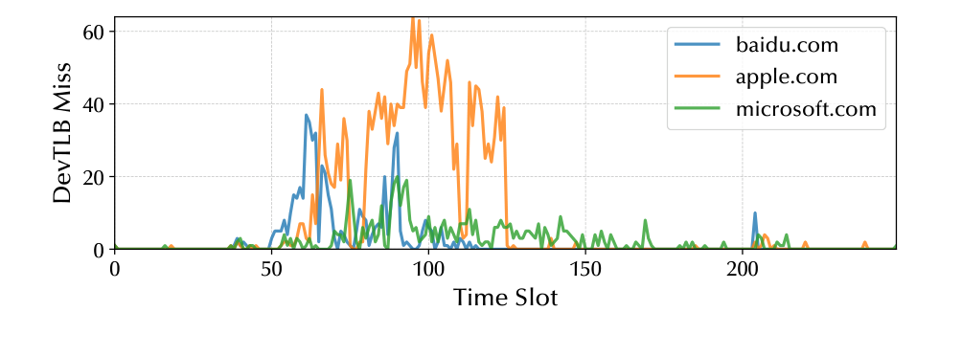
What it steals
The traces really are different
Temporal shape is the feature; miss count is a proxy for DSA activity.
Paper § VI-B, Fig. 10 · p. 9 · original example traces
33
Notes:
MAIN TALK | ~55 s
Three sites, three visibly different signatures — different burst timing and height. That's what the model keys on. No URLs, no content — just the silhouette of the accelerator working as the page loads. Striking that something this coarse separates sites at all.
SOURCE: Paper § VI-B, Fig. 10 · p. 9 · original example traces

Slide 34
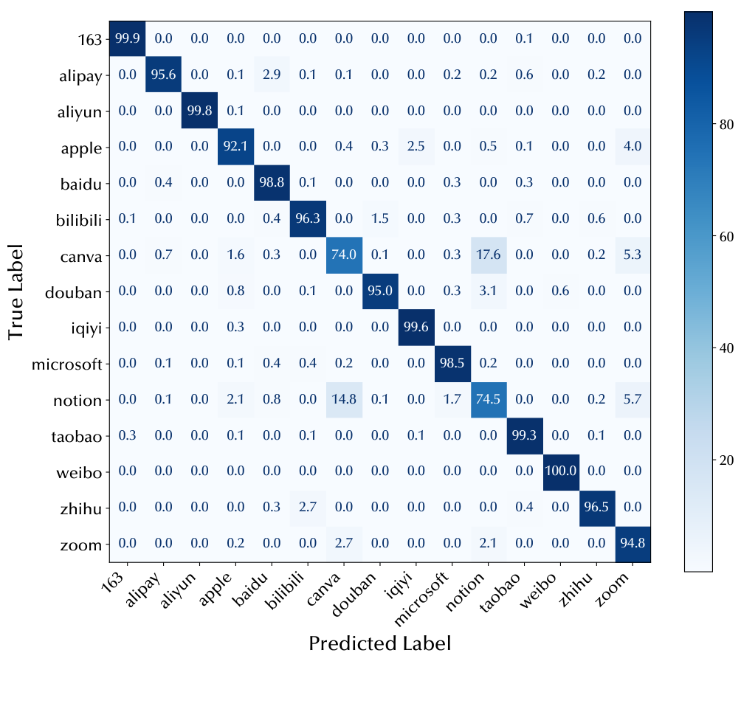
What it steals
85.73% — the number you must not misquote
85.73%
Full dataset
100 websites · 1% baseline
96.5%
Displayed subset
15 selected websites only
The headline is 85.73% on 100 sites; 96.5% is the 15-site subset.
Paper § VI-B, Fig. 11 · pp. 9–10 · original 15-site matrix
34
Notes:
MAIN TALK | ~70 s
On all 100 sites: 85.73% vs a 1% coin-flip. Strong. CAREFUL: the pretty confusion matrix is a 15-site SUBSET at 96.5% — not the headline. Don't let anyone quote 96.5% as the result. Misses are sensible — sites with similar traffic shapes (canva, notion) blur; authors call it future work.
SOURCE: Paper § VI-B, Fig. 11 · pp. 9–10 · original 15-site matrix

Slide 35
What it steals
Attack #2 — keystrokes, via transparent offload
User input
Packet handling
DTO offload
DSA observation
interactive SSH event
OpenSSH mem* calls
eligible calls → DSA
eviction or congestion
The demonstrated output is keystroke timing — not recovered command text.
Paper § VI-C · p. 10 · no end-to-end text recovery
35
Notes:
MAIN TALK | ~70 s
DTO silently redirects ordinary memcpy-style calls to DSA, no code changes. So unmodified OpenSSH, handling each interactive keystroke packet, generates DSA activity per keypress. The attacker times those. The line I won't blur: the paper recovers keystroke TIMING, and notes it could feed a text model — it does NOT recover what you typed.
SOURCE: Paper § VI-C · p. 10 · no end-to-end text recovery

Slide 36
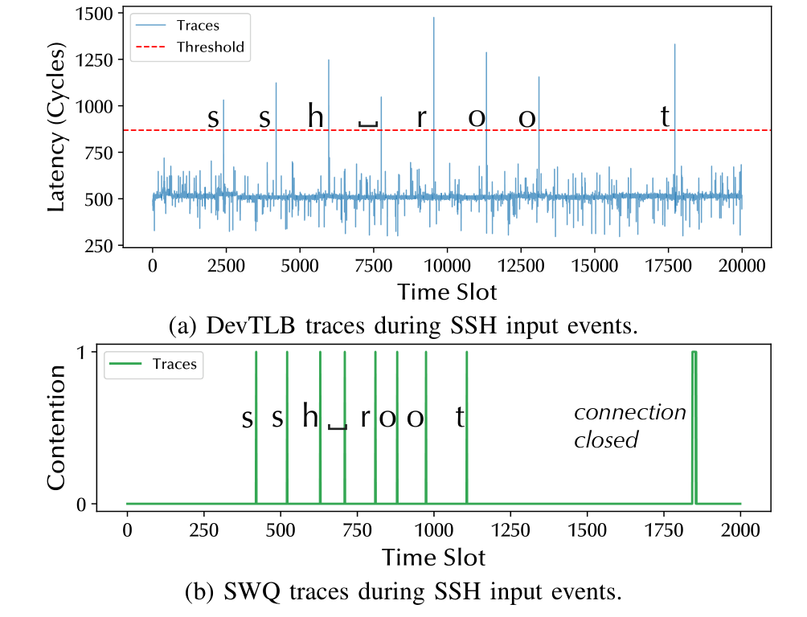
What it steals
You can see the typing
Read the panels
Top: completion latency
Bottom: queue contention
Labels: ground-truth input
Filtering affects event metrics; thresholds matter.
Both primitives reveal candidate keystroke events.
Paper § VI-C, Fig. 12 · p. 10 · original filtered traces
36
Notes:
MAIN TALK | ~60 s
Top: DevTLB attack; bottom: SWQ attack — both resolving 'ssh root' keystroke by keystroke. SWQ gives crisper spikes, foreshadowing its better timing. Honesty note for Q&A: events are filtered by byte-size and latency thresholds, so exact counts depend on those knobs — which matters for the next slide.
SOURCE: Paper § VI-C, Fig. 12 · p. 10 · original filtered traces

Slide 37
What it steals
SWQ wins timing — and a caveat I owe you
PRIMITIVE
REPORTED F1
TIMESTAMP DEVIATION (Σ)
DevTLB
92.0%
5.29 ms
SWQ
98.4%
1.21 ms
Reporting caveat: the detection / FP / FN counts in § VI-C do not fully reconcile with the printed F1 (see backup).
Use the headline values with attribution; disclose the arithmetic gap.
Paper § VI-C, Tables III–IV · pp. 10–12 · headline metrics as reported
37
Notes:
MAIN TALK | ~70 s
SWQ wins keystroke timing cleanly — 98.4% F1, 1.21 ms spread vs 5.29 for DevTLB, exactly what timer-free predicts. Use these headlines. But full disclosure: the paper's own detection/FP/FN counts don't perfectly reconcile with the printed F1 (backup). Doesn't overturn the conclusion, but a careful reader should know.
SOURCE: Paper § VI-C, Tables III–IV · pp. 10–12 · headline metrics as reported

Slide 38
What it steals
Attack #3 — fingerprinting the LLM next door
FAMILY
PARAMETER COUNTS
CHOICES
TinyStories
15M / 42M / 110M
3
LLaMA 2
7B
1
Gemma 3
1B / 4B
2
Qwen3
1.7B / 4B
2
50 traces per model · identical prompts · 80 / 20 split · 8 ms slots
The label is a model configuration — no weights or prompts are recovered.
Paper § VI-D, Table II · pp. 10–11
38
Notes:
MAIN TALK | ~65 s
LLM inference shuffles weights around memory; with DTO those moves hit DSA. Different sizes/architectures move memory in different rhythms. A slightly longer 8ms window becomes a model fingerprint. Be precise: which of 8 KNOWN configs, under IDENTICAL prompts. Not stealing weights, not reading prompts, not open-world.
SOURCE: Paper § VI-D, Table II · pp. 10–11

Slide 39
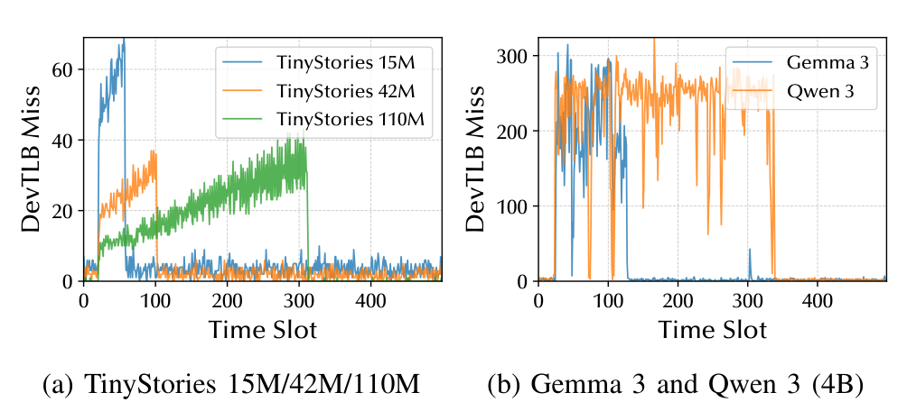
What it steals
98.6% — impressive, and bounded
98.6%
Validation accuracy
8 model choices
Generality beyond identical prompts and fixed runtimes remains open.
Distinguishable configurations within a controlled dataset.
Paper § VI-D, Fig. 13 · p. 11 · original model traces
39
Notes:
MAIN TALK | ~65 s
98.6%. Traces differ across sizes within a family and across families at a size — the model gets both. Striking that an accelerator twitch distinguishes LLMs through two VM walls. But keep the fence: fixed prompts, fixed runtimes, same host. Proves separability, not open-world identification.
SOURCE: Paper § VI-D, Fig. 13 · p. 11 · original model traces

Slide 40
Act 5 of 6
05
Does it hold up?
Robust across quiet / noisy and local / cloud
Better than prior work on capacity and timing — not every axis
The clean fix costs the thing DSA is for
40
Notes:
ACT 5: Does it hold up?
Robust across quiet / noisy and local / cloud · Better than prior work on capacity and timing — not every axis · The clean fix costs the thing DSA is for

Slide 41
Does it hold up?
It barely flinches under stress
METRIC
LOCAL
NOISY LOCAL
CLOUD
NOISY CLOUD
DevTLB covert (kbps)
17.19
16.81
16.97
16.52
SWQ covert (kbps)
4.02
4.08
3.96
3.80
Website accuracy
85.7%
86.0%
85.5%
85.1%
DevTLB keystroke F1
92.0%
90.5%
93.4%
93.0%
SWQ keystroke F1
98.4%
98.2%
99.1%
98.9%
LLM accuracy
98.6%
98.6%
97.7%
98.0%
Robustness covers these stressors; broader tenant interference remains open.
Paper § VI-E, Table III · p. 11 · all six reported rows
41
Notes:
MAIN TALK | ~70 s
Full Table III, all six rows. Most numbers barely move — tight CIs, no collapse. The one row worth naming: the DevTLB keystroke F1 varies a few points (90.5-93.4%), and cloud / noise can even raise it; the covert, website, SWQ-keystroke and LLM numbers stay within a point. Synthetic PCIe and memory pressure don't save you. Precise language: they stressed background NOISE, not a dozen real tenants fighting the same engine. 'Robust to noise' is proven; 'robust to a busy multi-tenant host' is not — open question. (Local column = the paper's geometric-mean baseline; other columns are the reported noisy / cloud runs.)
SOURCE: Paper § VI-E, Table III · p. 11 · all six reported rows

Slide 42
Does it hold up?
Better on two axes — honestly, not all
WORK / MECHANISM
CAPACITY
BIT ERROR
KEYSTROKE F1
KEYSTROKE Σ
WEBSITE ACC.
IPI
3.45 kbps
18.9%
97.9%
6.15 ms
— (F1 80.4%)
DEVIOUS / IOTLB
2.16 kbps
2.18%
—
10.08 ms
98.9% ¹
This work / DevTLB
17.19 kbps
4.63%
92.0%
5.29 ms
85.7%
This work / SWQ
4.02 kbps
13.11%
98.4%
1.21 ms
—
¹ DEVIOUS traces include GPU fingerprints; its IOTLB channel is since mitigated by PASID. IPI’s keystroke F1 beats DevTLB; DEVIOUS’s bit error beats both.
Best on capacity (DevTLB) and keystroke timing (SWQ) — not on every axis.
Paper § VI-F, Table IV · pp. 11–12 · cross-paper values, not matched re-runs
42
Notes:
MAIN TALK | ~70 s
Vs the prior IPI channel, DevTLB is ~5x capacity at a quarter of the error. SWQ has the best keystroke timing here. Fair referee: DEVIOUS actually has LOWER bit error than DevTLB. DSASSASSIN wins throughput and timing, not every axis. And these are cross-paper numbers, not a head-to-head — multipliers are indicative.
SOURCE: Paper § VI-F, Table IV · pp. 11–12 · cross-paper values, not matched re-runs

Slide 43
Does it hold up?
The clean hardware fix costs the thing DSA is for
DevTLB
SWQ
Partition replacement state by PASID
Cost: capacity · area · utilization
Goal: block cross-tenant eviction
Make queue-state feedback privileged
Challenge: legit submission retries
Goal: block occupancy inference
A defense must constrain interference and feedback, not just permissions.
Paper § VII · pp. 11–12 · proposals, not shipped fixes
43
Notes:
MAIN TALK | ~65 s
Root cause is structural: PASID TAGS entries but doesn't PARTITION the structure, and queue-full is a visible flag. Clean fix: partition the DevTLB by PASID like the IOTLB. Irony: that costs the capacity/perf DSA exists to provide. Hiding the queue flag collides with honest submitters needing retry info. Sketches, not deployed.
SOURCE: Paper § VII · pp. 11–12 · proposals, not shipped fixes

Slide 44
Does it hold up?
What an operator can do right now
EXPOSURE
BOUNDARY
SOFTWARE RESPONSE
DevTLB eviction
DSA engine
Allocate engines by trust domain
SWQ admission feedback
shared work queue
Avoid cross-tenant SWQ sharing
Sensitive-op offload
application path
Disable DSA on critical paths if needed
Separate queues do not close the shared-engine DevTLB channel.
Paper § VII · p. 12 · deployment guidance
44
Notes:
MAIN TALK | ~65 s
Via accel-config: give sensitive tenants their own ENGINE — not just queue, callback to slide 9, because separate queues leave the DevTLB channel open. Don't share SWQs across trust boundaries. For crown-jewel paths, turn DSA off. This is the misconception most likely to bite an operator, so I say it twice.
SOURCE: Paper § VII · p. 12 · deployment guidance

Slide 45
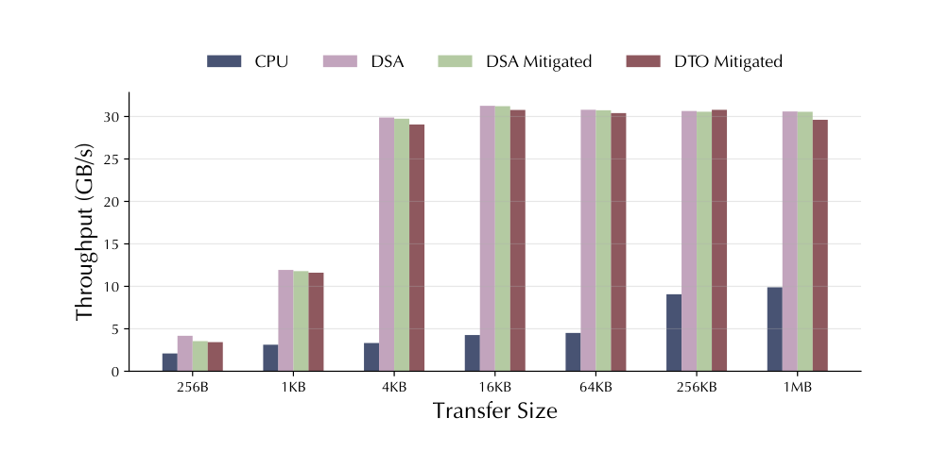
Does it hold up?
They measured the cost — not the leftover leak
Maximum reported loss
Native DSA
15.7%
DTO
17.9%
At
256-byte transfers
The plot measures throughput overhead; residual leakage is not quantified.
Paper § VII, Fig. 14 · p. 12 · original throughput chart
45
Notes:
MAIN TALK | ~65 s
Their defense sprinkles random translations to confuse the attacker, and they honestly measure cost — up to ~16-18% at small transfers, shrinking as transfers grow. The gap, and the perfect transition to critique: they measured what it COSTS, never how much leakage it LEAVES. Overhead study, not a proven fix.
SOURCE: Paper § VII, Fig. 14 · p. 12 · original throughput chart

Slide 46
Act 6 of 6
06
My verdict
The lasting contribution is the causal hardware analysis
Scope and reporting gaps qualify the headline claims
An isolation contract for shared accelerator state
46
Notes:
ACT 6: My verdict
The lasting contribution is the causal hardware analysis · Scope and reporting gaps qualify the headline claims · An isolation contract for shared accelerator state

Slide 47
My verdict
What’s genuinely excellent
Controlled reconstruction
page, field, queue, engine — each test is falsifiable
A real negative control
E2: separate engines eliminate the cross-VM DevTLB eviction
Two complementary interfaces
completion latency + admission feedback → distinct channels
The work turns an implementation detail into an isolation question.
Presenter assessment · paper §§ IV–VI
47
Notes:
MAIN TALK | ~65 s
My honest take: the lasting contribution is NOT the kbps number — it's the reverse engineering. Disciplined, falsifiable, with a real negative control in E2, which most exploit papers skip. First public look inside DSA, and it reframes accelerator internal state as part of the isolation boundary. Credit — disclosed to Intel.
SOURCE: Presenter assessment · paper §§ IV–VI

Slide 48
My verdict
What I’d push back on
LIMIT
WHAT IT CHANGES
Provisioning and co-location
who can reach the target — SWQ discovery is sketched; engine binding is assumed
Closed-world / fixed-prompt datasets
how far classification accuracy generalizes
Active congestion and probing
victim impact and possible detectability
Metric inconsistencies / missing detail
confidence in exact quantitative claims
The shared-state leakage is well-supported; deployment reach needs more evidence.
Presenter assessment · paper §§ V–VII, esp. § VI-C
48
Notes:
MAIN TALK | ~70 s
Four pushbacks. One: it rests on CO-LOCATION, assumed more than demonstrated. Two: classifiers are closed-world, fixed-prompt — generality unproven. Three: the SWQ attack is ACTIVE — jamming a queue the victim needs — so perf and detectability costs aren't really evaluated. Four: keystroke metrics don't reconcile. None breaks the core finding; they mean the shouting numbers need more evidence.
SOURCE: Presenter assessment · paper §§ V–VII, esp. § VI-C

Slide 49
My verdict
The experiments I’d want to see
Isolation study
Generality study
Deployment study
Residual leakage +
throughput
PASID-aware replacement
Cross-day / cross-host
Unseen sites / prompts
Matched runtimes
Many concurrent tenants
Victim latency / retries
Probe detectability
Measure security and performance together, under the same configuration.
Presenter-proposed · not reported in the paper
49
Notes:
MAIN TALK | ~65 s
If I supervised the follow-up: close the loop on the defense — leakage AND throughput in one config, for the real security-performance curve. Break the closed world — train one day, test another; train some sites, test unseen. Study it under a crowd — many tenants, how loud and detectable the attacker is. My proposed experiments.
SOURCE: Presenter-proposed · not reported in the paper

Slide 50
My verdict
Shared accelerator state belongs in the isolation model
01
Engine sharing exposes DevTLB replacement.
02
Queue sharing exposes admission feedback.
03
Application offload gives those signals meaning.
Discussion: what should an accelerator isolation contract guarantee?
Based on Chen et al., HPCA 2026 · main talk ends here
50
Notes:
MAIN TALK | ~70 s
Where we landed — the sentence I opened with, now earned. VT-d guards addresses and works. But the accelerator behind that wall has a shared heartbeat — in its translation cache and its queue — and offloaded apps give it meaning. As we offload more, the isolation model must cover internal state, not just addresses. Open question: when a cloud sells an 'isolated' accelerator, what must that contract guarantee? Thank you.
SOURCE: Based on Chen et al., HPCA 2026 · main talk ends here

Slide 51
Backup · Glossary
Glossary
TERM
MEANING IN THIS PAPER
DSA
Intel Data Streaming Accelerator
ATS / TA
Address Translation Services / Translation Agent
ATC / DevTLB
device-side cache of address translations
PASID
process address-space ID; translation context
WQ / SWQ / DWQ
work queue / shared / dedicated work queue
DMWr / ENQCMD
deferrable memory write / descriptor submission
DTO
DSA Transparent Offload library
Paper §§ II–V · pp. 2–8
51
Notes:
BACKUP | ~45 s
Reference for acronyms.
SOURCE: Paper §§ II–V · pp. 2–8

Slide 52
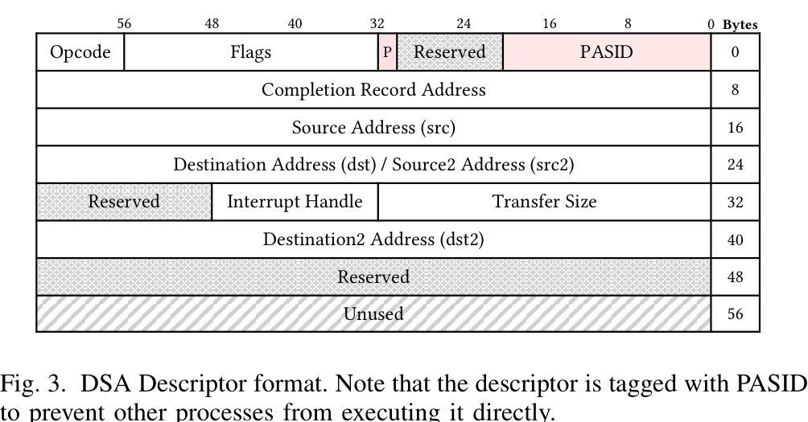
Backup · Descriptor detail
Descriptor layout — field meaning depends on opcode
OFFSET
FIELD
SLOT
0
opcode / flags / PASID
header
8
completion record
comp
16
source
src
24
dest OR source2
dst / src2
40
second dest
dst2
Paper Fig. 3 · p. 4
52
Notes:
BACKUP | ~45 s
Note the offset-24 overlap.
SOURCE: Paper Fig. 3 · p. 4

Slide 53
Backup · Timing & calibration
Observation windows have different constraints
ASPECT
DEVTLB
SWQ
Prepare
own comp-page cached
effective occupancy ≈ N−1
Idle window
permit victim execution
shorter than holding copy
Probe
time own completion
read acceptance / retry
Calibration
hit / miss distributions
queue depth + drain
Confounder
other users of the slot
other submissions / completions
Paper §§ IV-B–C, V-B–C · pp. 5–8
53
Notes:
BACKUP | ~45 s
Calibration / timing.
SOURCE: Paper §§ IV-B–C, V-B–C · pp. 5–8

Slide 54
Backup · Reporting audit
Keystroke count arithmetic needs clarification
FOR 512 GROUND-TRUTH EVENTS
DEVTLB
SWQ
Reported detections / FP
515 / 15
511 / 7
Implied TP = det − FP
500
504
Implied FN = 512 − TP
12
8
Printed FN / TP
61 / 500
9 / 507
Diagnostic F1 (fixed totals)
97.37%
98.53%
These calculations expose the inconsistency; they do not repair the experiment. Also: the abstract/contributions say 4.64% covert bit error; §VI-A and Table IV say 4.63%.
Paper § VI-C · p. 10 · diagnostic only
54
Notes:
BACKUP | ~45 s
Reported detection / FP / FN do not match the printed F1.
SOURCE: Paper § VI-C · p. 10 · diagnostic only

Slide 55
Backup · Evaluation detail
Sampling and dataset sizes
SETTING
WEBSITE TASK
LLM TASK
Sample interval
10 µs
10 µs
Samples per slot
400
800
Slot duration
4 ms
8 ms
Classes × traces
100 × 200
8 × 50
Total traces
20,000
400
80 / 20 split
16,000 / 4,000
320 / 80
Paper §§ VI-B, VI-D · pp. 9–11
55
Notes:
BACKUP | ~45 s
Reproducibility.
SOURCE: Paper §§ VI-B, VI-D · pp. 9–11

Slide 56
Backup · Metric interpretation
Different metrics answer different questions
METRIC
QUESTION IT ANSWERS
Raw rate / true capacity
how fast are attempts / useful bits reported?
Bit error rate
how often does a decoded bit differ?
Top-1 accuracy
how often is the class correct?
Precision / recall
how many detections correct / events found?
F1 = 2TP / (2TP+FP+FN)
balance of precision and recall
Timestamp σ
how dispersed are timing differences?
Paper §§ VI-A–F · pp. 9–12
56
Notes:
BACKUP | ~45 s
What each metric means.
SOURCE: Paper §§ VI-A–F · pp. 9–12

Slide 57
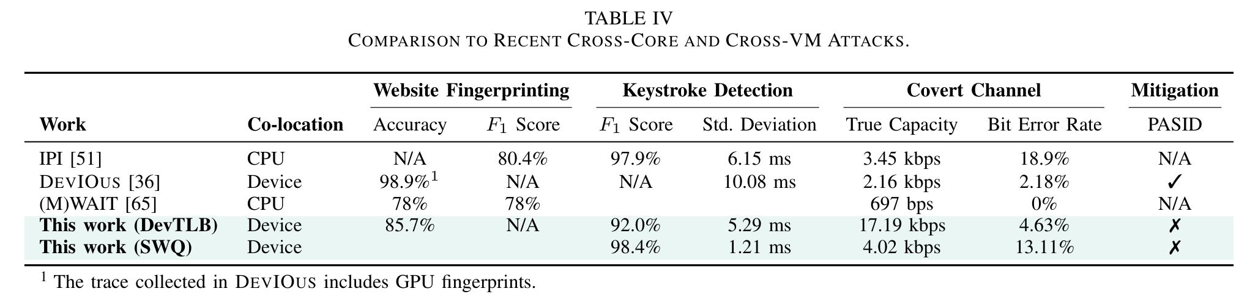
Backup · Prior-work detail
The original cross-paper comparison table
Paper Table IV · p. 12 · blank cells = not reported
57
Notes:
BACKUP | ~45 s
DEVIOUS trace includes GPU fingerprints.
SOURCE: Paper Table IV · p. 12 · blank cells = not reported

Slide 58
Backup · Artifact & reproducibility
Reproduction requires a configured DSA platform
Hardware & provisioning
DSA-capable Xeon; VT-d / IDXD; admin configuration + device access
Victim-specific software
VPP / DPDK for websites; DTO-enabled SSH and inference workloads
Artifact organization
playground → characterization; attack → traces; evaluate → metrics
github.com/hkustgz-secarch/dsassassin · DOI 10.5281/zenodo.17799273
Paper Appendix, p. 15 · authors’ artifact
58
Notes:
BACKUP | ~45 s
Hardware, victim software, artifact layout.
SOURCE: Paper Appendix, p. 15 · authors’ artifact

Slide 59
Backup · Q&A preparation
Likely questions and concise answers
QUESTION
ANSWER
Does encryption stop it?
content protection does not remove activity patterns
Do separate CPU cores help?
the observations arise in shared DSA resources
Do separate queues help?
SWQ: yes; DevTLB: also separate the engines
Are typed characters recovered?
it evaluates event timing, not full text recovery
Would timer removal solve it?
SWQ reads admission feedback without a duration
Is random insertion a proven fix?
overhead is measured; residual leakage is not
Answers from paper §§ IV–VII + presenter assessment
59
Notes:
BACKUP | ~45 s
Prepared Q&A.
SOURCE: Answers from paper §§ IV–VII + presenter assessment

Slide 60
Backup · References
Sources and provenance
Primary paper
Chen, Li, Deng, Wang, Chen. DSASSASSIN. HPCA 2026
Author-hosted PDF
i.benx.dev/assets/hpca26dsassassin.pdf
Artifact
github.com/hkustgz-secarch/dsassassin
Archive + record
doi.org/10.5281/zenodo.17799273 · 2026.hpca-conf.org
Primary source: user-supplied hpca26dsassassin.pdf
60
Notes:
BACKUP | ~45 s
Citation and links.
SOURCE: Primary source: user-supplied hpca26dsassassin.pdf

