Slide 1
HPCA 2026 | PAPER PRESENTATION
DSASSASSIN
Cross-VM side-channel attacks by exploiting
Intel Data Streaming Accelerator
PAPER AUTHORS
Ben Chen, Kunlin Li, Shuwen Deng, Dongsheng Wang, Yun Chen
HKUST (Guangzhou) and Tsinghua University
Presented by Siddharth Banakar and Dinesh Samala
29 October 2026
1
Notes:
SLIDE 1: DSASSASSIN
READ-ALOUD TRANSCRIPT
Hi everyone. We're Siddharth Banakar and Dinesh Samala, and today we're presenting DSASSASSIN. The paper studies Intel's Data Streaming Accelerator, or DSA, which moves memory operations away from the CPU.
The question is fairly simple. If two virtual machines share that accelerator, can one learn something about the other's activity without reading its memory? The authors show two ways that this can happen. We'll explain the hardware first, walk through the experiments and code, and then show how those observations become application-level inferences.
REFERENCE NOTES (not part of the spoken script)
- The paper studies Intel DSA on the evaluated Xeon platforms. Avoid claiming that DSA is present in every recent Xeon.
- The named presenters are distinct from the five original paper authors.
SOURCE: Chen, Li, Deng, Wang, and Chen. DSASSASSIN, HPCA 2026. Sections I and II, pp. 1-3.

Slide 2
Presentation plan
01
The system
Offload goals, DSA operations, IOMMU, VT-d, and sharing
02
Evidence and attacks
Field tests, engine controls, DevTLB and SWQ probes
03
From signals to inference
Activity traces, covert communication, websites
04
Workload results
Keystroke events, model configurations, tested noise
05
Mitigations and conclusions
Sharing boundaries, proposed defenses, remaining limits
Follow one request, one probe, and then one inferred label.
2
Notes:
SLIDE 2: Presentation plan
READ-ALOUD TRANSCRIPT
Here's the route we'll take. First, we'll look at why memory operations are offloaded, then follow a DSA request and its address translations. That gives us the pieces we need to understand what the virtual machines share.
Then we'll look at the experiments and the two attacks. After that, we'll follow a probe result into a trace and an inference. We'll finish with the application results, the evaluation limits, and the proposed mitigations. The first question is why these memory operations are being sent to an accelerator at all.
REFERENCE NOTES (not part of the spoken script)
- This agenda is presenter organization, not a separate empirical claim. Slides 1 and 2 introduce the talk; the five sections cover slides 3-25.
SOURCE: Presentation organization based on paper Sections II, IV, V, VI, and VII.

Slide 3
Why offload memory operations?
Free CPU time for
application work
Offloaded operation
What DSA does
Copy / dualcast
Copy to one or two destinations
Bulk copies consume CPU
execution cycles.
Fill
Write a repeated pattern
Submit work asynchronously.
The CPU can compute while
DSA moves or transforms data.
Compare
Compare buffers or a pattern
CRC / DIF
Generate or check integrity data
Network buffers, storage,
and VM checkpoints
Delta records
Encode or apply changes
Submission overhead and memory bandwidth still matter.
3
Notes:
SLIDE 3: Why offload memory operations?
READ-ALOUD TRANSCRIPT
Before we look at the attack, why use DSA at all? A CPU can already copy and compare memory, but moving large buffers repeatedly uses instruction-execution time and ties up cores that could be doing application work.
The program selects these bulk jobs; ordinary CPU loads and stores still execute on the CPU. DSA takes those bulk operations as asynchronous jobs. While it handles a buffer, the CPU can work on something else, provided the program doesn't need that result yet. That can help with network buffers, storage, and virtual-machine checkpoints.
The supported jobs include copies and dualcast, which copies one source to two destinations; filling and comparing memory; CRC checksums and DIF integrity operations; and creating or applying delta records.
There is still submission and completion overhead, so small jobs aren't automatically faster when offloaded. DSA also doesn't create extra DRAM bandwidth. The benefit depends on the operation and workload. The security question is what happens when different tenants share the hardware doing that work.
REFERENCE NOTES (not part of the spoken script)
- DSA is a data-movement and transformation accelerator. Offload can free CPU execution resources and allow independent computation to overlap with asynchronous work; it does not remove memory-bandwidth limits.
- Dualcast copies one source to two destinations. Fill writes a repeated pattern. Compare can compare buffers or compare against a pattern. CRC and DIF operations support integrity generation/checking. Delta-record operations create or apply a representation of changes.
- CRC means cyclic redundancy check. DIF means data integrity field. These are integrity mechanisms, not a claim that DSA performs general encryption.
- Network buffers, storage operations, and VM checkpoints are examples of data-movement workloads. They are motivation and use cases, not three additional attacks evaluated in this paper.
- Submission, queueing, synchronization, and completion processing have costs. Benefits depend on transfer size, batching, parallel work, CPU implementation, and available memory bandwidth.
- The program or offload library selects eligible bulk jobs. DSA does not transparently execute every ordinary CPU load and store.
- Intel explains CPU-cycle relief, asynchronous overlap, and the unchanged peak DRAM-bandwidth constraint in its DSA optimization article: https://www.intel.com/content/www/us/en/developer/articles/technical/accelerate-memory-bandwidth-bound-kernels-with-dsa.html
- Intel's fourth-generation Xeon OVS-DPDK guide explains that descriptor creation and completion waiting can outweigh CPU-copy time for small packets. The crossover depends on the workload and configuration: https://www.intel.com/content/www/us/en/developer/articles/guide/tuning-guide-ovs-dpdk-dsa-4th-gen-xeon-scalable.html
SOURCE: Paper Section II-A, pp. 2-3, and Section IV-B for dualcast; Intel DSA memory-bandwidth optimization article and 4th-generation Xeon OVS-DPDK tuning guide (official links in context).

Slide 4
Private addresses can still share hardware
Victim VM
Attacker VM
Own address space and data
Own requests and measurements
↓
↓
Shared DSA engine and work queue
The attacker measures its own completion time or submission result.
The observable signal is resource activity, not the victim’s bytes.
4
Notes:
SLIDE 4: Private addresses can still share hardware
READ-ALOUD TRANSCRIPT
Imagine two virtual machines using the same physical accelerator. Their memory is protected, so the attacker can't simply load an address and read the victim's data. Requests carry an address-space identity, and the translation system checks which memory they may access.
But address permissions don't automatically separate every internal hardware resource. Both VMs may still use the same engine or compete for admission to the same queue. The attacker can submit its own requests and observe whether they were accepted or how long they took to finish.
That's the distinction to keep in mind throughout this talk. The observation is about shared resource activity. Any later claim about a website or a keystroke has to be inferred from that observation. To see where those signals come from, let's follow a DSA request.
REFERENCE NOTES (not part of the spoken script)
- PASID identifies an address-space context; do not equate address authorization with independent replacement capacity.
- The paper's cross-VM setup has no shared memory or direct communication channel between attacker and victim. Covert-channel experiments separately use cooperating sender and receiver roles.
SOURCE: Paper Sections I, II-B, III, and V-A, pp. 1-3 and 7-8.

Slide 5
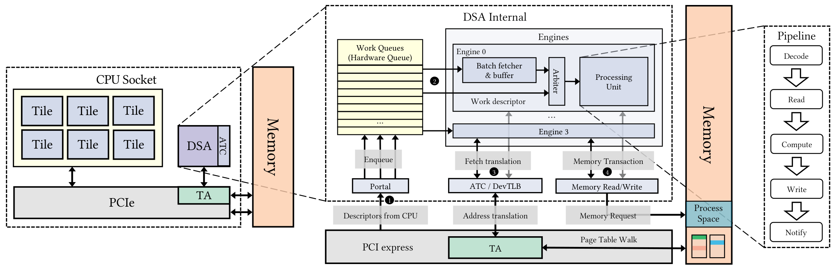
How one DSA request completes
Prepare descriptor
Submit to portal
Execute in engine
Write completion
The attacker can observe acceptance and completion of its own work.
5
Notes:
SLIDE 5: How one DSA request completes
READ-ALOUD TRANSCRIPT
A program starts by preparing a descriptor. Think of it as a small request record containing the operation, the relevant addresses, and where to report completion. The program submits that descriptor through a portal, and the work queue buffers it for an engine.
On the original diagram, follow the request into the processing unit. The stages are decode, read, compute, write, and notify. The engine may need address translations before issuing memory transactions. Once the work is complete, the completion record tells the submitting program that it can continue.
There are two different moments to observe here. A submission can be accepted before the operation has finished. So the attacker can ask, 'Did my request get into the queue?' It can also ask, 'How long did my request take to complete?' Those become the two channels. First, we need to understand the translations used along this path.
REFERENCE NOTES (not part of the spoken script)
- Figure 1 contains functional stages, not a cycle-accurate instruction schedule. Use the drawn stage names because the prose's numeric stage references are inconsistent.
- The batch fetcher and arbiter select and prepare work within the engine. Their scheduling behavior is revisited with Listing 5.
- Accepted submission does not imply completed operation.
SOURCE: Paper Figure 1 and Sections II-A/B, pp. 2-3.

Slide 6
How IOMMU and VT-d protect device accesses
IOMMU translates device accesses and checks memory permissions.
VT-d is Intel's architecture for I/O translation and isolation.
DSA: DevTLB
Miss: ATS request
IOMMU
Virtual page + PASID context
Mapping and access permissions
Mapping + permissions
Host-side IOTLB lookup
Page-table walk if needed
Hit: reuse the cached mapping
Source, destination, and completion records
occupy ordinary memory buffers.
Physical page in RAM
Permissions can stay intact while shared cache state leaks activity.
6
Notes:
SLIDE 6: How IOMMU and VT-d protect device accesses
READ-ALOUD TRANSCRIPT
Now let's make the address-translation path concrete. An IOMMU translates device memory requests and checks whether those accesses are allowed. Intel VT-d is Intel's architecture for this I/O translation and isolation.
A request is interpreted in its device and address-space context. PASID identifies a process address space within that context; it isn't a globally meaningful identity by itself. The translation maps the requested address to a physical address and supplies the relevant access permissions. Under virtualization, that may involve multiple translation stages rather than one flat lookup.
DSA keeps reusable translations in its device-side cache, the DevTLB. On a hit, it reuses an authorized cached mapping. On a miss, it sends an ATS translation request to the host's Translation Agent, associated with the IOMMU. The host may answer from its IOTLB cache. Otherwise, it may need a page-table walk to resolve the request.
The physical page is simply a region of RAM backing the data, perhaps a source buffer, destination buffer, or completion record. Physical describes its address, not a new type of storage. The DevTLB holds mapping information, context, and permissions, not those bytes or an application name. Let's now look at how many translations each engine retains.
REFERENCE NOTES (not part of the spoken script)
- IOMMU means input/output memory management unit. It translates and authorizes device DMA accesses. DMA means direct memory access.
- Intel VT-d means Intel Virtualization Technology for Directed I/O. It is Intel's I/O translation and isolation architecture, implemented through DMA-remapping hardware; it is not an alternative name for the device-side DevTLB.
- PASID means Process Address Space Identifier. It selects a process address-space context together with the relevant device/translation context; a PASID number alone is not a globally unique identity.
- ATS means Address Translation Services. A device can request an address translation from the host Translation Agent. A successful response provides the translated address and access-permission information that can be cached by the device.
- The IOTLB is the Input/Output Translation Lookaside Buffer in the host translation path. A DevTLB miss does not necessarily cause a page-table walk because the IOTLB may satisfy the translation request.
- A request can be rejected if the mapping or permissions do not allow the requested access. The diagram shows the successful authorized translation path.
- The cached mapping includes relevant context and permission information. The slide is a conceptual path, not a reconstructed bit-level entry format or a claim that every VM has its own replacement capacity.
- A physical page is ordinary RAM viewed by physical address. It can back source data, destination buffers, instructions, or a completion record. Application data lives in those pages, not in the translation-cache entry.
- Virtualized translation can involve multiple stages. The diagram deliberately collapses those stages to explain the device cache, host translation path, and physical memory.
- The paper warms IOTLB and page-table state during DevTLB characterization. Shared replacement capacity can leak activity even when address-space permissions remain enforced.
- DevTLB means Device Translation Lookaside Buffer. In this presentation it is the device-side address-translation cache, distinct from the host IOTLB.
- Intel's Scalable I/O article describes PASID-selected client address spaces, translated host physical addresses, and the ATS path between a device cache and host IOMMU: https://www.intel.com/content/www/us/en/developer/articles/technical/scalable-io-between-accelerators-host-processors.html
- Intel describes VT-d as its I/O virtualization and isolation technology: https://www.intel.com/content/www/us/en/support/articles/000058162.html
- Intel's VTune documentation distinguishes the host remapping hardware and its IOTLB cache: https://www.intel.com/content/www/us/en/docs/vtune-profiler/cookbook/2025-0/analyze-uncore-perfmon-events-for-intel-ddio.html
- Translation permissions are shown as architectural information, not as a reverse-engineered claim about literal DevTLB entry bits.
SOURCE: Paper Section II-B and Figure 1, pp. 2-3, and Section IV-B, pp. 4-6; Intel Scalable I/O, VT-d, and host-IOTLB documentation (official links in context).

Slide 7
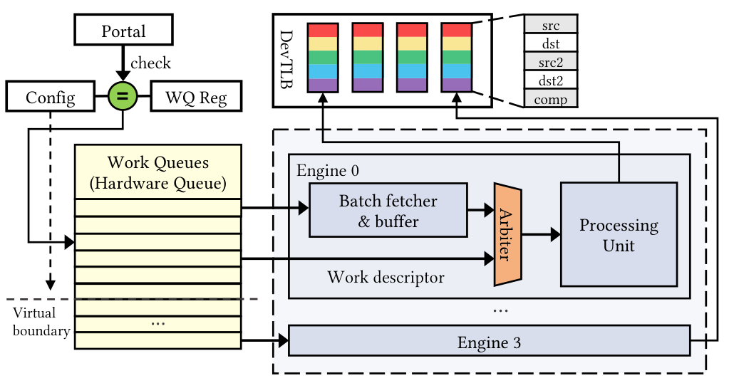
Five translation slots per engine
Observed on the tested platforms
Five slots per engine:
src, src2, dst, dst2, comp
One entry in each slot
A new page in the same role
can replace the old mapping.
Shared replacement capacity
creates the timing signal.
Address-space authorization does not imply separate cache capacity.
7
Notes:
SLIDE 7: Five translation slots per engine
READ-ALOUD TRANSCRIPT
The authors reverse-engineered the structure shown here. On their tested hardware, each engine has five translation slots. They correspond to the source, second source, destination, second destination, and completion-record fields. Each slot retains one translation.
That small capacity makes replacement easy to observe. Suppose my completion record is on page A, and its translation is currently in the completion slot. A later completion write using another page can replace it. When I access my own page again, I may have to fetch its translation again, which can make my request slower.
Notice what I haven't learned. I still don't know the other page's address or contents. I have evidence that the shared state changed. Also, this is the organization measured on the tested platforms, not a claim about every possible accelerator design. The next question is how a descriptor selects one of these slots.
REFERENCE NOTES (not part of the spoken script)
- The five one-entry field slots are an empirical finding. Shared replacement capacity is separate from permission to use another address space's translation.
- For cross-page transactions, the paper reports that only the final page segment's translation remains in the corresponding slot.
- The batch fetcher's own descriptor reads and completion-record writes bypass this indexing path. Distinguish them from engine completion writes used by the NOOP probe.
SOURCE: Paper Figure 2 and Sections IV-A/B, pp. 4-6.

Slide 8
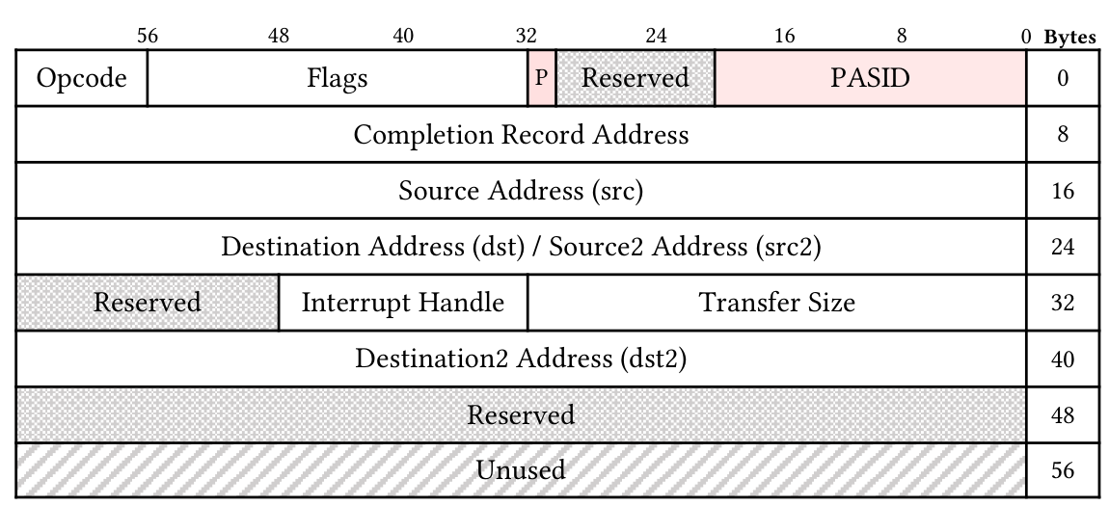
Descriptor fields select the slot
Operation
Fields used
NOOP
comp
Compare
src, src2, comp
Copy
src, dst, comp
Dualcast
src, dst, dst2, comp
Completion-record writing is enabled in these examples.
At offset 24, the same bytes mean src2 for compare and dst for copy.
8
Notes:
SLIDE 8: Descriptor fields select the slot
READ-ALOUD TRANSCRIPT
Here's the descriptor format from the paper. The important point is that the operation determines what each address field means. A copy uses source and destination addresses. A compare uses two source addresses. With completion writing enabled, both also use the completion-record address.
Look at offset 24. For a compare operation, those bytes represent the second source. For a copy, the same bytes represent the destination. The researchers found that these roles use separate translation slots, even though they share a position in the descriptor. We'll see the code that tests that shortly.
A NOOP is especially useful for probing because it avoids moving a payload while still writing a completion record when configured to do so. That gives the attacker a simple way to exercise its own completion slot. Before looking at the experiments, let's make the required sharing conditions explicit.
REFERENCE NOTES (not part of the spoken script)
- Relevant descriptor offsets are 8 for completion, 16 for source, 24 for destination or second source, and 40 for second destination.
- The operation table uses semantic operation names. Listing 1 prints DSA_OPCODE_COMPVAL in a helper described as a two-source compare; the slides do not silently treat that constant as a verified two-buffer compare encoding.
- NOOP probing depends on completion-record setup and flags. Those prerequisites are omitted from the short printed listings.
SOURCE: Paper Figure 3 and Section IV-B, pp. 4-5.

Slide 9
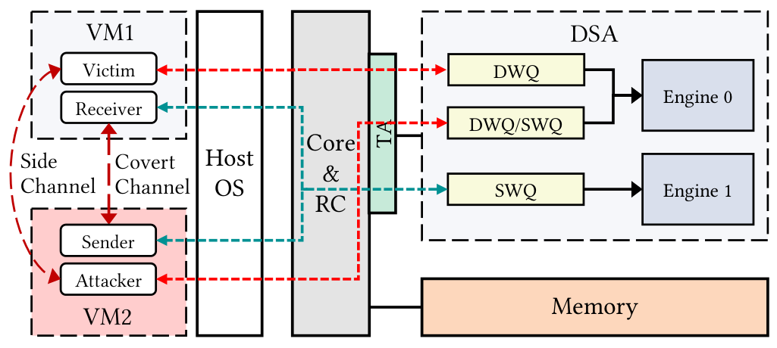
The sharing assumptions for each channel
DevTLB timing
Same engine.
Work queues may differ.
SWQ contention
Same shared work queue.
Provisioned device access
and co-location are assumed.
The paper also requires the CAP_SYS_RAWIO submission capability.
Separating queues still leaves the DevTLB channel on a shared engine.
9
Notes:
SLIDE 9: The sharing assumptions for each channel
READ-ALOUD TRANSCRIPT
The two channels require different kinds of sharing. For the translation-cache channel, the attacker and victim need access to the same engine. Their work queues can be different. For the queue channel, they need to share the same shared work queue, or SWQ.
These are assumptions about the deployment. The paper gives the attacker provisioned access to DSA and explicitly requires the CAP_SYS_RAWIO capability for descriptor submission. It doesn't give the attacker authority to reconfigure the host's engines and queues. So we shouldn't describe this as an attack available to every ordinary process by default.
Within that setup, the VMs don't share memory, and the attack doesn't require a shared CPU core. The attacker observes its own submissions and completions. With those conditions clear, we can look at the experiments that establish the cache's capacity and sharing boundary.
REFERENCE NOTES (not part of the spoken script)
- Section V-A explicitly names CAP_SYS_RAWIO. Provisioning and submission capability must remain visible in the threat model.
- The paper distinguishes privileged queue/engine configuration from use of an existing binding, but its affinity wording is not fully consistent. Treat engine/queue co-location as an assumption rather than a universally available operation.
- Figure 7 includes both sender/receiver and attacker/victim role labels. These refer to covert-channel and side-channel cases, not four mandatory simultaneous processes.
SOURCE: Paper Figure 7 and Section V-A, pp. 7-8.

Slide 10
One conflicting page can replace a slot
PAPER LISTING 2
probe_noop(base); // base is 4KB aligned
probe_noop(base + OFFSET); // try evicting
probe_noop(base); // probe if base is present
Second access
Final probe of base
Observation
Same 4 KiB page
Hit
The cached page is reused
A different page
Miss
One conflict replaces the entry
For NOOP, base is the attacker’s own completion-record page.
10
Notes:
SLIDE 10: One conflicting page can replace a slot
READ-ALOUD TRANSCRIPT
This is the capacity experiment. The first call uses base and puts its translation into the tested slot. The second call uses base plus an offset. The third call returns to base so the researchers can check whether its translation survived.
When the second address stays within the same four-kilobyte page, the final access reuses the translation. When it moves to another page, the final access misses. Across their experiments, that behavior supports a single cached entry for the field: one conflicting page is enough to replace it.
For the NOOP helper, base means the completion-record address. It isn't a victim buffer that the attacker somehow knows. The code shown here is a short experimental excerpt, so the descriptor setup and completion flags aren't included. This establishes capacity within a field. Next, we need to check whether different fields share that same entry.
REFERENCE NOTES (not part of the spoken script)
- The paper also reports eviction of a 4 KiB translation by an address on a 2 MiB huge page, suggesting no separate per-page-size entries in the tested structure.
- Do not claim that one three-call observation alone proves an arbitrary cache's entire organization. The conclusion follows from the reported characterization suite.
- Listing 2 is a microbenchmark excerpt, not a complete runnable attack.
SOURCE: Paper Listing 2 and Section IV-B, p. 5.

Slide 11
Source and destination use separate slots
PAPER LISTING 3
Change the source
// different page
assert(PAGE_OF(src0) != PAGE_OF(dst0));
probe_memcpy(src0, dst0); // prime devtlb
// src1 is on a different page with the src
probe_memcpy(src1, dst0);
Keep dst fixed.
Only src changes.
The dst mapping survives.
PAPER LISTING 4
Change the role
// src2 overlaps dst
probe_memcmp(src, src2);
// dst and src2 in same page
probe_memcpy(src, dst);
Same page and byte position.
src2 does not give dst a hit.
Translation reuse follows the semantic field, not just the address.
11
Notes:
SLIDE 11: Source and destination use separate slots
READ-ALOUD TRANSCRIPT
The first listing asks whether changing the source also destroys the destination's cached translation. It copies from one source to a destination, then changes the source page while keeping the destination the same. The destination still contributes a hit. That tells us the source and destination have independent cached state.
The second listing tests the overlapping descriptor position we saw earlier. It compares two buffers, then performs a copy. The second source from the compare and the destination from the copy are placed on the same page. If those two roles shared an entry, that page could provide a reuse hit in the copy.
Instead, the reported reuse comes only from the unchanged source role. The second-source translation doesn't act as a destination translation. So it is the field's meaning that matters, not just the address or its byte position in the descriptor. Now we can test which engine shares those slots.
REFERENCE NOTES (not part of the spoken script)
- The paper extends the independence test to dualcast, retaining two destination hits while changing the source.
- Listing 4 reports one hit from src rather than the two hits expected if src2 and dst shared an entry.
- These printed helpers omit descriptor initialization and other execution setup. Preserve their original text and semantic operation names.
SOURCE: Paper Listings 3 and 4, Figure 3, and Section IV-B, p. 5.

Slide 12
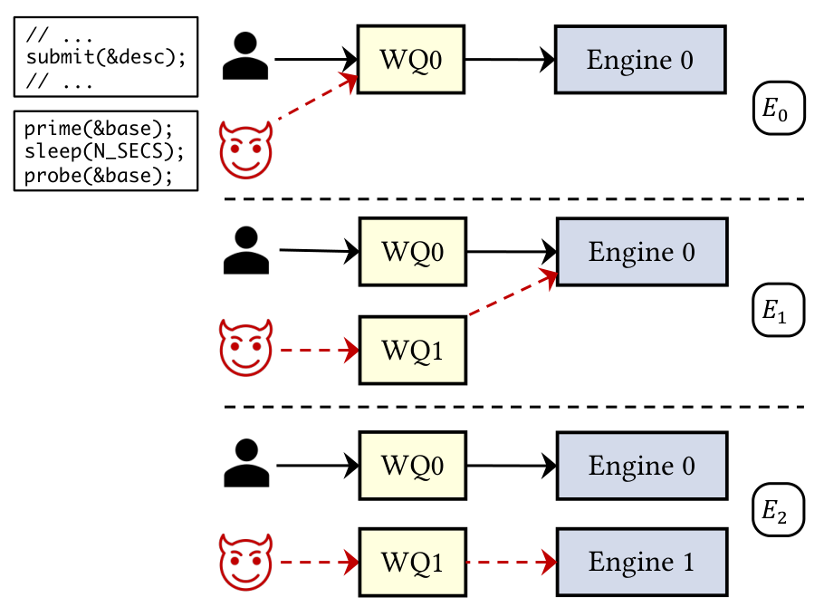
Eviction follows the shared engine
Case
Shared resource
Probe
E0
Same queue + engine
Miss
E1
Different queues; same engine
Miss
E2
Different engines
Hit
E2 preserves the attacker’s entry.
It is the separate-engine control.
The tested eviction follows the shared engine, not queue identity.
12
Notes:
SLIDE 12: Eviction follows the shared engine
READ-ALOUD TRANSCRIPT
The authors now move from one engine's behavior to interference between two virtual machines. They run three configurations shown in the original figure.
In E0, both sides use the same queue and engine. The attacker's primed translation is replaced, so its later probe misses. In E1, they use different queues but still reach the same engine. The probe still misses. Queue separation alone hasn't separated the translation-cache state.
E2 changes the engine as well. This time, the primed translation survives and the probe hits. That's the control that ties the observed interference to the shared engine. It supports a concrete boundary in the tested configuration; it isn't a guarantee about every accelerator or every deployment.
These characterization experiments explain what is shared. The next question is whether an attacker can recognize a hit or miss using a signal available from its own code.
REFERENCE NOTES (not part of the spoken script)
- E0 and E1 report cross-VM eviction; E2 is the separate-engine control.
- Engine sharing is a requirement of the measured DevTLB channel. Sharing alone does not guarantee that every probe will detect a victim operation.
- Separate queues can still share engine-local replacement capacity.
SOURCE: Paper Figure 5 and Section IV-B, p. 6.

Slide 13
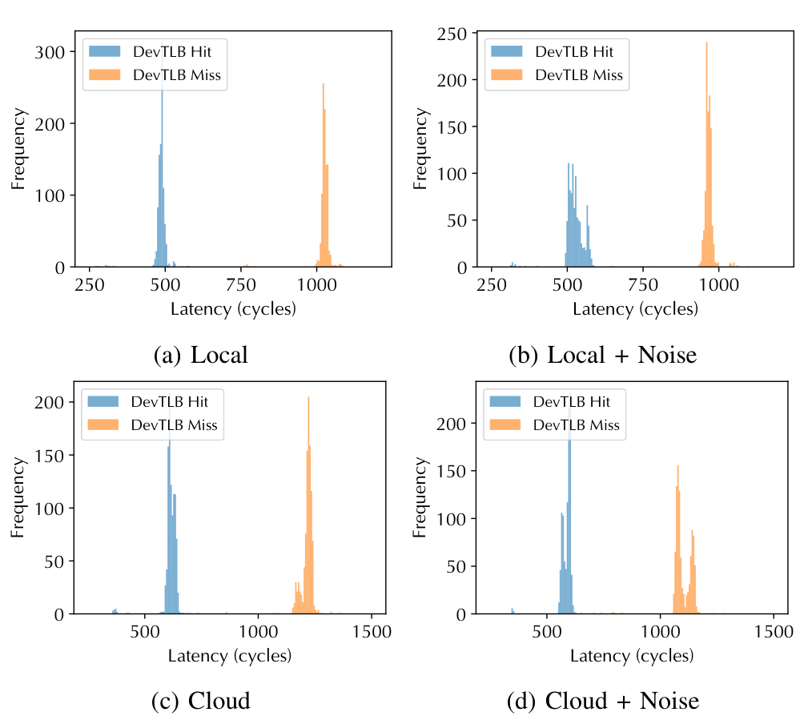
How a probe distinguishes a hit from a miss
~500 cycles
DevTLB hit
>1,000 cycles
DevTLB miss
Calibrate a threshold.
The paper used 600 to 900 cycles.
The spy times its own probe; it does not read the victim’s hit counters.
13
Notes:
SLIDE 13: How a probe distinguishes a hit from a miss
READ-ALOUD TRANSCRIPT
The attacker doesn't get a message saying which cache entry the victim touched. It measures the time taken by its own request. In the paper's measurements, requests whose translations hit cluster around five hundred cycles. Misses take more than a thousand cycles.
That separation lets the attacker choose a threshold and classify a probe as likely hit or likely miss. The authors report thresholds between six hundred and nine hundred cycles in these experiments. Those are measured values for their setup, not universal constants to copy onto any machine.
The figures also include local and cloud runs with background load. The distributions move, but remain distinguishable in those tests. Performance counters help the researchers characterize the hardware; the attack's observation is its own completion timing. A single slow request still has possible competing explanations. Repeated, calibrated measurements are what make the next attack sequence useful.
REFERENCE NOTES (not part of the spoken script)
- The injected stressors include approximately 2 GB/s of NVMe/PCIe traffic and 10 GB/s of CPU memory-copy traffic.
- A miss classification is inferred from completion latency. It is not direct access to victim addresses or to a hardware victim-hit log.
- The paper uses privileged characterization counters to investigate structure; those counters are not the attacker-facing timing signal.
SOURCE: Paper Figure 4 and Section IV-B, pp. 5-6.

Slide 14
DevTLB attack: prime, wait, probe
Prime your page
Wait for activity
Time your next probe
PAPER LISTING 1 | LINES 7-12
Read the timing order
enqcmd(wq_portal, &desc);
// time polling for completion
start = rdtsc();
while (comp.status == 0);
end = rdtsc();
return end - start;
ENQCMD returns first.
RDTSC then starts the timer.
Poll your completion record.
Slow polling suggests
replacement under the
calibrated conditions.
Listing 1 times a compare helper. The NOOP attack reuses this timing pattern.
Repeated probes turn replacement activity into an observable trace.
14
Notes:
SLIDE 14: DevTLB attack: prime, wait, probe
READ-ALOUD TRANSCRIPT
Now we can put the attack together. First, I submit a completion-enabled NOOP using my own completion page. That primes the completion slot. Then I wait while the victim may run on the same engine. Finally, I submit another probe using my page and time its completion.
The code excerpt shows the timing pattern. ENQCMD submits the descriptor first. The first timestamp comes after that submission. The loop waits for the completion status to change, and the second timestamp ends the measurement. Subtracting the two gives the polling interval shown here.
There's an important source detail: this excerpt comes from the paper's compare helper. The attack uses NOOP with this timing approach; the slide isn't claiming that the displayed excerpt is its complete implementation. A fast probe suggests retention, while a slow probe suggests replacement. We now have an activity signal. The other channel uses queue admission feedback instead of a duration.
REFERENCE NOTES (not part of the spoken script)
- Listing 1's complete helper prints DSA_OPCODE_COMPVAL while using two source-address fields. The displayed timing excerpt avoids presenting that inconsistent initialization as a verified recipe.
- The timer begins after ENQCMD and therefore does not measure the whole interval from before submission.
- Completion-record association, flags, initial status, alignment, mapping, and ordering/error-handling details are not provided by this excerpt.
- A slow sample alone does not identify who caused a delay. Co-location, preparation, calibration, and the observation window support the inference.
SOURCE: Paper Listing 1, lines 7-12, p. 4; DevTLB attack in Section V-B, p. 8.

Slide 15
Why use a long ordinary copy?
PAPER LISTING 5
Test the ordering
enqcmd(wq_portal, &batch_desc);// (1)
_mm_sfence();
enqcmd(wq_portal, &desc); start = rdtsc();// (2)
while (desc_comp.status == 0);
latency = rdtsc() - start;
Swap the two submissions.
Measure ordinary work’s
completion latency.
Observed preference:
ordinary work over batch work
A batch is an unreliable
way to hold up the queue.
A long ordinary copy provides the anchor for the congestion attack.
15
Notes:
SLIDE 15: Why use a long ordinary copy?
READ-ALOUD TRANSCRIPT
To observe queue contention, the attacker needs to keep work outstanding long enough to create an observation window. A batch might seem like an easy way to do that, but its scheduling priority matters.
In this experiment, the authors submit a batch descriptor and an ordinary work descriptor to the same queue. The fence separates the submissions, and the code times completion of the ordinary work. They repeat the experiment after swapping the two submission positions.
The ordinary work's completion latency stays nearly unchanged. Together with the other tested cases, that supports a preference for ordinary work over batch-buffer work. A batch therefore isn't a reliable way to hold up the ordinary requests the attacker wants to observe.
This listing is a scheduling experiment, not the congestion attack itself. Its result explains the next design choice: use one long ordinary copy to keep the queue busy during the probe window.
REFERENCE NOTES (not part of the spoken script)
- The comparison includes ordinary work alone, alongside batch work, and with the two submissions reordered.
- The fence and timestamps belong to this microbenchmark. Do not describe Listing 5 as the Listing 6 congestion loop.
- The measured work-over-batch preference is an observation about the tested implementation, not a universal DSA scheduling specification.
SOURCE: Paper Listing 5 and Section IV-C, pp. 6-7.

Slide 16
SWQ attack: fill, wait, probe
PAPER LISTING 6
Prepare the queue
struct dsa_hw_desc desc_buf[] = {...};
void congest(int wq_size) {
enqcmd(wq_portal, &mass_desc);
for(int i = 1; i < wq_size - 1; i++)
enqcmd(wq_portal, &desc_buf[i]);
}
int probe() { return enqcmd(wq_portal, &desc); }
1 long copy + N−2 fillers.
Target occupancy: N−1.
ZF = 0: accepted
ZF = 1: retry
Full in the prepared
observation window.
Probe before the long copy completes. The paper observed contention at 32 MiB and above.
The signal is admission feedback, not completion time.
16
Notes:
SLIDE 16: SWQ attack: fill, wait, probe
READ-ALOUD TRANSCRIPT
Here is the second attack. The first submission is the long copy. The loop then submits queue-size minus two additional descriptors. The aim is to keep the queue near full while leaving one admission opportunity during the observation window.
The attacker waits, giving the victim a chance to submit. Then the probe helper tries to submit one more descriptor. This time the observation is the submission result. A zero ZF means the request was accepted. A set ZF means retry, corresponding to a full queue in this experiment.
Under the prepared conditions, a retry is evidence that another submission consumed the remaining capacity. It isn't proof of a particular victim operation by itself. Work can drain, and other activity can interfere, so the window must stay controlled and shorter than the anchor copy's execution.
The paper observed contention with copies of at least thirty-two mebibytes. The signal needs no duration measurement, but it actively congests a resource the victim also uses.
REFERENCE NOTES (not part of the spoken script)
- One anchor descriptor plus wq_size - 2 fillers targets N - 1 outstanding positions. Treat this as a controlled observation model, not a guarantee that occupancy stays fixed while the queue drains.
- The printed helper's nonzero return corresponds to retry/full feedback in this experiment. An accepted request is not a completed request.
- The 32 MiB value is the paper's characterized threshold, not a universal hardware requirement.
- Descriptor setup, alignment, initial completion state, error handling, and retry policy are omitted from the short listing.
- The victim-performance cost and detectability of active congestion are not fully evaluated.
SOURCE: Paper Listing 6, p. 7; Sections IV-C and V-C, pp. 6-8.

Slide 17
From a probe result to an inference
1
Measure your own request
What the probe
does not contain
Completion-polling latency or an ENQCMD result
2
Estimate activity
A browser name.
A typed character.
A victim address.
Calibrate latency or prepare the queue window
3
Build an observation window
Count inferred misses or locate candidate events
4
Interpret the pattern
Use workload context and labelled examples
The measurement is physical activity; the label comes from inference.
17
Notes:
SLIDE 17: From a probe result to an inference
READ-ALOUD TRANSCRIPT
At this point, neither channel has produced a website name or a character. The raw data is much simpler: a duration from my request, or an accepted-or-retry result from my submission.
The next step is to turn those measurements into a time series. For the timing channel, a calibrated threshold marks likely misses. The attacker can count those events within fixed windows and record how the counts change over time. Queue feedback can likewise reveal when contention appears.
The meaning comes from the workload and the analysis. In a classification experiment, the attacker first collects examples with known labels and trains a model to recognize their patterns. Keystroke timing instead looks for candidate events and their timestamps.
So the hardware never tells the attacker, 'This is a browser.' The experiment supplies that context, and the analysis supplies the inferred label. We'll first see a cooperative communication test, then the application cases.
REFERENCE NOTES (not part of the spoken script)
- Distinguish raw observation, event classification, feature aggregation, and application inference.
- Website and LLM classification require known labeled workloads in the evaluated datasets. A single hit or miss does not identify a website or model.
- Keystroke-event detection and timestamp estimation are different tasks from identifying the typed symbols.
SOURCE: Presenter explanation connecting paper Sections V-B/C and VI-A/D, pp. 8-11.

Slide 18
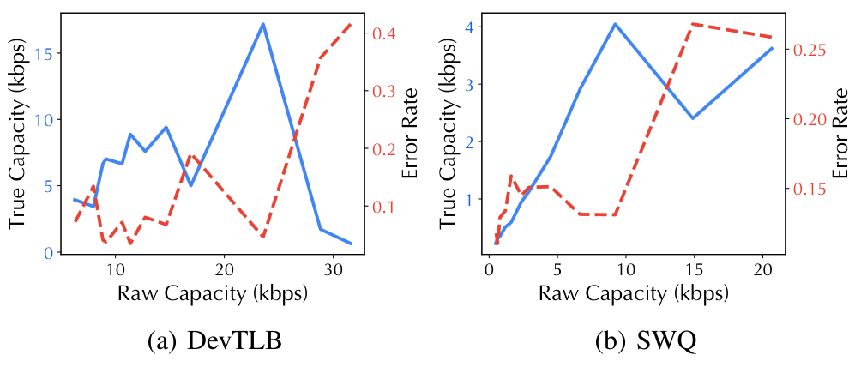
Covert communication through shared state
17.19 kbps
DevTLB
4.63% bit error
4.02 kbps
SWQ
13.11% bit error
A cooperating sender chooses activity; the receiver decodes it.
Increasing the raw rate eventually loses useful capacity to errors.
18
Notes:
SLIDE 18: Covert communication through shared state
READ-ALOUD TRANSCRIPT
A covert channel is a controlled communication experiment. Here, the sender cooperates with the receiver: it creates activity to represent one bit value and stays idle to represent the other. The receiver uses its probes to decode those changes.
The reported DevTLB channel reaches seventeen point one nine kilobits per second, with four point six three percent bit error. The SWQ channel reaches four point zero two kilobits per second, with a higher error rate.
The plot shows why increasing the raw signaling rate doesn't always help. Faster signaling can create more errors and reduce useful capacity. This establishes a communication channel under coordinated conditions. Next, the sender stops cooperating: ordinary website traffic becomes the source of activity.
REFERENCE NOTES (not part of the spoken script)
- These are reported true-capacity values, distinct from raw attempted signaling rate.
- Use 4.63% as in Section VI-A and Table IV. The abstract/contribution text also contains 4.64%, a reporting inconsistency.
- The covert channel uses cooperating sender and receiver roles, unlike the non-cooperative application side-channel cases.
- The approximately fivefold capacity comparison is against the IPI covert channel; cross-paper values are not matched reruns.
SOURCE: Paper Figure 9 and Section VI-A, p. 9; comparison values in Table IV, p. 12.

Slide 19
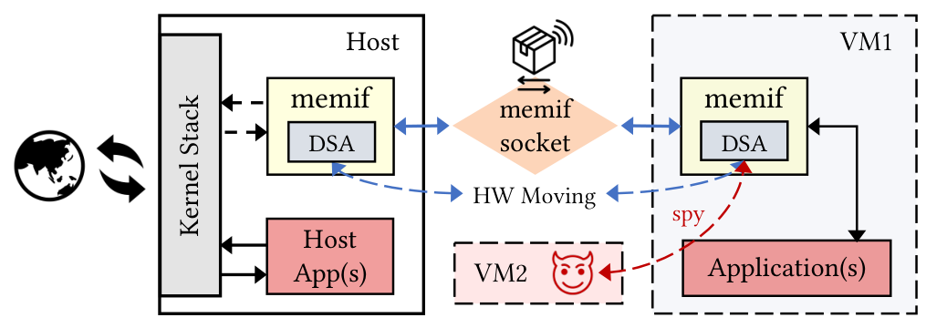
Why website traffic reaches DSA
Website traffic → VPP/memif transfers → DSA activity → probe trace
The experiment supplies the browser workload; the TLB does not name it.
19
Notes:
SLIDE 19: Why website traffic reaches DSA
READ-ALOUD TRANSCRIPT
This figure connects the hardware channel to the website experiment. The victim application runs in one VM, and the spy runs in another. The network path uses VPP and memif, with DSA accelerating packet movement.
Loading a website creates a sequence of network transfers. Those transfers generate accelerator work, and that work can replace translations in the engine the spy shares. The spy continues to measure its own probes, so the resulting trace reflects changes in accelerator activity over time.
There is no packet payload, URL, or browser-process name in that observation. The attacker knows the experimental task is browsing and has collected examples from known websites. That context is what lets a later classifier associate a trace with a site.
Now let's look at how the paper builds those features and what its accuracy numbers actually describe.
REFERENCE NOTES (not part of the spoken script)
- Figure 8 places the DSA spy in VM2 and victim applications in VM1. The setup uses DSA-accelerated VPP/memif packet movement.
- The diagram is the evaluated network configuration, not a claim that every browser or network stack uses DSA.
- Website identity is a trained label assigned from activity traces. The attacker does not read packet contents or directly discover the browser from the DevTLB.
SOURCE: Paper Figure 8, p. 8, and Section VI-B, pp. 9-10.

Slide 20
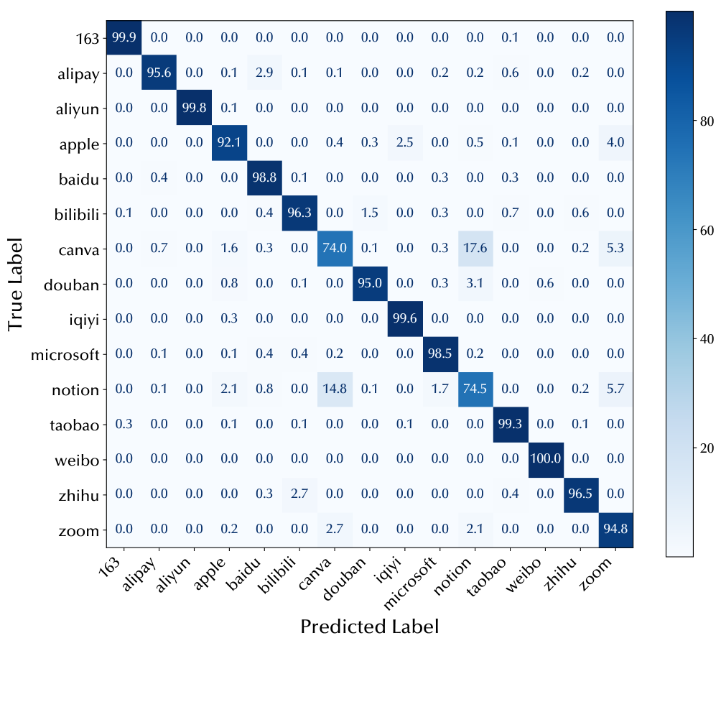
How a trace becomes a website label
85.73%
Accuracy over 100 sites
20,000 traces; 80/20 split
10 µs samples
400 samples per 4 ms bin
250 bins per trace
Attention-BiLSTM classifier
Shown: 15-site subset, 96.5% accuracy.
85.73% is the full-dataset result; the matrix shows a selected subset.
20
Notes:
SLIDE 20: How a trace becomes a website label
READ-ALOUD TRANSCRIPT
The spy samples every ten microseconds and groups four hundred samples into a four-millisecond slot. Each slot records a miss count. About two hundred and fifty slots form a trace, so the feature is the pattern of activity across roughly a second.
The dataset contains one hundred websites with two hundred traces per site, giving twenty thousand traces. The authors use an eighty-twenty training and test split and an attention-based bidirectional LSTM to map those traces to website labels.
The headline result is eighty-five point seven three percent on all one hundred sites. The confusion matrix shown here covers only fifteen selected sites, where the reported accuracy is ninety-six point five percent. Those are different evaluation scopes.
This is a closed-world task: training and testing use the same known set of website labels. It doesn't establish recognition of arbitrary unseen websites. The next application uses the timing of individual events rather than a whole-page loading pattern.
REFERENCE NOTES (not part of the spoken script)
- A random top-1 guess over 100 equally weighted labels has a 1% baseline; do not call it a coin flip.
- 20,000 traces and the 16,000/4,000 split are arithmetic from the stated dataset and split ratio.
- The displayed confusion matrix is the 15-site subset, not a visualization of the full-100-site headline accuracy.
- The evaluated split does not establish cross-day, cross-host, or open-world generalization.
SOURCE: Paper Figures 10 and 11 and Section VI-B, pp. 9-10.

Slide 21
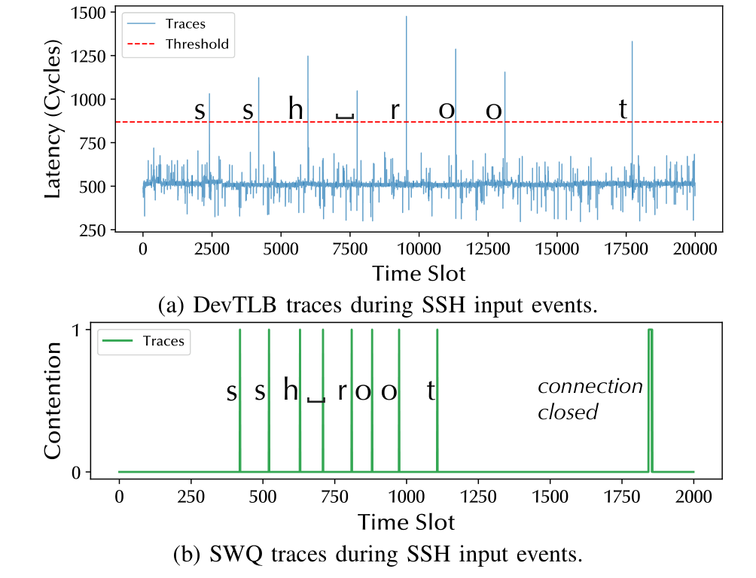
Keystrokes reveal events and timing
SSH packets → DTO offload → DSA activity
Probe
F1
σ
DevTLB
92.0%
5.29 ms
SWQ
98.4%
1.21 ms
The letters are known input
labels in the experiment.
They were not decoded
from the probe.
F1 values are reported as printed; the paper’s event counts are inconsistent.
The demonstrated output is candidate keystroke events and their timing.
21
Notes:
SLIDE 21: Keystrokes reveal events and timing
READ-ALOUD TRANSCRIPT
For the SSH experiment, the victim uses DSA Transparent Offload, or DTO. It redirects eligible memory operations to DSA, so handling interactive SSH traffic can generate accelerator activity. The attacker looks for that activity and estimates when candidate keystroke events occurred.
The plots are filtered traces. The letters shown on them are known input labels used to evaluate the experiment. They are not characters decoded from the cache. The demonstrated result is event detection and timing, not recovery of the command text.
The paper reports an F1 score of ninety-two percent for DevTLB and ninety-eight point four percent for SWQ. The standard deviations of timestamp differences are five point two nine milliseconds and one point two one milliseconds, respectively.
There is a reporting caveat: the printed detection, false-positive, and false-negative counts don't fully reconcile with those metrics. We therefore keep the headline scores labeled as reported. The final application asks which model configuration produced an activity pattern.
REFERENCE NOTES (not part of the spoken script)
- Figure 12 labels the known command 'ssh root'. Those labels are ground truth, not recovered characters.
- The paper applies size- and latency-related filtering before evaluating event traces. Exact counts depend on that processing.
- For 512 ground-truth events, the printed DevTLB counts are 515 detections, 15 false positives, 61 false negatives, and 500 true positives. Those totals are inconsistent.
- The printed SWQ counts are 511 detections, 7 false positives, 9 false negatives, and 507 true positives. Those totals are also inconsistent.
- F1 and timestamp deviation answer different questions. Neither alone establishes text recovery.
SOURCE: Paper Figure 12 and Section VI-C, p. 10; headline F1 values in Tables III and IV, pp. 11-12.

Slide 22
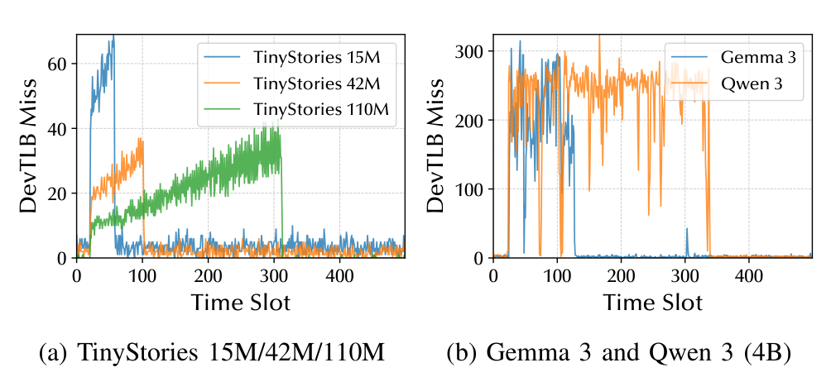
Fingerprinting model configurations
98.6%
Validation accuracy
8 tested configurations
TinyStories, LLaMA 2,
Gemma 3, Qwen3
Fixed prompts.
50 traces per configuration.
This classifies a tested configuration; it does not recover weights or prompts.
22
Notes:
SLIDE 22: Fingerprinting model configurations
READ-ALOUD TRANSCRIPT
Model inference also moves substantial amounts of data. With the evaluated offload setup, those memory operations create DSA activity. Different model configurations can therefore produce different patterns in the probe trace.
The paper tests eight configurations across four groups: TinyStories, LLaMA 2, Gemma 3, and Qwen3. It collects fifty traces per configuration, uses identical prompts, and splits the data eighty-twenty for training and validation. The aggregation window is eight milliseconds.
Within that task, the reported validation accuracy is ninety-eight point six percent. The inferred label is one of the known model configurations. The attacker doesn't recover model weights or read the prompt.
The fixed prompts and evaluated runtimes matter when interpreting that number. The result shows that the configurations are distinguishable within this dataset; it doesn't establish identification across arbitrary prompts, hosts, or unseen models. We can now ask how these results change under the tested background load.
REFERENCE NOTES (not part of the spoken script)
- The eight configurations are TinyStories 15M, 42M, and 110M; LLaMA 2 7B; Gemma 3 1B and 4B; and Qwen3 1.7B and 4B. That is four named model groups, not three.
- The paper uses llama.c and ollama in its CPU and CPU-GPU evaluation paths. Runtime and model choices are part of the experimental setup.
- 50 traces per configuration gives 400 traces; the stated split corresponds to 320 training and 80 validation traces.
- An 8 ms slot groups 800 samples at the stated 10 microsecond interval.
SOURCE: Paper Table II, Figure 13, and Section VI-D, pp. 10-11.

Slide 23
Robustness within the tested setup
Metric
Local
Noisy local
Cloud
Noisy cloud
DevTLB covert (kbps)
17.19
16.81
16.97
16.52
SWQ covert (kbps)
4.02
4.08
3.96
3.80
Website accuracy
85.7%
86.0%
85.5%
85.1%
DevTLB keystroke F1
92.0%
90.5%
93.4%
93.0%
SWQ keystroke F1
98.4%
98.2%
99.1%
98.9%
LLM accuracy
98.6%
98.6%
97.7%
98.0%
Noise tests use synthetic PCIe and memory pressure.
The results cover these stressors, not every multi-tenant workload.
23
Notes:
SLIDE 23: Robustness within the tested setup
READ-ALOUD TRANSCRIPT
This table brings the results together across local and cloud settings, with and without injected background load. Most reported metrics change modestly across those conditions. The DevTLB keystroke F1 varies more, ranging from ninety point five to ninety-three point four percent.
The useful conclusion is that the channels remained effective under these tested stressors. The experiments include PCIe and memory pressure, so the results aren't limited to an entirely idle system.
But that isn't the same as testing every source of interference on a busy shared host. Many independent tenants, changing workloads, or different provisioning could create additional challenges. With that scope in mind, let's look at what the paper proposes to reduce the leakage.
REFERENCE NOTES (not part of the spoken script)
- Keep all six reported rows: DevTLB covert, SWQ covert, website classification, DevTLB keystroke F1, SWQ keystroke F1, and LLM classification.
- The noise study uses specified synthetic PCIe and host-memory stressors. It does not establish general resilience to arbitrary contention from many DSA tenants.
- The listed values are reported results, not a new experimental reproduction.
SOURCE: Paper Table III and Section VI-E, p. 11.

Slide 24
Mitigations and what remains unmeasured
Configure sharing
Change hardware
Check the evidence
Separate sensitive tenants
by engine.
Do not share an SWQ
across trust boundaries.
Partition replacement
state by PASID.
Restrict queue-state
feedback.
These are proposals.
Random-entry overhead:
15.7% native
17.9% DTO
at 256-byte transfers.
Residual leakage
was not measured.
A performance-cost measurement does not establish a secure mitigation.
24
Notes:
SLIDE 24: Mitigations and what remains unmeasured
READ-ALOUD TRANSCRIPT
The practical boundary follows directly from the experiments. Separate queues can still share an engine's translation state, so protecting against this DevTLB channel requires attention to engine assignment. For the SWQ channel, avoid sharing the same queue across trust boundaries. Disabling offload on a sensitive path is another possible tradeoff.
The paper also proposes hardware changes, including partitioning translation-cache replacement state by address-space context and restricting queue-state feedback. Those are proposals, not evaluated deployed fixes, and they come with performance or interface costs.
For a software mitigation based on inserting random translations, the authors measure throughput loss. The maximum reported losses are fifteen point seven percent for native DSA and seventeen point nine percent with DTO, at 256-byte transfers. What they don't quantify is the leakage that remains after mitigation. So we have a cost measurement, but not a complete security-performance result. Let's close with what the experiments do establish.
REFERENCE NOTES (not part of the spoken script)
- Engine and queue allocation guidance concerns the observed sharing boundaries. It is not a universal guarantee against all accelerator side channels.
- Restricting admission feedback must account for legitimate software that needs to handle retry responses.
- The 15.7% and 17.9% values are measured throughput losses for the random-translation experiment at its smallest tested transfer size, not the cost of every proposed defense.
- The paper reports mitigation overhead without quantifying residual leakage.
SOURCE: Paper Figure 14 and Section VII, pp. 11-12.

Slide 25
What the experiments establish
01
Shared-engine state is observable
DevTLB replacement changes the attacker’s own probe latency.
02
Shared-queue state is observable
Admission feedback exposes occupancy during a prepared window.
03
Application patterns supply meaning
Classification remains bounded by the workload and evaluation setup.
Isolation must account for shared accelerator state as well as addresses.
25
Notes:
SLIDE 25: What the experiments establish
READ-ALOUD TRANSCRIPT
The paper establishes two observable channels in shared DSA resources: translation replacement affects completion timing, and shared-queue admission reveals contention. Controlled experiments connect those observations to the engine and queue boundaries.
The application results then show how repeated observations can support communication, website classification, keystroke timing, and model-configuration classification under the evaluated conditions. The hardware supplies an activity signal; the workload and analysis give it meaning.
The broader lesson is that protecting addresses doesn't automatically hide activity in shared accelerator state. Both need to be considered when defining isolation. Thank you. We're happy to take questions.
REFERENCE NOTES (not part of the spoken script)
- This is a conclusion from the reported evidence and stated scope, not a separate personal-verdict section.
- The deck does not claim recovery of victim memory contents, typed characters, model weights, or prompts.
SOURCE: Synthesis of paper Sections IV-VII and IX, pp. 4-12.

