Slide 1
VCARE – Online Doctor Consultation
Software design and development J component
Team Members:
V Shruthiy - 18BCB0139
Maitreyee Paliwal - 18BCB0087
Siddharth Chatterjee - 19BCE2249
Sahitya Madipalli - 19BCI0232
Abhishek Mishra - 18BCB0027

Slide 2
Abstract
The healthcare sector in a developing country like India is not very advanced and the health index here is low in comparison to other developed nations. And even though people heavily rely on conventional face-to-face consultation, in hard times like this with the onset of newly discovered Corona virus strain, the online consultancy is the more preferred option. This eases the pressure on hospitals as they can attend to more serious cases.

Slide 3
Problem Statement
The problem arises when people have to visit a doctor, to get themselves checked from a general physician and then they are directed to see a specialist doctor. This prolongs the patients’ sufferings and results in extra consultancy fees that could be reduced. Also due to geographical conditions, access to a doctor’s clinic might not always be possible.
Therefore to solve this problem, we are developing a system where user can easily predict the disease, consult a doctor and save time and money. With this software application, we aim to make the process as simple and flawless as possible so that more people believe in online consultation, use it without hesitation and eventually help us get a wider reach

Slide 4
System definition
A web project which helps in predicting the disease based on the symptoms of the patient. It also informs the patients about nearby doctors' availability and precautions to be taken. The heart of the project is Fuzzy Logic , a soft computing technique which makes use of knowledge base made by the experts (doctors in this case) to predict the disease severity.

Slide 5
System analysis and design
STAKEHOLDER REQUIREMENTS
Primary stakeholders-
Users – Doctors, Patients (students under vCARE)
Project Build Team – Developers, Testers, etc. (Extension)
Secondary Stakeholders-
Admin
Hospitals and Pharmacies

Slide 6
Software Requirements
• Front-End: HTML , CSS , JavaScript
• Back-End: PHP, MYSQL
• Database: mySQL
• Local Server: XAMPP
• Tools: Bootstrap (CSS, JS, HTML framework)
Mathematical tool – Fuzzy logic

Slide 7

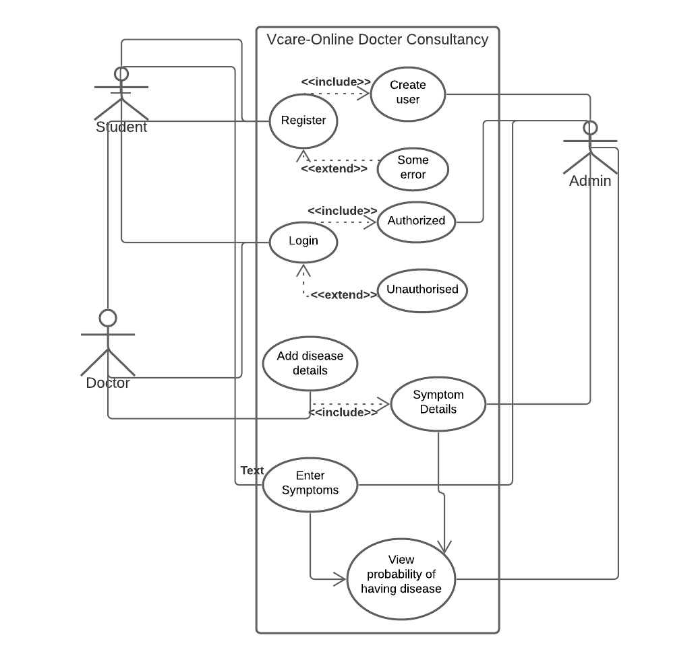
System architecture
Use Case diagram

Slide 8
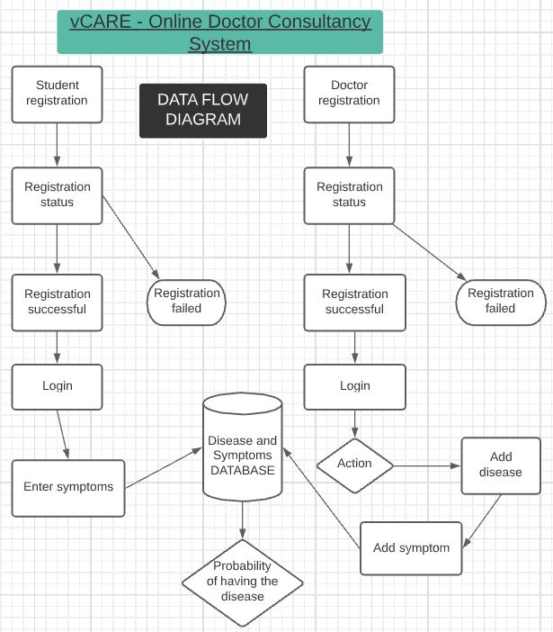
Data Flow diagram

Slide 9
REFERENCES
https://www.researchgate.net/publication/323973550_Online_medical_consultation_a_reviewhttps://ijcsmc.com/docs/papers/May2019/V8I5201938.pdf
https://www.atsjournals.org/doi/full/10.1164/rccm.200207-777CP
https://www.sciencedirect.com/science/article/pii/S093336570000072
https://ieeexplore.ieee.org/abstract/document/7284190
https://www.sciencedirect.com/science/article/abs/pii/S0306987718309691

