Slide 1
vCARE Online Disease PREDICTION SYSTEM
CSE 1005 Software design and development J component
PROJECT REVIEW II
Team Members:
V Shruthiy - 18BCB0139
Maitreyee Paliwal - 18BCB0087
Siddharth Chatterjee - 19BCE2249
Sahitya Madipalli - 19BCI0232
Abhishek Mishra - 18BCB0027

Slide 2
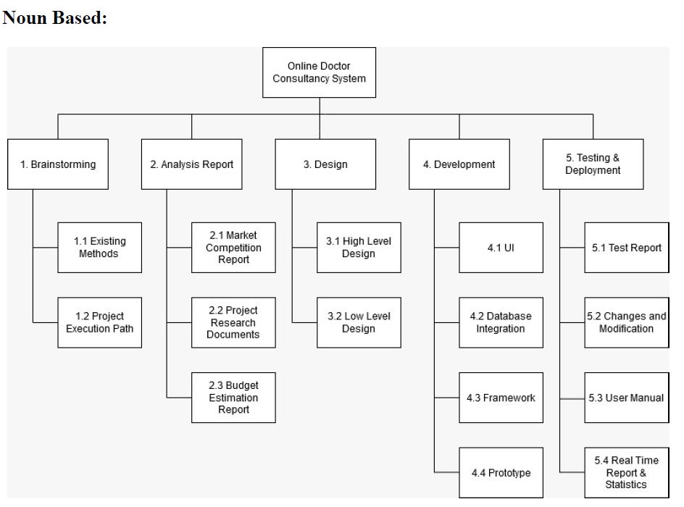
WORK BREAKDOWN STRUCTURE

Slide 3
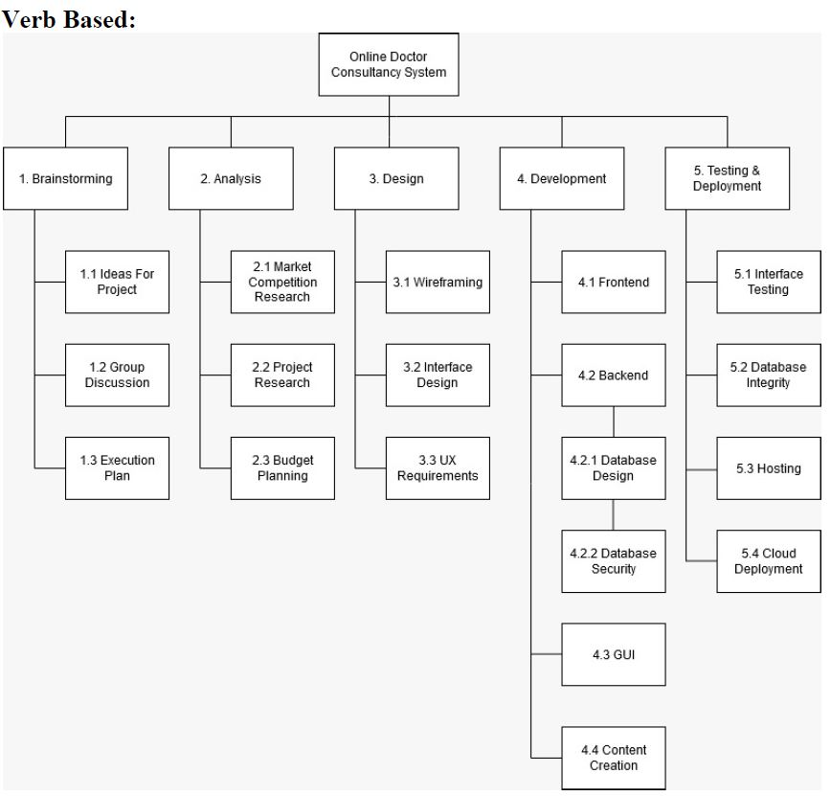
WORK BREAKDOWN STRUCTURE

Slide 4
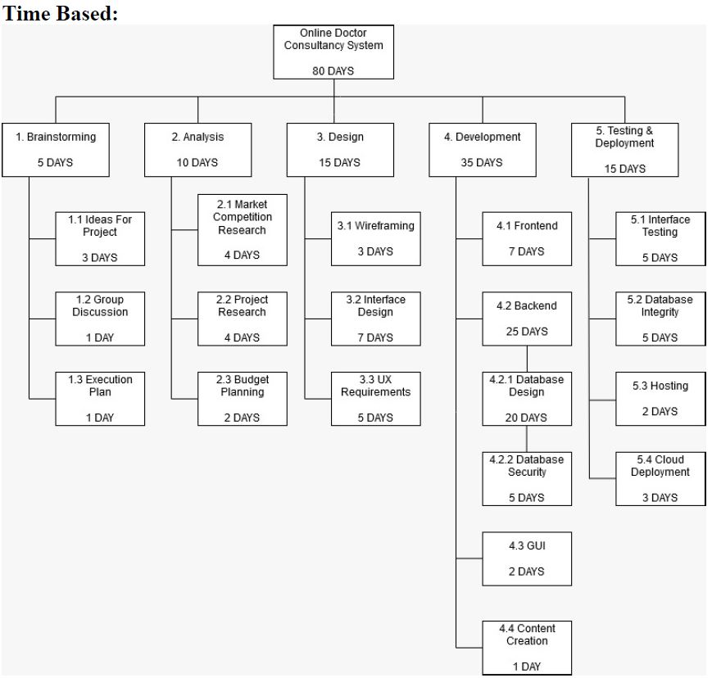
WORK BREAKDOWN STRUCTURE

Slide 5
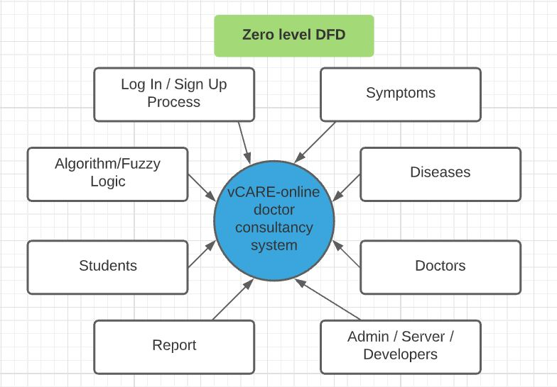
Data flow diagrams

Slide 6
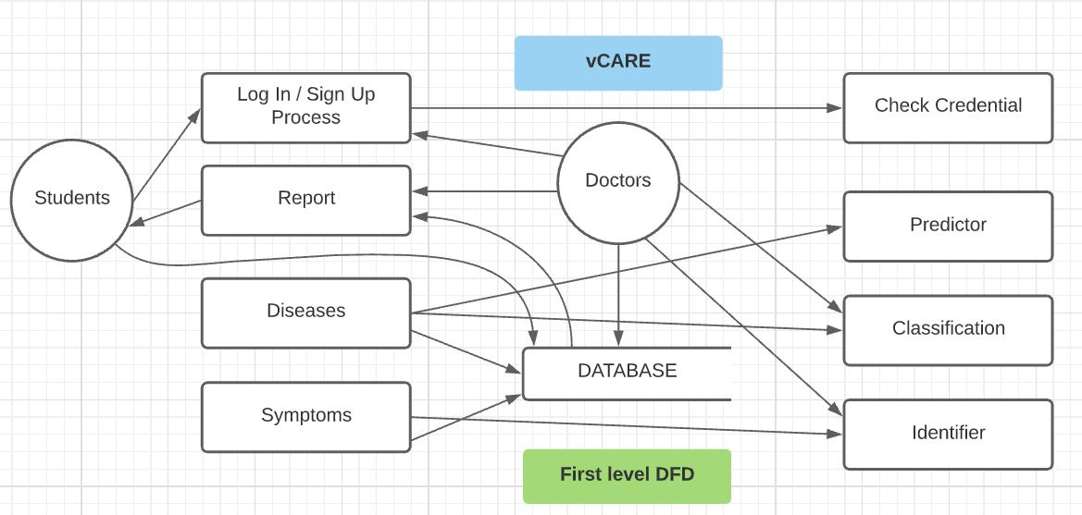
Data flow diagrams

Slide 7
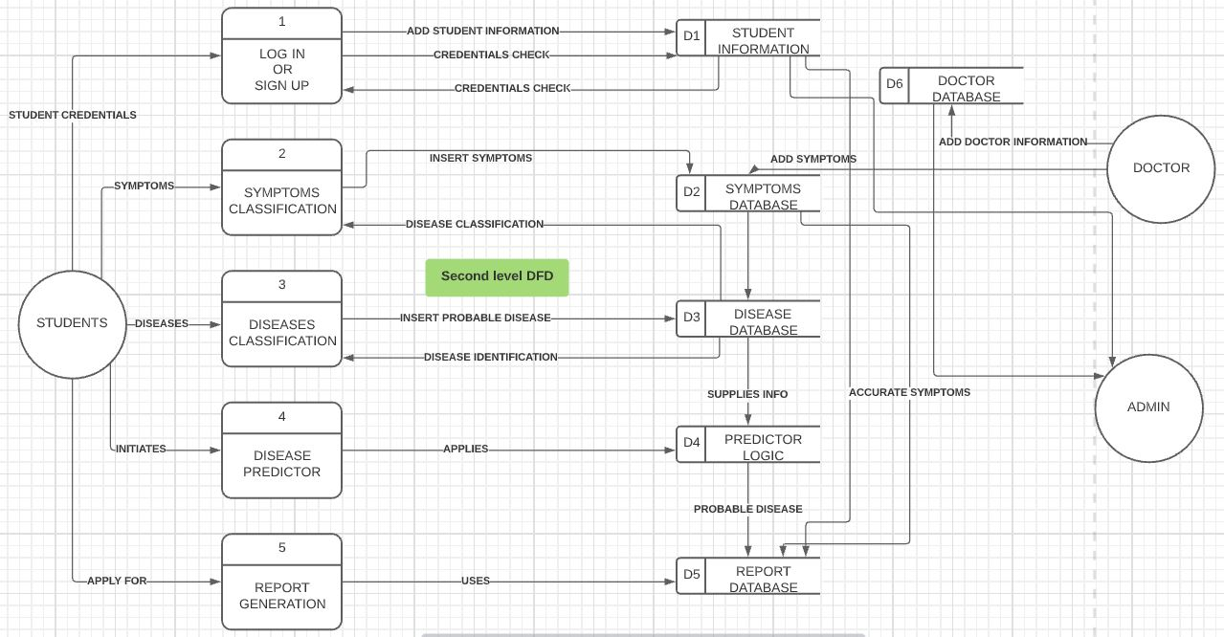
Data flow diagrams

Slide 8

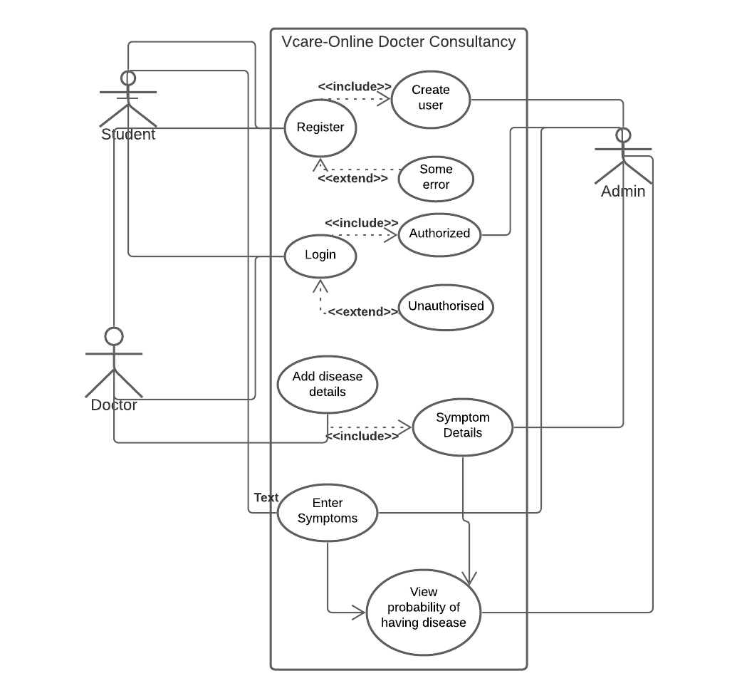
System architecture
Use Case diagram

Slide 9
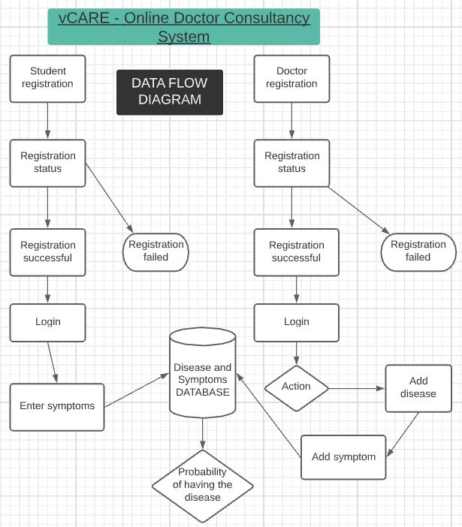
Data Flow diagram
From Review I

Slide 10
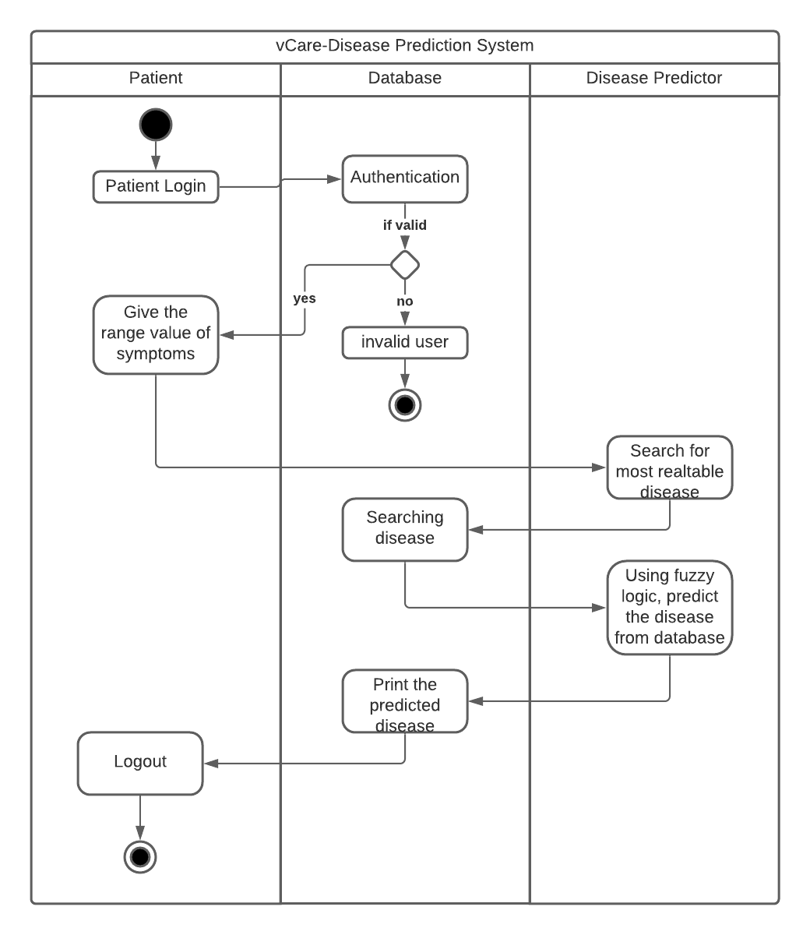
ACTIVITY diagram

Slide 11
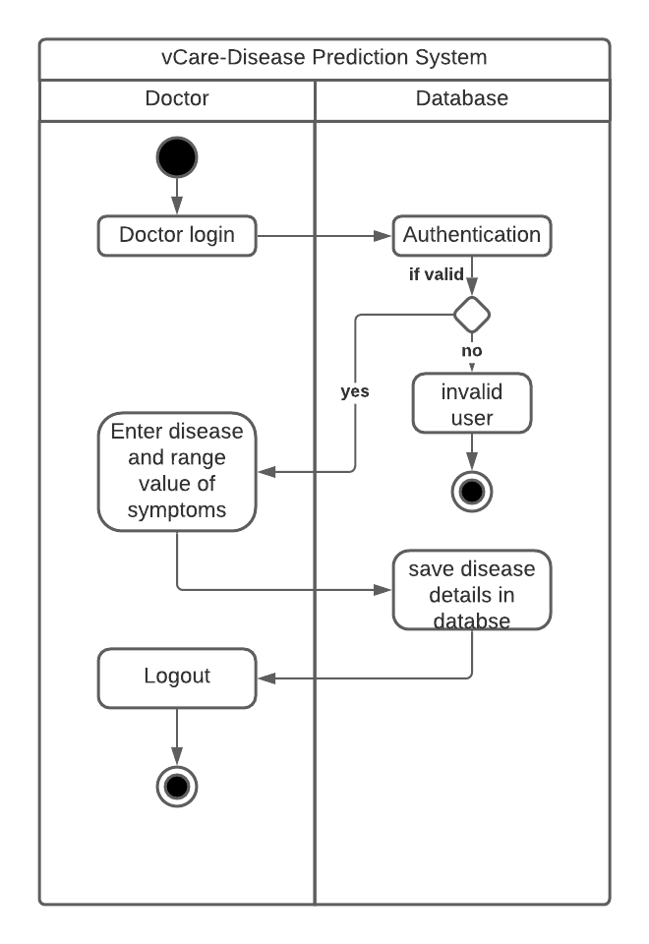
ACTIVITY diagram

Slide 12
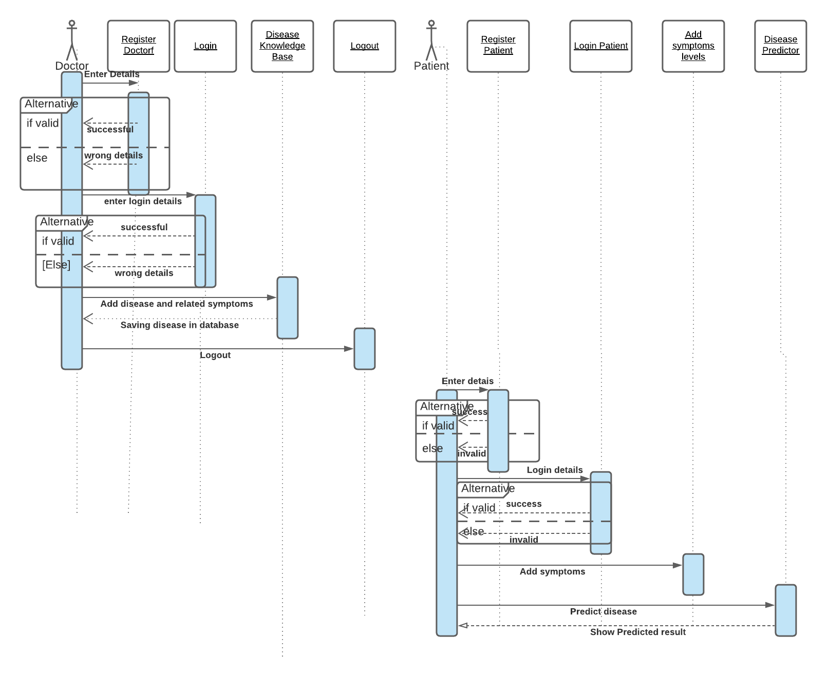
SEQUENTIAL diagram

Slide 13
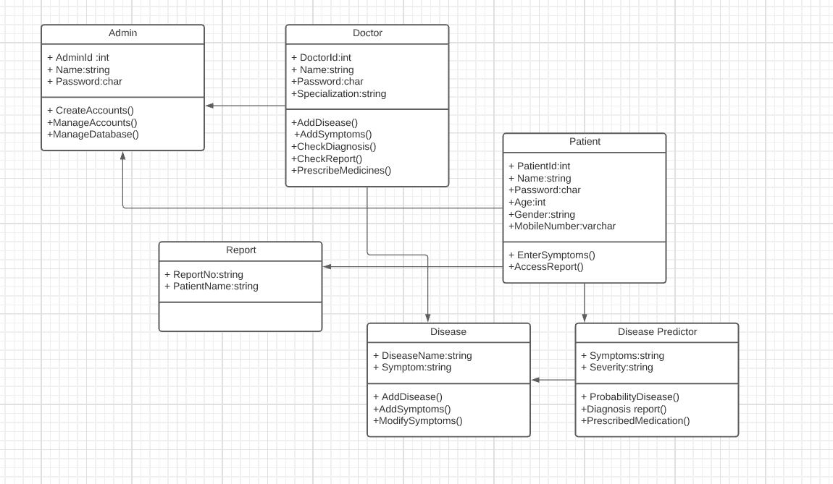
CLASS diagram

