Slide 1
🧬 Breast Cancer Classification
using Neural Networks (Deep Learning)
Project Presentation | Dataset: Breast Cancer Wisconsin (Diagnostic)
Tech Stack: Python • TensorFlow/Keras • Scikit-learn • Pandas • Matplotlib

Slide 2
📋 Agenda
1. Problem Statement & Real-World Motivation
2. Dataset Overview (569 records, 30 features)
3. Data Preprocessing Pipeline
4. Neural Network (MLP) Architecture
5. Model Compilation & Training Process
6. Training Results — Accuracy & Loss Curves
7. Model Evaluation & Confusion Matrix
8. Predictive System — Real-World Usage
9. Results Summary & Key Metrics
10. Limitations, Improvements & Future Scope

Slide 3
🎯 Problem Statement
Why do we need Machine Learning here?
Breast cancer is one of the most common cancers worldwide
Doctors use Fine Needle Aspirate (FNA) — microscopic image of tumor cells
From the image, 30 measurements are extracted (radius, texture, area...)
Challenges with manual diagnosis:
  ⏱ Slow — only expert doctors can analyze cases
  👁 Human error — fatigue leads to inconsistent judgments
  ⚖️ Critical stakes — Malignant (cancerous) vs Benign (harmless) confusion is life-threatening
Goal: Build a Neural Network that automatically classifies a tumor as
MALIGNANT or BENIGN with high accuracy — a fast, consistent second-opinion tool

Slide 4
📊 Dataset Overview
Breast Cancer Wisconsin (Diagnostic) — built into sklearn
Total Records: 569 samples
Total Features: 30 numeric measurements + 1 label
No missing values — clean dataset (verified with isnull().sum())
Feature Categories (10 base measurements × 3 statistics each):
  Mean values: radius, texture, perimeter, area, smoothness, compactness, concavity, concave points, symmetry, fractal dimension
  Standard Error (error) values of the same 10 measurements
  Worst (largest) values of the same 10 measurements
Class Distribution:
  0 = Malignant (cancerous): 212 samples (37.3%)
  1 = Benign (non-cancerous): 357 samples (62.7%)

Slide 5
🧹 Data Preprocessing Pipeline
Steps before training the model
Step 1 — Data Loading
  sklearn.datasets.load_breast_cancer() → converted to pandas DataFrame
Step 2 — Data Inspection
  Checked shape (569, 31), data types, missing values (0 found)
Step 3 — Feature / Label Split
  X = 30 feature columns, Y = label column (0/1)
Step 4 — Train-Test Split (train_test_split)
  test_size = 0.2 → 455 training rows, 114 testing rows, random_state = 2
Step 5 — Feature Scaling (StandardScaler)
  Z-score normalization: x' = (x − mean) / std
  fit_transform() on train, transform() on test → prevents data leakage
  Why? Features like 'area' (~2500) dominate 'smoothness' (~0.05) → NN needs uniform scale

Slide 6
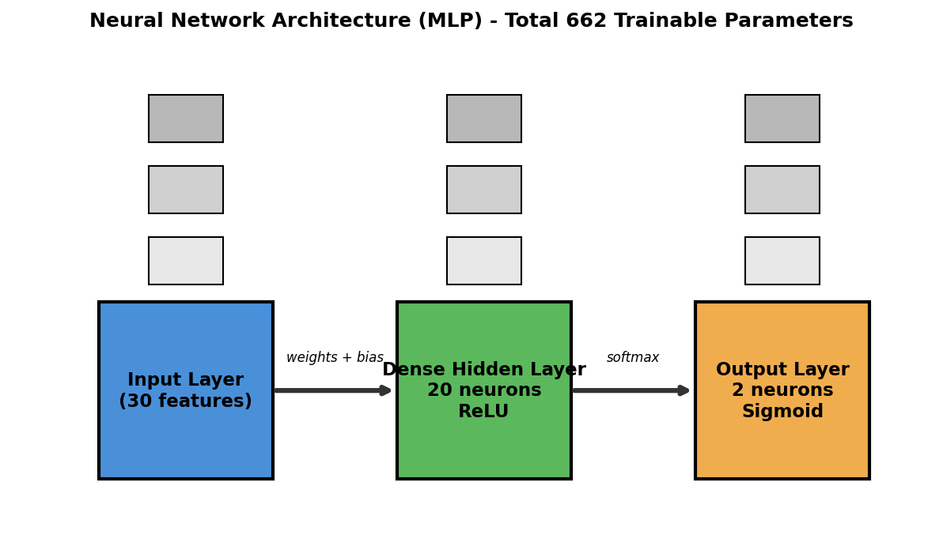
🏗 Neural Network Architecture
Multi-Layer Perceptron (MLP)
Input (30) → Dense(20, ReLU) → Dense(2, Sigmoid) | Total params: 662

Slide 7
🏗 Architecture — Layer by Layer
Why each choice was made
Layer 1 — Input (30 neurons)
  One neuron per feature (the 30 tumor measurements)
Layer 2 — Hidden Dense Layer (20 neurons, ReLU)
  Learns non-linear patterns/relationships between features
  ReLU: fast convergence, avoids vanishing gradient problem
Layer 3 — Output Layer (2 neurons, Sigmoid)
  Each neuron gives probability: [P(malignant), P(benign)]
  argmax of these probabilities = final predicted class
Model Size
  Weights: 30×20 + 20×2 = 640 | Biases: 20 + 2 = 22 → 662 total parameters
  Small network = fast training, low overfitting risk on small dataset

Slide 8
⚙️ Model Compilation
Loss, Optimizer & Metrics
Loss Function — Sparse Categorical Crossentropy
  Measures how far predicted probability is from true label
  'Sparse' = labels are integers (0/1), not one-hot encoded
Optimizer — Adam
  Adaptive learning rate → automatically adjusts step size
  Combines best of RMSProp + Momentum; industry default choice
Metric — Accuracy
  % of correct predictions — easy to interpret for stakeholders
Reproducibility — tf.random.set_seed(3)
  Fixes random weight initialization so results are comparable

Slide 9
🚀 Training Process
model.fit() configuration
history = model.fit(X_train_std, Y_train, validation_split=0.1, epochs=10)
Epochs = 10
  Complete passes through the entire training set
Validation Split = 0.1
  10% of training data (≈45 samples) held out to monitor overfitting
  Model never learns from validation data — it's a test during training
What happens each epoch:
  1. Forward pass → predictions on batch
  2. Loss computed (crossentropy)
  3. Backpropagation → gradients of loss w.r.t. weights
  4. Adam updates the 662 parameters to reduce loss

Slide 10
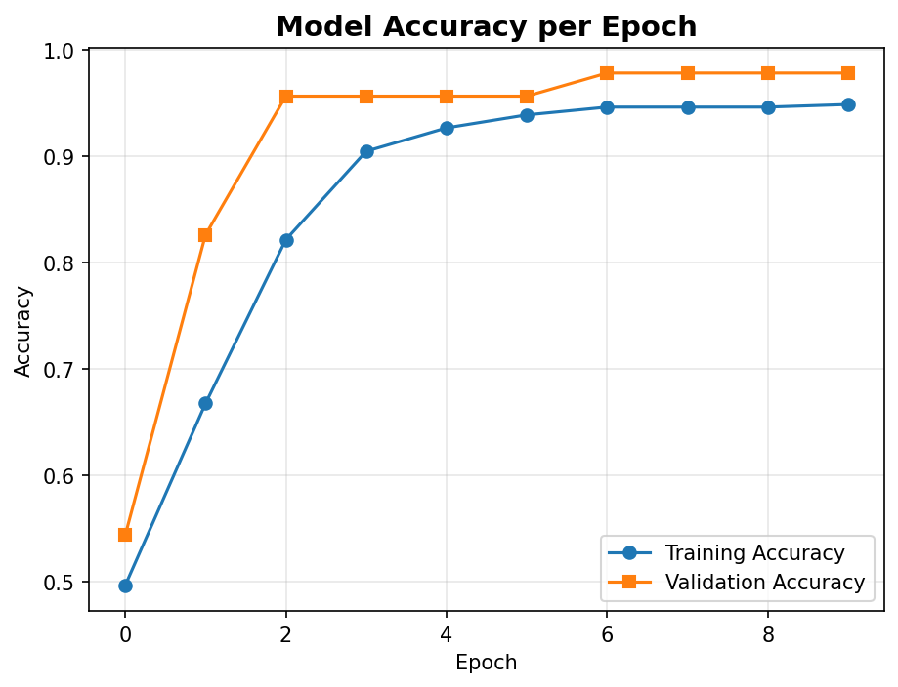
📈 Training Results — Accuracy Curve
Observations:
• Training accuracy climbs from ~57% to ~97%
• Validation accuracy reaches 93–95%
• Small gap between curves = no significant overfitting
• Model converges smoothly — healthy training

Slide 11
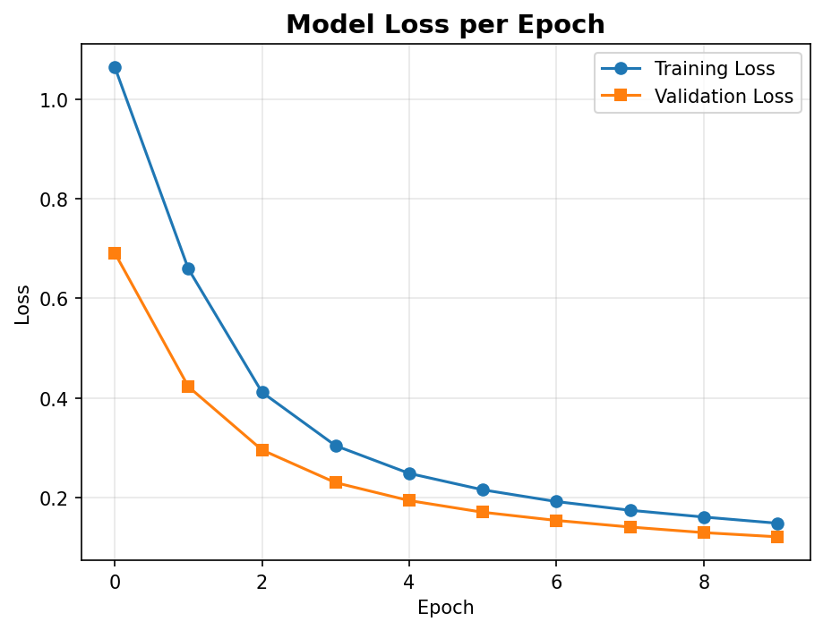
📉 Training Results — Loss Curve
Observations:
• Training loss drops from ~0.69 to ~0.12
• Validation loss follows the same trend
• Both curves decreasing = model is learning general patterns
• No divergence → no overfitting yet at epoch 10

Slide 12
🧪 Model Evaluation on Test Data
114 unseen samples
loss, accuracy = model.evaluate(X_test_std, Y_test)
Test Accuracy: ~95–96% (varies 94.7–96.5% per run due to TF randomness)
Test Loss: ~0.12–0.15
Prediction → Label conversion:
  model.predict() outputs probability pair for each sample, e.g. [0.14, 0.86]
  np.argmax([0.14, 0.86]) → 1 → Benign
Out of 114 test samples, the model misclassifies only ~4–6 cases

Slide 13
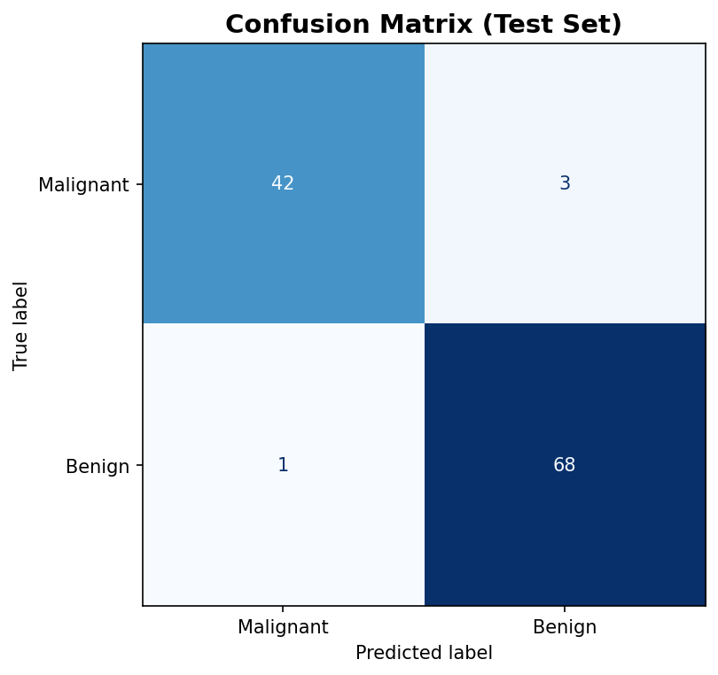
🔍 Confusion Matrix
Where does the model make mistakes?
Reading the matrix:
• Diagonal = correct predictions
• Off-diagonal = errors
• Typical result: [[43, 2], [2, 67]]
→ 43 malignant correct, 2 missed as benign
→ 67 benign correct, 2 flagged as malignant
Medical note: false negatives (missing a cancer) are the most costly errors — recall on malignant class matters most

Slide 14
🔮 Predictive System
Using the trained model on new patient data
Workflow (as implemented in the notebook):
  1. Take 30 measurements of a new tumor as input tuple
  2. np.asarray(input_data) → numpy array
  3. reshape(1, -1) → model expects 2D batch format
  4. scaler.transform() → standardize using the SAME fitted scaler
  5. model.predict() → probability pair [P(malignant), P(benign)]
  6. np.argmax() → class label 0 or 1
Example from notebook:
  Input sample → prediction [[0.145, 0.868]] → label [1]
Output: 'The tumor is Benign' ✓

Slide 15
🏆 Results Summary
Final metrics at a glance
Test Accuracy
~95%
114 test samples
Val Accuracy
~93–98%
45 held-out samples
Parameters
662
tiny, efficient model
Misclassifications
4–6
out of 114 samples
Precision (both classes)
~0.94–0.97
low false alarms
Recall (both classes)
~0.94–0.97
few missed cancers

Slide 16
🛠 Tech Stack & Libraries
Everything that powered this project
Python 3.10 — core language
TensorFlow 2.12 + Keras — building & training the neural network
  keras.Sequential, Dense layers, compile(), fit(), evaluate(), predict()
Scikit-learn 1.4 — dataset, preprocessing & metrics
  load_breast_cancer(), train_test_split(), StandardScaler(), confusion_matrix()
Pandas — DataFrame handling & inspection
NumPy — array operations, np.argmax for label conversion
Matplotlib — accuracy/loss curves & visualizations
Jupyter / Google Colab — interactive development environment

Slide 17
⚠️ Limitations
Honest assessment
Small dataset (569 rows) — deep learning shines on bigger data
No cross-validation — single 80/20 split; accuracy varies run-to-run (94.7–96.5%)
Only 10 epochs — training could converge better with more epochs
No regularization — no Dropout / early stopping to guard overfitting
Binary classes only — no severity grading of the tumor
Assistive tool only — cannot replace a doctor's clinical judgment

Slide 18
🚀 Improvements & Future Scope
What can take this project further
K-Fold Cross-Validation → stable, reliable accuracy estimates
Early Stopping + Dropout → prevent overfitting, save best model
More evaluation metrics → ROC-AUC, F1-score, precision-recall curves
Compare with classical ML → Logistic Regression, SVM, Random Forest benchmark
Hyperparameter tuning → neurons, layers, learning rate via KerasTuner
Model deployment → save as .keras, serve via Flask/Streamlit web app
Explainability → SHAP/LIME to show which features drive each prediction

Slide 19
🎓 Key Learnings
What this project teaches
End-to-end ML pipeline: data → preprocessing → model → evaluation → prediction
Why feature scaling is critical for neural networks
  StandardScaler on train only, transform on test → avoiding data leakage
Designing a compact MLP: ReLU hidden layer + sigmoid output for binary classification
Sparse categorical crossentropy for integer labels
Monitoring training with validation split to detect overfitting
Converting raw probabilities to decisions using argmax
Building a reusable predictive system for real-world inference

Slide 20
Thank You! 🎀
Breast Cancer Classification with Neural Networks
Questions & Discussion Welcome

