Slide 1
E Shoppers
The Online Store
Project

Slide 2
INTRODUCTION
The project E Shoppers (online Shopping Cart) is web oriented site based on the technologies of Html,Css,Javascript,Mysql and Php.
Html,Css includes the client side communication where as mysql,php refers to the database connectivity and server side communication respectively.

Slide 3
JavaScript (JS) allows client-side scripts to interact with the user to control the browser and alter the document content that is displayed.
The project facilitates a user to purchase products online. It provides further much convenience to the administrator of the application to maintain and manipulate the data involving the products and the customers.

Slide 4
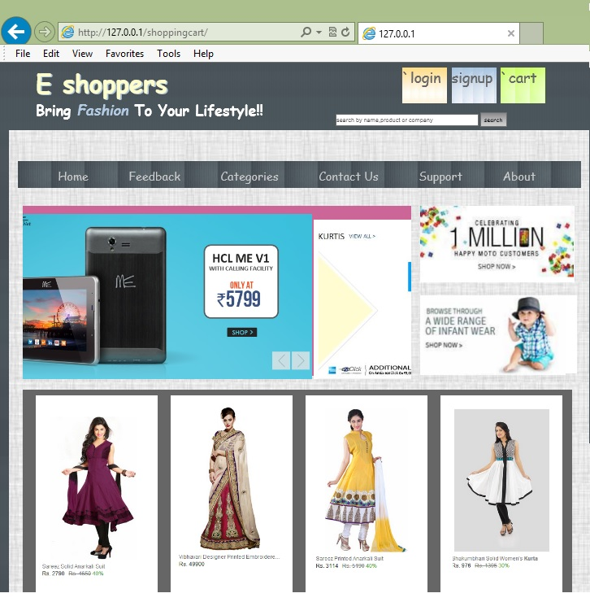

Slide 5
PROBLEM STATEMENT
Generally till date people used to walk up to the market ,spend their precious time in travelling ,wasting fuels to buy the products. To search for an appropriate product a customer used to visit a lot of shops. The problem had many dimensions in it and facets. To provide a solution to this problem a better option is the shopping cart or generally known as online shopping. This project facilitates a user to perform online shopping rather than walking up to the market to purchase products.It gives customer the freedom to select products from a wide variety while being in the comfort of his house and watching tv sitting on his couch.

Slide 6
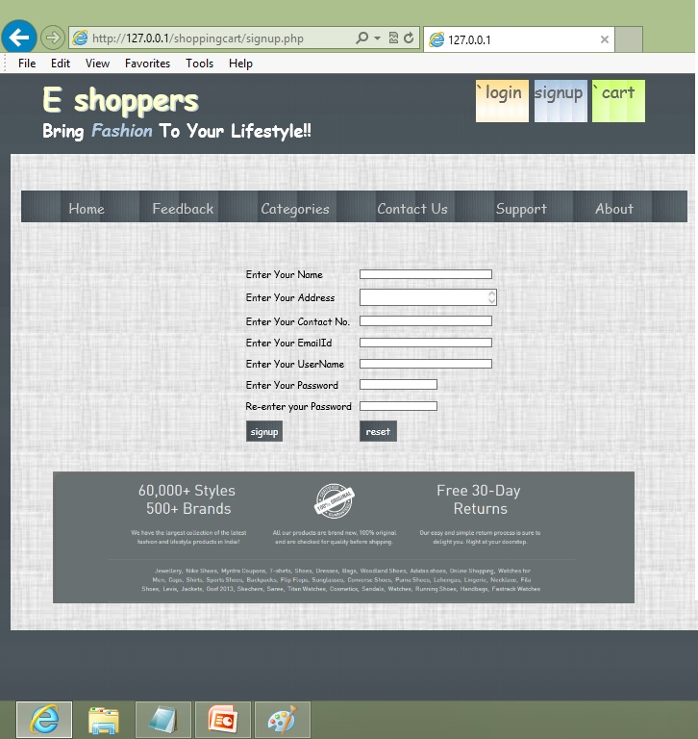

Slide 7
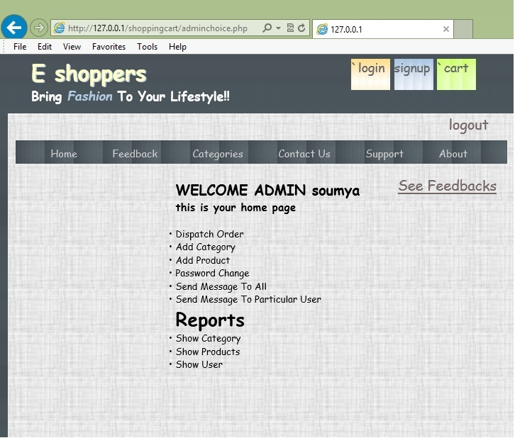

Slide 8
REQUIREMENT SPECIFICATION
Language(s) to be used :
Front End :
PHP, HTML, Javascript, AJAX
Back End
MySql
SOFTWARE USED ::
OS :- Windows 7/8
Web Server : Apache Version : 2.2.22
Database server : MySQL Version : 5.5.24
PHP Version :5.4.3
Editing platform
Adobe Dreamweaver 12.0

Slide 9
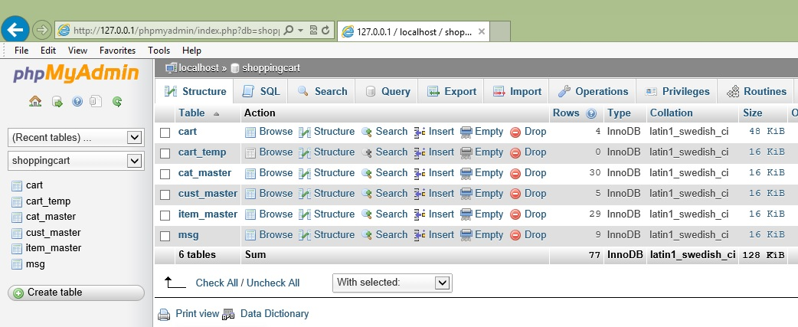

Slide 10
RESULT AND CONCLUSION
The project is successfully developed for serving the purpose of online shopping.
Advantages:
Choose products faster and easier at one place.
Saves time of travelling to the vendor/seller’s place.
Good/Trusted & Tension free delivery services. Products bought online will be delivered to the footsteps of the buyer free of cost(may be varied based on the vendor/seller).
Alerts and real time reporting through Emails (to both vendor as well as buyer).
Reports generated can be saved for future references.
Inventory reports for the vendor/seller on daily, monthly, yearly basis.

Slide 11
FUTURE SCOPE OF PROJECT
E-commerce is fast gaining ground as an accepted and used business paradigm. It is reasonable to say that the process of shopping on the web is becoming commonplace.
With the increase in the demand for E-commerce market, our web application is very good option to use.

Slide 12
LIMITATIONS OF PROJECT
1. Mode of payment is restricted to cash on delivery only.
2. The option for Wishlists is not activated.

Slide 13
THANK YOU

