Slide 1
Relevant Tables and Business Logic
Table Name | Description
BC subs | Contains all the basics details of customers
Voice Line | Contains all the details about billing system
NRDP Calls | Contains the details of skill numbers in different regions
Contract Details | Contains details about contract term days, installation dates, etc
XM Product | Contains details of customers engaged in XM business.
Outage details | Contains details of outage of networks that are both planned and unplanned in a region
Business Logic Tip: Features should reflect what influences customer retention in telecom—billing issues, network quality, and product bundling are key drivers.

Slide 2
Feature Selection Based on Business Logic
Billing
Funding Source Payment Method Days to Expiry Payment Provider
Account Characteristics
Current Tenure Average Subscription tenure Past churn count Past involuntary churn count Voucher User
Serviceability
Internet Service Voice call Service Video call Service Multiplay Service Wifi pro Service Security Service
Calendar Timing Features
Day of the week Day of the month Month
Usage Behaviour
Usage Repertoire Frequency Preferred Genre Preferred time of day
Device
Primary device Secondary device Device durations
Outage Details
Number of planned outages Number of unplanned outages

Slide 3
Model Selection & Scalability Considerations
Recommended Models:
Logistic Regression: Simple, interpretable baseline model.
Random Forest Classifier: Handles non-linear relationships, good for feature importance.
XGBoost Classifier: Highly accurate, scalable—ideal for large datasets.
CatBoost Classifier: Accurate and ideal for categorical dataset.
Training & Maintenance Strategy:
Use batch training on a regular schedule (e.g., weekly or monthly).
Monitor data drift and retrain if customer behavior or business changes.
For fast deployment, consider AutoML tools or model versioning (e.g., using MLFlow).

Slide 4
Improved Few Shot example Functionality.
Comcast had 31.842 million Broadband customers in 2024.
With estimation of 1-2% churn that’s 64,000 churn events/month and 21,000 by day.
Comcast Representatives are estimated to get 10,000- 12,000 calls per day as estimated.
The Improved version of few shot example usage which is updated on daily basis based on customer engagement, helps the system to be more relevant and more accurate.

Slide 5
Feedback Mechanism
If Feedback is Positive
The Transcripts and Score are added to Few shot examples storage
The Positive feedback score variable is updated and number of usesvariable is also updated.
After every call, Positive or negative feedback is collected from the sales representatives.
If Feedback is negative
The negative feedback score and number of uses variables are updated.
The new selections will happen by keeping in perspective the ratio of positive/negative feedback/Usage count

Slide 6
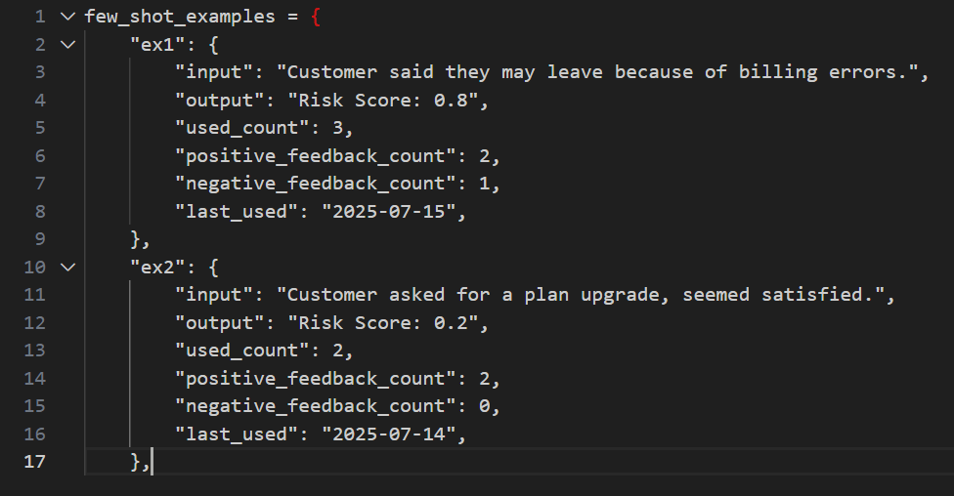
Example of Few Shot Example Datatype:

