Slide 1

Sreyas Institute of Engineering and Technology
An Autonomous Institution
Approved by AICTE, Affiliated to JNTUH
Accredited by NAAC-A Grade, NBA (CSE, ECE & ME) & ISO 9001:2015 Certified
A
PROJECT
On
CLINICAL COST INSIGHT
[REVIEW-3]
BACHELOR OF TECHNOLOGY
IN
COMPUTER SCIENCE AND ENGINEERING
BY
B.CHAITRA 23VE1A0506
G.SIDDHARTH 23VE1A0516
K.GANESH 23VE1A0529
N.SWETHA 23VE1A0543
ACADEMIC BATCH: (2023-2027)
Under the Guidance of
DR.U.M.FERNANDES DIMLO – professor

Slide 2
Testing Definition and Types
Definition of Testing:
Testing is the process of evaluating a system or component to ensure it meets specified requirements and functions correctly.
In this project, testing is done to verify the search functionality, user authentication accuracy, cart operations, and booking system behavior.
Types of Testing:
Unit Testing: Testing individual components to ensure they function properly in isolation
Integration Testing: Verifying if different components (e.g., Flask backend and MongoDB Atlas, frontend and REST API) work together as intended.
System Testing: Ensuring the entire platform functions properly under real-world conditions including deployment on Render and Vercel.
User Acceptance Testing (UAT): Ensuring that the search results, booking flow, and price comparison align with actual patient requirements.

Slide 3
Test Cases
Test Case ID | Test Case Description | Input | Expected Output | Pass/Fail Criteria
TC1 | Test search functionality for a diagnostic test | Test name “CBC” entered in search bar | Matching labs with prices displayed | Results load correctly and are sorted by price.
TC2 | Test user authentication (valid credentials) | Correct username/password | System grants access to dashboard | Login succeeds and user is redirected
TC3 | Test user authentication (invalid credentials) | Incorrect username/password | System denies access With correct price | Login fails and error is shown
TC4 | Test booking via email request | User confirms booking with email mode | Booking saved and email send to lab | Booking appears in history and email is delivered

Slide 4
Output
Output Explanation The simulation demonstrates a Flask-based healthcare test price comparison platform, incorporating fuzzy search, real-time price fetching, and a booking system. The search module successfully returns matching diagnostic tests with prices across all 11 Hyderabad labs, sorted from lowest to highest price. The cart system accurately adds, removes, and persists items per user session, with correct total price calculation. The booking module saves requests to the database and triggers email notifications via SendGrid to the respective lab. The authentication system correctly restricts access, maintaining separate sessions for users and admin. Final Output: "User searches for a test, compares prices across labs, adds preferred lab to cart, and successfully books the test — receiving an email confirmation with lab contact details."

Slide 5
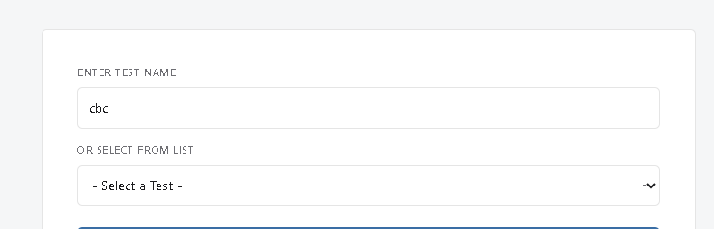
Output

Slide 6
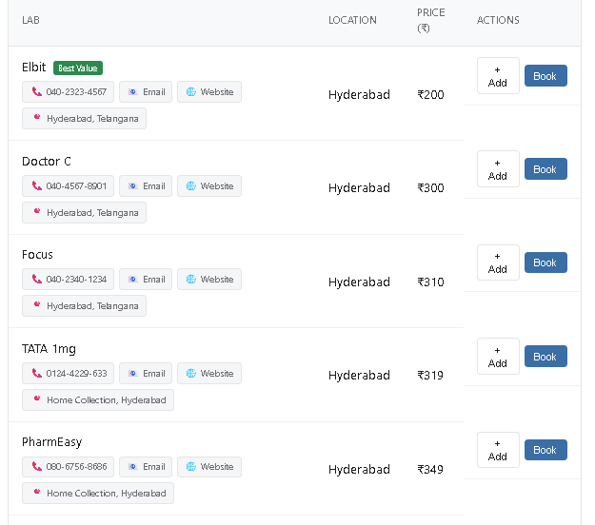
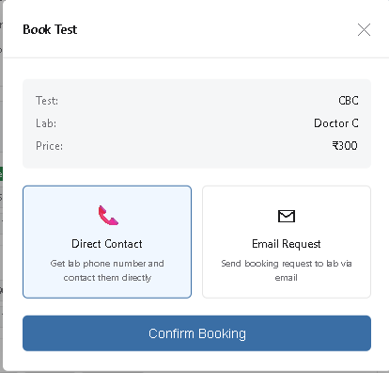
Output

Slide 7
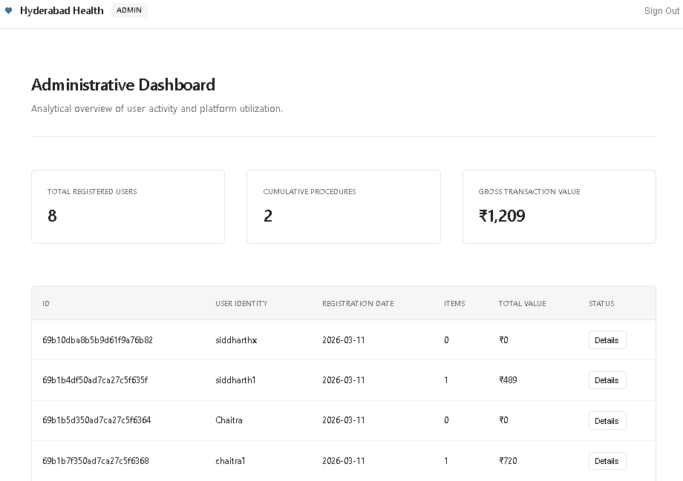
Output

Slide 8
Limitations of the Project
1.
Data Limitations: ○ Lab prices are manually maintained and may not reflect real-time pricing. ○ Only 11 labs and 16 tests are currently covered.
2.
Authentication Limitations: ○ Passwords stored without hashing in SQLite. ○ No OTP or forgot password feature implemented.
3.
Infrastructure Limitations: ○ Render free tier sleeps after 15 mins of inactivity. ○ MongoDB free tier limited to 512MB storage.
4.
Payment: ○ No payment gateway — booking is request-based only.

Slide 9
Future Scope or Future Enhancements
1.
Real-Time Price Updates: Integrating web scraping or lab APIs to automatically fetch and update diagnostic test prices in real-time.
2.
Advanced Authentication Methods: Implementing more secure methods like OTP verification, biometric login, and forgot password functionality for enhanced security.
3.
Payment Gateway Integration: Incorporating online payment options like Razorpay or UPI to allow users to pay for tests directly through the platform.
4.
AI and Machine Learning Integration: Incorporating AI to recommend tests based on user symptoms and predict the most cost-effective lab based on location and history.

Slide 10
Conclusion
The Healthcare Test Price Transparency Platform is an innovative project combining web development, database management, and real-world healthcare needs.
It demonstrates the use of fuzzy search for test matching and integrates user authentication to control access and personalize the experience.
The project works effectively within certain limitations but offers ample opportunities for improvement and enhancement in future versions.
The integration of more advanced technologies like AI-based recommendations and payment gateways will expand the platform's functionality and usability.

