Slide 1
Machine Learning
-Siddharth Parikh

Slide 2
Index
Gradient Descent
Principle Component Analysis
Boosting

Slide 3
Gradient Descent

Slide 4
Gradient Descent
Optimization Algorithm
Finds Local minima

Slide 5
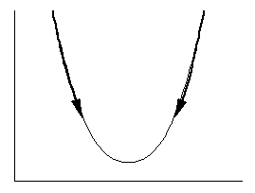
Cost function

Slide 6
Cost function
Derivative of J:
Positive: function is increasing
Negative: function is decreasing

Slide 7
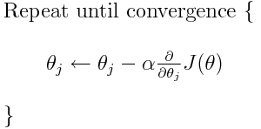
Algorithm
Initialize theta
.

Slide 8
Problem

Slide 9
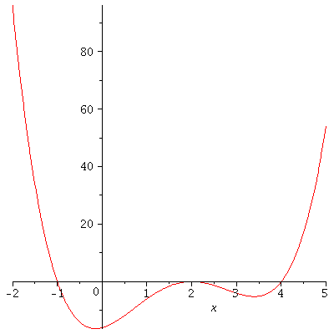
Problem
Sensitive to starting point because of local minima

Slide 10
Solution
Run algorithm multiple times with random starting points

Slide 11
Problem
Step size
Too small
Too large

Slide 12
Solution
Fixed
Linear
Rate = C/iterations
Newton’s method
Second order derivative

Slide 13
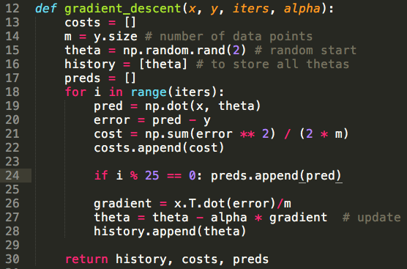
Code

Slide 14
Principle Component Analysis

Slide 15
PCA
Used to reduce the dimensionality of the data
Summarize the data without losing too much variance

Slide 16
Prerequisite
Eigenvector and eigenvalue

Slide 17
Prerequisite
Eigenvector and eigenvalue
Linear transformation which will not change the direction of the vector
Au = lu, where u is eigenvector and l is corresponding eigenvalue
Property:
All eigenvectors of symmetric matrix are perpendicular to each other.

Slide 18
PCA
Suppose we have n d-dimensional data points (x1,x2,x3…,xn )
Problem Statement:
Determine a subspace of dimension q (<d) and project xi’s onto that subspace preserving as much information as possible

Slide 19
Optimization Problem
Find Maximum covariance given that axis is orthonormal
This problem is Lagrangian Optimization Problem

Slide 20

Code

Slide 21
Boosting

Slide 22
Boosting
Crowd can be more intelligent than participant in the crowd
Difference between strong and weak classifier

Slide 23
Experimental Results
No over fitting

Slide 24
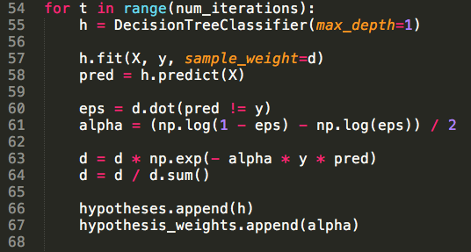
Code

Slide 25
Thank you

