Slide 1
BEHAVIORAL FINANCE (MBA680) | GROUP PROJECT
Personal Investment Advisor and Robo-Advisory Project
A step by step walk-through of Steps 1 to 6, with the survey questions used at each step
Portal: siddharthjaiswal05.github.io/mba_680_assignment_2
PRESENTED BY
Abhinav Raj
Chhitij Nigam
Raghav Patidar
Siddharth Jaiswal
Notes:
Personal Investment Advisor and Robo-Advisory Project

Slide 2
THE WORK, END TO END
The Six Steps at a Glance
The map. Each of the next nine slides takes one step and shows the questions, the method and the result together.
Every step, the part of the form it used, and what it produced
Step | What it required | Part of the form used | How it was done | What came out
1 | Pick a peer group and build the survey | Section 1, About you | Eight profile questions, roll number instead of a name | Four anonymous investor profiles
2 | Measure the attitude to risk | Section 2, eight ladder rows | A sure amount against a double or nothing coin flip | A risk pattern for each person
3 | Measure the attitude to waiting | Section 3, six now or later rows | Rs 10,000 today against a larger amount later | A yearly discount rate for each person
4 | Fit the curves and score the personality | Sections 4, 5 and 6 | Probability equivalence, then a least squares fit; BFI-2 scored by facet | Risk aversion A, curvatures alpha and beta, five domain scores
5 | Build the portfolio | Nothing new, it reuses Steps 2 to 4 | Maximise E(r) minus half A sigma squared along the capital allocation line | An advised equity weight for each person
6 | Write the advice and ship the tool | Section 4 scores plus Section 7 | Rules that fire on the respondent's own answers | Personal commentary and a live portal
The seven Section 7 questions are our own addition to the class form. They are introduced on the Step 5 behavioral slide, where they are used.
Notes:
The Six Steps at a Glance

Slide 3
STEP 1 OF 6
Choose the Peer Group and Build the Survey
Requirement: field an investor survey on a peer group and record it in a form that an estimator can read.
The eight questions in Section 1, as they appeared
What came back
Question on the form | Answer type
Roll number | Text, used instead of a name
Age | Years
Money coming in each month | One of five bands
Money you can invest (Rs) | Rupees
How much investing have you done? | None to Substantial
How many years will you keep it invested? | Years
What is the money mainly for? | One of four goals
Anything that limits you? | Optional free text
Roll | Investable wealth | Experience | Horizon | Primary goal
251250039 | Rs 90,000 | Moderate | 5 yrs | Wealth creation
251250047 | Rs 2 lakh | None | 10 yrs | Wealth creation
251250002 | Rs 10 lakh | Limited | 6 yrs | Wealth creation
251250030 | Rs 1 lakh | Limited | 15 yrs | Specified goal
How the step was completed
Four responses collected and transcribed into one machine readable file.
How it was done
Output of Step 1
Fielded to four classmates through the portal. The export of their answers is the file the estimator reads.
engine/responses_real.json, the single input to every later step.
Notes:
Choose the Peer Group and Build the Survey

Slide 4
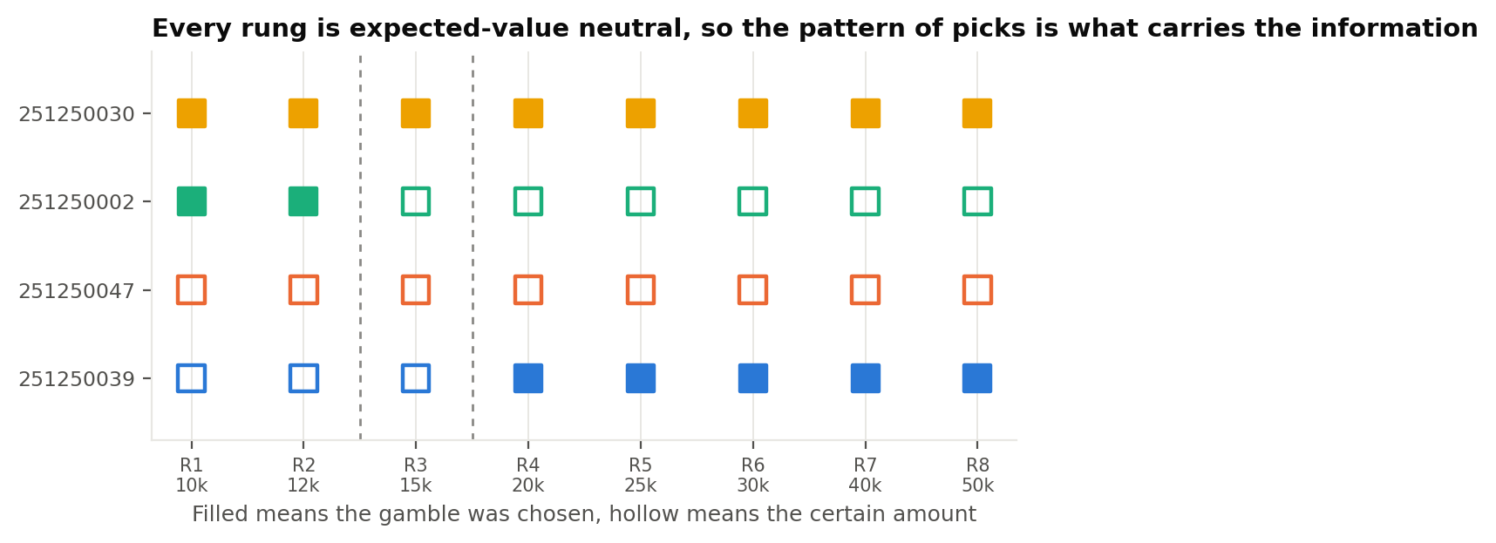
STEP 2 OF 6
Measure the Attitude to Risk
Requirement: put a sure amount against a fair gamble and see which one the respondent takes, row by row.
Section 2, all eight rows exactly as asked
# | A: you get for sure | B: coin flip
1 | Rs 10,000 | Rs 20,000 or nothing, 50:50
2 | Rs 12,000 | Rs 24,000 or nothing, 50:50
3 | Rs 15,000 | Rs 30,000 or nothing, 50:50
4 | Rs 20,000 | Rs 40,000 or nothing, 50:50
5 | Rs 25,000 | Rs 50,000 or nothing, 50:50
6 | Rs 30,000 | Rs 60,000 or nothing, 50:50
7 | Rs 40,000 | Rs 80,000 or nothing, 50:50
8 | Rs 50,000 | Rs 1 lakh or nothing, 50:50
How the step was completed
All four patterns were classified. 251250047 took the sure amount every time and 251250030 took the coin flip every time.
How it was done
What it told us
The sure amount equals the gamble's average on every row, so one utility curve means the same side all eight times. We read the pattern of the picks.
251250039 and 251250002 switch part way down, at rows 4 and 3, exactly as prospect theory predicts.
Notes:
Measure the Attitude to Risk

Slide 5
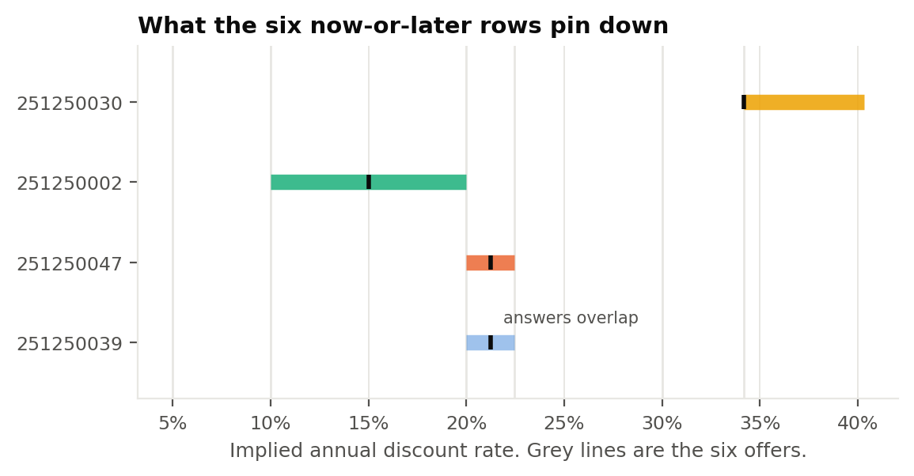
STEP 3 OF 6
Measure the Attitude to Waiting
Requirement: offer money now against more money later and find the return that makes waiting worthwhile.
Section 3, all six rows exactly as asked
# | Take now | Or wait and get | Wait how long
1 | Rs 10,000 | Rs 10,500 | 1 year
2 | Rs 10,000 | Rs 11,000 | 1 year
3 | Rs 10,000 | Rs 12,000 | 1 year
4 | Rs 10,000 | Rs 13,000 | 1 year
5 | Rs 10,000 | Rs 15,000 | 2 years
6 | Rs 10,000 | Rs 18,000 | 2 years
How the step was completed
A discount rate was produced for all four. 251250039 came out near 21.2% a year and 251250002 near 15.0%.
How it was done
Each row implies a yearly return. The lowest offer waited for and the highest one turned down bracket the personal discount rate, and the midpoint of that bracket is the point estimate.
What it told us
Every rate sits above any return on offer, and 251250030 preferred cash at every rung. Worth a conversation about the real horizon.
Notes:
Measure the Attitude to Waiting

Slide 6
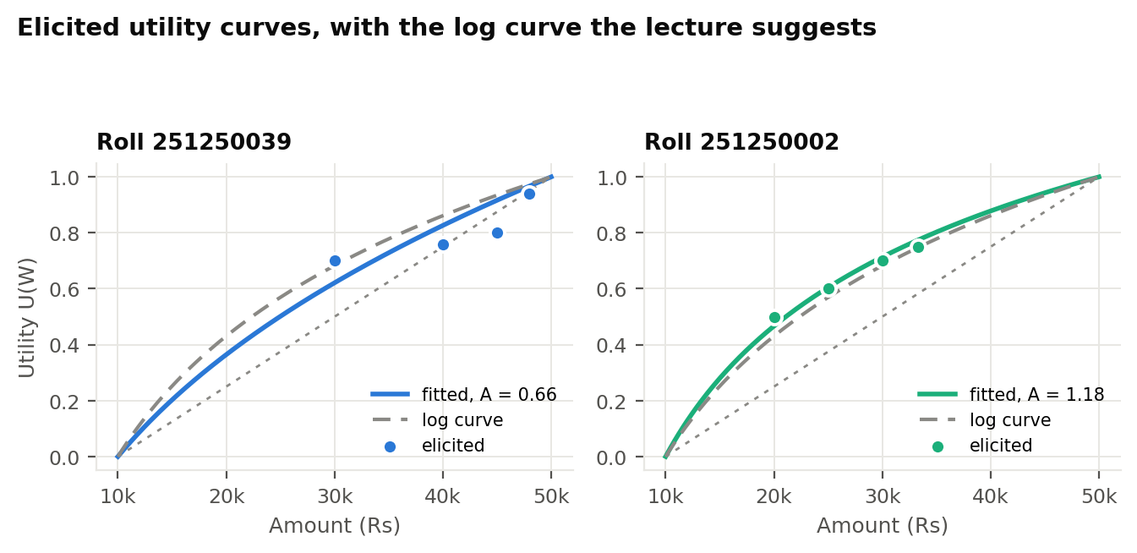
STEP 4 OF 6, PART 1
Fit the Utility Curve
Requirement: elicit a utility curve over wealth by the probability equivalence method from the lecture.
Section 5, with one respondent's own answers alongside
Item | Question on the form | 251250039 said
A | The lowest amount that feels relevant to you | Rs 10,000
B | The highest amount that feels relevant to you | Rs 50,000
U1 | Rs 30,000 for sure, or play the game. What winning chance makes the two feel the same? | 70 in 100
U2 | Rs 40,000 for sure, or play the game. What winning chance makes the two feel the same? | 76 in 100
U3 | Rs 45,000 for sure, or play the game. What winning chance makes the two feel the same? | 80 in 100
U4 | Rs 47,999 for sure, or play the game. What winning chance makes the two feel the same? | 94 in 100
The fitted curves
Roll | Range A to B | Risk aversion | Fit R2
251250039 | Rs 10,000 to Rs 50,000 | 0.66 | 0.202
251250047 | To come | To come | To come
251250002 | Rs 10,000 to Rs 50,000 | 1.18 | 0.948
251250030 | To come | To come | To come
How it was done
Set U(A) = 0 and U(B) = 1. At indifference the stated chance is the utility of the sure amount, so U(X) = p. Those points were fitted with a constant relative risk aversion curve by least squares.
Both curves came out concave, so both respondents are risk averse: A = 0.66 and A = 1.18. That coefficient is the A used directly in Step 5.
Notes:
Fit the Utility Curve

Slide 7
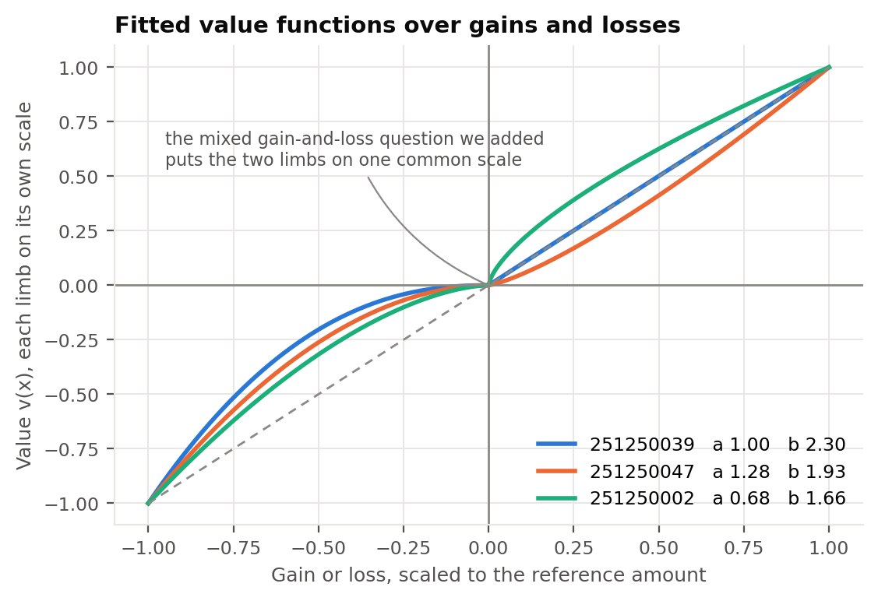
STEP 4 OF 6, PART 2
Fit the Value Function Over Gains and Losses
Requirement: measure how gains and losses are coded against a reference point, as prospect theory sets it out.
Section 6, all seven fields exactly as asked
Item | Question on the form | Answer scale
W0 | The amount you measure gains and losses against | Rupees
V1 | Win Rs 10,000 for sure, or play for Rs 20,000 | Winning chance
V2 | Win Rs 20,000 for sure, or play for Rs 40,000 | Winning chance
V3 | Win Rs 30,000 for sure, or play for Rs 60,000 | Winning chance
V4 | Lose Rs 10,000 for sure, or risk losing Rs 20,000 | Chance of the bigger loss
V5 | Lose Rs 20,000 for sure, or risk losing Rs 40,000 | Chance of the bigger loss
V6 | Lose Rs 30,000 for sure, or risk losing Rs 60,000 | Chance of the bigger loss
The fitted parameters
Roll | Gain alpha | Loss beta | Spread across rows
251250039 | 1.00 | 2.30 | 0.81 and 1.10
251250047 | 1.28 | 1.93 | 0.51 and 0.32
251250002 | 0.68 | 1.66 | 0.49 and 1.64
251250030 | To come | To come | To come
How it was done
The gamble pays double or nothing, so v(X) = p times v(2X) at indifference. With v(x) = x to the power alpha the sure amount cancels and alpha is minus log base 2 of p.
All three gain rows measure the same curvature, so the spread between them is a direct read on how reliably the answer was given.
Notes:
Fit the Value Function Over Gains and Losses

Slide 8
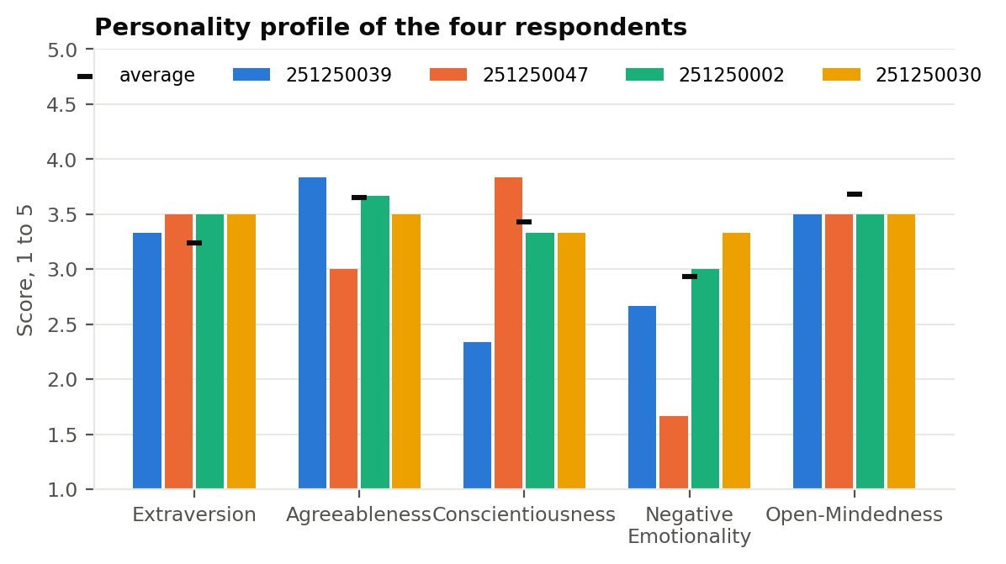
STEP 4 OF 6, PART 3
Score the Personality Profile
Requirement: collect a standard personality measure so the advice can speak to behaviour, not only to risk.
Section 4, thirty short items, one sample from each domain
Domain | A sample item from the thirty | Scale
Extraversion | Is outgoing, sociable. | 1 to 5
Agreeableness | Is compassionate, has a soft heart. | 1 to 5
Conscientiousness | Is systematic, likes to keep things in order. | 1 to 5
Negative emotionality | Can be tense. | 1 to 5
Open-mindedness | Is curious about many different things. | 1 to 5
How the step was completed
How it was done
All four answered all thirty items, so every domain and facet score is complete.
Thirty items from the BFI-2, two per facet, chosen so all fifteen facets are covered within the thirty question cap. Reverse keyed items were flipped, facets averaged, domains averaged from their facets, then placed against the published norming means.
Output of this step
1 means not like me at all and 5 means very much like me.
Five domain scores and fifteen facet scores per person.
Notes:
Score the Personality Profile

Slide 9
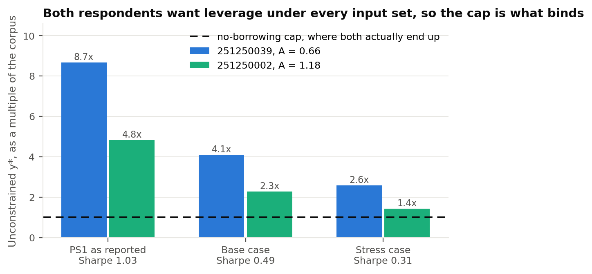
STEP 5 OF 6
Build the Mean-Variance Portfolio
Requirement: combine the measured risk aversion with the Problem Statement 1 portfolio and set the equity weight.
The inputs, all carried forward rather than asked again
The recommendation, base case inputs
Input | Value used | Where it came from
Risky portfolio | 24.9% return, 18.0% risk | Problem Statement 1
Risk-free rate | 6.5% | Treasury bill yield
Risk aversion A | 0.66 and 1.18 | The Step 4 utility curve
Borrowing | Capped at zero | Student investor constraint
Roll | A | y* uncapped | Advised equity | Return | Risk
251250039 | 0.66 | 4.11x | 100% | 15.2% | 18.0%
251250047 | To come | To come | To come | To come | To come
251250002 | 1.18 | 2.29x | 100% | 15.2% | 18.0%
251250030 | To come | To come | To come | To come | To come
How it was done
Maximise U = E(r) minus half A sigma squared along the capital allocation line. The optimum is y* = [E(rP) minus rf] divided by A times sigmaP squared, capped at one because borrowing is not available.
Three return scenarios are carried through, because the expected return is the least certain input in the whole exercise.
Both respondents with a fitted curve want more than their whole corpus in the risky portfolio, so the cap sets the answer: hold 100%, which is Rs 90,000 and Rs 10 lakh.
Notes:
Build the Mean-Variance Portfolio

Slide 10
STEP 5 OF 6, EXTENDED
Build the Behavioral Portfolio
Requirement: go past mean-variance and size the layered portfolio that behavioral portfolio theory describes.
Section 7, the questions we added to the class form
What the layered portfolio needs
Item | Question added to the form | What it measures
E1 | A coin flip. Tails you lose Rs 10,000, heads you win G. How big must G be? | Loss aversion, lambda
E2 | A 10 in 100 chance of Rs 10,000. What sure amount feels as good? Same at 90 in 100. | Probability weighting
E3 | What is the smallest amount you must still have at the end? | The safety floor
E4 | How often could you live with falling below that amount? | Shortfall tolerance
E5 | What amount at the end would you call a success? | The aspiration level
E6 | Split 100 points between staying safe and a real shot at the big number. | Security and potential split
E7 | What would you give up to raise your chance of success by 10 points? | Weight on the aspiration
A floor in rupees, a tolerance for breaching it, an aspiration level, and loss aversion. Together they split the corpus into a safety sleeve and a potential sleeve, each priced off the same frontier.
How it was completed
The engine, the estimators and the layer solver are built and tested, and all seven questions are live in the portal. The code path runs end to end on worked inputs.
The next pass
How it was done
The four respondents answer the seven added questions, and the same run then prints a sized behavioral portfolio beside the mean-variance one.
Each layer needs one number the class form does not collect, so we wrote the seven shortest questions that supply them. They take about a minute to answer.
Notes:
Build the Behavioral Portfolio

Slide 11
STEP 6 OF 6
Turn the Numbers Into Advice
Requirement: write the commentary and the behavioral guidance that goes back to each respondent.
The rules, and the answer that triggers each one
251250039: build in the follow-through
Guidance | Fires when | Fired for
Automate the monthly contribution | Conscientiousness below the group mean | 251250039
Fix the review dates in advance | Organization facet below 3 out of 5 | 251250039
Step the equity weight up over time | Low negative emotionality and a long horizon | 251250047
Show the downside in rupees, not percent | A switch part way down the risk ladder | 251250002
Confirm the real horizon first | Cash preferred at every rate offered | 251250030
Conscientiousness 2.33. Automate the contribution and rebalance on a threshold.
251250047: methodical and calm
Conscientiousness 3.83 and the group's lowest negative emotionality at 1.67. A glide path suits this well.
251250002: frame it in rupees
How it was done
Balanced across every domain. The switch at row 3 suggests risk is judged in nominal amounts, so show the downside as a rupee figure.
Risk aversion is already measured in Step 4, so personality is used only where it predicts something else: whether the client stays with the plan. Each rule names the answer that set it off, so nothing in the advice is unexplained.
251250030: start with a conversation
Took the gamble throughout and preferred cash now at every rate. A short interview will establish the real horizon before the plan is set.
Notes:
Turn the Numbers Into Advice

Slide 12
WHAT WAS DELIVERED
How Each Step Was Completed
The same six steps again, this time with the evidence for each one.
Step by step, what exists at the end of the project
Step | How it was completed | Where to see it
1. Peer group and survey | Eight profile questions fielded to four classmates, answers stored under roll numbers and exported to one file | Portal Section 1, responses_real.json
2. Risk attitude | All eight ladder rows answered by all four; each pattern classified and the expected utility check reported | Report Section 2, figure c3
3. Time preference | All six rows answered by all four; a discount rate bracket and a midpoint estimate produced for each | Report Section 3, figure c4
4. Curves and personality | Utility curves fitted for two respondents, value curves for three, and all thirty personality items scored for all four | Report Section 4, figures c1, c2, c5
5. Portfolio | Advised equity weight computed for every respondent with a fitted curve, under three return scenarios | Report Section 5, figures c6, c7
6. Advice and tool | Written commentary per respondent, plus a live portal that fields the form and repeats the whole calculation in the browser | Report Section 6, the portal
Beyond the brief | Seven extra questions added to the form so the behavioral layers can be sized from stated preferences | Portal Section 7
Two respondents are scheduled for a short re-elicitation so their utility and value curves join the Step 5 run.
Notes:
How Each Step Was Completed

Slide 13
THE DELIVERABLE
The Robo-Advisory Portal
One static page, no server and no sign-in, so it opens on a phone in a classroom.
Fields the whole form
Fits and plots live
Builds both portfolios
All six class sections plus the seven added questions, written in plain English, with autosave and a one-click export of each respondent's answers.
Draws the respondent's own utility curve, value function and weighting function in the browser, using the same estimators that produced this deck.
The mean-variance allocation and the behavioral layers, against the real Problem Statement 1 frontier, with commentary generated from the respondent's own answers.
siddharthjaiswal05.github.io/mba_680_assignment_2
Notes:
The Robo-Advisory Portal

Slide 14
SCOPE AND CONCLUSION
What We Established, and What Comes Next
Sample
Return input
Horizon
Distribution
Universe
Four respondents, so the conclusions are about the method rather than a population.
The least certain input, which is why three scenarios are carried through.
Single-period models, before contributions, taxes and costs.
Normality assumed, so tail figures are the optimistic end.
Current index membership, inherited from Problem Statement 1.
Every one of the six steps is traceable to the exact question that produced it, and every number in this deck is computed from a submitted answer.
Risk aversion is measured from the utility curve, and the ladder is read as the pattern it genuinely reveals.
Seven added questions complete the behavioral portfolio, and they are already live in the portal.
The next pass collects those answers and re-elicits two respondents, which closes out Steps 4 and 5 for the full group.
Measure what the data supports, and extend the instrument where it does not.
Notes:
What We Established, and What Comes Next

