Slide 1

Product Ideas and Versions
Generated on January 31, 2025

Slide 2
Set 1 - Form Data
Product: N/A Brand: N/A Category: N/A

Slide 3
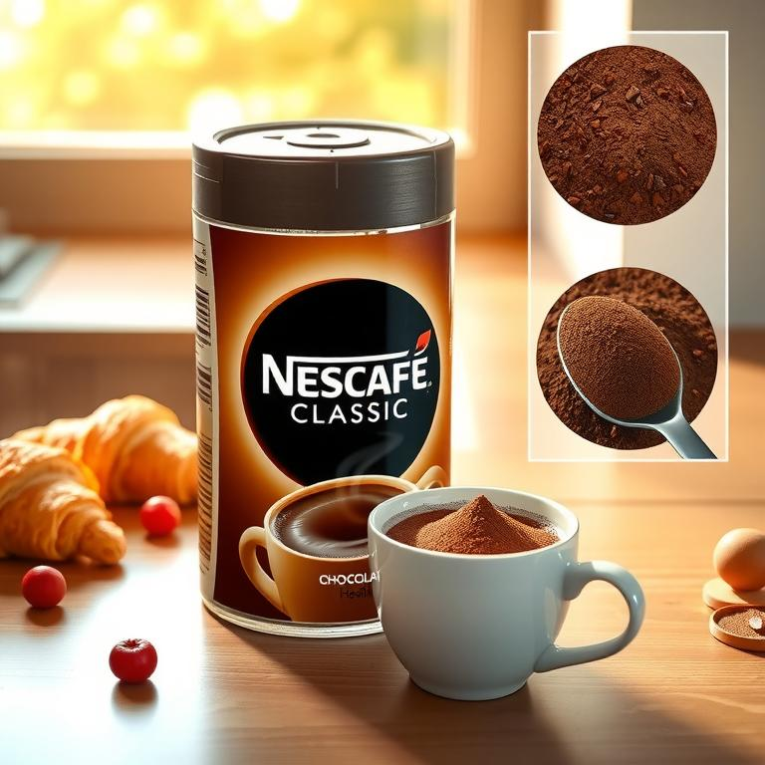
Nescafé Classic Chocolate Hazelnut Fusion
Set 1-91-Img-1
Indulge in the irresistible new Nescafé Classic Chocolate Hazelnut Fusion! This instant coffee powder combines the rich aroma and bold flavor of classic Nescafé with the decadent sweetness of chocolate and the nutty warmth of hazelnut. Each cup delivers a luxurious coffee experience, boosting your energy with a delightful twist. It's the perfect pick-me-up for those who appreciate a richer, more complex coffee flavor profile and a delicious treat for the tastebuds. Experience the unique fusion of classic coffee and irresistible chocolate hazelnut – your new favorite morning ritual awaits!

Slide 4
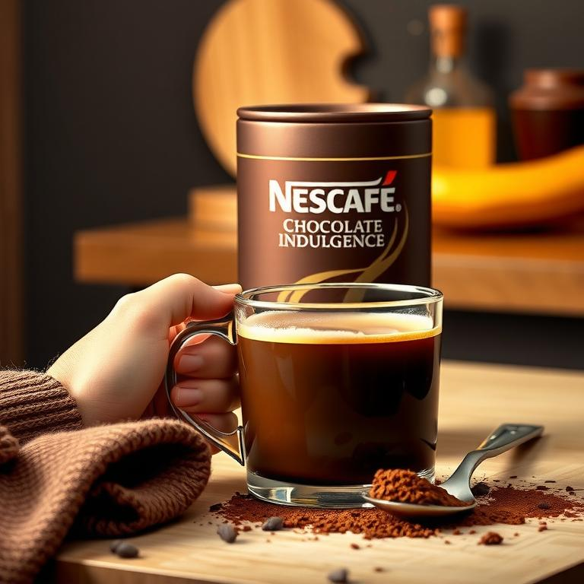
Nescafé Classic Chocolate Indulgence
Set 1-85-Img-1
Experience the ultimate in rich coffee indulgence with Nescafé Classic Chocolate Indulgence! This instant coffee powder blends the smooth, classic taste of Nescafé with the delightful sweetness of real chocolate. Each cup delivers a rich aroma and flavor, creating a decadent treat perfect for a relaxing moment or an energy boost. Simply add hot water to this premium blend for a velvety smooth, intensely chocolatey coffee experience that's both satisfying and convenient.

Slide 5
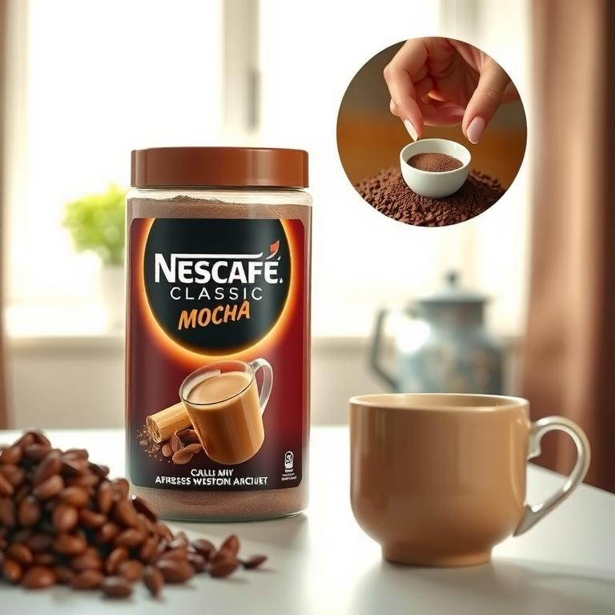
Nescafé Classic Chocolate Mocha Mix
Set 1-86-Img-1
Elevate your morning routine with Nescafé Classic Chocolate Mocha Mix! This unique instant coffee powder combines the aromatic depth of Nescafé Classic with the smooth taste of rich chocolate, offering a delightful mocha experience without the fuss. It's bursting with rich aroma and flavor, making it an ideal quick and easy way to enjoy a delicious, sophisticated mocha at home or on-the-go. Simply add hot water or milk for a creamy, decadent treat that's perfectly balanced and intensely satisfying.

