Slide 1


One-Month Gen-AI Internship: Progress Report
This presentation outlines my key achievements and learnings from my one-month Gen-AI internship. The focus is on the rapid skill development, project milestones, and the continuous pursuit of knowledge in this rapidly evolving field.
by Tapasmita Pattnaik

Slide 2
Learning Progression: From Fundamentals to Advanced AI
Foundation in AI/ML with Python & PostgreSQL
My journey began with mastering Python for data manipulation and analysis using NumPy and Pandas, followed by PostgreSQL for efficient data management. I then learned Django to integrate AI models into web applications and React for dynamic user interfaces. Lastly, I gained hands-on experience in supervised and unsupervised machine learning, developing predictive models and uncovering data patterns.
Implementing Complex LLM Solutions
The internship culminated in implementing complex LLM solutions, such as building chatbots and performing advanced text analysis. This involved hands-on experience with fine-tuning LLMs and developing bespoke solutions to specific business challenges.
1
2
3
Exploring Large Language Models
Building upon the fundamentals, the internship progressed to exploring the world of large language models (LLMs). This involved understanding their capabilities, limitations, and how to integrate them into real-world applications. I learned to enhance model responses by integrating external knowledge through intelligent document chunking, creating semantic embeddings, and using vector databases for efficient retrieval.

Slide 3




Technical Stack Evolution
Languages & Databases
1
Python, PostgreSQL
LLM Technologies & RAG
2
OpenAI, Gemini AI, Hugging Face, Groq AI, Mistral AI
Frameworks & Tools
3
LangChain, LLaMA Index, ChromaDB, FAISS
Frontend
4
React, Streamlit, MUI
This pyramid illustrates the evolution of my technical stack during the internship. The foundation was laid with fundamental programming languages and databases. I then progressed to exploring various LLM technologies, leveraging frameworks and tools to build practical applications. The final layer focuses on the frontend development skills necessary to create user-friendly interfaces.

Slide 4
Project Milestones: Demonstrating Practical Application
Multi-Document Chatbot
KlariFAI Clone - on going
The first project involved building a multi-document chatbot capable of providing comprehensive answers to complex queries.
The second project involved building a clone of KlariFAI.

Slide 5



Technical Implementation Details
Document Processing Pipeline
Input Handling: Raw data is received and preprocessed to ensure compatibility with various file formats, preparing it for further steps.
Text Extraction: Relevant text is parsed and extracted from the uploaded documents, focusing on essential information while filtering out irrelevant content.
Chunking Strategy: Extracted text is divided into smaller, manageable segments, enabling efficient analysis, indexing, and retrieval.
Vector Embedding Optimization
Model Selection: A suitable embedding model, like Groq LLM, is chosen to convert text chunks into numerical vectors, ensuring semantic meaning is effectively captured for accurate retrieval.
Batch Processing: Text chunks are processed in batches to generate embeddings simultaneously, enhancing performance and scalability for large datasets.
Chatbot Interaction
User queries are processed and transformed into vector representations. The vector database is then queried to retrieve relevant chunks, providing context-aware answers.

Slide 6
Technical Challenges Overcome
Challenges
Solutions
Large document handling
Implemented chunk optimization strategies
Context relevance
Enhanced embedding strategy
Response accuracy
Refined prompt engineering
Integration complexity
Developed robust API layer
Summary generation
Advanced summary algorithms
Source citation accuracy
Citation management system

Slide 7
Skills Mastered: Building a Comprehensive Skillset
1
RAG Implementation
2
Front-End Development
I gained practical experience with Retrieval Augmented Generation (RAG), a technique for enhancing LLM performance by integrating external knowledge sources. This involved building robust retrieval systems and fine-tuning LLMs to leverage retrieved information.
I developed proficiency in front-end development, using frameworks like Streamlit to build interactive user interfaces for AI applications. This involved understanding UI/UX principles and creating intuitive user experiences.
3
LLM Integrations
4
Data Handling & Preprocessing
I learned how to seamlessly integrate various LLMs like GPT-3, BERT, and others into different projects. This included choosing the right model for specific tasks, fine-tuning parameters, and managing API interactions.
I gained proficiency in data handling and preprocessing techniques, essential for preparing large datasets for AI models. This involved understanding data cleaning, feature engineering, and model-specific data transformations.

Slide 8

Upcoming Focus: Expanding Horizons in Cloud & DevOps
Cloud Platforms
DevOps Practices
Machine Learning Pipelines
I will be delving into cloud platforms like Azure, AWS, and GCP, exploring their capabilities for deploying and scaling AI applications. Understanding cloud infrastructure is crucial for building robust and scalable AI solutions.
I will be implementing DevOps practices to streamline the development and deployment of AI applications. This will involve using tools for continuous integration and continuous delivery (CI/CD) to ensure efficient and reliable deployments.
I will be exploring machine learning pipelines, automating the process of data preprocessing, model training, and evaluation. This will involve using tools like MLflow and Kubeflow to create efficient and scalable ML pipelines.

Slide 9




Technical Growth Metrics: Quantifying Progress
Increased model accuracy
Improved model accuracy on various benchmarks by implementing data augmentation techniques and fine-tuning model hyperparameters.
Reduced training time
Optimized model training processes by leveraging GPU acceleration and distributed training techniques, resulting in faster training times.
Enhanced model efficiency
Developed strategies to reduce model size and complexity while maintaining performance, improving model efficiency and reducing computational overhead.

Slide 10




Collaborating with Cross-Functional Teams
Effective Communication
Collaborated with engineers, designers, and product managers to effectively communicate technical concepts and ensure clear alignment across teams.
Constructive Feedback
Actively sought and provided constructive feedback to team members, fostering an environment of continuous improvement and knowledge sharing.
Collaborative Problem-Solving
Worked collaboratively with team members to overcome technical challenges, leveraging each other's strengths to achieve common goals.

Slide 11
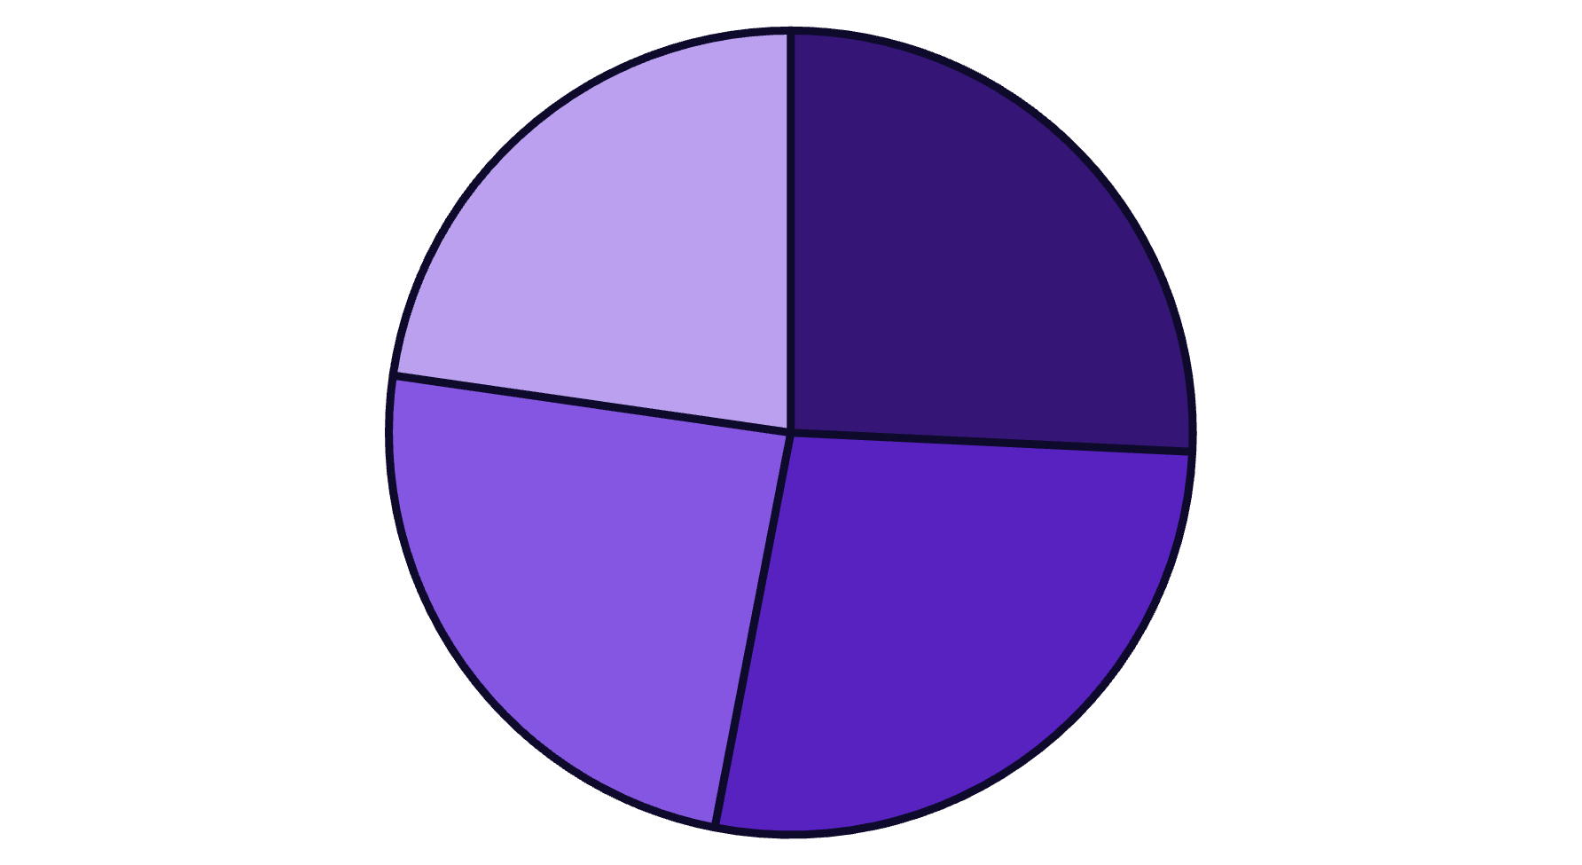
Growth Areas & Expertise
LLM Prompt Engineering
RAG Architecture
Vector DB Management
Frontend Framework
This spider chart illustrates the areas of expertise I've developed during my internship.
My proficiency in LLM prompt engineering, RAG architecture, and vector DB management is particularly strong.

Slide 12

Applying Lessons Learned to Future Endeavors
The knowledge and skills acquired during this internship will be invaluable in future endeavors. I am confident in my ability to contribute to real-world AI projects and continue learning and growing in this dynamic field.

Slide 13
Self-Evaluation
Area
Rating
Notes
Technical Growth
★★★★☆
Strong progress in LLM & RAG
Project Delivery
★★★★★
Consistent quality focus
Learning Agility
★★★★★
Quick tech adaptation
Team Collaboration
★★★★☆
Effective knowledge sharing

Slide 14

Conclusion: Key Takeaways and Next Steps
This internship provided me with a solid foundation in Gen-AI, equipping me with the skills and knowledge necessary to build and deploy cutting-edge AI solutions. I am excited to continue exploring advanced AI concepts and contribute to the development of innovative applications that will shape the future.

