Slide 1

Factors in World Happiness
By James Cadigan, Siddharth Kona, Radhi Patel, Sidney Watts and Emma Pan

Slide 2
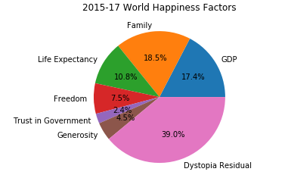
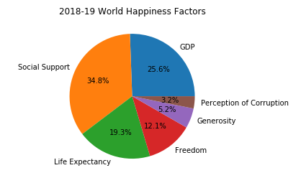
What is World Happiness?
World Happiness is a standard created by Sustainable Development Solutions Network
Value between 0 and 10
Method of weighting changed for 2018 and onward

Slide 3
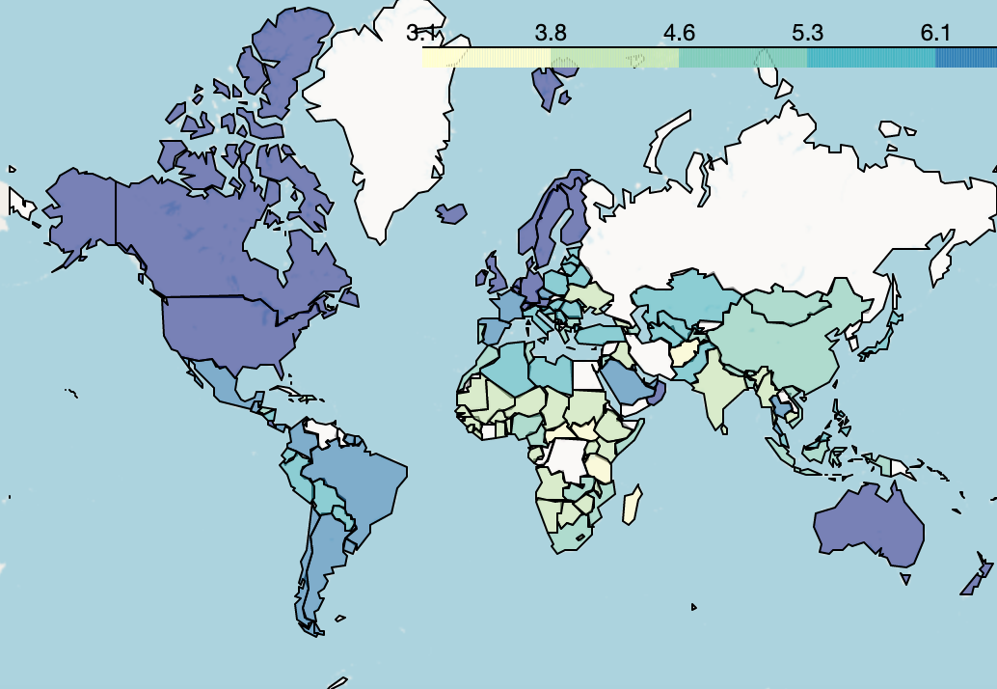
Happiness by Region
North America, Europe, and Oceania highest happiness
Sub-Saharan Africa and southern Asia lowest

Slide 4
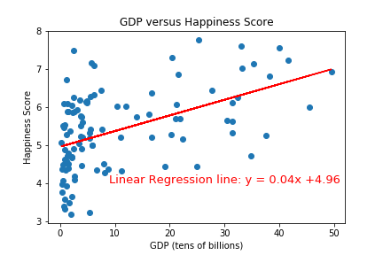
Happiness by GDP (overview)
Unsurprisingly, there is a positive correlation between happiness and GDP
Countries with outlier GDPs are removed.

Slide 5
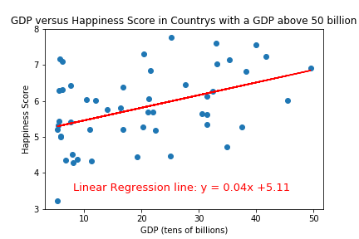
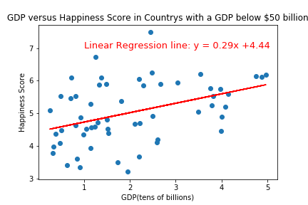
Happiness by GDP (continued)
GDP is a larger factor in happiness to countries with lower GDPs

Slide 6
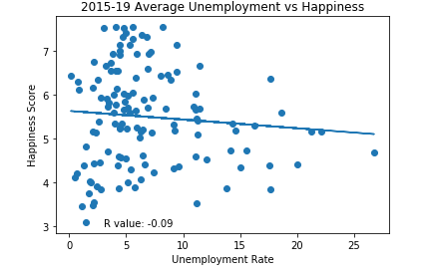
Unemployment
R-Value astonishingly close to 0
Almost conally shaped around linear regression line
Although technically negative, not significant

Slide 7
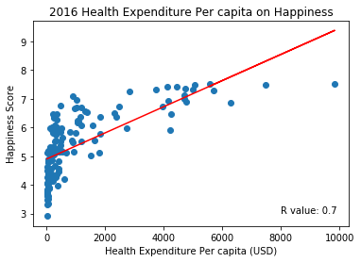
Happiness by Health Expenditure
Current expenditures on health per capita in current US dollars. Estimates of current health expenditures include healthcare goods and services consumed during each year.

Slide 8
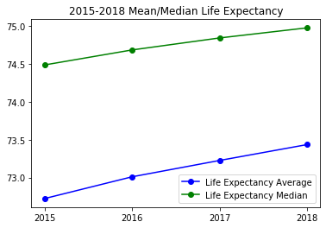
Happiness by Life Expectancy
Combined 130 countries of Life Expectancy with World Happiness
Mean growth from 2015 to 2018 is ~0.98%
Median growth from 2015 to 2018 is ~0.66%

Slide 9
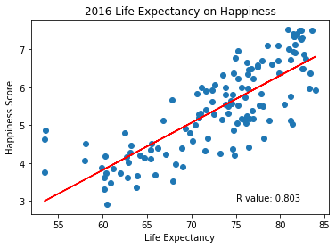
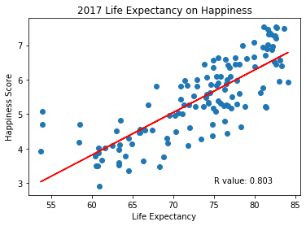
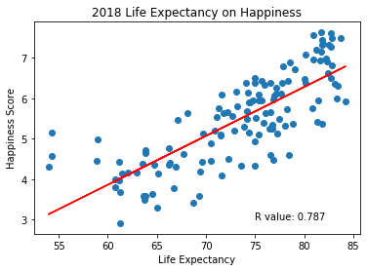
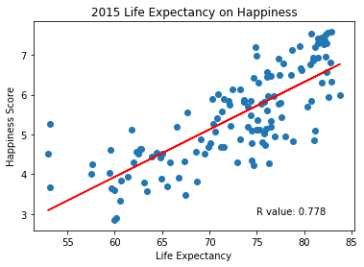
Life expectancy versus Happiness

Slide 10
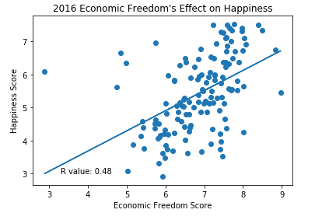
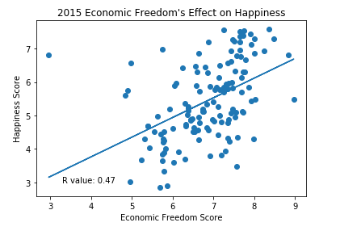
Economic Freedom
Measurement of five areas:
Size of Government
Legal System/ Property Rights
Sound Money
Freedom to Trade Internationally
Regulation
Similar Regression, Severe outlier in Venezuela

Slide 11
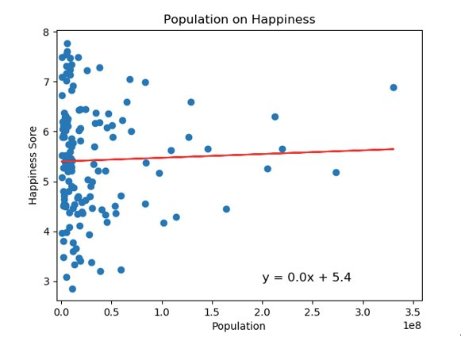
Population by Happiness
Population is not correlated with happiness
Ranking of the levels and changes in happiness around the world, is on migration within and between countries.

Slide 12
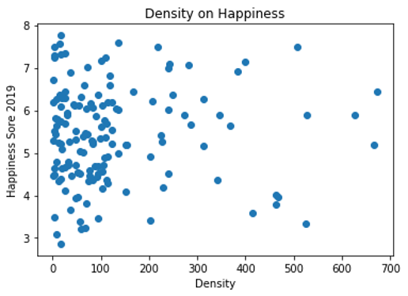
Density on Happiness
Density is not correlated with happiness

Slide 13
Conclusions
GDP plays a large role in happiness for poorer countries and has a lesser (but still positive) effect on richer ones
Unemployment doesn’t have an effect on happiness scores
Health expenditure and life expectancy both have a high and positive effect happiness score
Economic freedom has a positive effect on happiness scores
Population and Density don’t have an effect on happiness

