Slide 1

Student Record Management System
Problem Solving with C Laboratory
Section -C
Group Members:
SRN Roll No Name
PES1UG19CS482 56 Siddharth Magadum
PES1UG19EC250 59 Sadir Irfan
PES1UG19CS597 66 Yuvaraj M
PES1UG19EC178 65 Narayan Pawar

Slide 2
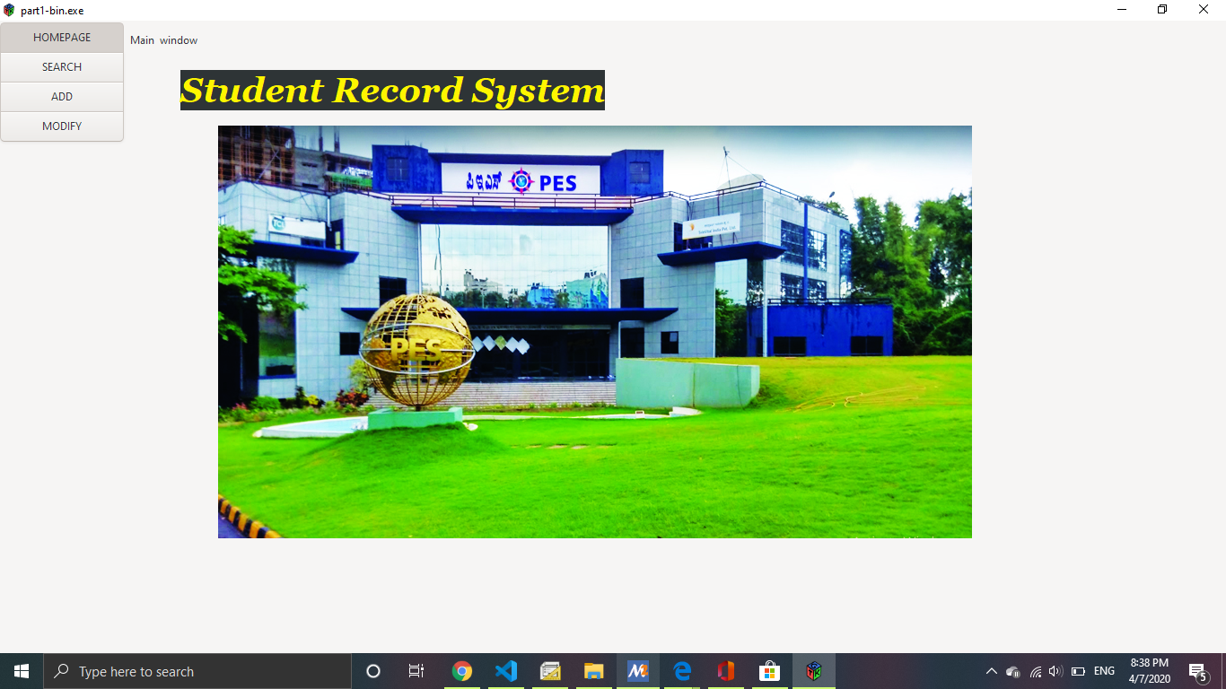
Home Page

Slide 3
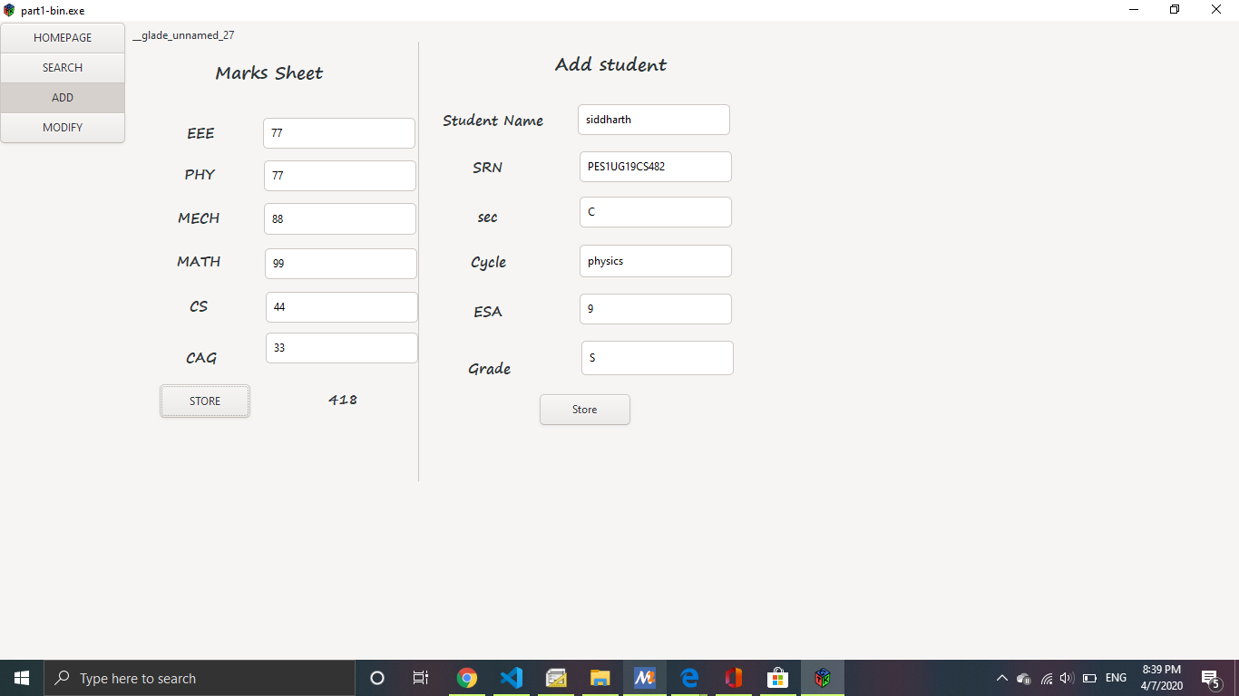
Window to add student record

Slide 4
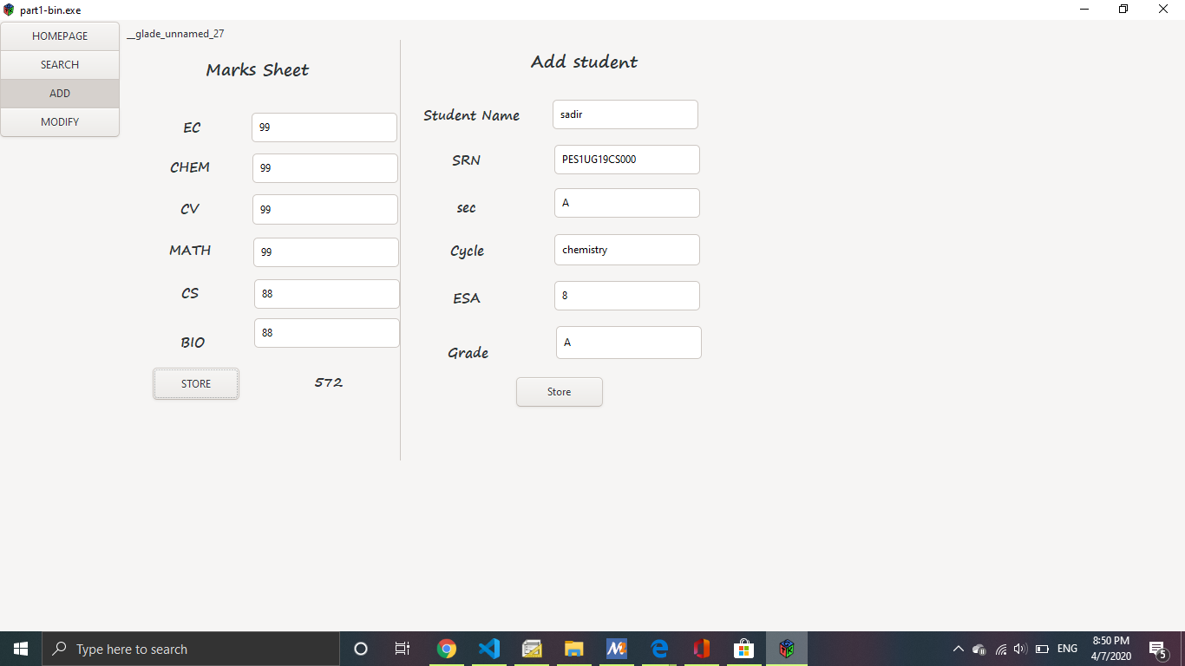

Slide 5
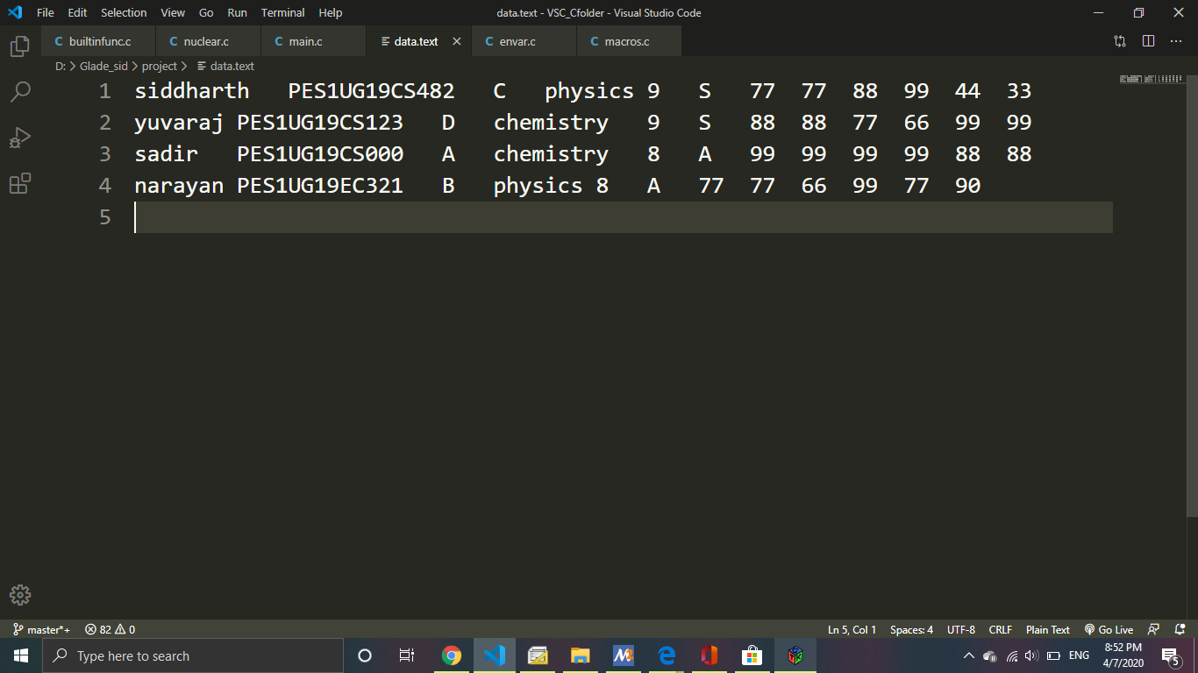
List of students mark sheet

Slide 6
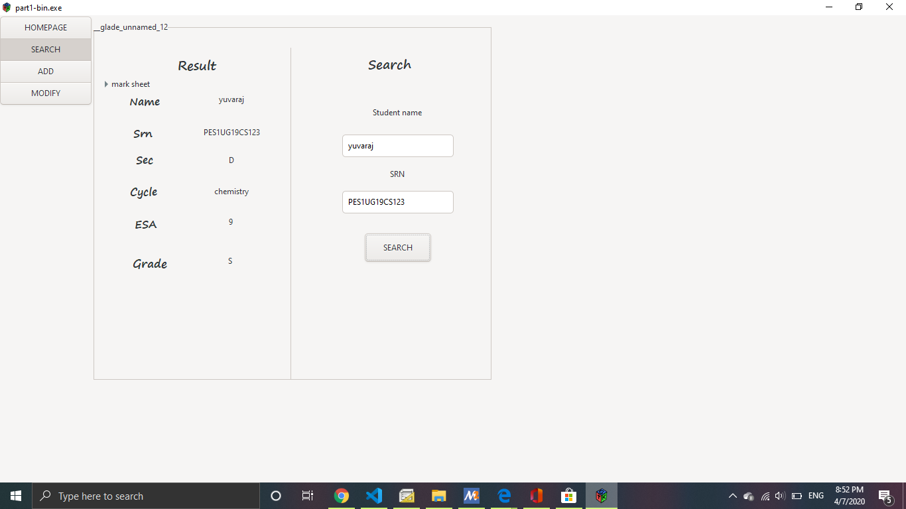
Searching student with Name and SRN Number

Slide 7
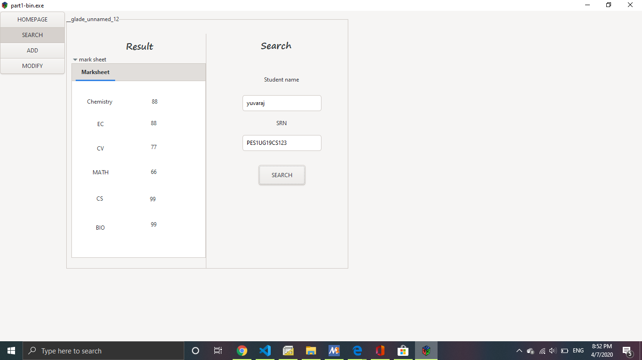

Slide 8
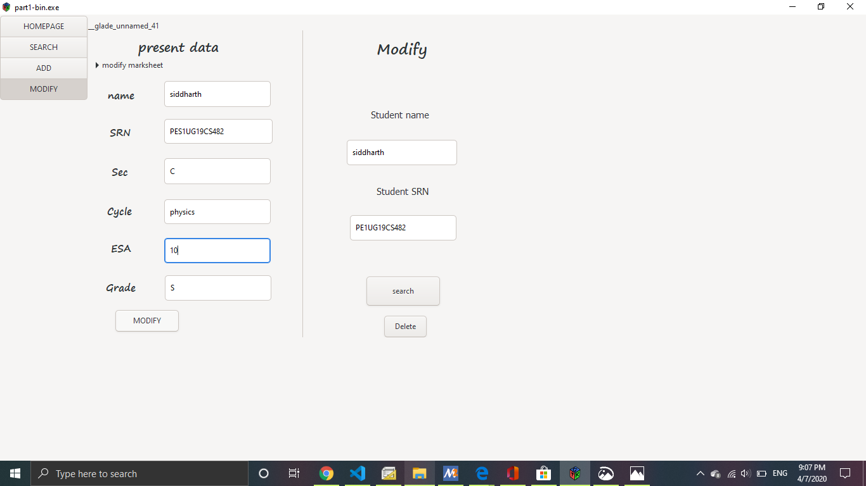
Option to modify or delete student details
ESA changed from 9 to 10

Slide 9
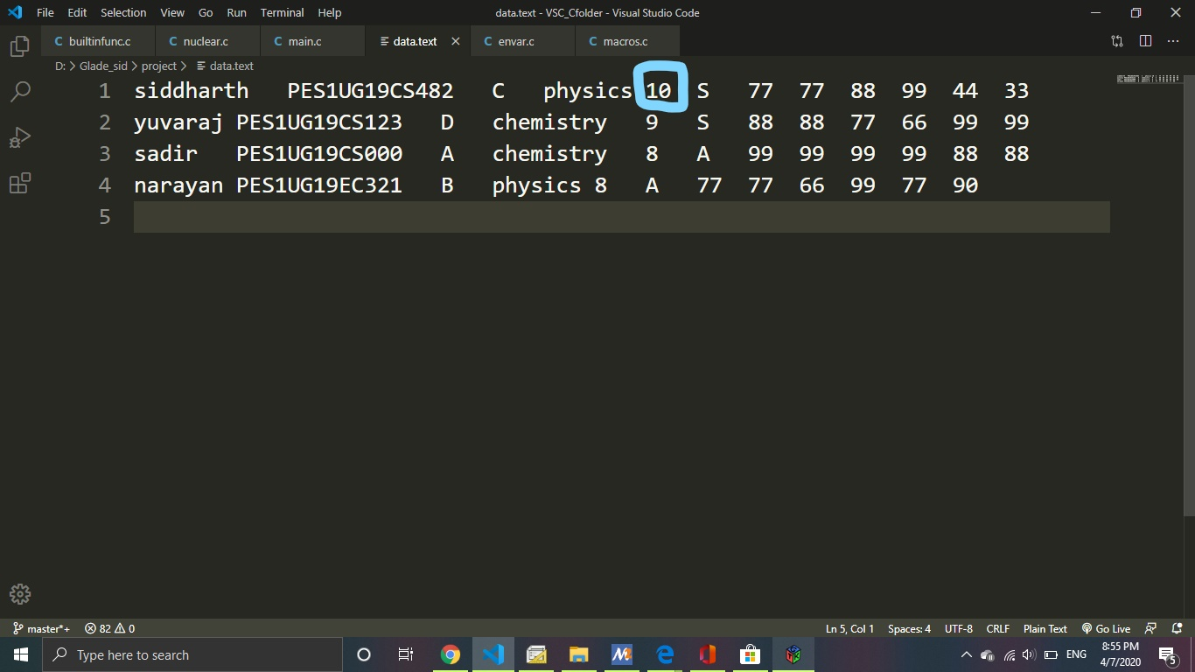
Modified value in student record

Slide 10
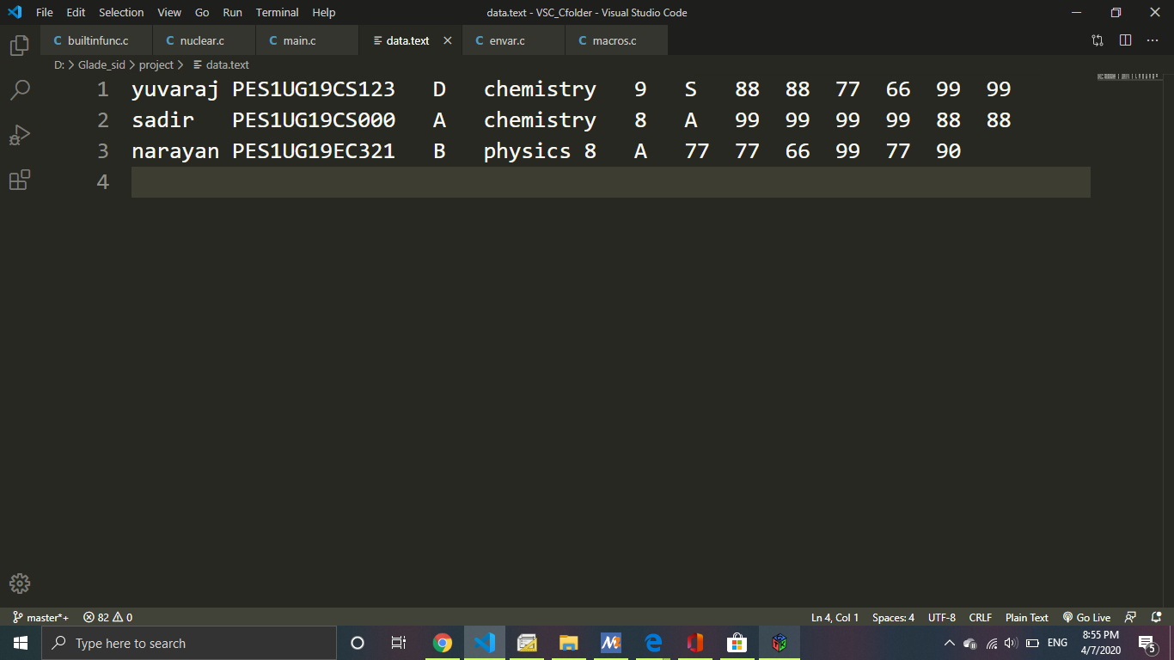
Student record after deleting

Slide 11
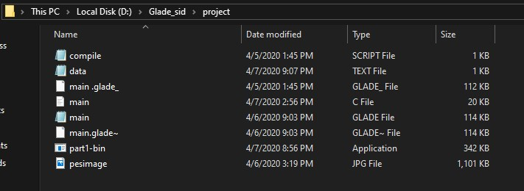
Required files to run the glade project (gtk GUI)

Slide 12
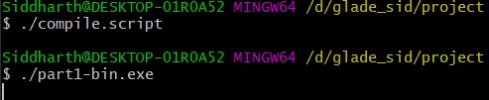
Running the program

Slide 13
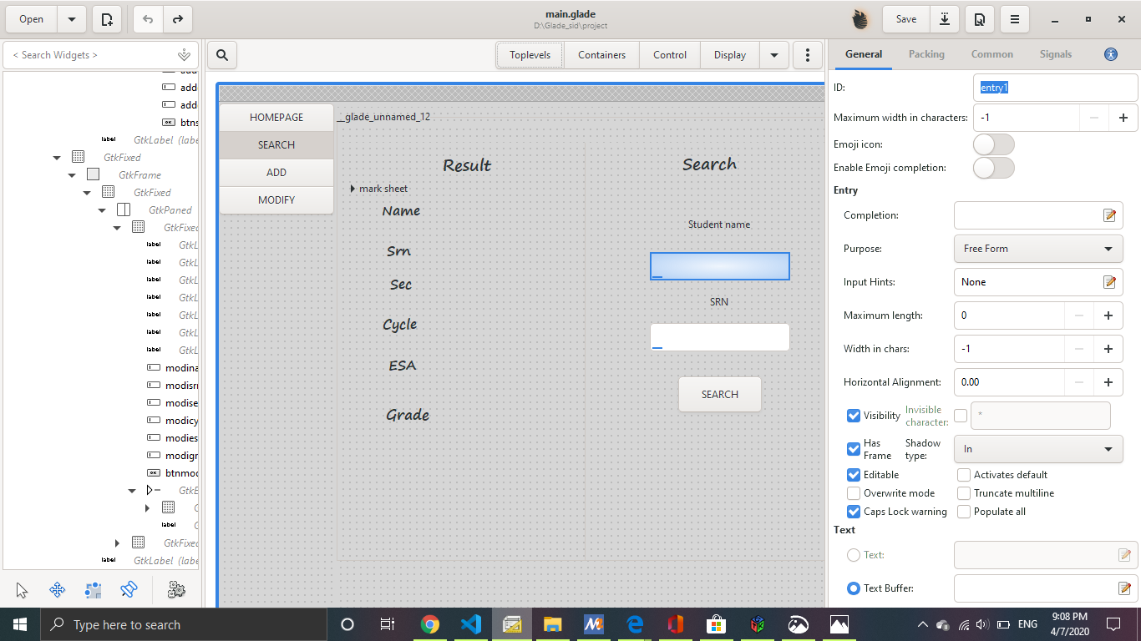
Building gtk GUI using glade application

Slide 14
Thank You

