Slide 1
CSCI 222 GROUP C- 4
ASSIGNMENT 1
SIDDHARTH SINGH (TEAM LEADER) DARREN TOH
EVAN EMMANUEL ONG YEO SHUN YUAN JUSTINE
PAVINDER SINGH S/O GURMIT SINGH DOMINIC CHONG

Slide 2
TABLE OF CONTENTS
Use Case Diagram
- Detailed Use Case
- Sequence Diagram
- Class Diagram
- Activity diagram
- Component Diagram
Gantt Chart

Slide 3
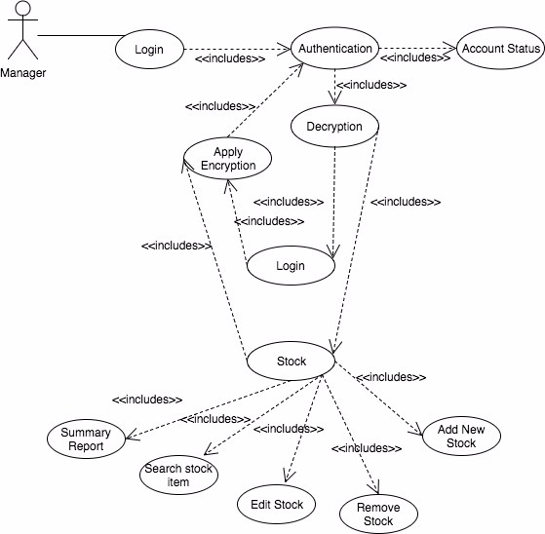
USE CASE DIAGRAM: 1

Slide 4
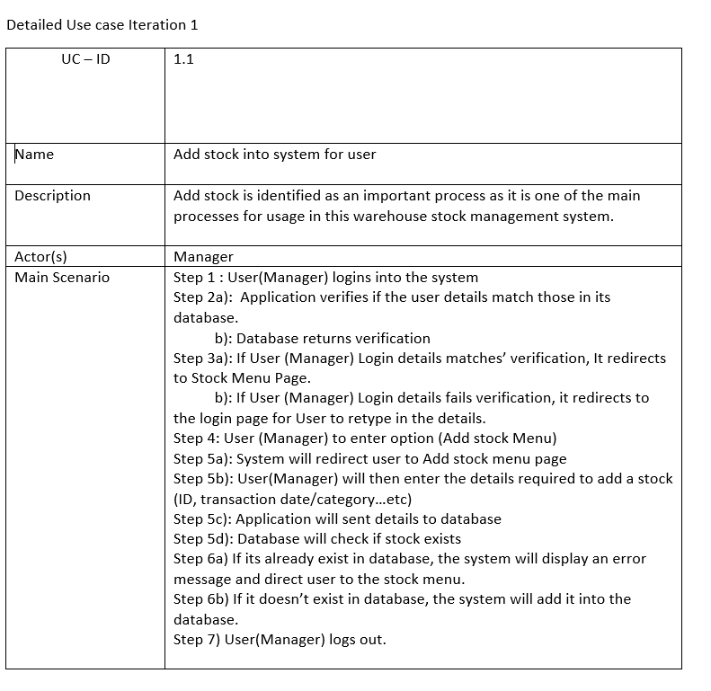
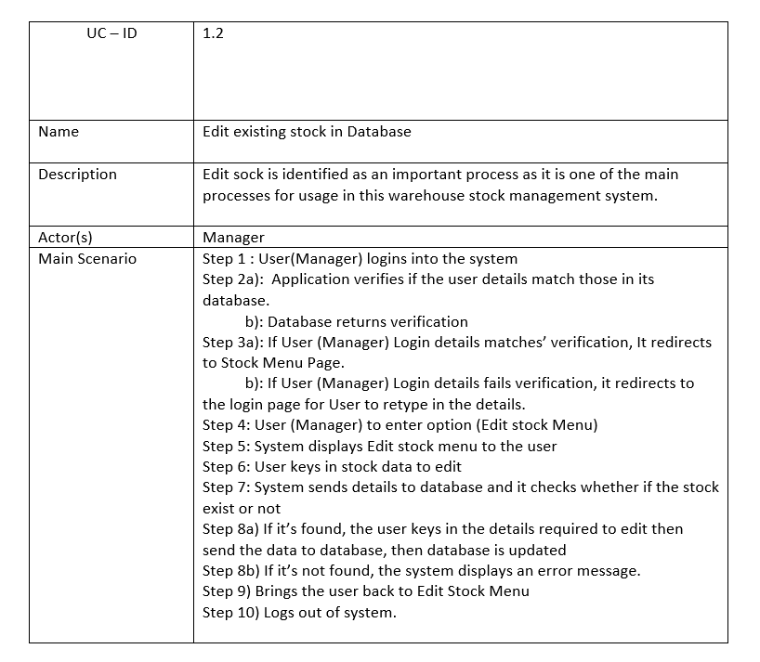
DETAILED USE CASE: 1
ADD STOCK EDIT STOCKS

Slide 5
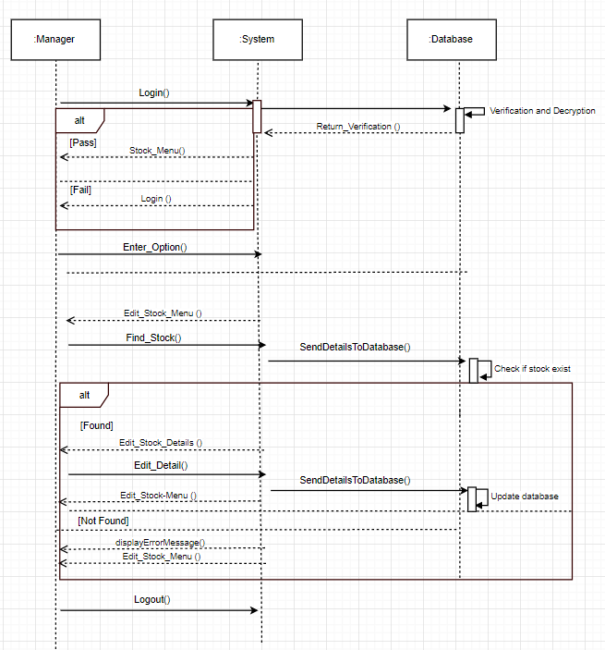
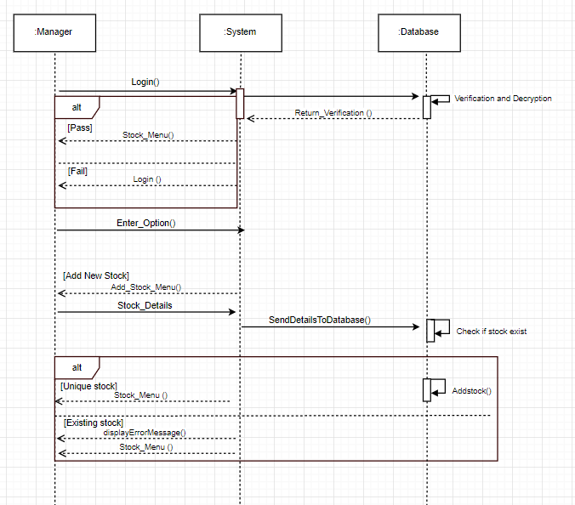

SEQUENCE DIAGRAM: 1
ADD STOCK EDIT STOCKS

Slide 6
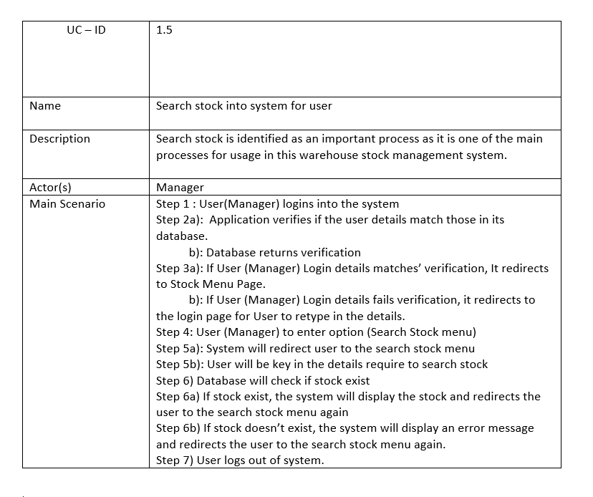
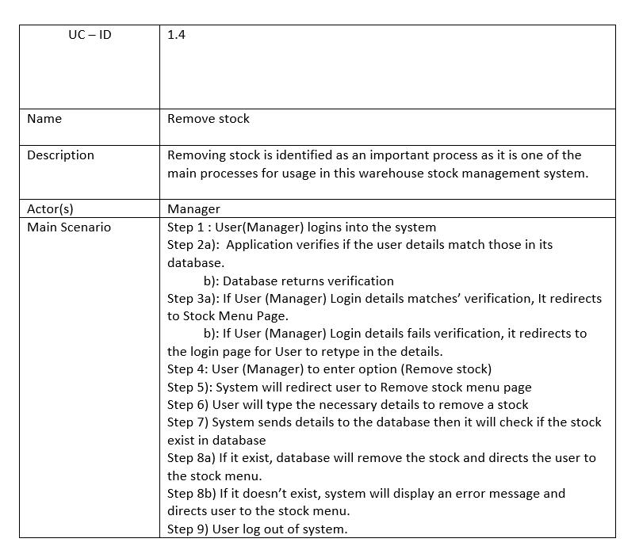
DETAILED USE CASE: 1
SEARCH REPORT REMOVE STOCKS

Slide 7
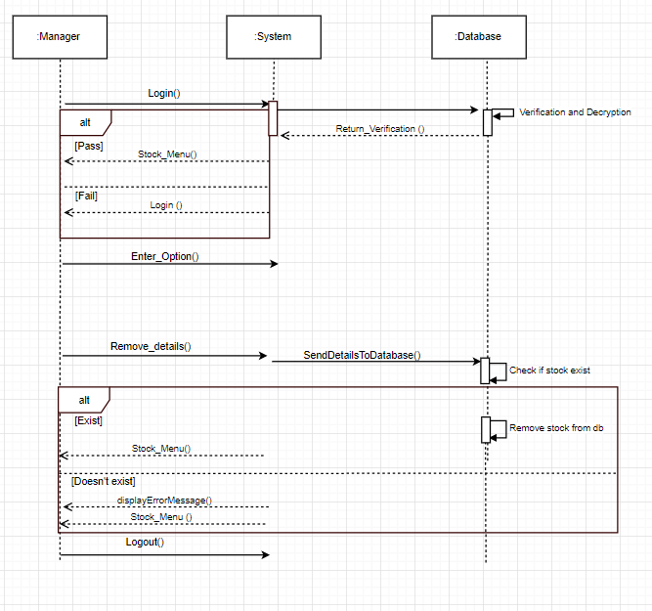
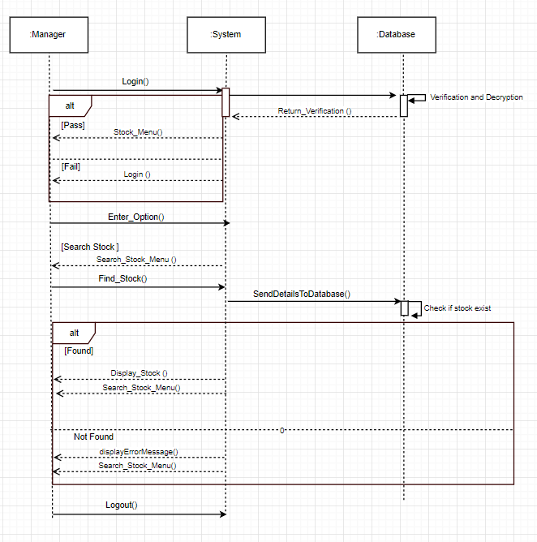
REMOVE STOCK SEARCH STOCKS

Slide 8
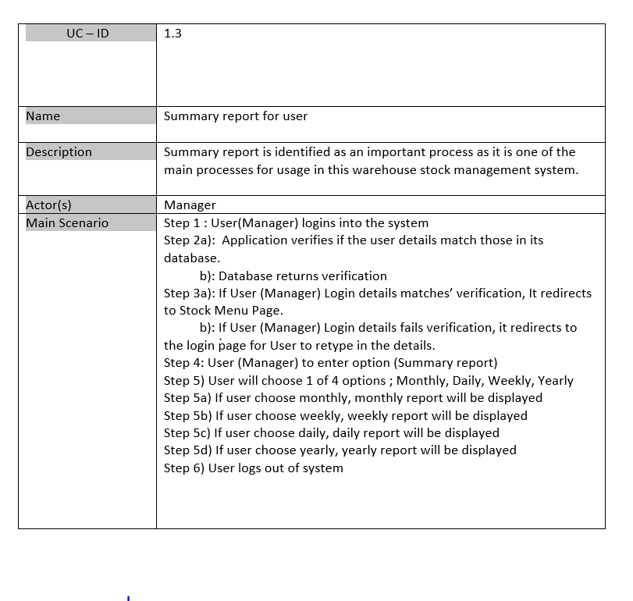
DETAILED USE CASE: 1
SUMMARY REPORT

Slide 9
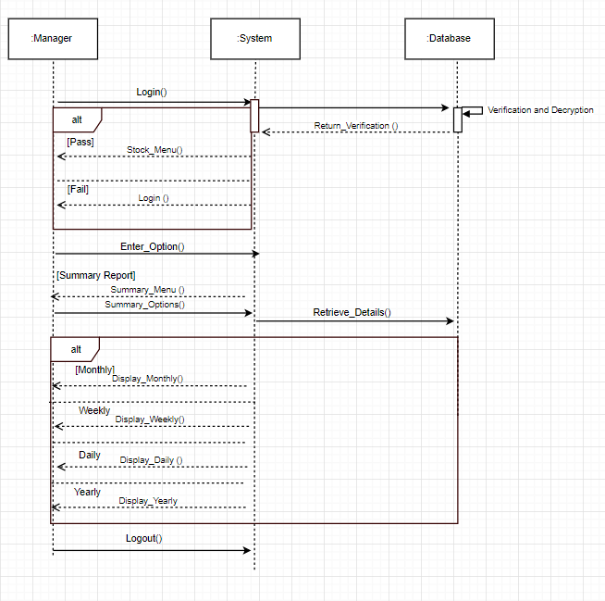
SUMMARY REPORT

Slide 10
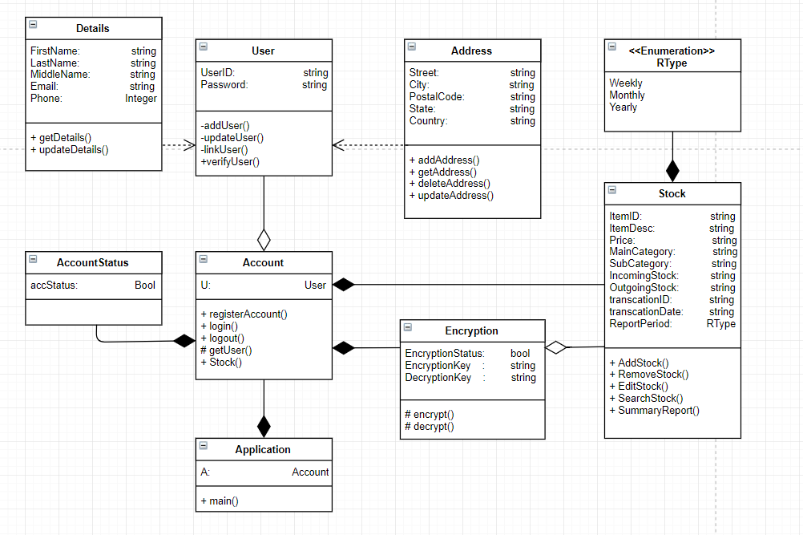
CLASS DIAGRAM: 1

Slide 11
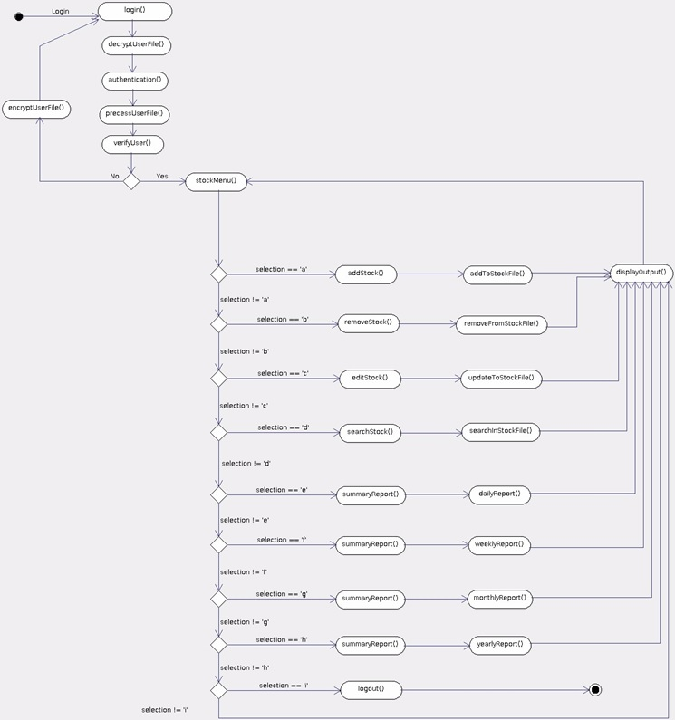
ACTIVITY
DIAGRAM: 1

Slide 12
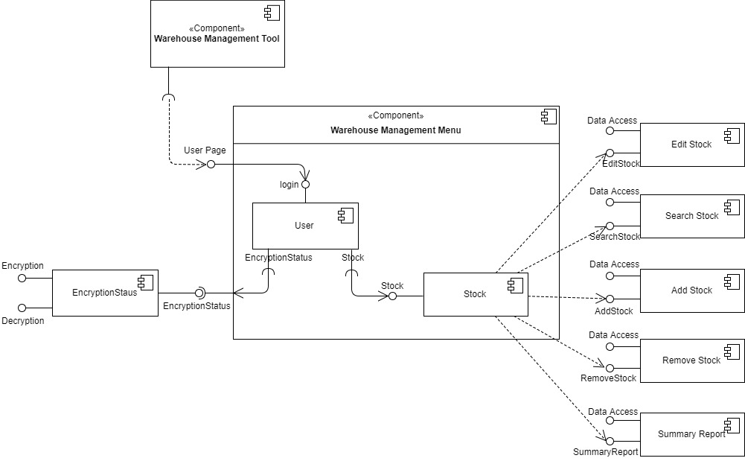
Component Diagram: 1

Slide 13
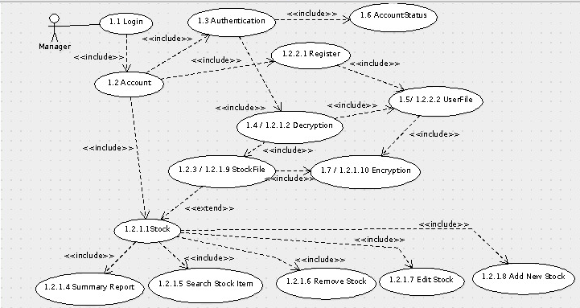
Use Case: 2

Slide 14
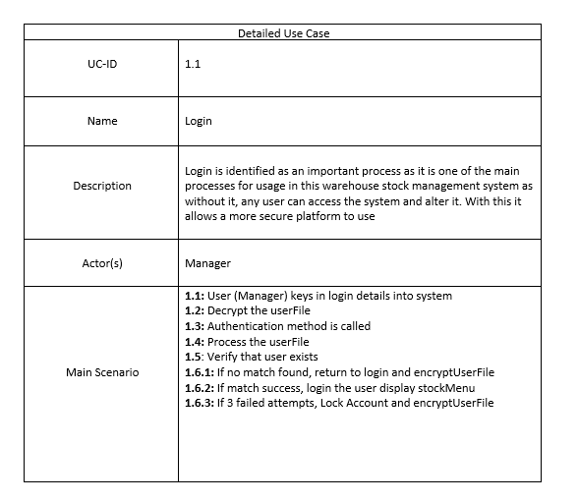
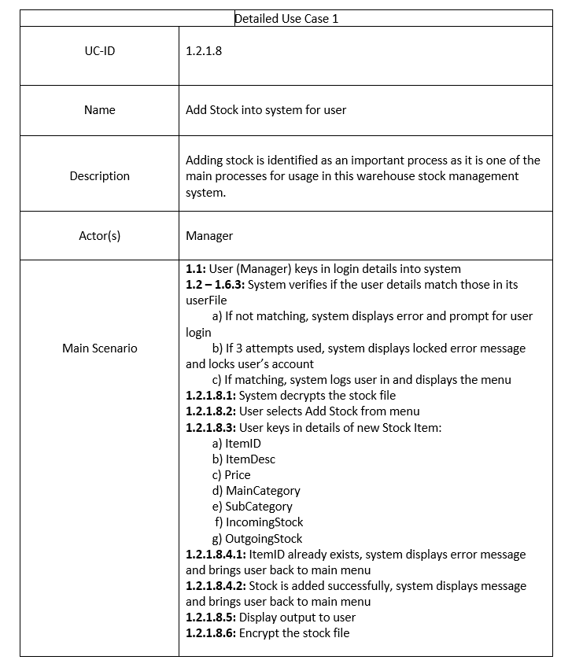
DETAILED USE CASE 2:
LOGIN ADD STOCKS

Slide 15
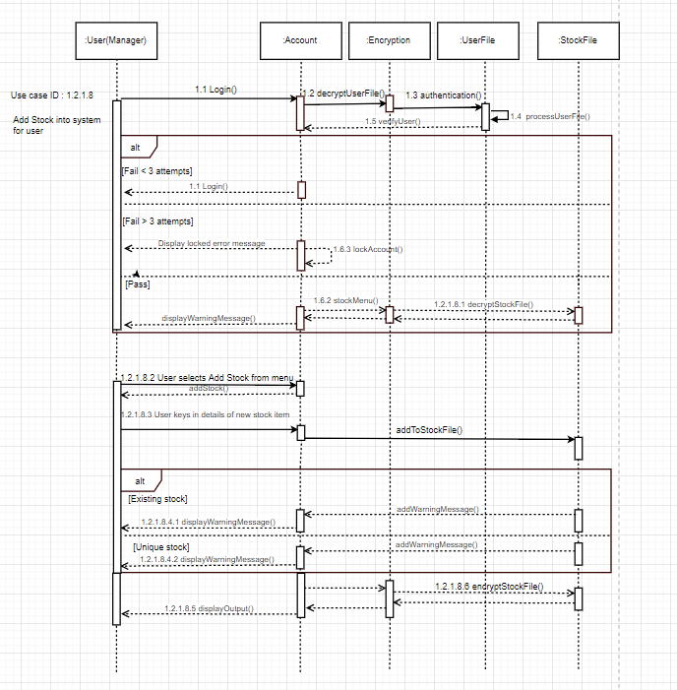
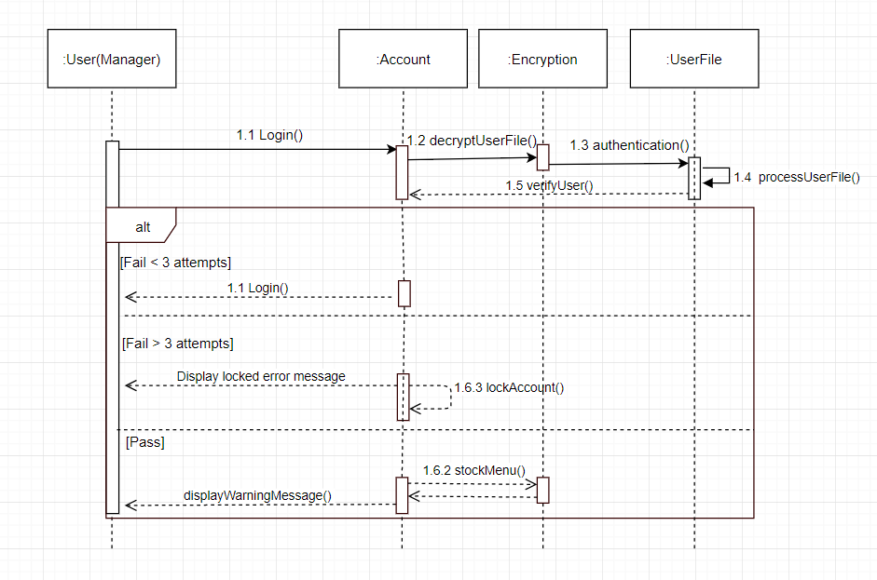
SEQUENCE DIAGRAM: 2
LOGIN ADD STOCKS

Slide 16
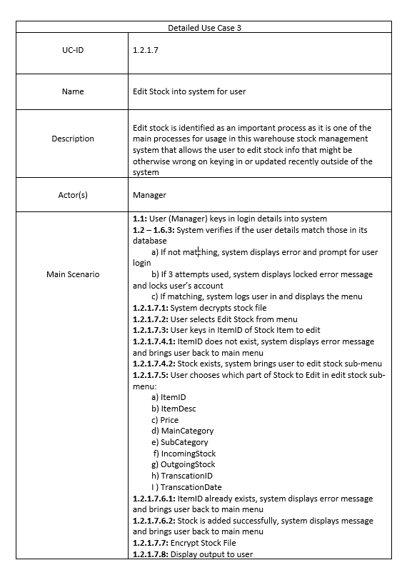
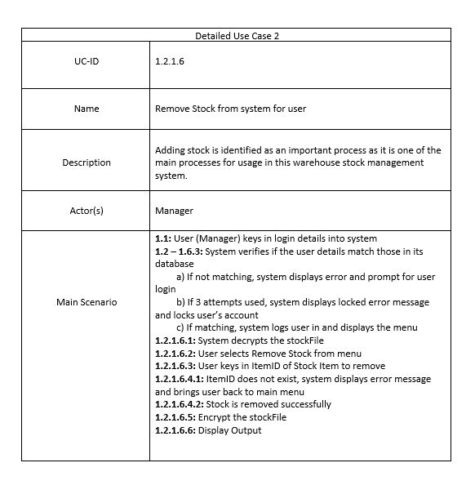
DETAILED USE CASE 2:
EDIT STOCKS REMOVE STOCKS

Slide 17
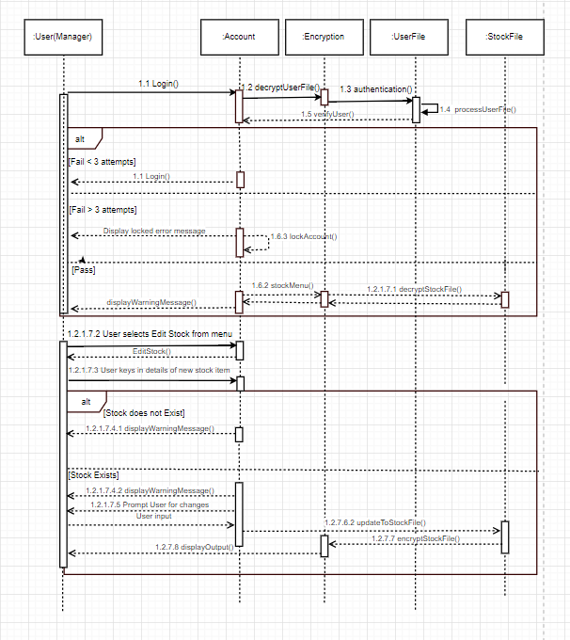
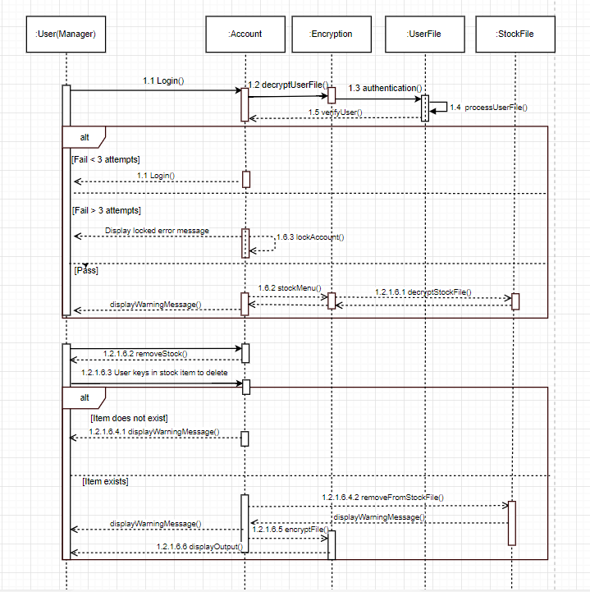
EDIT STOCKS REMOVE STOCKS

Slide 18
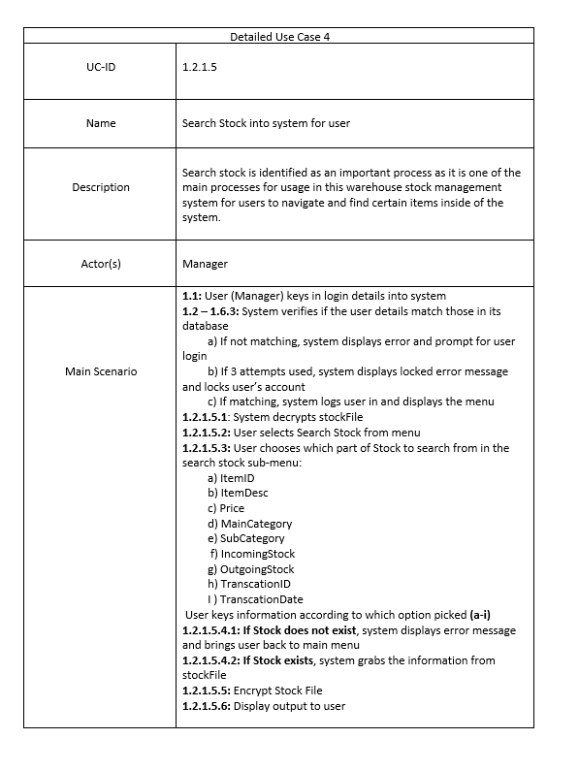
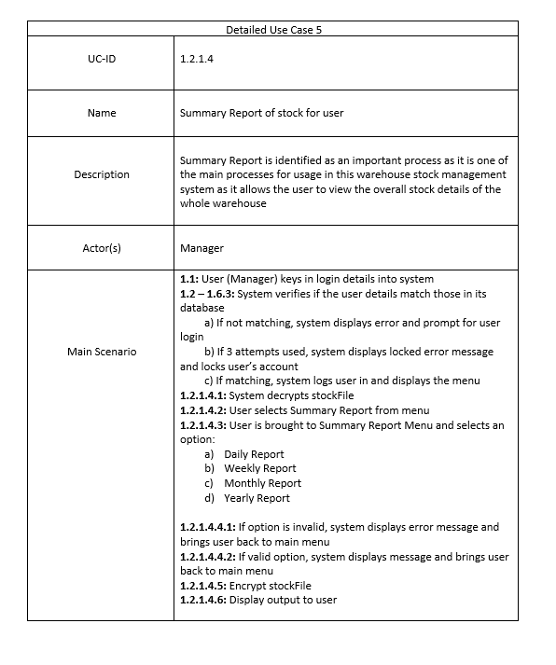
DETAILED USE CASE 2:
SEARCH STOCKS STOCK SUMMARY

Slide 19
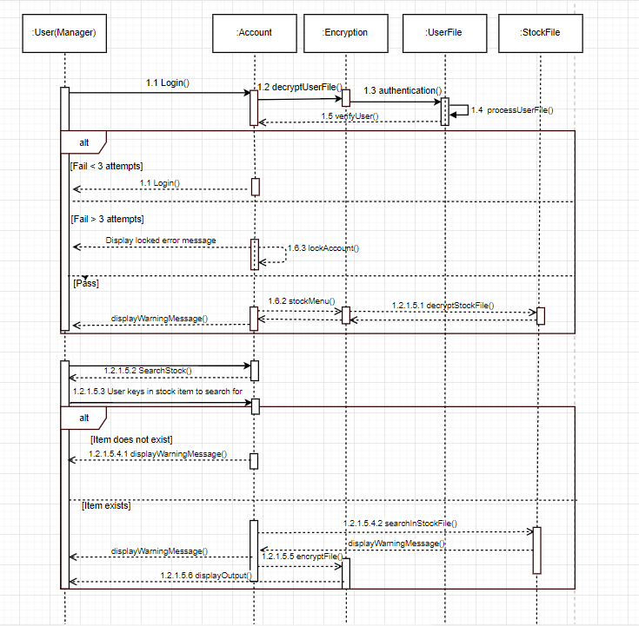
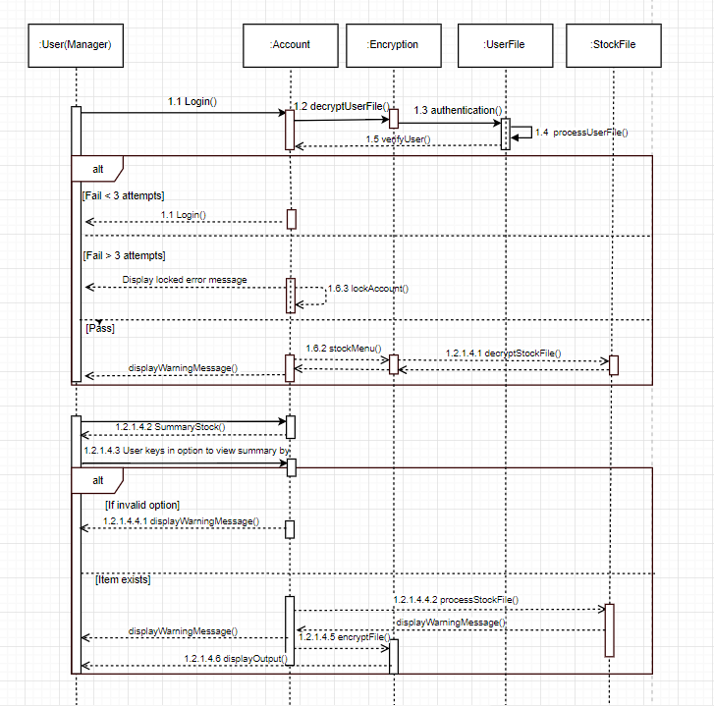
SEARCH STOCKS STOCK SUMMARY

Slide 20
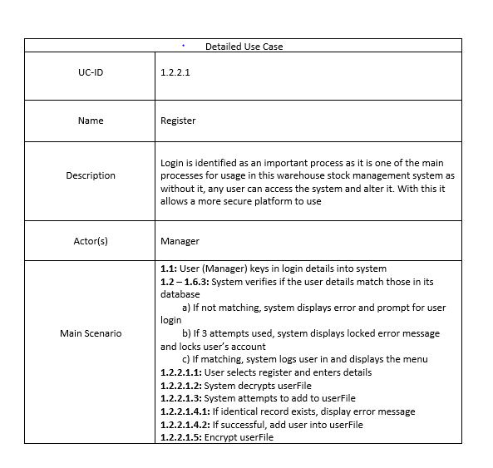
DETAILED USE CASE 2:
REGISTER

Slide 21
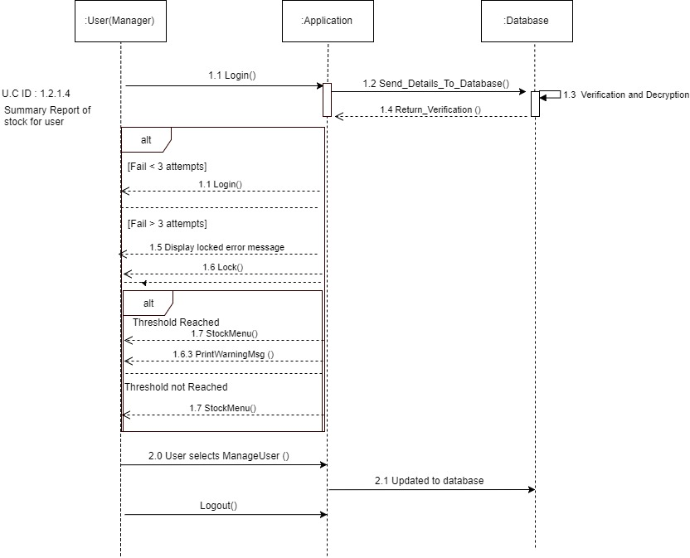
REGISTER

Slide 22
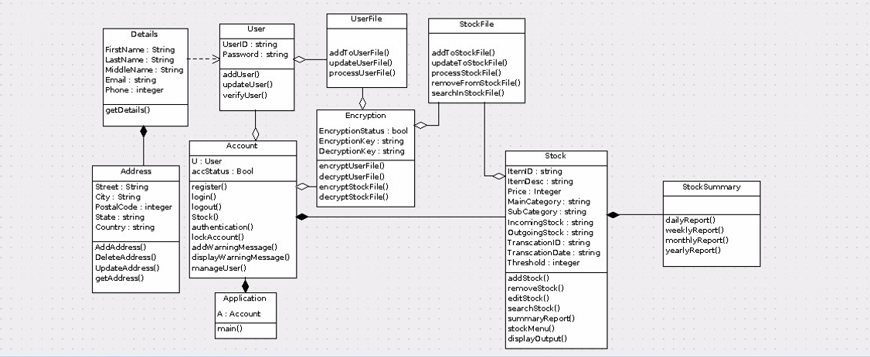
Class diagram: 2

Slide 23
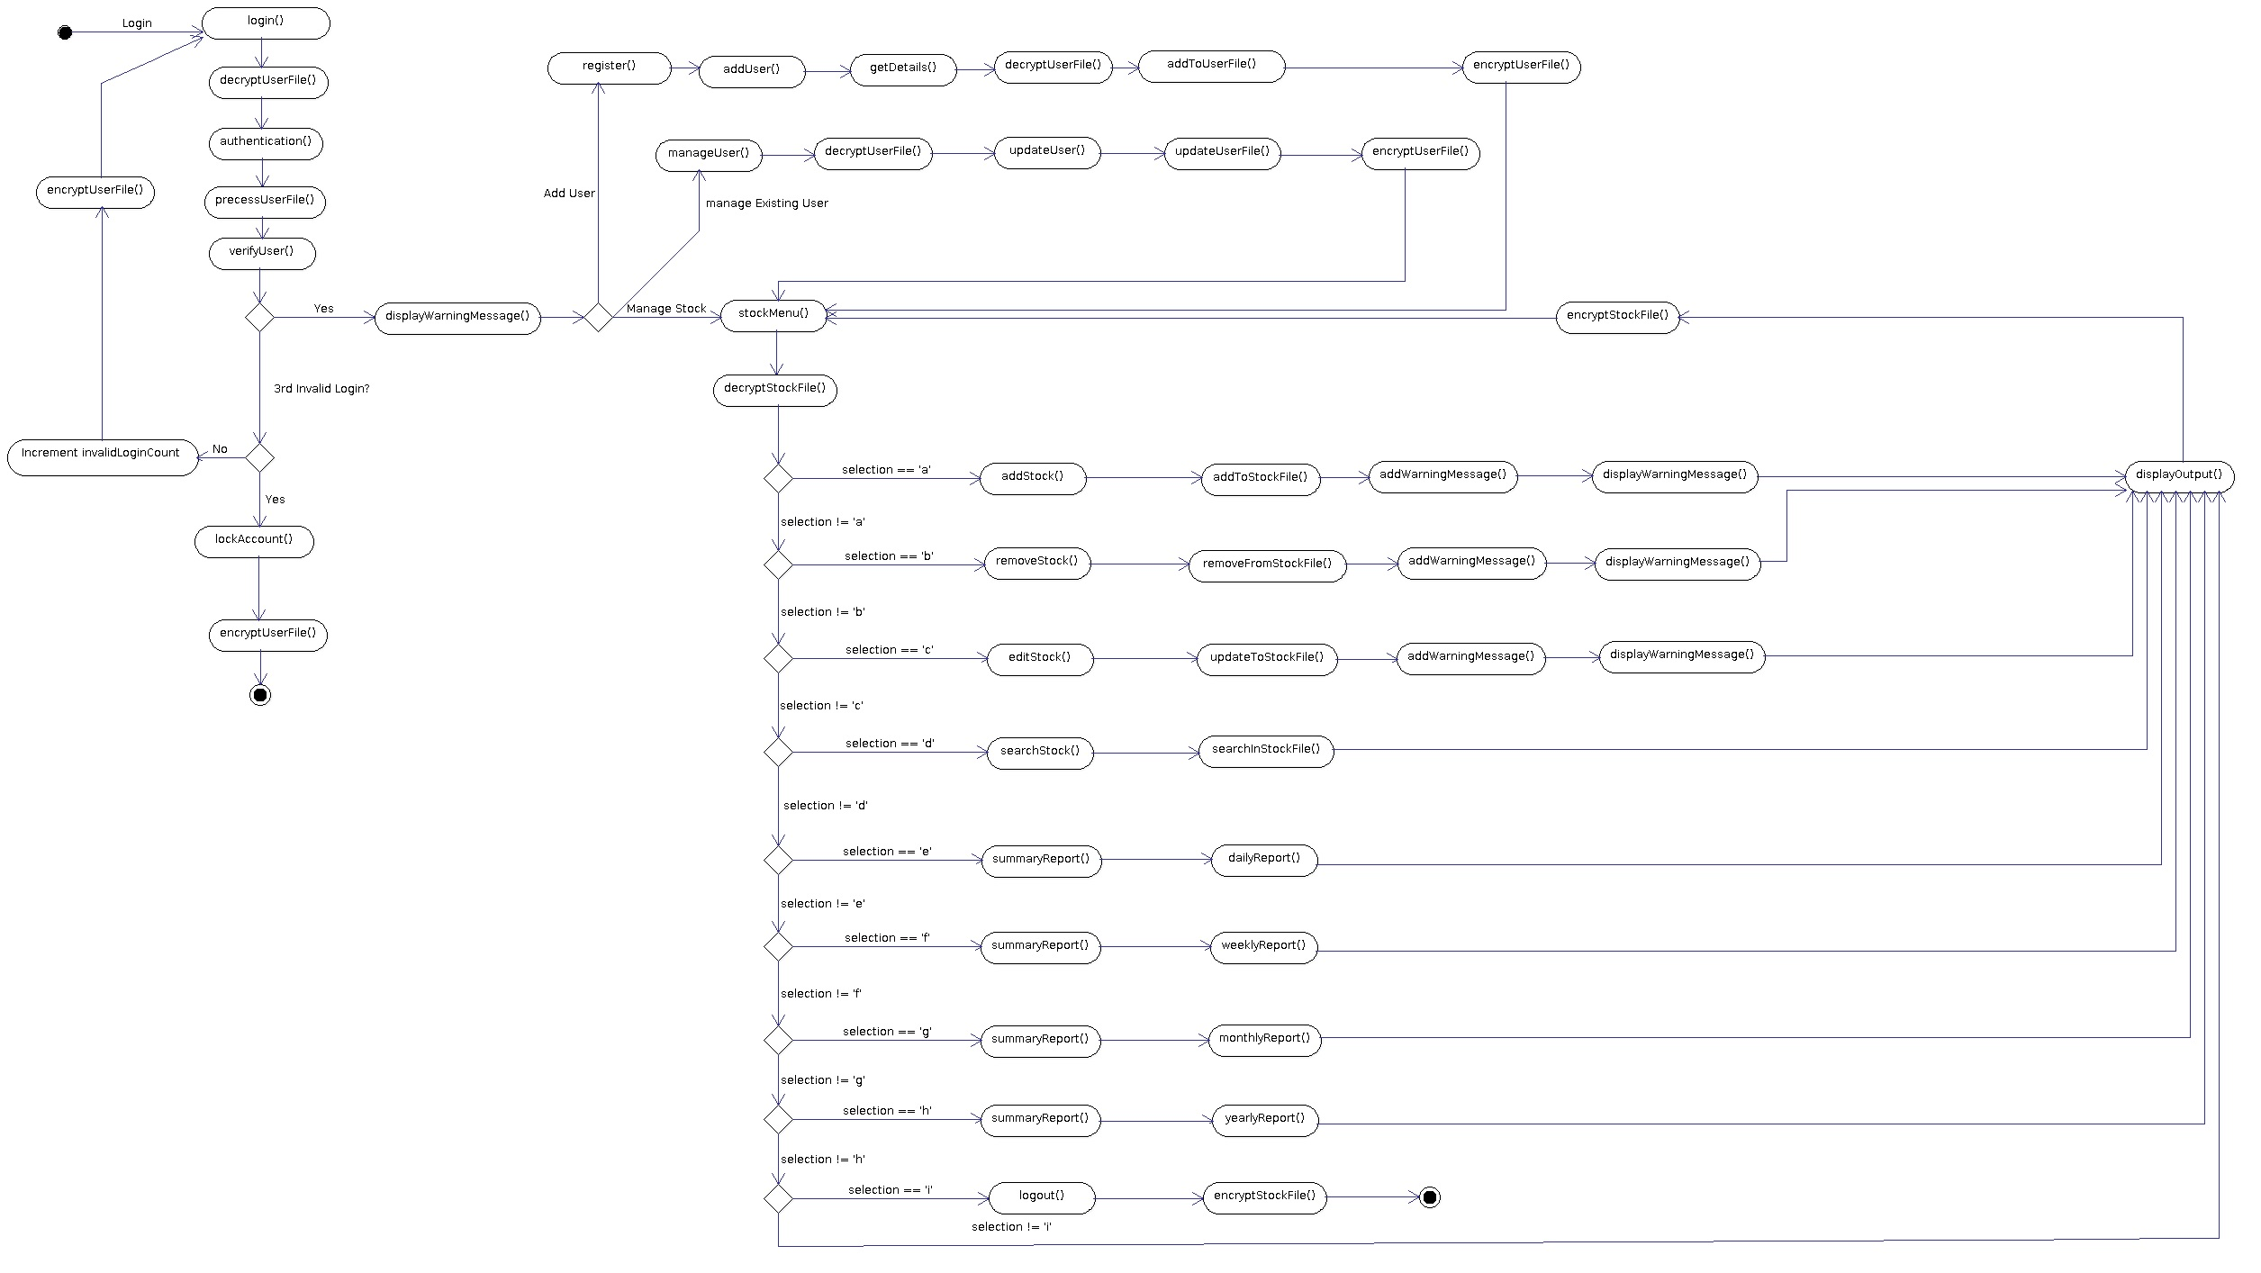
ACTIVITY
DIAGRAM: 2

Slide 24
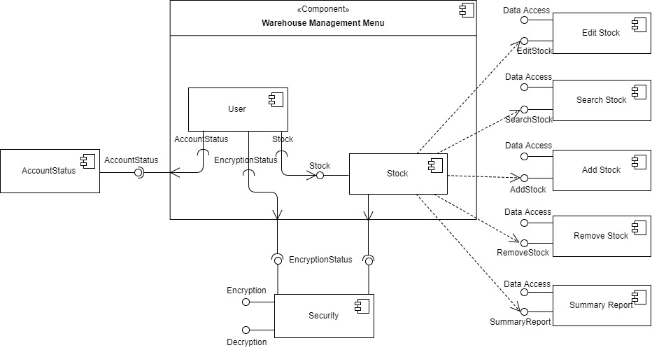
Component Diagram: 2

Slide 25
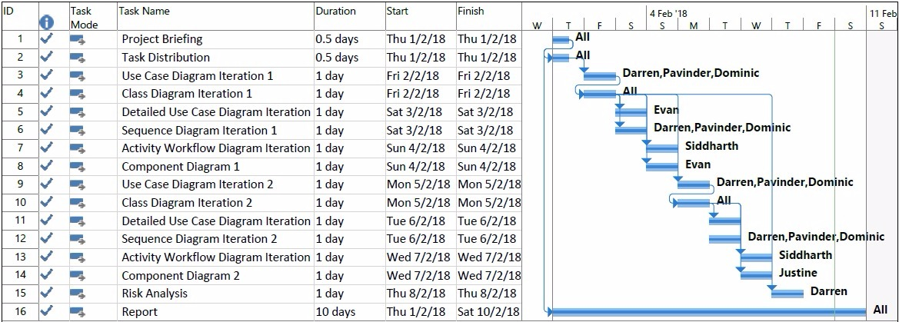
GANTT CHART

Slide 26



THANK YOU!!
This Photo by Unknown Author is licensed under CC BY-SA

