Slide 1
Customer Retention Analysis
Created By: - Siddharth Mukherjee

Slide 2
Introduction
Customer satisfaction has emerged as one of the most important factors that guarantee the success of online stores; it has been posited as a key stimulant of purchase, repurchase intentions and customer loyalty. A comprehensive review of the literature, theories and models have been carried out to propose the models for customer activation and customer retention. Five major factors that contributed to the success of an e-commerce store have been identified as: service quality, system quality, information quality, trust and net benefit. The research furthermore investigated the factors that influence the online customers repeat purchase intention. The combination of both utilitarian value and hedonistic values are needed to affect the repeat purchase intention (loyalty) positively. The data is collected from the Indian online shoppers. Results indicate the e-retail success factors, which are very much critical for customer satisfaction.

Slide 3
Summary of Data Set :-
In this project, a dataset was provided containing the details of the participants of a survey, along with their online shopping experiences, preferences, and opinions regarding various ecommerce websites. The Dataset was first checked for null values, and then the various feature columns were analysed. Exploratory Data analysis was conducted to investigate the relationships that existed between the columns, using various visualization techniques. The dataset was worked with to study and understand how various Hedonic values, Utilitarian values in combination with several perceived risks helped to understand Customer retention and loyalty to various ecommerce websites.

Slide 4
About the Data Set :-
The given dataset consists of 71 columns and 269 rows
The column titled : 'Which of the Indian online retailer would you recommend to a friend?' represents a customer’s loyalty to a website and therefore, its customer retention.

Slide 5
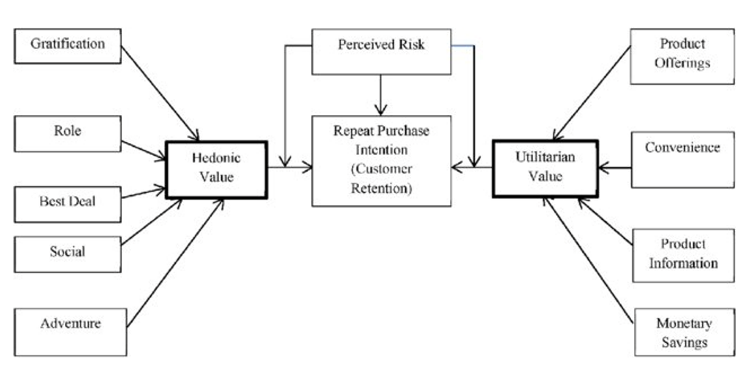
Theoretical Background :-

Slide 6
Theoretical Background :-
According to studies it is observed that repeat customer purchase resulting from a long standing loyalty positively affects an e-retailer growth and profitability.
The motivation level of a Customer to shop from an e-retail vendor depends on various factors. They can be psychologically categorized into two broad categories: (a) Hedonistic (b) Utilitarian shopping values.
Hedonistic values represent the excitement, and pleasurable experiences derived from shopping online.
Hedonic shopping values are considered as the most vital factor for online customer satisfaction leading to customer retention. Hedonic shoppers prefer to shop on an e-retail store, which offers more than transaction related interactive controls (information, security, and privacy), but also the aesthetics, emotional value, sensual stimulation etc., which enhances the pleasure of e-retail shopping experience.
Utilitarian shopping values are those related to the level of fulfillment as a result of being able to achieve the shopping goals.
The utilitarian shopping values are rational, goal oriented and effective decision-based, which improve the customer satisfaction. Utilitarian e-retail customers concentrate mainly on functions related to specific task, for example: price comparison features, customer review before making a purchase.

Slide 7
Theoretical Background :-
Aside from Hedonic and Utilitarian values, certain perceived risks also influence the purchase decision of an online customer and therefore, these risks are also a crucial factor in determining the loyalty of a customer to an e-commerce brand.
Online shopping has a more pronounced perception of risk than the traditional physical shopping store,because of temporal and spatial separation between the sellers and buyers.
Risk could arise from an unpredictable event during a transaction or delivery period or at the end of a delivery and may not be pleasant to the online customer.

Slide 8
Exploratory Data Analysis :-
The individual columns of the dataset were first analyzed to study their composition and then, with reference to the diagram and the theoretical background of the case study, the relationships between various columns were understood through data visualization using Count plots.

Slide 9
Analysing the Target Class :_
Underlying Assumptions:
Column: 'Which of the Indian online retailer would you recommend to a friend?' can be regarded as a representation of customer Loyalty / Retention since customers who recommend the services of an ecommerce are very highly likely to buy from those websites again.

Slide 10
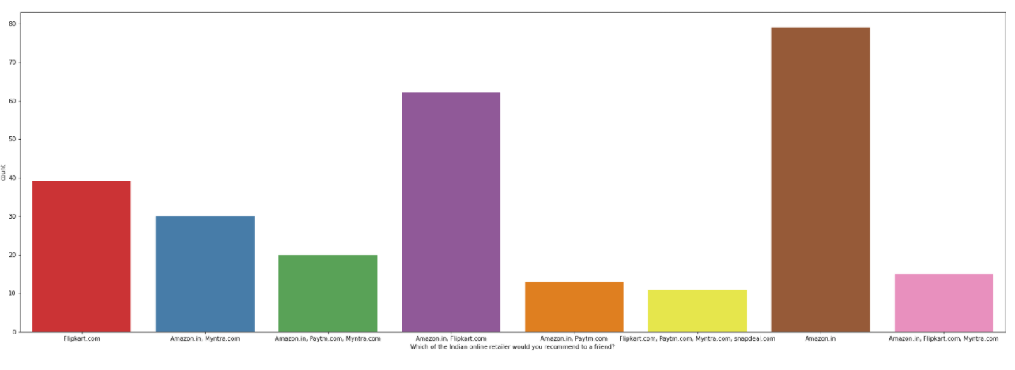
It is observed that Amazon is the most popular E commerce website followed by Flipkart.

Slide 11
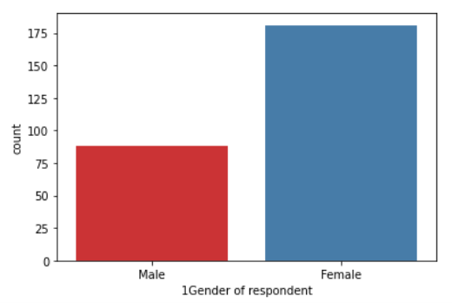
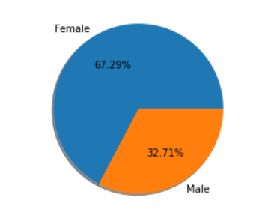
Consumer Demographics :-
Columns which contained details regarding the demographics of the participants (age, gender, location) were visualized and analyzed.

Slide 12
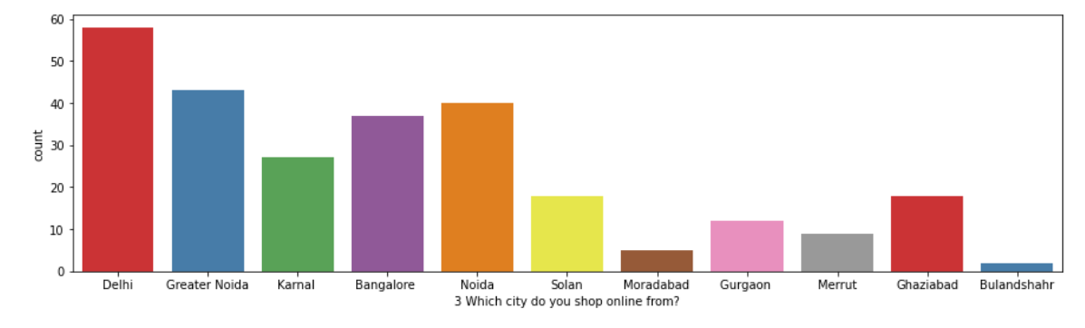
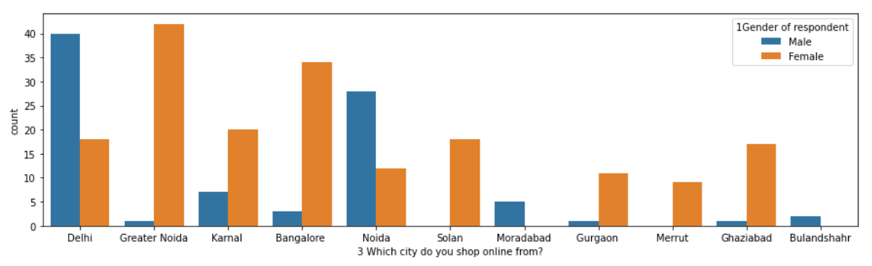
Consumer Demographics :-

Slide 13
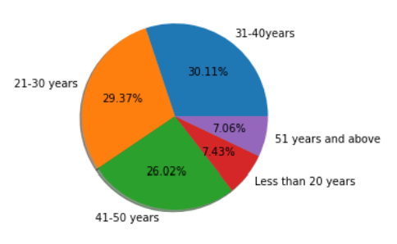
Consumer Demographics :-

Slide 14
Consumer Demographics :-
Based on the above graphs it is observed that:
Majority of the participants are female, comprising 67.29% of the total participants of the survey.
Most of the participants hail from Delhi, Greater Noida, Noida, and Bangalore.
Of those who hailed from Delhi and Noida, the majority were Male. While of those who hailed from Greater Noida, Bangalore and Karnal, Ghaziabad and Solan the majority were Female.
The age distribution of the majority of the participants lies in the range of 21-40 years, with 59.48% of the total participants falling within that age range, while 26.02% of the participants belong to the age range of 41-50 years.

Slide 15
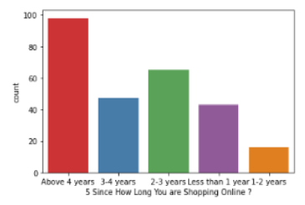
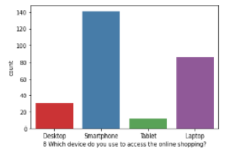
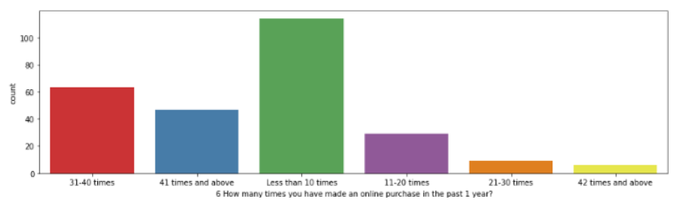
Consumer online shopping activities and preferences :-

Slide 16
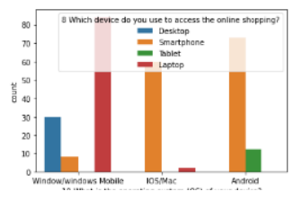
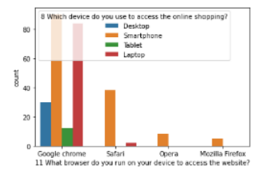
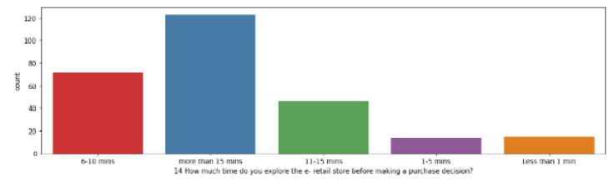
Consumer online shopping activities and preferences :-

Slide 17
Consumer online shopping activities and preferences :-
Based on the above graphs it is observed that:
Majority of the consumers have been shopping for over 4 years and have made less than 10 purchases in the last 1 year.
Smartphone and mobile internet are the most popular means of accessing ecommerce websites, with most common screen size being 5.5 inches or greater.
Windows operating system is the most popular on Laptop/Desktop devices while android is the most popular OS on smartphone devices followed by iOS.
Google Chrome is the most popular web Browser, especially on portable devices, followed by Safari.
Search Engine is the most common means of arriving at the E commerce websites, followed by Application and Direct URL.
Most consumers spend over 15 mins browsing an e-commerce website before making a purchase decision.

Slide 18
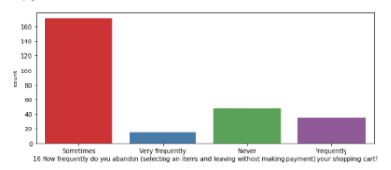
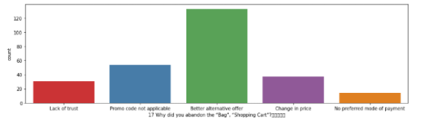
Consumer Hesitation :-
Various factors/reasons which contributed to consumers’ hesitation to complete a purchase online were analysed from the data provided under the columns of the data frame.

Slide 19
Consumer Hesitation :-
Based on the above graphs it is observed that:
Consumers sometimes abandon items in shopping cart.
Finding a better alternative offer is the most common reason behind why consumers abandon items on a particular e commerce website.

Slide 20
Consumer opinions on Website Features :-
Analyzing the opinions of the participants on the various features of the e-commerce websites reveals that Majority of the consumers strongly agree that:
The content on the website must be easy to read and understand.
Information on similar product to the one highlighted is important for product comparison.
Complete information on listed seller and product being offered is important for purchase decision.
All relevant information on listed products must be stated clearly.
Navigation in website should be easy.
Loading and processing should be quick.
Interface of the website must be user friendly

Slide 21
Consumer opinions on Website Features :-
Convenient Payment methods should be available.
There is trust in the online retail store fulfilling its part of the transaction at the stipulated time.
There should be Empathy (readiness to assist with queries) towards the customers.
Online retail store should be able to guarantee the privacy of the customer.
There should be Responsiveness, availability of several communication channels (email, online rep, twitter, phone etc.).
Online shopping gives monetary benefit and discounts.
Enjoyment is derived from shopping online
Shopping online is convenient and flexible
Return and replacement policy of the e-tailer is important for purchase decision

Slide 22
Consumer opinions on Website Features :-
Gaining access to loyalty programs is a benefit of shopping online.
Displaying quality Information on the website improves satisfaction of customers.
User derive satisfaction while shopping on a good quality website or application.
Net Benefit is derived from shopping online can lead to users satisfaction.
User satisfaction cannot exist without trust.
E commerce websites must Offer a wide variety of listed product in several category.
There should be Provision of complete and relevant product information .
Monetary savings must be considerable

Slide 23
Consumer opinions on Website Features :-
The Convenience of patronizing the online retailer.
Shopping on the website gives you the sense of adventure.
Shopping on your preferred e-tailer enhances your social status.
You feel gratification shopping on your favorite e-tailer.
Shopping on the website helps you fulfill certain roles.
Getting value for money spent is important

Slide 24
Consumer Ecommerce Website preferences and opinions :-
Analyzing the Preferences and opinions of the participants regarding the e-commerce websites reveals that:
Amazon.in, Flipkart.com, Paytm.com, Myntra.com, Snapdeal.com are the most popular e-commerce websites.
Amazon.in, Flipkart.com, Paytm.com, Myntra.com, Snapdeal.com are the easiest to use websites and applications.
Amazon.in and Flipkart.com have the most visually appealing web-page layout.
Amazon.in and Flipkart.com have the widest variety of products on offer
Amazon.in and Flipkart.com have the most complete, relevant description information of products.
Amazon.in, and Paytm.com have the fastest loading speed while Flipkart is regarded by very few as being quick to load

Slide 25
Consumer Ecommerce Website preferences and opinions :-
Amazon.com, Flipkart.com, Paytm.com are considered quick to complete purchases.
Amazon.in, Flipkart.com are regarded by most to have several payment options available
Amazon.in is regarded to offer speedy order delivery by most.
Amazon.in offers the most Privacy for customers’ information.
Amazon.in , followed by Flipkart.com, Paytm.com, Myntra.com, Snapdeal.com provide the best security for customer financial information.
Amazon.in is perceived to be the most trustworthy website by the majority of participants.
Amazon.in, Flipkart.com, Myntra.com, Snapdeal have the highest presence of online assistance through multi-channel.
Most people face longer time to get logged in during promotion, sales period on Amazon.in and Flipkart followed by Paytm and Myntra.

Slide 26
Consumer Ecommerce Website preferences and opinions :-
Amazon.in, Flipkart.com take the longest time displaying graphics and photos during promotion, sales period.
Most people face Late declaration of price on Myntra and Paytm during promotion, sales period.
Myntra and Paytm take the longest page loading time during promotion, sales period.
Snapdeal.com and Amazon.in have the most limited modes of payment on most products during promotion, sales period.
Paytm.com and Snapdeal.com have Longer delivery periods compared to others.
Amazon.in and Paytm.com have had recent changes in website/Application design, as observed by the consumers.

Slide 27
Consumer Ecommerce Website preferences and opinions :-
Most consumers face frequent disruption when moving from one page to another on Amazon.in, Myntra.com and Snapdeal.com.
Most consumers are of the opinion that Amazon.in website is as efficient as before followed by Flipkart.com.
Most Consumers would recommend Amazon.in to a friend, followed by Flipkart.

Slide 28
Analysing Relationship between Customer retention and Perceived Risks :-
Columns that represent abandoning shopping carts on e commerce websites, reasons behind abandoning shopping carts, Longer delivery period, Website disruption, Customer Data security, Trustworthiness etc. represent perceived risks.
While the Column representing the recommended e commerce brands represents customer loyalty / retention.
The relationships between the columns representing the perceived risks and the column representing Customer retention were visualized and observations were made.

Slide 29
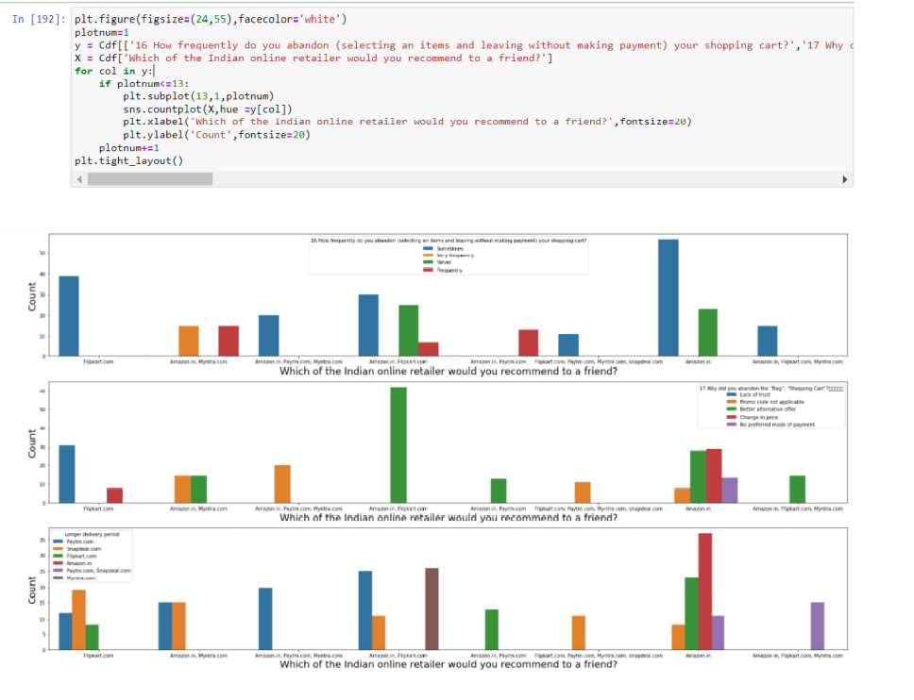
Analyzing Relationship between Customer retention and Perceived Risks :-

Slide 30
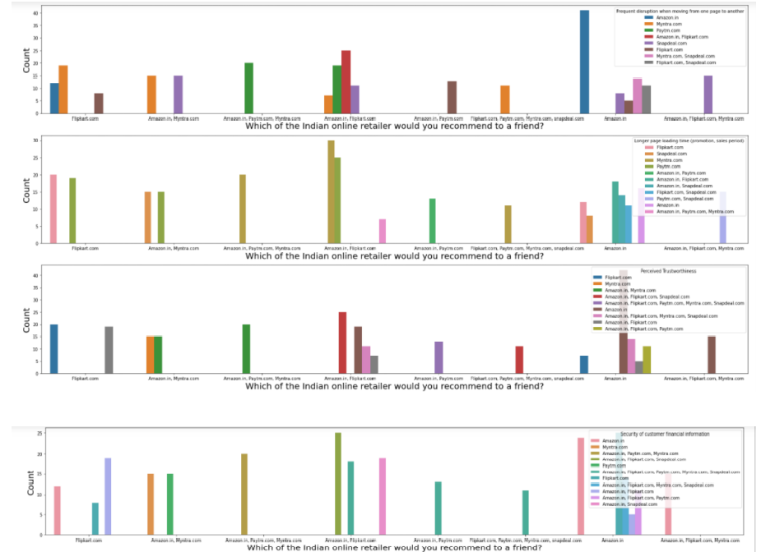
Analyzing Relationship between Customer retention and Perceived Risks :-

Slide 31
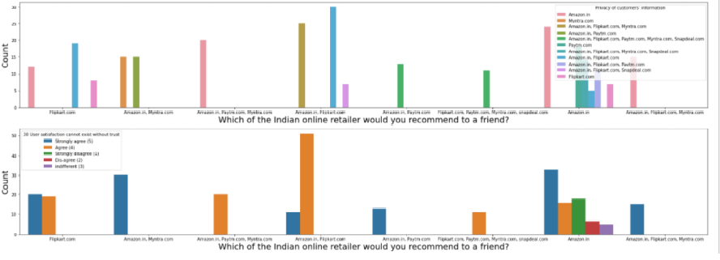
Analysing Relationship between Customer retention and Perceived Risks :-

Slide 32
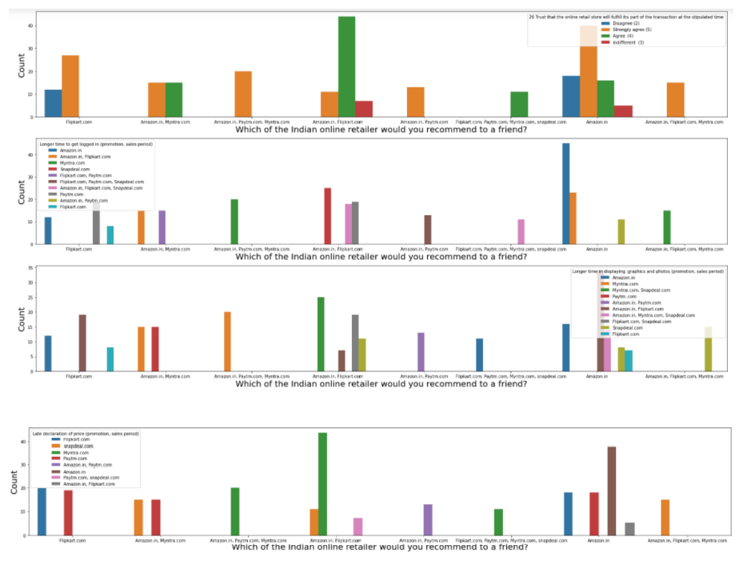
Analyzing Relationship between Customer retention and Perceived Risks :-

Slide 33
Analyzing Relationship between Customer retention and Perceived Risks :-
From the graphs above the following observations are made:
Customers sometimes abandon their shopping carts on Amazon and Flipkart implying there is a low level of perceived risk for those websites. While some people frequently abandon their shopping carts on Amazon.in and Myntra.com and Paytm.com, which may indicate a higher level of perceived risk on those websites.
Customers usually abandon their shopping carts on Amazon and Flipkart when they find a better alternative offer which implies that there is a greater importance for utilitarian value, While on Flipkart alone they mostly abandon due to lack of trust and on amazon alone, they abandon either due to Promo code not being applicable or Change in price.
Customers face longest delivery Periods when they purchase on Amazon.in, followed by flipkart.com and paytm, however Amazon.in is still the most preferred shopping website.
It is observed that those who prefer Flipkart.com, Paytm.com, Myntra.com and Snapdeal.com to Amazon.in do so because they face frequent disruption when moving from page to page on Amazon.in
Those who prefer Amazon.in and Flipkart.com face longer page loading time during promotion and sales period on snapdeal.com and myntra.com

Slide 34
Analyzing Relationship between Customer retention and Perceived Risks :-
Amazon.in has the highest trustworthiness as perceived by most consumers.
Amazon.in,Flipkart.com,Paytm.com have the highest security for customer financial information.
Amazon.in,Flipkart.com,Paytm.com maintain the greatest privacy for customer information.
Customers who believe that user satisfaction can’t exist without trust recommend Amazon.in and Flipkart.com
Those customers who recommend Amazon.in and Flipkart.com the most trust that online retail stores will fulfill their part of the transaction at the stipulated time.
Customers face the longest time to get logged in on Amazon.in and Flipkart.com the most and yet, recommend those 2 websites the most.
Customers prefer Amazon.in and Flipkart.com To Myntra.com and Snapdeal.com because Myntra and Snapdeal take longer to display graphics and photos during promotion and sales period.
Customers prefer Amazon.in and Flipkart.com To Myntra.com and Snapdeal.com because Myntra and Snapdeal take too long to declare prices during promotion and sales period.

Slide 35
Analyzing Relationship between Customer retention and Hedonic Value :-
Hedonic Values serve the purpose of giving emotional / multisensory gratification and a sense of fulfillment of a role to Consumers.
Columns that represent Enjoyment derived from shopping online,Satisfaction of shopping on a good quality website,access to loyalty programs,Sense adventure in shopping online,Social status enhancement from shopping online,feeling a sense of gratification from shopping online and fulfillment of roles are hedonic values.
The relationships between the columns representing the Hedonic Values and the column representing Customer retention were visualized using the code below and observations were made.

Slide 36
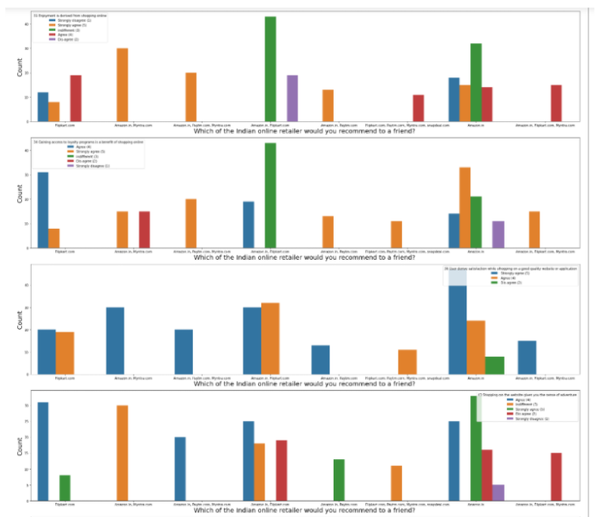
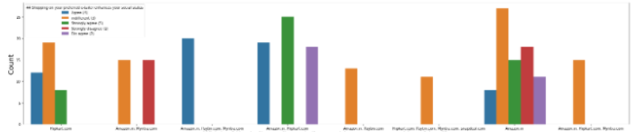
Analyzing Relationship between Customer retention and Hedonic Value :-

Slide 37
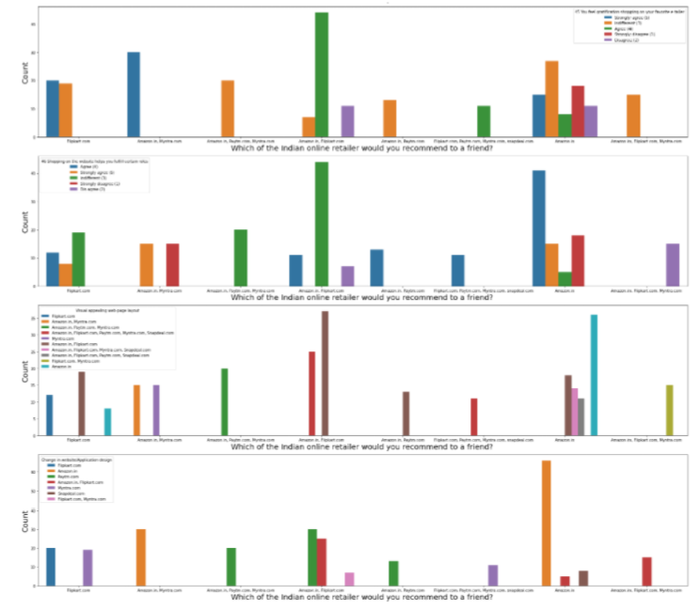
Analyzing Relationship between Customer retention and Hedonic Value :-

Slide 38
Analyzing Relationship between Customer retention and Hedonic Value :-
From the graphs above the following observations are made:
Customers who recommend Myntra.com,paytm.com and Amazon.in Strongly agree that enjoyment is derived from shopping online, while those who recommend Flipkart and Amazon.in are indifferent about it.
Gaining Access to loyalty programs is a benefit of shopping online for those who recommend Amazon.in and Flipkart.com
Those who Recommend Amazon.in,flipkart.com and Myntra.com strongly derive satisfaction while shopping on a good quality website / application.
Those who Recommend Amazon.in,flipkart.com,paytm.com and Myntra.com strongly agree that they get a sense of adventure from shopping online.

Slide 39
Analyzing Relationship between Customer retention and Hedonic Value :-
Although most consumers are indifferent to whether or not shopping on e-commerce websites enhances their social status, Those who recommend Amazon.in,Flipkart.com,paytm.com and myntra.com agree that shopping on those websites enhances their social status.
Most consumers agree that shopping on Amazon.in and Flipkart.com get a sense of gratification from shopping on their favourite e-tailer.
Most consumers agree that shopping on Amazon.in,Flipkart.com,Myntra.com,snapdeal.com and Paytm.com agree that shopping on the websites fulfills certain roles.
Most consumers consider Amazon.in and Flipkart.com to have the most visually appealing web-page layout.
Most consumers who recommend Amazon.in appreciate change in website/application design.

Slide 40
Analyzing Relationship between Customer retention and Utilitarian Value :-
Utilitarian values are based on rational decisions,are goal related and give importance to functional values of products / transactions on websites that are aimed at enhancing customer satisfaction through meaningful online transactions.
Coulmns that represent Product information, Monetary saving and benefits,net benefits,Payment convenience, ease of browsing the website, Wide variety of products in several categories,Return/replacement policies, delivery time etc are Utilitarian values.
The relationships between the columns representing the Utilitarian Values and the column representing Customer retention were visualized using the code below and observations were made.

Slide 41
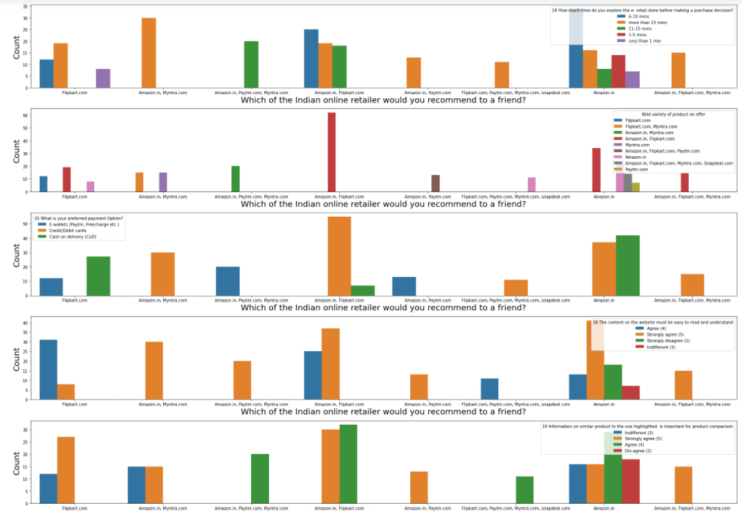
Analyzing Relationship between Customer retention and Utilitarian Value :-

Slide 42
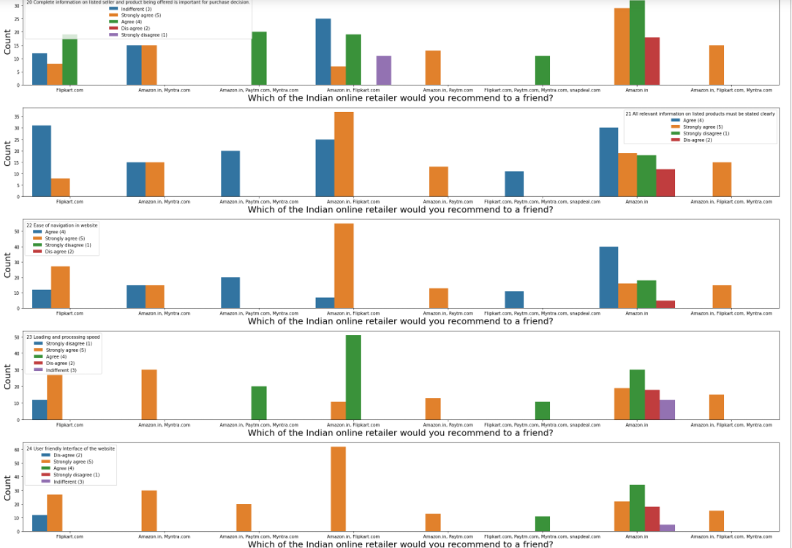
Analyzing Relationship between Customer retention and Utilitarian Value :-

Slide 43
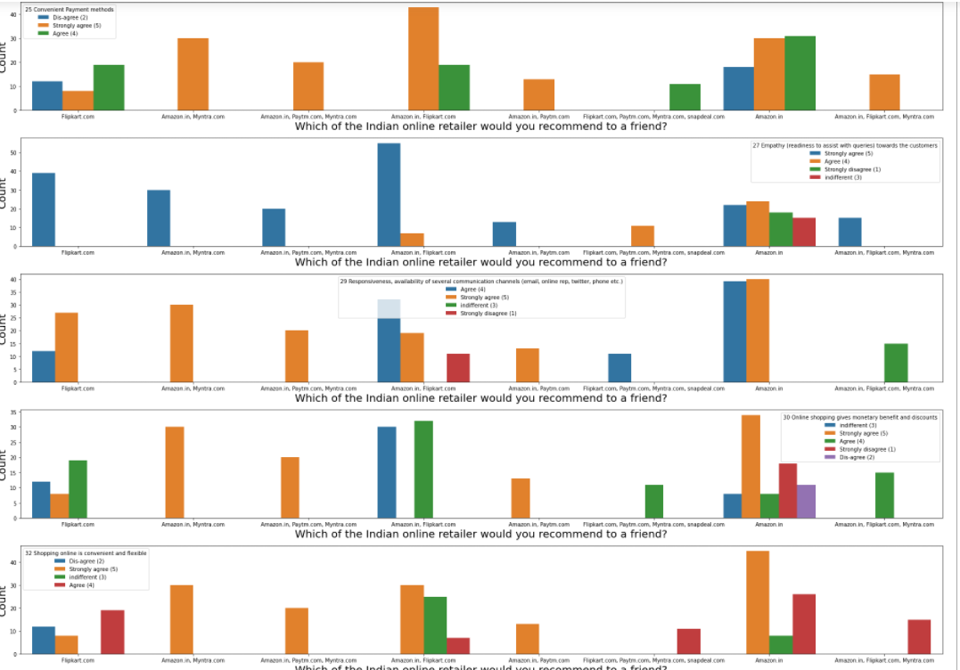
Analyzing Relationship between Customer retention and Utilitarian Value :-

Slide 44
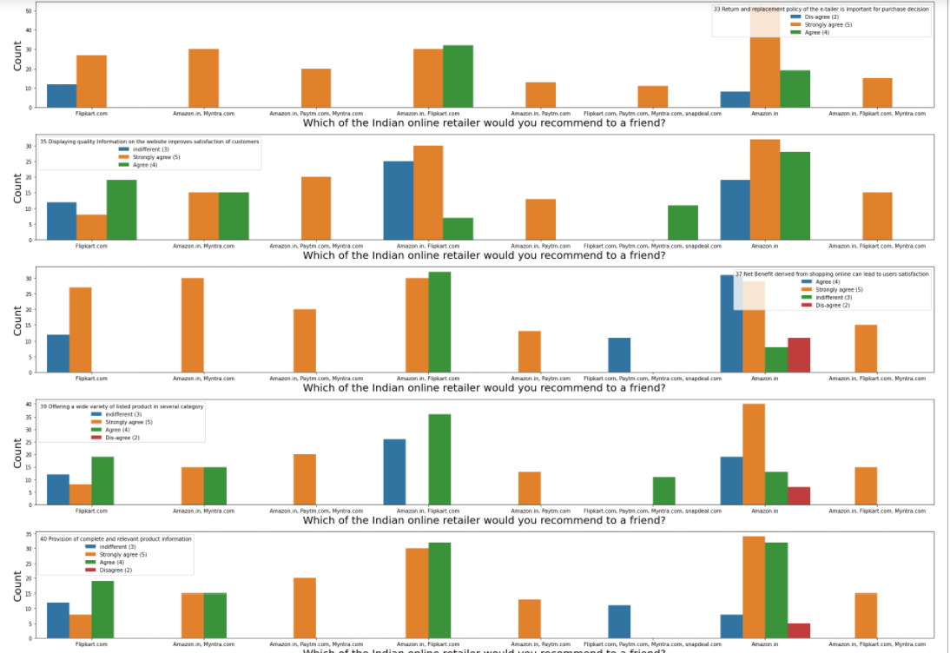
Analyzing Relationship between Customer retention and Utilitarian Value :-

Slide 45
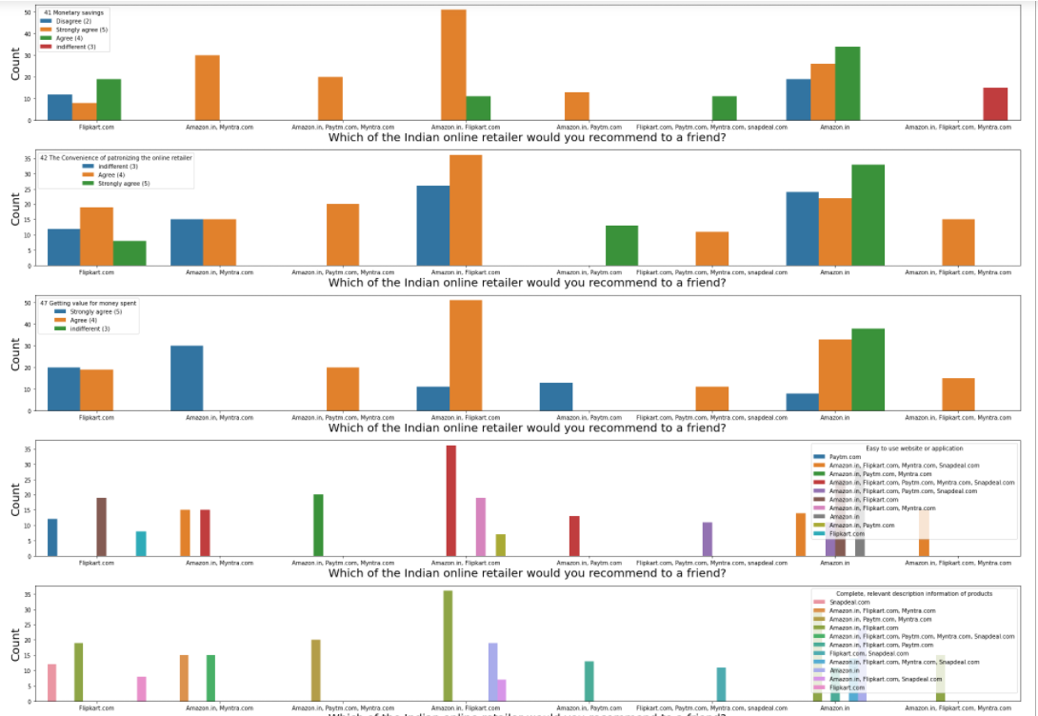
Analyzing Relationship between Customer retention and Utilitarian Value :-

Slide 46
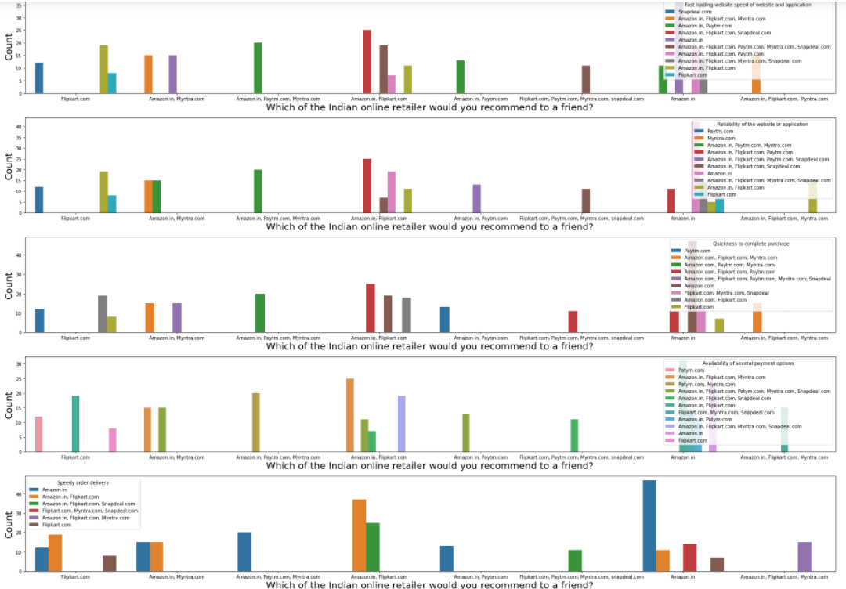
Analyzing Relationship between Customer retention and Utilitarian Value :-

Slide 47
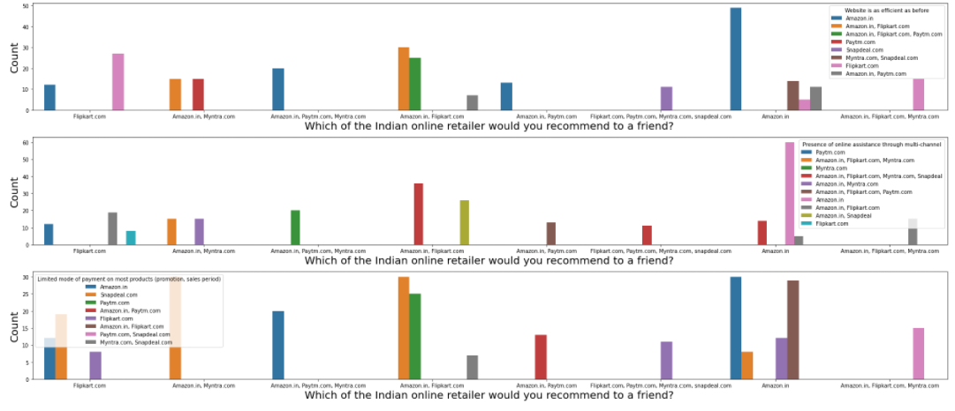
Analyzing Relationship between Customer retention and Utilitarian Value :-

Slide 48
Analyzing Relationship between Customer retention and Utilitarian Value :-
From the graphs above, the following observations can be made:
Most Consumers who recommend amazon and myntra spend more than 15 minutes on Amazon and Myntra.
Amazon and Flipkart offer the widest varieties of products
Most Consumers who recommend amazon and flipkart Prefer payments via Credit/Debit cards and Cash on Delivery.
Most Consumers who recommend amazon and flipkart appreciate the ease of understanding and reading content on the respective websites.
Most Consumers who recommend amazon and flipkart find it important for information on similar product to be available for comparison.
Most Consumers who recommend amazon and flipkart find complete product information important.

Slide 49
Analyzing Relationship between Customer retention and Utilitarian Value :-
Most Consumers who recommend amazon and flipkart clarity on product information to be important.
Most Consumers who recommend amazon and flipkart find ease of website navigation important.
Most Consumers who recommend amazon and flipkart want the website to load and process quickly.
Most Consumers who recommend amazon and flipkart find the interface of the websites user friendly.
Most Consumers who recommend amazon and flipkart find the payment methods most convenient.
Most Consumers who recommend amazon and flipkart find it important for customer support representatives to be empathetic.

Slide 50
Analyzing Relationship between Customer retention and Utilitarian Value :-
Most Consumers who prefer Amazon and flipkart find it important for there to exist Responsiveness and availability of many communication channels.
Most Consumers who recommend Amazon and flipkart find that shopping on there gives them monetary benefits and discounts.
Most Consumers who recommend Amazon find shopping on there convenient and flexible.
Most Consumers recommend Amazon because return and replacement policy is important for purchase decisions.

Slide 51
Analyzing Relationship between Customer retention and Utilitarian Value :-
Most Consumers recommend Amazon and flipkart because they display quality information on websites.
Most Consumers recommend Amazon and flipkart because they believe net benefit is derived from shopping online leads to user satisfaction.
Most Consumers recommend Amazon and flipkart because they offer a wide variety of products in several categories.
Most Consumers recommend Amazon and flipkart because they provide complete and relevant product information.
Most Consumers recommend Amazon,myntra,paytm and flipkart because they offer monetary savings.
Most Consumers recommend Amazon and flipkart because they consider convenience of patronizing the online retailer important.
Most Consumers recommend Amazon and flipkart because they get value for money spent.

Slide 52
Analyzing Relationship between Customer retention and Utilitarian Value :-
Most Consumers recommend Amazon,paytm,myntra and flipkart because of the ease of using them.
Most Consumers recommend Amazon and flipkart because they are quick to load,reliable, many payment options are available, purchasing is quick.
Most Consumers recommend Amazon because the website is as efficient as before.
Most Consumers recommend Amazon because of presence of online assistance through multiple channels.
Most Consumers recommend Amazon and flipkart because snapdeal,myntra,paytm have limited modes of payment during promotion or sale periods.

Slide 53
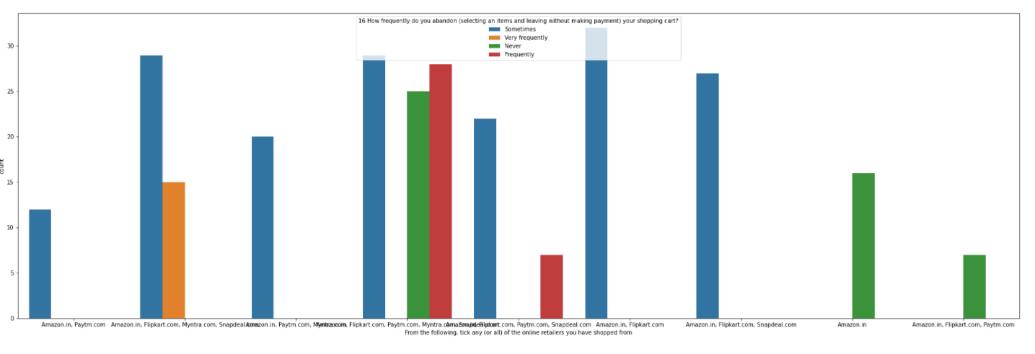
Perceived Risk on E Commerce Websites :-
The relations between perceived risks and online e-commerce websites were visualized and observations were made.

Slide 54
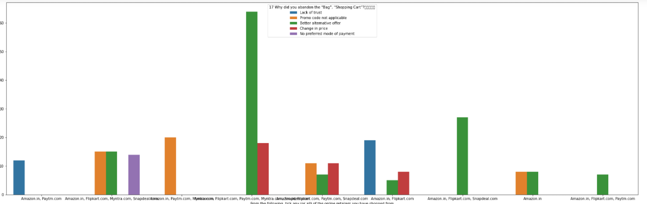
Perceived Risk on E Commerce Websites :-

Slide 55
Perceived Risk on E Commerce Websites :-
From the graphs above it is observed that:
Most customers abandon their shopping carts on Amazon and flipkart because of change in price or when they find a better deal elsewhere, whereas on paytm,myntra snapdeal etc, the reasons are varied but largely are due to lack of trust or absence of preferred mode of payment.

Slide 56
Finding the correlation between Customer Retention and Perceived Risks :-
Next step was to find the strength of correlation, both positive and negative between the feature columns and Target column.
The object type columns were encoded using LabelEncoder technique and the correlations between the feature columns and label column were determined and visualised.

Slide 57
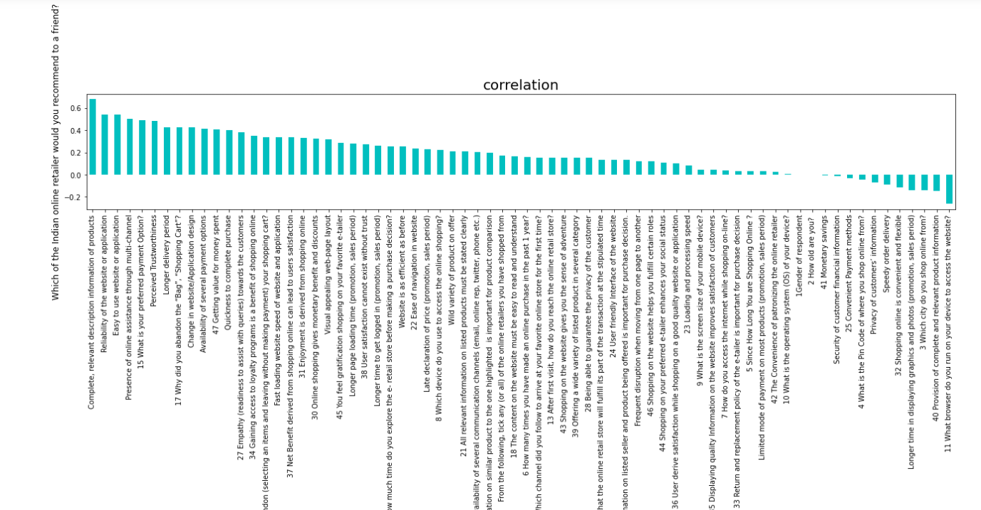
Finding the correlation between Customer Retention and Perceived Risks :-

Slide 58
Finding the correlation between Customer Retention and Perceived Risks :-
From the chart above it is observed that Complete product information,Website/application reliability,ease of using website/application,customer support,variety of payment options,Trustworthiness,Delivery Period,Getting value for money spend,enjoyment derived from shopping,website efficiency,visual appeal of website layout,Gratification from shopping online,Loyalty program access, etc have a strong positive correlation with customer retention, speedy order delivery,longer loading time of website,provision of complete relevant information etc have a strong correlation with customer retention.

Slide 59
Concluding Remarks.
From the above Exploratory Data Analysis, it is determined that for any website to retain customers, for the growth of its customer-base and to build and maintain a successful business, it is important that the E-tailers focus on enhancing customer experience in shopping on their websites, while ensuring that all of their particular hedonic and utilitarian needs are satisfied, while taking steps to minimize the perceived risks. Offering a huge variety of products, impeccable website design, user friendly interface, a huge variety of safe and convenient payment options, offering strong data security and privacy, helpful, empathetic support staff and impeccable customer service, optimized website processes that universally load in optimal time on all types of platforms and systems, faster delivery etc. are vital to ensure customer loyalty to the brand of the e-tailer Experienced customers, give great importance to their experiences of previous purchases, which in turn speeds up the process of attaining their shopping goals.

Slide 60
Concluding Remarks.
In this way customers would purchase repeatedly on the basis of the judgment of value, which is necessary to help consumers to accomplish their goal of shopping. The major reason why Amazon.in and Flipkart.com dominate the E commerce market in terms of customer retention and brand loyalty is that they have dedicated all their resources to studying and understanding the various requirements of individual customers that play as important factors in fulfilling their hedonic and utilitarian needs while giving them a sense of trust in making purchases on their respective websites while at the same time giving them incentives in various forms(discounts, cashbacks loyalty programs etc.) that keep them returning to make recurring purchases.

