Slide 1
STATISTICS CASE STUDY SUBMISSION
Group Name: Tech Ninjas
Member name & Roll number : ABHIJEET VERMA & DDA1610042
Member name & Roll number : SIDDHARTH MOHANTY & DDA1610186
Member name & Roll number : YOGESH DEO & DDA1610299
Member name & Roll number : SWAROOP VENIGALLA & DDA1610123

Slide 2
Summary of the Analysis Performed
The essence of the whole project is to analyze and understand how consumer attributes and loan attributes are influencing the tendency of defaulting.
We performed Data Cleaning and preparation on the Loan dataset and imputed the NA values for all the driver variables and Created two new columns named loan_status_1 with three levels current new, default new and late and int_rate_grp with three levels as Low, Medium and High.
During Univariate analysis created histograms and bar charts to check out the distribution of all the driver variables, Box plots to detect the Outliers, then performed the Multivariate analysis to understand how different variables interact with each other.
After univariate and multivariate analysis Hypothesis testing was carried out where we have analyzed the if the continuous driver variables have different mean values for the two categorical variables loan_status_1 and int_rate_grp.

Slide 3
Problem Solving Methodology
Understanding Dataset
(Data Cleaning)
Data Cleaning
(Imputed the NA values for all the driver variables)
Data Preparation ( Creating a new column named loan_status_1 with three levels current_new, default_new and late, created bin variables )
Exploratory Data Analysis
(Performed Univariate & Multivariate analysis)
Performed Hypothesis testing
(analyzed if the continuous driver variables have different mean values for the two categorical variables loan_status_1 and int_rate_grp )

Slide 4
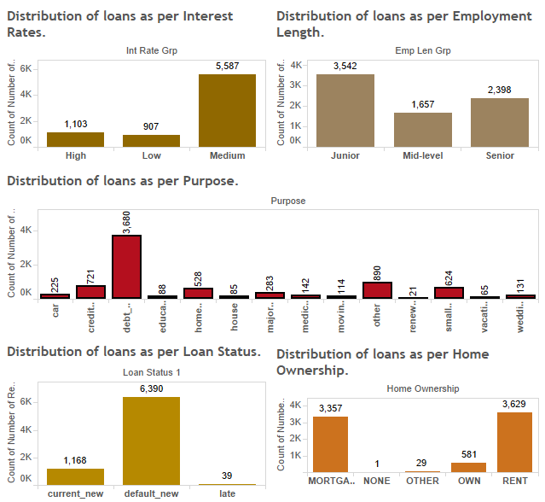
Distribution of Loan Defaults Across Categorical Variables

Slide 5
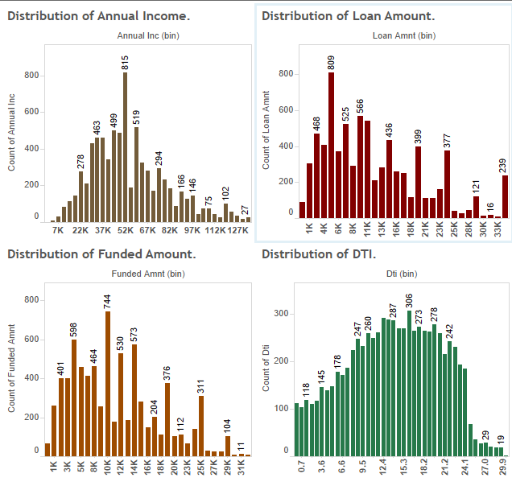
Distribution of Loan Defaults Across Continuous Variables

Slide 6
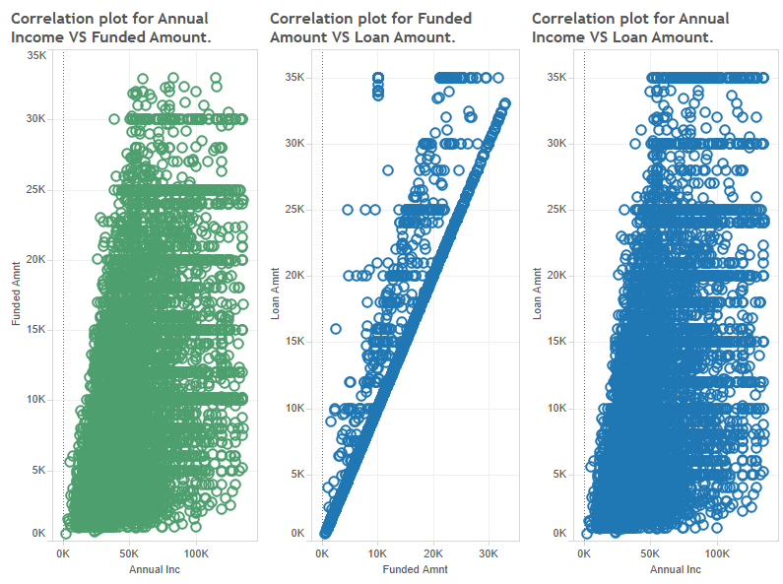
Dashboard Showing Correlation Between Continuous Variables

Slide 7
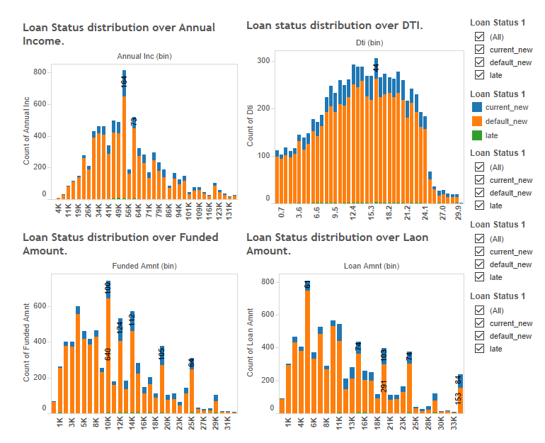
Break Down of Loan Status Across All Continuous Variables

Slide 8
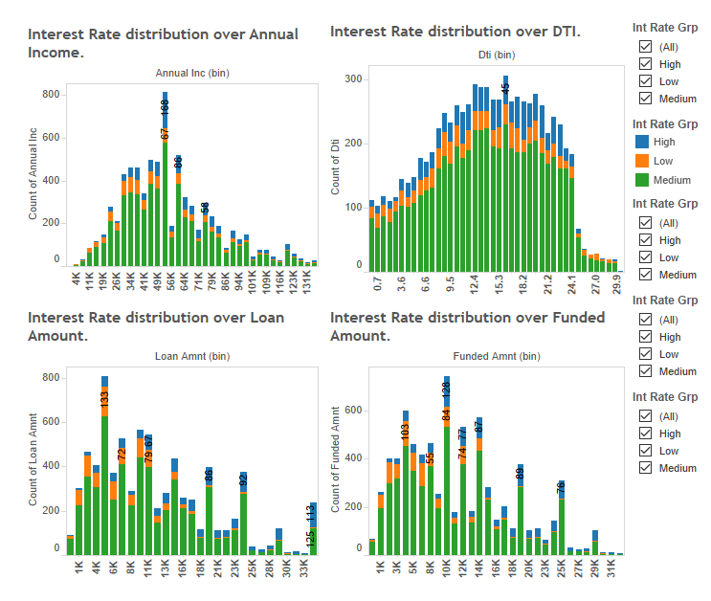
Break Down of Int Rate Grp Across All Continuous Variables

Slide 9
Insights From Univariate Analysis
Variable Name | Type of Variable | Type of Skewness | Skewness Value | Max Defaulter bin/category | Mean | Median | Mode for Cont/Count of Max Default Category for Categorical
Annual Inc | Continuous | Positive | 0.58 | 52K | 54800 | 55000 | 55000
Loan Amount | Continuous | Positive | 0.84 | 5K | 12640 | 10750 | 10000
Funded Amnt | Continuous | Positive | 0.65 | 10K | 11620 | 10180 | 10000
DTI | Continuous | Negative | -0.15 | 16.1 | 14.16 | 14.44 | 0
Int Rate Grp | Categorical | NA | NA | Medium | NA | NA | 5587
Employee Len | Categorical | NA | NA | Junior | NA | NA | 3542
Purpose | Categorical | NA | NA | debt_consolidation | NA | NA | 3680
Loan_status_1 | Categorical | NA | NA | Default_new | NA | NA | 6390
Home_Ownership | Categorical | NA | NA | RENT | NA | NA | 3629

Slide 10
Insights From Multivariate Analysis
Variable 1 | Variable 2 | Correlation Value
annual_inc | loan_amnt | 0.4192540
annual_inc | funded_amnt | 0.38799247
annual_inc | dti | 0.004411587
loan_amnt | funded_amnt | 0.85987457
loan_amnt | dti | 0.066168403
funded_amnt | dti | 0.068332714
In the above table values highlighted in orange are highly correlated values.
There is a direct correlation between annual_inc and loan_amnt. People with higher annual_inc apply for higher loans and vice-a-versa
As above there is a similar relationship between annual_inc vs funded_amnt and loan_amnt vs dti.
From the plots of loan status across all continuous variable we can observe that Default loan status dominates across all continuous variables.
From the plots raof interest rate grp across all continuous variable we can observe that Medium category dominates across all variables

Slide 11
Hypothesis Testing Results Based on Loan Status(Default_new & current_new)
Null Hypothesis | Alt Hypothesis | Test Statistic | P-value | Insight
Mean( annual_inc) for loan status as “default_new” = mean(annual_inc) for loan status as “current_new” | Mean( annual_inc) for loan status as “default_new” ! = mean(annual_inc) for loan status as “current_new” | -10.639 | 1.308887e-25 | Reject the null hypotheis
Mean(loan_amnt) for loan status as “default_new” = mean(loan_amnt) for loan status as “current_new” | Mean(loan_amnt) for loan status as “default_new” ! = mean(loan_amnt) for loan status as “current_new” | -19.407 | 2.958715e-75 | Reject the null hypotheis
Mean(funded_amnt) for loan status as “default_new” = mean(funded_amnt) for loan status as “current_new” | Mean(funded_amnt) for loan status as “default_new” ! = mean(funded_amnt) for loan status as “current_new” | -19.016 | 7.948493e-73 | Reject the null hypotheis
Mean(dti) for loan status as “default_new” = mean(dti) for loan status as “current_new” | Mean(dti) for loan status as “default_new” ! = mean(dti) for loan status as “current_new” | -3.093 | 0.002015514 | Reject the null hypotheis

Slide 12
Hypothesis Testing Results Based on Int Rate Grp(High & Low)
Null Hypothesis | Alt Hypothesis | Test Statistic | P-value | Insight
Mean(annual_inc) for int_rate_grp as “High” = Mean(annual_inc) for int_rate_grp as “Low” | Mean(annual_inc) for int_rate_grp as “High” != Mean(annual_inc) for int_rate_grp as “Low” | 12.034 | 3.179604e-32 | Reject the null hypotheis
Mean(loan_amnt) for int_rate_grp as “High” = Mean(loan_amnt) for int_rate_grp as “Low” | Mean(loan_amnt) for int_rate_grp as “High” != Mean(loan_amnt) for int_rate_grp as “Low” | 29.92 | 1.434289e-160 | Reject the null hypotheis
Mean(funded_amnt) for int_rate_grp as “High” = Mean(funded_amnt) for int_rate_grp as “Low” | Mean(funded_amnt) for int_rate_grp as “High” != Mean(funded_amnt) for int_rate_grp as “Low” | 26.684 | 3.981736e-134 | Reject the null hypotheis
Mean(dti) for int_rate_grp as “High” = Mean(dti) for int_rate_grp as “Low” | Mean(dti) for int_rate_grp as “High” != Mean(dti) for int_rate_grp as “Low” | 3.9043 | 9.794598e-05 | Reject the null hypotheis

Slide 13
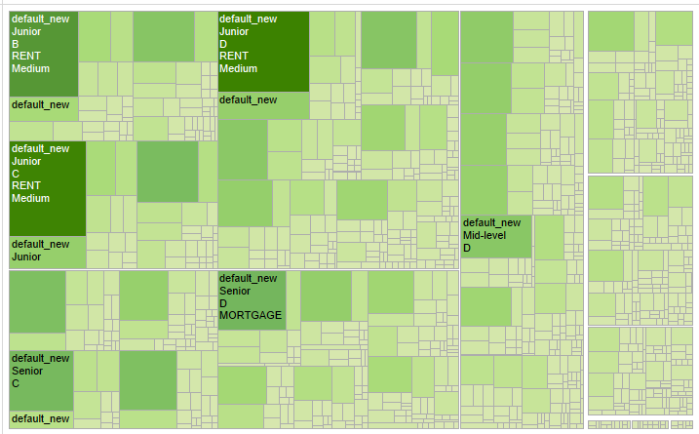
Heat Map Showing Most Defaulting Combinations

Slide 14
Conclusion
Most of the borrowers fall in the annual income range of 30K to 67K, funded amount range between 2K to 15K and DTI between 8.0 to 24.1
Maximum number of loans are in the medium Interest Rate Range.
Most defaulters are the junior level employees.
Loans availed for debt consolidation ie loans taken to settle other loans have higher default.
Maximum borrowers apply for loan between 1K and 7K.
A very high percentage i.e almost 84% of loans is under default category of Loan Status.
Lower the employment length higher the default.
Most defaulters are there in the medium interest rate category.
Almost 88% of loans against rented properties being defaulted.
The most defaulting combination is default_new, Junior, D, Rent, medium.

