Slide 1
SPARK FUNDS INVESTMENT CASE STUDY SUBMISSION
Group Name: Tech Ninjas
Member name & Roll number : ABHIJEET VERMA & DDA1610042
Member name & Roll number : SIDDHARTH MOHANTY & DDA1610186
Member name & Roll number : YOGESH DEO & DDA1610299
Member name & Roll number : SWAROOP VENIGALLA & DDA1610123

Slide 2
Summary of the Analysis Performed
The essence of the whole project is to analyze and understand the Global trends in Investments so that Investment decisions can be taken effectively.
The purpose and focus of the analysis is to identify the best sectors, countries and a suitable investment type for making investments.
The overall strategy is to invest where others are investing, implying that the best sectors and countries are the ones where most investments are happening.
While doing the analysis few criterion which were kept in mind, they are the countries have to be English speaking countries and the amount of investment has be between 5 million to 15 million.
Angel, Seed, Venture and Private equity are the investment types around which our analysis has revolved.

Slide 3
Flowchart depicting the problem solving methodology
Understanding Dataset
(Determining Unique companies, Unique key & Merging Data Frames)
Data Cleaning
( Removing all the NA Values and Replacing missing values according to Skewness factor)
Funding Type Analysis
( Calculating average investment amount for funding types, finding Investment type suitable for Spark funds)
Country Analysis
(Top 9 countries which have received highest total funding, finding top 3 English speaking countries )
Plots ( Creating Plots in R showing fraction of total investments in each funding type, displaying top 9 countries against the total amount of investments of funding type FT, displaying the number of investments in the top 3 sectors of the top 3 countries on one chart for the chosen investment type FT).
Sector Analysis 2
(finding out the most heavily invested main sectors in each of the three top countries )
Sector Analysis 1
(Code for a merged data frame with each primary sector mapped to its main sector)

Slide 4
Analysis
Lot of effort was invested in preliminary data understanding and cleaning to make sure that we get accurate insights out of the data.
First task was to merge the companies and rounds2 data set so that we have all the required columns in a single data file(master_frame). The attribute company_permalink in rounds2 and permalink in companies was used as the common key for merging.
Initially while merging , the merge was not successfully because of presence of noise like leading/trailing white spaces in companies_permalink column in rounds2.
To overcome this, cleaned the data by removing the leading and trailing whitespaces from permalink column in both companies and rounds. Merged both the files after converting the attribute values to uppercase.
In the master file the attribute raised_amount_usd had NA values in it. As it is a ratio attribute, operations like mean, sum will be performed on this. So its not desirable to have NA values,
Records having non NA values were analyzed to find out the distribution of investment. Plotting an histogram it was observed that the distribution of raised_amount_usd is skewed towards right.
Ideally the NA values should be replaced with a central value and in this case as the distribution is skewed median is chosen as the appropriate value to replace the NA values.

Slide 5
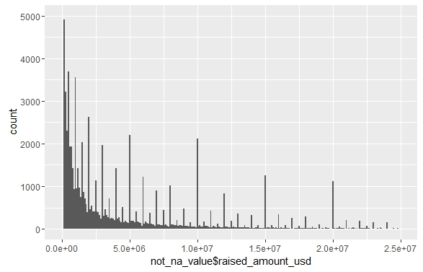
Skewed Nature of Investment Amount

Slide 6
Analysis
There are also blank values present in the country code and category list. As these attributes are categorical attributes mode value of these attributes were replaced in the missing or blank values.
For selecting the appropriate funding type, mean value of investment for each funding type globally was computed. As per the mentioned criteria venture funding type qualified to be the ideal funding type. Plot in slide 7 depicts the same.
For selecting the top 3 English speaking country for funding type venture, calculated total investment for each country and selected the top 9 countries out it.
Out of these 9 countries selected the top 3 English speaking countries which are USA, GBR and IND. Picked the English speaking countries based on the reference file provided by you. Plot in slide 9 depicts the same
Now the analysis will be confined to the top 3 countries only. Based on the category list present in the master data file a main category was decided for this. The category to main category mapping was decided as per the mapping file provided.
After this the top performing sector was decided based on the number of investments in these sectors.
And the top company based on the invested amount was selected from the top sector.

Slide 7
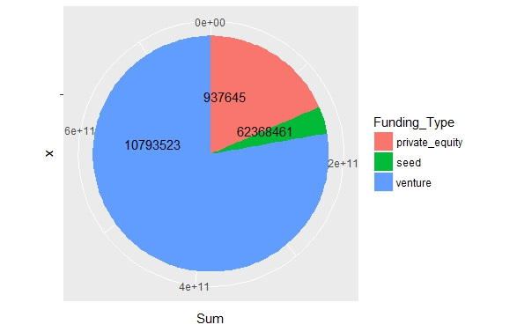
<Results> Showing the fraction of total investments (globally) in venture, seed and private equity
Plot 1

Slide 8
Analysis
In the pie chart the pie/sector are plotted based on the total amount of investment done in these sectors.
The mean value of the investment in these sectors are mentioned as labels in the pies.
From the pie chart its clear that most of the investment is done in venture because the pie covers more than 50% of the total area of the circle.
Also the mean value for venture is approx 11 million which falls in the adequate range.
Hence it is concluded that venture is the ideal funding type.

Slide 9
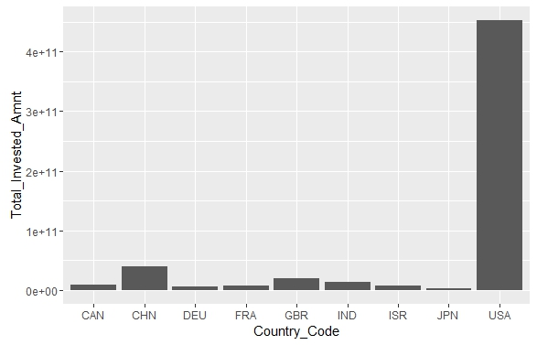
<Results> showing top 9 countries against the total amount of investments of funding type FT.
Plot 2

Slide 10
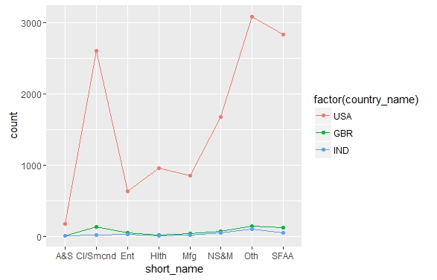
<Results> showing the number of investments in the top 3 sectors of the top 3 countries for the chosen investment type FT.
Plot 3

Slide 11
Conclusion
The key findings out of our analysis is:
The preferable funding type for investment is venture
The top 3 English speaking countries where investment can be done is USA, GBR and IND.
The details regarding the top sectors and companies are present in the sheet named Table 6.1 of the attached excel sheet.

