Slide 1
Employee Payroll & Statutory Deduction System
Database Management Systems • 25TU03MJM0
Siddharth [FULL NAME] | Roll: [ROLL NUMBER]
Semester 3 • CSE Panthers • Mentor: Dr. Sahithi
Woxsen University • Academic Year 2026–27
PBL • MySQL + Python • Siddharth [ROLL NUMBER]

Slide 2
Problem and motivation
Payroll information spans employees, salary, attendance, earnings, deductions and loans.
Spreadsheet duplication and formula drift make totals harder to audit.
A relational database can connect records and enforce key business rules.
PBL • MySQL + Python • Siddharth [ROLL NUMBER]

Slide 3
Objectives and scope
Maintain employee and effective salary data; record attendance.
Calculate payroll, itemized deductions and loan repayment.
Produce payslip/transfer records and management reports.
Educational prototype only: fictional rates, no live bank connection.
PBL • MySQL + Python • Siddharth [ROLL NUMBER]

Slide 4
Users and modules
HR: employee, department and designation maintenance.
Payroll: salary, attendance, payroll and payslips.
Finance: deductions, loans and transfer status.
Manager: department cost, payroll variance and summary reports.
PBL • MySQL + Python • Siddharth [ROLL NUMBER]

Slide 5
ER model and key relationships
Department 1:N Employee; Designation 1:N Employee and Salary Structure.
Employee 1:N Attendance, Loan and Payroll Detail.
Employee M:N Payroll Period resolved through Payroll Detail.
Payroll Detail 1:N Earnings/Deductions; at most one Payslip and Transfer.
Open docs/review-1/er_diagram.md for the complete ER diagram.
PBL • MySQL + Python • Siddharth [ROLL NUMBER]

Slide 6
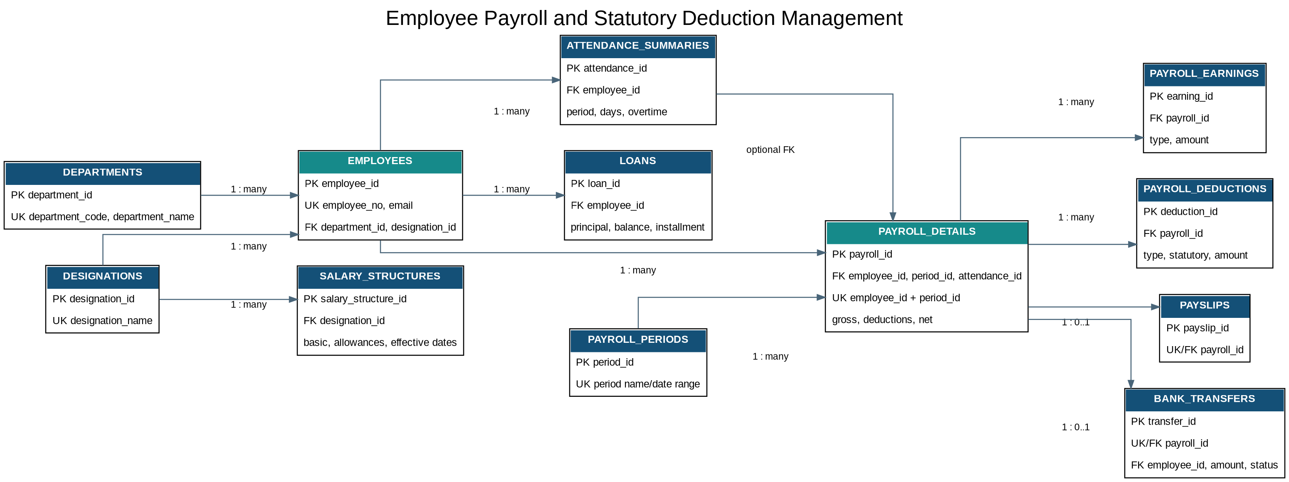
Payroll ER Diagram

Slide 7
Normalization and integrity
1NF: scalar facts; each earning/deduction is a separate row.
2NF/3NF: attributes depend on the row key; department/designation descriptions stored once.
PK, FK, UNIQUE, CHECK and DEFAULT protect facts and relationships.
One payroll per employee-period; payroll totals reconciled; loan balance cannot go negative.
PBL • MySQL + Python • Siddharth [ROLL NUMBER]

Slide 8
MySQL reports and transactions
Views and joins: employee gross, deduction and net pay.
GROUP BY: deduction totals and department payroll cost.
Nested query: active loan balances relative to installments.
Variance and bank transfer status reports.
Payroll and loan changes commit together or roll back together.
PBL • MySQL + Python • Siddharth [ROLL NUMBER]

Slide 9
Python application demo
Tkinter employee table: search, add, update and delete.
CLI: attendance, payroll calculation, payslip record and transfer instruction.
Parameterized MySQL Connector/Python queries.
Reports are displayed in the app; MySQL enforces relational constraints.
PBL • MySQL + Python • Siddharth [ROLL NUMBER]

Slide 10
Validation and honest results
Test plan covers duplicate keys, invalid attendance, negative loan and inconsistent payroll totals.
MySQL execution and screenshots must be captured on the student machine; unavailable in this build workspace.
Rates are fictional (10% pension, 5% PAYE, basic/176 overtime); replace only with instructor-approved local policy.
PBL • MySQL + Python • Siddharth [ROLL NUMBER]

Slide 11
Conclusion and next steps
Project demonstrates ER design, 3NF, SQL, constraints, transactions and Python integration.
Run setup and validation scripts; record actual outputs; add genuine screenshots.
Replace personal placeholders and complete faculty certificate/signature.
Future: approved local tax rules, access control, audit history and secure hosted database.
PBL • MySQL + Python • Siddharth [ROLL NUMBER]

