Slide 1
LINUX
What is Linux?
Linux is an Operating System (OS)
OS means: software that controls computer hardware and runs programs
Just like:
Windows
macOS
But Linux is:
Free (open-source)
Highly secure & stable

Slide 2
LINUX
Definition:
Linux is an open-source operating system based on UNIX, used to manage system resources and run applications.

Slide 3
LINUX
Linux is based on the UNIX operating system. UNIX is a powerful, multi-user, multitasking operating system originally developed in the 1970s at AT&T Bell Labs. It laid the foundation for many modern operating systems, including Linux.
Linux is free and open-source, accessible to everyone.
This promotes global collaboration and innovation.
Linux offers efficient performance and strong security.
It works well across many devices and industries.

Slide 4
LINUX
History of Linux
1: UNIX (1969)
Developed at Bell Labs
Multi-user and powerful OS
But it was not free
2: MINIX (1987)
Created by Andrew Tanenbaum
Used for teaching OS concepts
Limited features
3: Linux (1991)
Created by Linus Torvalds (student from Finland)
Wanted a free OS like UNIX
Developed first Linux kernel
Shared it on internet

Slide 5
LINUX
What is a Linux Distribution?
A Linux distribution (distro) is a complete operating system
It includes:
Linux kernel
Software
Tool
Simple meaning:
Linux + programs = Distribution
Linux alone is not enough
When we add software, it becomes usable
That full system is called a distribution

Slide 6
LINUX
Examples of Linux Distributions
Ubuntu → easy for beginners
Red Hat (RHEL) → used in companies
CentOS → free server OS
Debian → very stable
Fedora → latest features
Kali Linux → used for security
Around 600 + Linux Distributions are available

Slide 7
LINUX
Examples of Linux Distributions
Ubuntu → easy for beginners
Red Hat (RHEL) → used in companies
CentOS → free server OS
Debian → very stable
Fedora → latest features
Kali Linux → used for security
Why many distributions?
Because different users need different things:
Beginners → easy system
Companies → stable & secure
Hackers/security → special tools

Slide 8
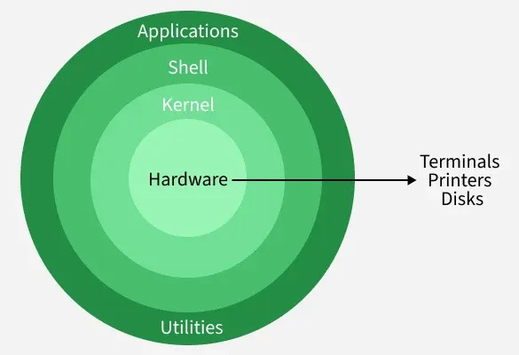
LINUX
Architecture of Linux:
User → Applications → Shell → System Libraries → Kernel → Hardware

Slide 9
LINUX
1.Applications
These are programs used by users
Examples:
Browser
Text editor
Media player
They send requests to the system

Slide 10
LINUX
2. Shell
The shell is the command-line interface that allows users to communicate with the operating system by entering commands.
Interprets and executes user commands.
Acts as a bridge between user actions and kernel processing.
3. System Utilities
System utilities are built-in tools that help users manage, configure, and maintain the operating system.
Used for tasks like software installation, user management, and monitoring.
Simplify system administration processes for both beginners and administrators.

Slide 11
LINUX
4. Kernel
The kernel is the core of the Linux operating system that manages hardware resources and controls communication between software and hardware.
Handles process management, memory, and device control.
Prevents conflicts between multiple running programs.
Types of Kernels: Monolithic, Microkernel, Hybrid, Exokernel
.
5. Hardware Layer
The hardware layer consists of physical components that execute commands and provide system resources.
Includes CPU, RAM, storage, and input/output devices.
Communicates with the OS using device drivers and kernel services.

Slide 12
LINUX
Applications of Linux Operating System:
1.Servers and Hosting
Powers most web servers, cloud platforms, and data centers worldwide.
Offers high stability, security, and uptime for critical services.
2. Development
Provides powerful tools and environments for coding, testing, and debugging.
Supports multiple programming languages and frameworks.
3. Desktop and Personal Use
Offers customizable and secure desktop environments.
Supports daily computing tasks like browsing, office work, and media usage.
4. Cybersecurity
Widely used for ethical hacking and penetration testing (e.g., Kali Linux).
Provides advanced tools for threat detection and security analysis.

Slide 13
LINUX
Applications of Linux Operating System:
5. Embedded Systems
Runs efficiently on low-resource devices like IoT and routers.
Supports real-time processing and hardware-level control.
6. Supercomputers
Used in high-performance computing environments worldwide.
Handles massive scientific calculations and simulations efficiently.
7. Education
Helps students learn programming, networking, and system administration.
Free and open-source, making it ideal for academic institutions.

Slide 14
LINUX
Linux Installation

