Slide 1

Text Summarization
Name : Siddharth Pal
Course : AI-ML
Roll No : 25

Slide 2
Outline
Abstract
Introduction
Objective
Project Workflow
Methodology
Results
References

Slide 3
Abstract
The amount of text data is increasing day by day at a very fast pace hence text summarization has become essential. Manually generating precise and fluent summaries of lengthy articles is very tiresome and time-consuming task. Hence generating automated summaries for the data and using it to train machine learning models will make these models space and time-efficient. Hence, this success comes from the application of deep learning models on natural language processing tasks where these models are capable of modeling intricate patterns in data without handcrafted features.
Here, the text summarization problem has been explored using Transfer Learning with a Unified Text-to-Text Transformer approaches.

Slide 4
Introduction
Summarization is closely related to data compression and information understanding both of which are key to information science and retrieval. The technology of text summarization can improve information extraction systems and also allows readers to quickly view a large number of documents for important information
A news article often has a brief title that summarizes its content for readers to decide whether they have want to read further. Therefore, a well summarized title is crucial in delivering the main point of the news article to its potential readers.
As a result, automatic text summarization techniques have a huge potential for news articles in that it expedites the process of summarizing a given documents for humans and if models are well trained, generates the summary with a high accuracy.
Here the goal is to build a text automatic summarization model with deep learning algorithms that can output a one-sentence summarization given an article.
Here the dataset is ‘CNN / DailyMail Dataset’ is an English language dataset which contains over 300k unique news articles written by journalists at CNN and the Daily Mail.
The data consists of news articles and highlight sentences.

Slide 5
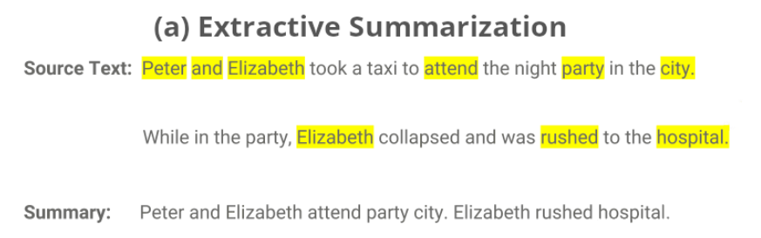
There are two approaches for text summarization:
Extractive summarization : In extractive summarization, most important phrases or sentences from the text are identified and selected based on a score that is computed depending on the words in that sentence.

Slide 6
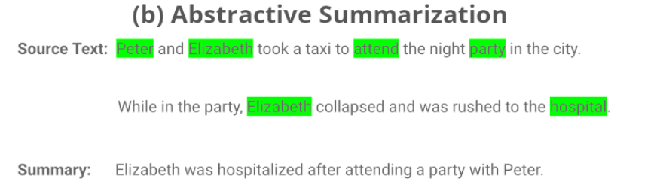
2. Abstractive Summarization : Abstractive summarizers do not select sentences from the originally given text passage to create the summary. Instead, they produce a paraphrasing of the main contents of the given text, using a vocabulary set different from the original document. This is very similar to what we as humans do, to summarize.

Slide 7
Objective
The main objective of this project is to summarize the given article provided by the user with the help of NLP and deep learning algorithms.

Slide 8
Project-Workflow
3.
Extraction
2.
Processing
Input
Score and Rank sentences.
Feature Extraction
1.
Top ranked sentences are extracted in summary.
Pre-processing
Segmentation
Tokenization
4.
Summarized Text
Removal of stop words

Slide 9
Data Collection
Data has been collected from Kaggle.
“CNN / Daily-Mail Dataset “is an English-language dataset containing just over 300k unique news articles as written by journalists at CNN and the Daily Mail.
We have used here 2 columns namely : Articles and Highlights

Slide 10
Data Description
This data consist of three fields:
ID : a string containing the heximal formatted SHA1 hash of the url where the story was retrieved from
Article : a string containing the body of the news article
Highlights : a string containing the highlight of the article as written by the article author

Slide 11
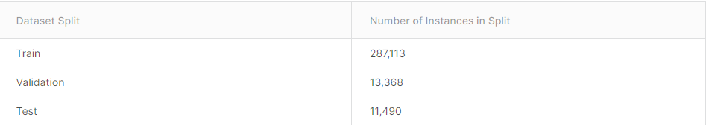
Dataset Split
The CNN/DailyMail dataset has 3 splits: train, validation, and test.

Slide 12
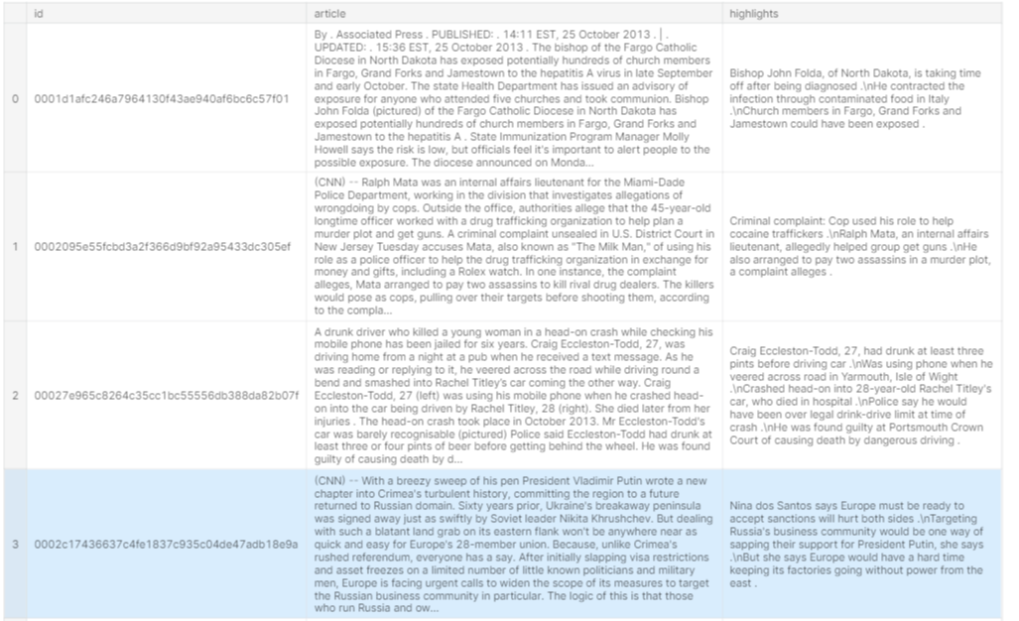
Glimpse of Dataset
Shape of this data is : (287113,3)

Slide 13
Data Pre-processing
5000 samples has been used to train the model (Random sampling has been used)
Lower casing - To convert the input text into the same casing format so that all capital, lower case and mixed case are treated similarly.
Eliminate Punctuation - HTML tags and links- Removal of punctuations, links and tags that do not add meaning to the text such as “!"#$%&\'()*+,-./:;<=>?@[\\]^_{|}~`” to standardize the text.
Eliminate Stop words and frequently occurring words - Removal of common words such as ‘the’, ‘a’, etc. that are frequently used in a text but do not provide valuable information for downstream analysis.
Stemming - Reducing the inflected words to their root form.
Lemmatization - Reducing derived words to their base or root form while making sure that root words belong to the language.

Slide 14
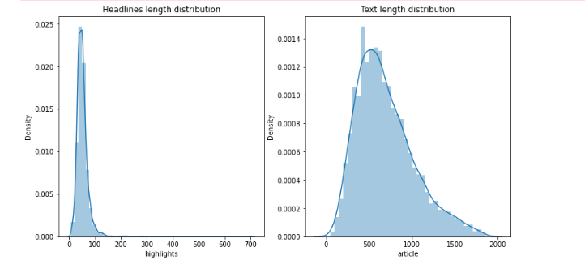

Data Pre-Processing
Checking the Headlines and text length distribution
Mean Length Analysis

Slide 15
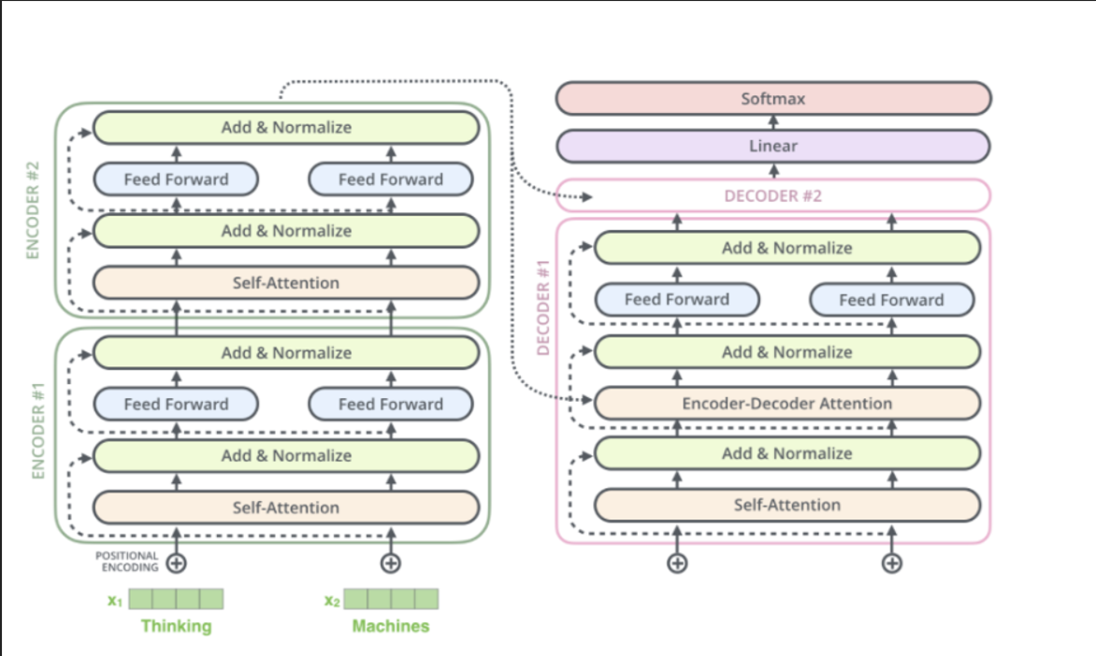
Model
Simple-T5 : Uses a sequence-to-sequence generation method that feeds the encoded input via cross-attention layers to the decoder and generates the decoder output autoregressive. We have fine-tuned a T5 model , where the encoder takes an input a series of tokens which are mapped to a sequence of embeddings. A block containing two subcomponents are present in the encoder block namely, a self-attention layer and feed forward network. The decoder and encoder are similar in structure, except that there's a generalized attention mechanism after every self-attention layer. This allows the model to operate only on the previous outputs. The final decoder block produces an output which is fed into another layer. This final layer is a dense layer where the activation function is softmax . The weights from the output of this layer are fed into the input embedding matrix

Slide 16
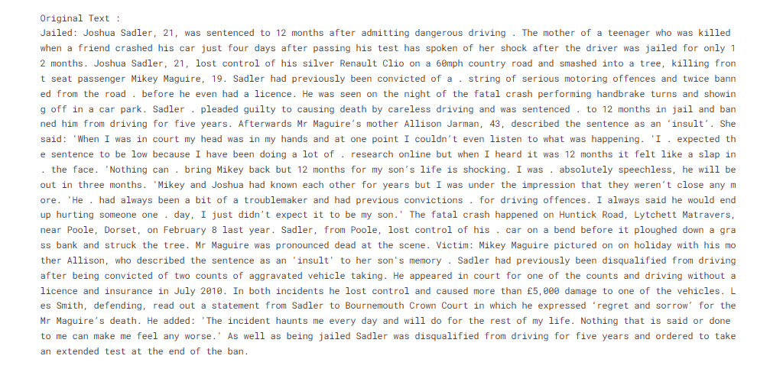
Result

Slide 17
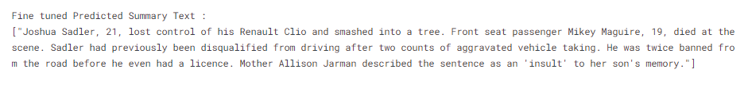
Output

Slide 18
References
https://www.kaggle.com/datasets/gowrishankarp/newspaper-text-summarization-cnn-dailymail
https://github.com/abisee/cnn-dailymail
https://www.irjet.net/archives/V8/i12/IRJET-V8I12220.pdf
https://web.stanford.edu/class/archive/cs/cs224n/cs224n.1174/reports/2746634.pdf
150330194118.pdf (ijarest.com)
https://arxiv.org/ftp/arxiv/papers/2108/2108.01064.pdf
https://youtu.be/4Bdc55j80l8

